Slide 1
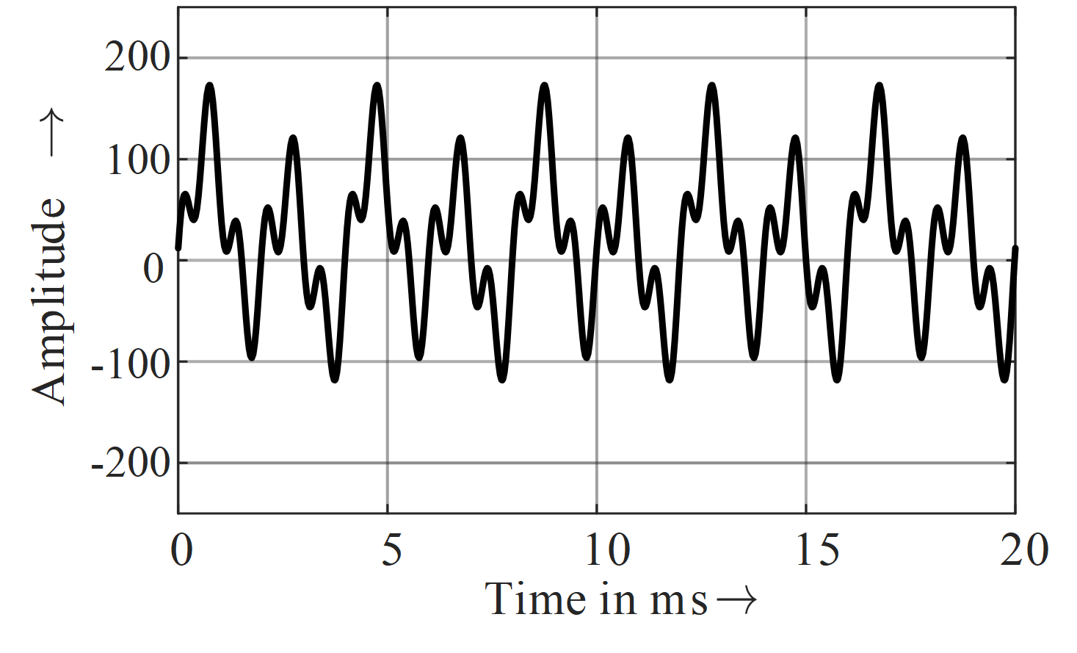
Your title
First Name Last Name Affiliation, Country | First Name Last Name Affiliation, Country | First Name Last Name Affiliation, Country
Introduction
A display board of about 1000 mm X 1500 mm ONLY (portrait format) will be provided for each author. Please use standard A0 format (841 mm X 1189 mm) as printing format.
Font Type is Open Sans. The smaller font size for text boxes is 48 points. Your poster must be legible from a 5 m distance.
Results
You will have 5 minutes to present the poster. There will be plenty of time after the poster presentations for discussion.
Please avoid commercial references. Advertising of products is prohibited.
Table 1 – Example of a table
A | B | C
0.02 | 0.06 | 0.08
0.002 | 0.221 | 0.222
0.222 | 0.888 | 0.999
Methodology
You can include as so many sections as you want, but please try to not overload the poster with text. Pictures, graphs and tables are preferred.
The poster should include the research/industry problem, the applied methodology/solution and the conclusions.
Figure 2 – Example of a diagram
Conclusions
If possible, indicate the open issues and further work
Do not forget to print the poster and bring it to the workshop !!
Figure 1 – Example of a figure

