Slide 1
Agent Performance Analysis
Presentor: Omar Saleem
Mentor: Shilpa Kadam
THE CAIN PROJECT

Slide 2

Agenda
Business understanding & Goal
Let’s understand our data
Cleansing and pre-processing
Experimentation with different Models
Ensemble Using Optimisation
Conclusion and Business Benefits
Thank You

Slide 3

Business understanding
Insurance Agency
Types Of Insurance Different KPI’s
  Growth Rate
  Agency Cash Flow
  Total New Quote
  Improve in the Quantity
Business Problem
  Goal statement for Next Year
  Improve Agency Segmentation of the agency for ABC Insurance
  Boost Top Performers and Giving Special importance for Low performers

Slide 4
Data Description
The Data we have is the data collected by the ABC Insurance which has many child agencies.
The Data Is collected form year 2005 to 2015
The Data has 49 columns ,different measure like Quantities, Amounts , Sources of the policy, Aggregated Growth Rate, Growth Rate, Source from which the policy is made etc.
The Unique set for the data is the Agent_ID and Product_ABBR(Product Abbreveation)
Present Measure for grading is the 3 year Growth

Slide 5
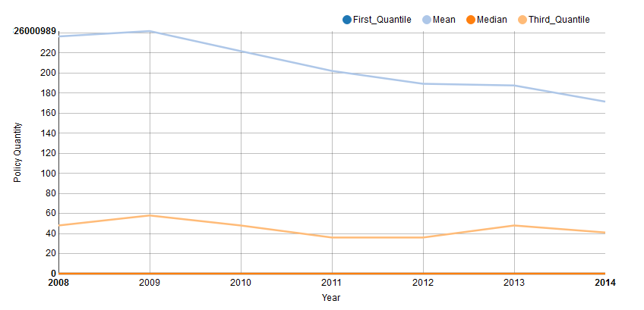
Present Performance
Policy Inforce Quantity distribution over years

Slide 6
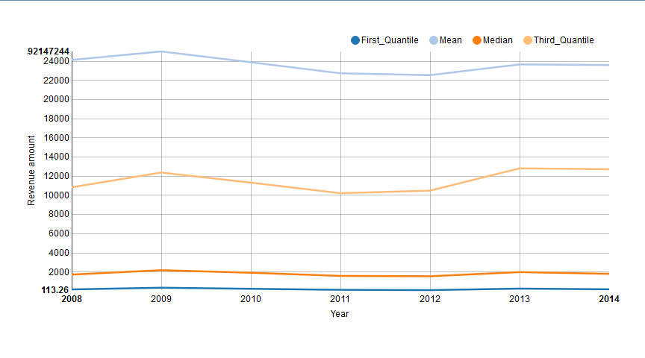
Present Performance
Total Written Premium Amount distribution over years

Slide 7

Goal Statement
From the graphs of the revenue from Written Premium we can say that there is no much change in the Revenue from the premium
From the graphs of the Quantity Distribution we can see that these is an decrease in quantity consumed over years
Amount | Quantity
So for the next year the priority should be the Quantity of the Premiums made and the number of new customers made keeping in the mind about the compensating revenue as well

Slide 8

Data Pre-Processing
Considering the 3 year growth rate as the target
  The years 2005,2006,2007 years doesn’t have the completely missing values in the target variable
  If the joining year is 2008 then until 2010 the 3 year growth rate cannot . They should be managed
  The missing values in the Loss ratio are replaced by the median of positive for positive missing and Negative for negative missing
  The columns with more than 25% missing columns are ignored as model might get hurt by that
  The most Important Thing to do is to convert the Long Format to the Wide format with respective the unique combination of agent and the Product line (As the data for growth rate is aggregated at that level)
  The Correlation bet ween the Quantity variables and Amount Variables is very High. So we can ignore and create Features to over come the process

Slide 9
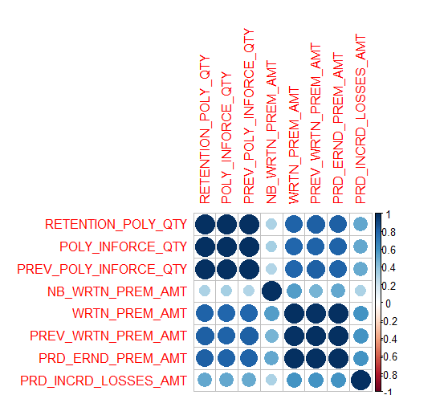
Correlation Plot for Amount and Quantity variables

Slide 10
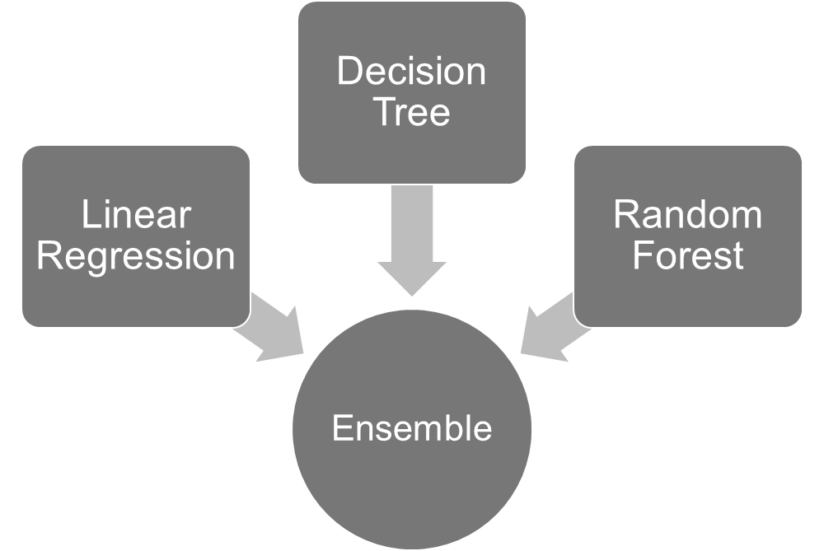
Model Building
RMSE: 0.286
RMSE: 0.30
RMSE: 0.252
RMSE: 0.204

Slide 11
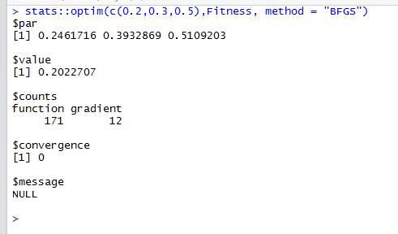
Ensemble Using Optimization
Linear Optimization for finding the appropriate the weights for the results from different models
Fitness Function: RMSE for the Weighted average results and the The training Results
In order to compensate the overfitting the Fitness function is modified in such a way that the 5 sample are used to get the aggregated fitness

Slide 12
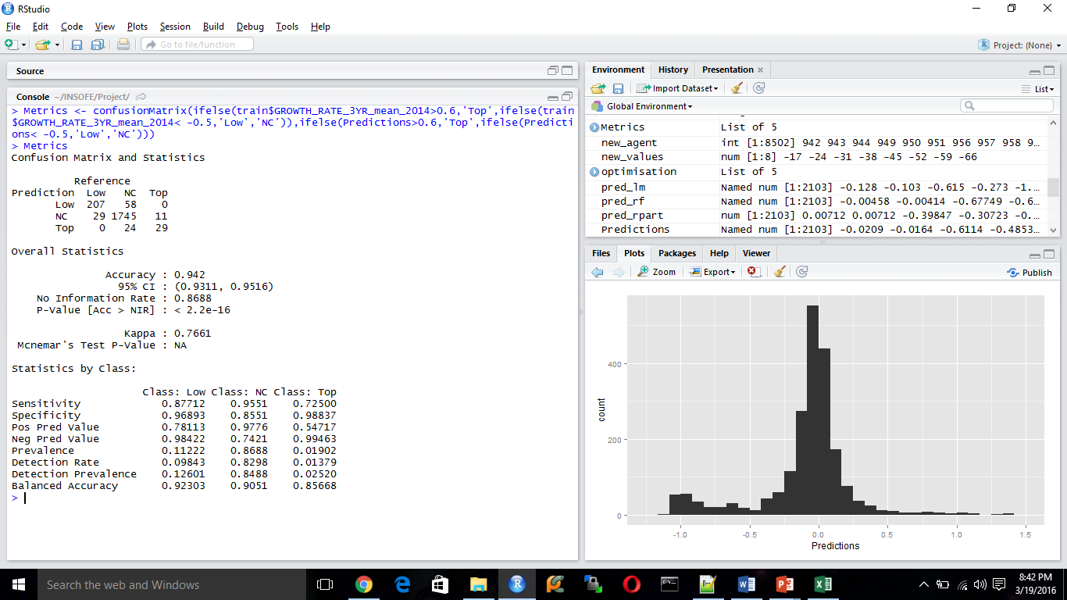
Conclusions
Considering the Distribution we have taken only he top performers are agencies with more than ‘0.5’ 3 year growth rate and the Low performers are agencies with Less than ‘-0.5’ 3 year growth rate . Which is giving up to an accuracy of 94.2%

Slide 13
Conclusions
Insights from Top Performers
  The Number of Negative combinations from the Quantity growth rate and Amount growth rate
Product Id | Number Of Negative growth
ANNIV | 11
CYCLES | 1
DTALK | 1
DWELLFIRE | 2
HOMEOWNERS | 5
MOBILEHOME | 3
MOTORHOME | 3
PERSUMBREL | 1
WORKCOMP | 1

Slide 14
Conclusions
Insights from Low Performers
  The Number of Negative combinations from the Quantity growth rate and Amount growth rate
Product Id | Number Of Negative Growth
ANNIV | 73
BOILERMACH | 3
BOP | 1
COMMAUTO | 2
COMMINLMAR | 1
COMMPOL | 10
CRIME | 1
CYCLES | 16
DTALK | 17
DWELLFIRE | 34
FIREALLIED | 2
GARAGE | 1
GENERALIAB | 3
HOMEOWNERS | 82
MOBILEHOME | 7
MOTORHOME | 29
PERSINLMAR | 3
PERSUMBREL | 28
SNOWMOBILE | 1
YACHT

Slide 15

Quires

Slide 16

Thank You

