Slide 1


Credit card default: A data science solution
By Marcos Dominguez, Data Scientist

Slide 2
Credit Card Default
By Marcos Dominguez

Slide 4
Solution: machine learning model
Input Data
ML Model
Default? Yes or No

Slide 5

Fine tuning
Minimize overlooking “No” predictions
Recall
Cost of overlooking a “No” > Cost of overlooking a “Yes”

Slide 6
MODEL SELECTION: random forest
Compared:
Multiple models
Multiple parameters
Most accurate
Least computationally complex

Slide 7
Input variables
26 variables total
Credit Limit
Payment Status
Monthly Payment
Monthly Balance
…and many more
Most important:
Payment Status

Slide 8
Strategy
Use ML model to identify customers likely to default
1
Notify relationship managers
2
Provide options:
3
Forbearance
Consolidate credit card debt

Slide 9
Forecast

Slide 10
Forecast Numbers
 | Without ML (thousands) | With ML (thousands)
6 Month Forecast | $(79,875) | $(40,600)
Total Savings | $0 | $39,275
Model Accuracy | 0 | 55%
Defaults Prevented | 0 | 21,950

Slide 11
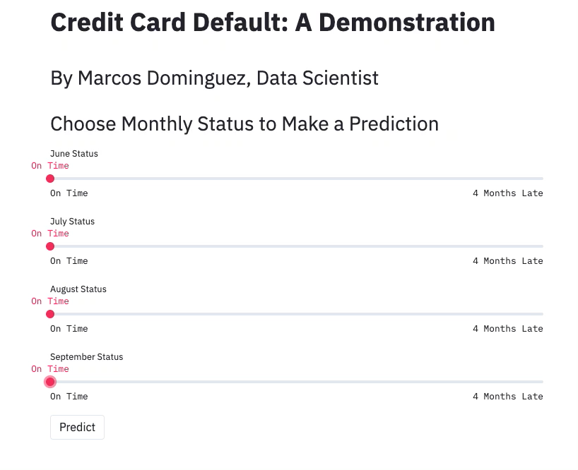
Demo

Slide 12
Acknowledgements
Dataset: UCI Machine Learning Repo, ”default of credit card clients”
Open-source tools used:
Scikit-learn
Pandas
Numpy
Matplotlib, seaborn
Streamlit
imblearn
ipywidgets

