Slide 1
Loan Portfolio Risk using ML
By Marcos Dominguez, Data Scientist

Slide 2
01
Why ML?

Slide 3
How banks benefit as the end-user…
Automation
Efficiency
Minimize errors
Accuracy
Prevent defaults
Reduce loan loss risk
Cutting-Edge
Outperform competitors
Increase portfolio

Slide 4
02
Prediction Pipeline using ML

Slide 5
Prediction pipeline in a nutshell…
Classification Model
Linear Regression Model
Loan portfolio
Risky Loans
Risky Loans
Loan Loss Amount

Slide 6
03
Data

Slide 7
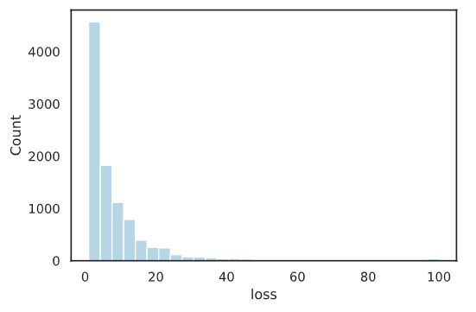
Loan Portfolio
Size
Features
Target
~100k loans
770 anonymized, numerical columns
Loan loss: 0-100%
Imbalanced Target

Slide 8
04
Methodology

Slide 9
Methodology
EDA
Prediction Pipeline
Model Selection
Data cleaning, NaNs, data formatting
XGBoost for both classification, regression
Undersampling, hyperparameter tuning, feature engineering

Slide 10
05
Results

Slide 11
Performance Metrics
Classification
Recall: 0.94
Regression
$$R^{2}:0.73$$
𝑅^2:0.73
ROC AUC: 0.92
MAE: 0.29
Precision: 0.29

Slide 12
Actuals vs Predicted
Risky Loans
Actual
Predicted
9,783 loans
9.25% of portfolio
6,388 loans
6.06% of portfolio
Loan Loss
Actual
Predicted
Avg: 8.62%
Min: 1.0%
Max: 100.00%
Avg: 1.65%
Min: 0.43%
Max: 34.50%

Slide 13
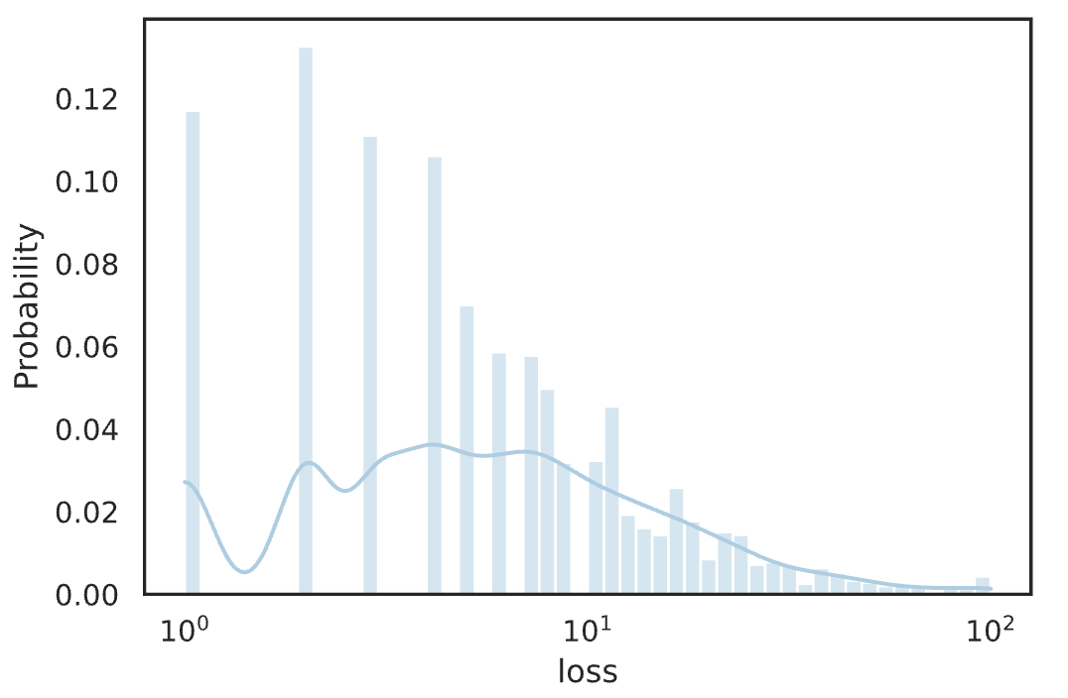
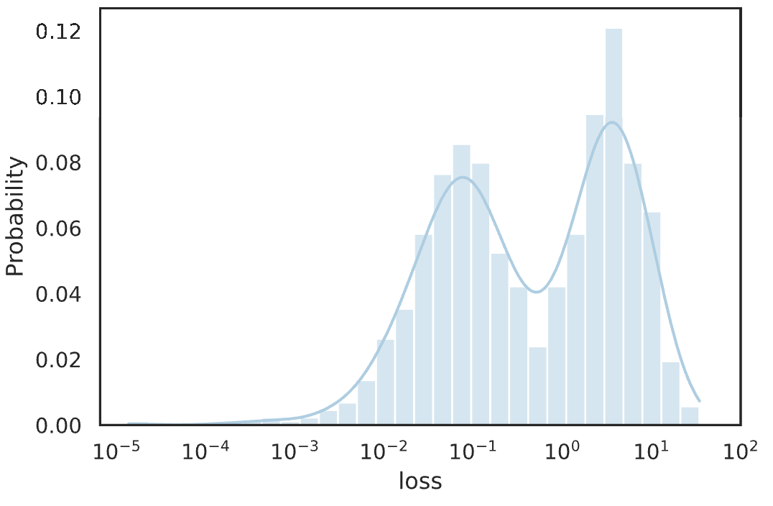
Probability Density Functions: Actual vs Predicted
Actual*
Predicted*
*Standardized using $\log_{10}$

Slide 14
06
Next Steps

Slide 15
Research differences in distributions…
Actual*
Predicted*
Why?
*Standardized using $\log_{10}$

Slide 16






Acknowledgements
Thank you!
Questions? Contact me: md.ghsd@gmail.com
github.com/mdominguez2010

Slide 17
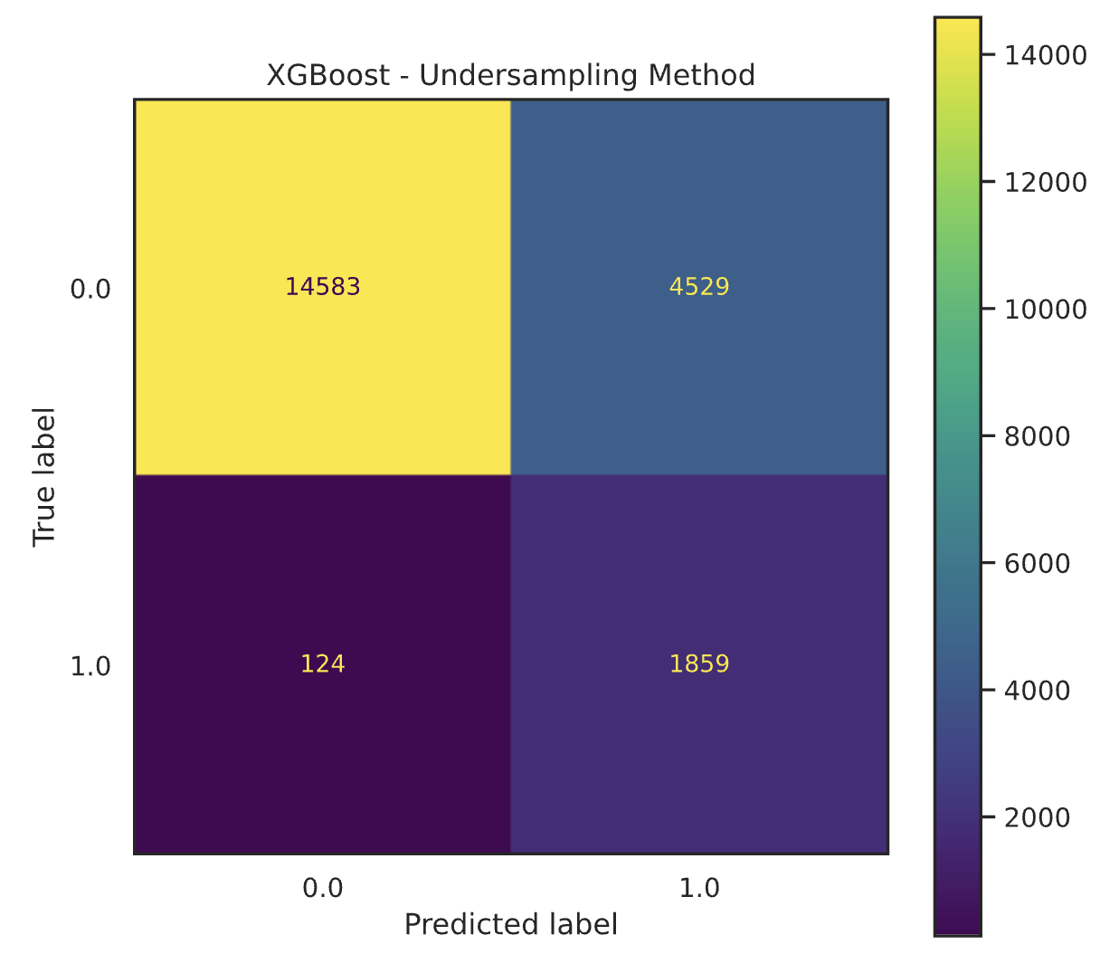
Appendix
Model Confusion Matrix

