Slide 1
Loan Portfolio Risk using ML
By Marcos Dominguez, Data Scientist

Slide 2
01
Why ML?

Slide 3
How banks benefit as the end-user…
Automation
Efficiency
Minimize errors
Accuracy
Prevent defaults
Reduce loan loss risk
Cutting-Edge
Outperform competitors
Increase portfolio

Slide 4
02
Prediction Pipeline using ML

Slide 5
Prediction pipeline in a nutshell…
Classification Model
Linear Regression Model
Loan portfolio
Risky Loans
Risky Loans
Loan Loss Amount

Slide 6
03
Data

Slide 7
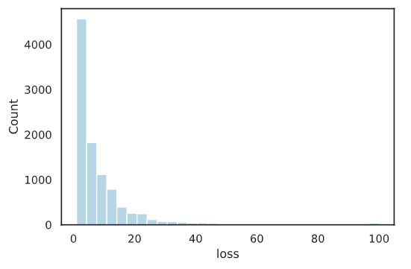
Loan Portfolio
Size
Features
Target
~100k loans
770 anonymized, numerical columns
Loan loss: 0-100%
Imbalanced Target

Slide 8
04
Methodology

Slide 9
Methodology
EDA
Prediction Pipeline
Model Selection
Data cleaning, NaNs, data formatting
XGBoost for both classification, regression
Oversampling, hyperparameter tuning, feature engineering

Slide 10
05
Results

Slide 11
Performance Metrics
Classification
Recall: 0.54
Regression
$$R^{2}:0.71$$
𝑅^2:0.71
ROC AUC: 0.90
MAE: 0.41

Slide 12
What the models predicted…
Classification: Risky Loans
Regression: Loan Loss
2,478 loans
2.35% of portfolio
Avg: 2.68%
Min: 0.44%
Max: 25.30%

Slide 13
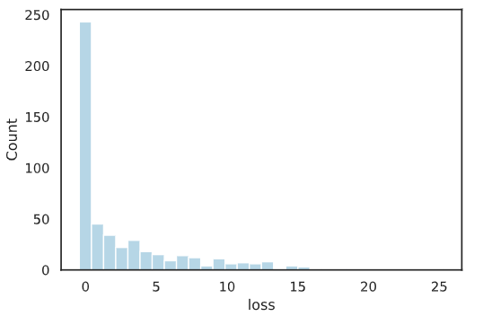
Distributions: Actual vs Predicted
Actual Loss
Predicted Loss

Slide 14
06
Next Steps

Slide 15
Research the difference in scale…
Actual Loss
Predicted Loss

Slide 16






Acknowledgements
Thank you!
Questions? Contact me: md.ghsd@gmail.com
github.com/mdominguez2010

