Slide 1
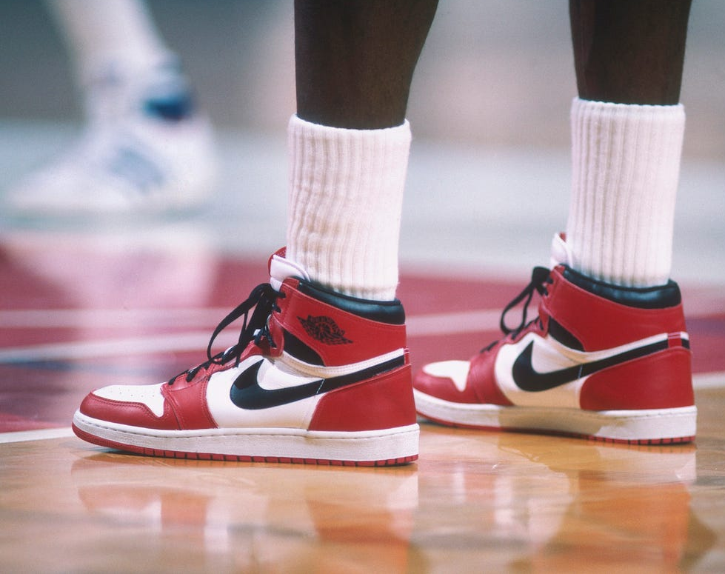
The Sneaker Game: Datafied
By Marcos Dominguez, Data Scientist and Sneakerhead

Slide 2
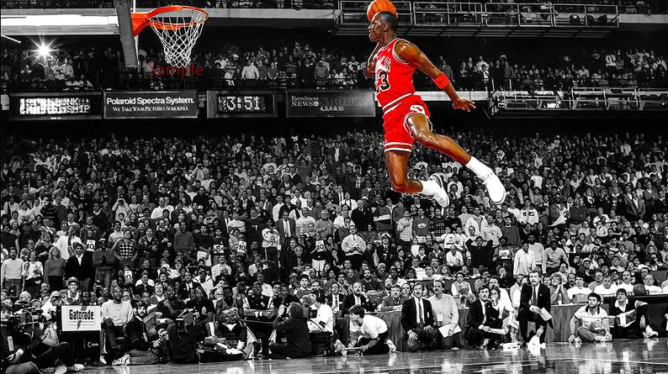
Sneaker culture
What is a sneakerhead?
Sports history
Community
Swag

Slide 3
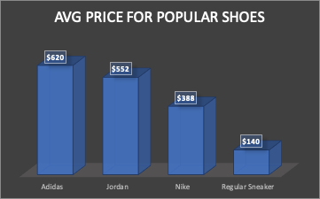
The sneaker market is like no other
What’s with the crazy prices?
Tired of getting ripped off?
Is there a better way to price sneakers?

Slide 4
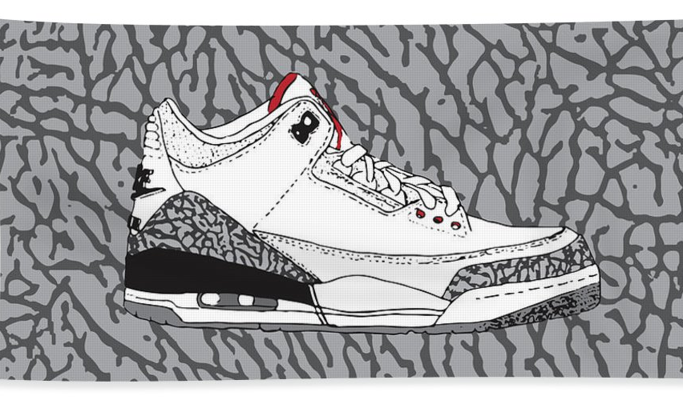
Have no fear, linear regression is here!
I have a better way of pricing sneakers to ensure you pay a reasonable price!

Slide 5
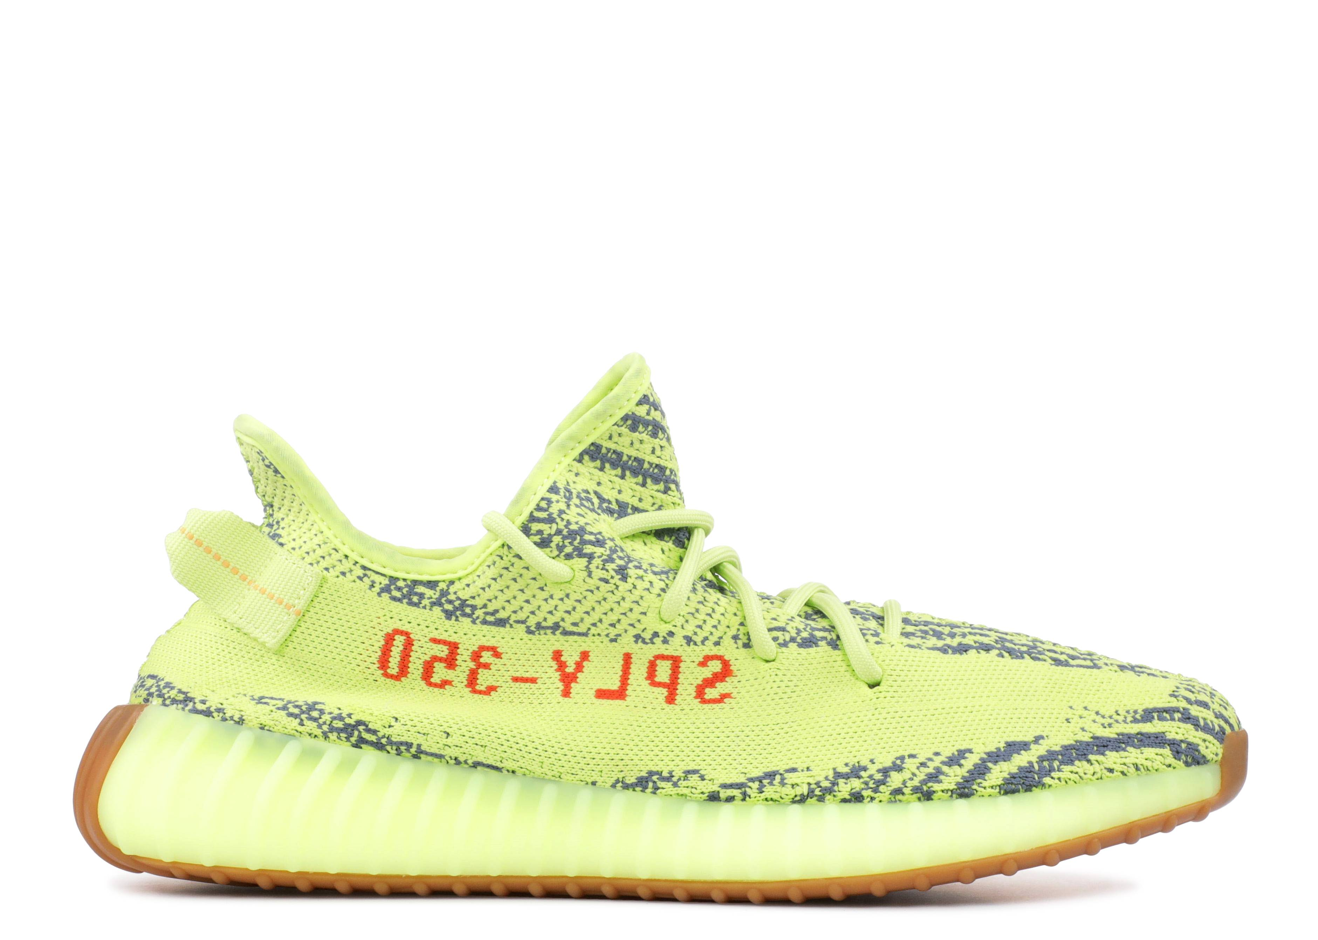
Features used to predict prices
Age of sneaker (in years)
Sales Volume
Price over Premium
Volatility
Brand Name
Jordan, Nike, Adidas, or Other

Slide 6
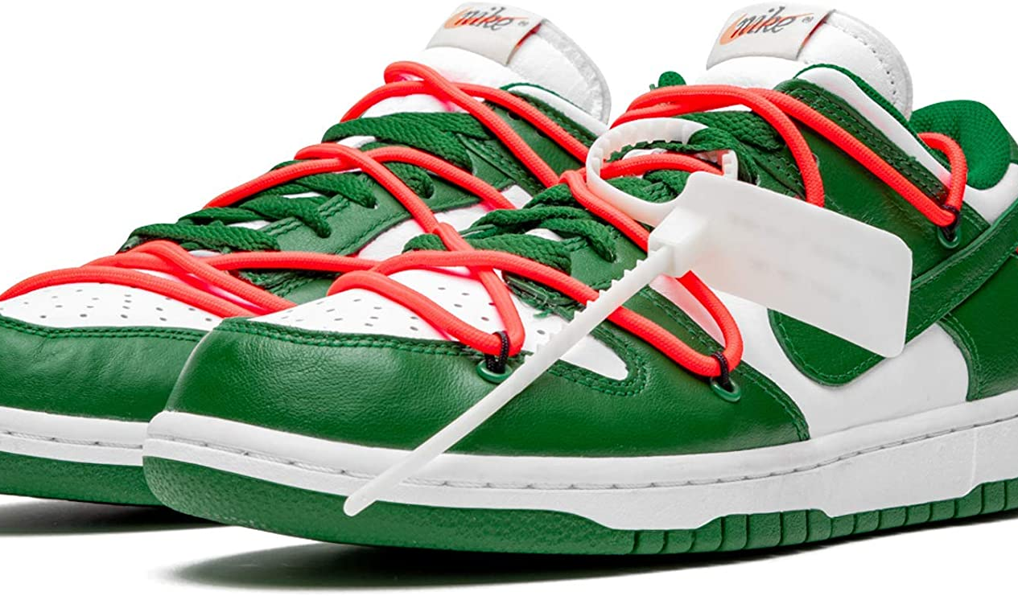
Method: Linear Regression
Tested 2 models
OLS
Polynomial
Two variations
Without Ridge regularization
With Ridge regularization
Feature engineering to correct overfitting

Slide 7
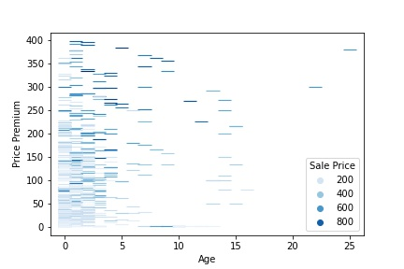
Feature Engineering
Multiplicative Interaction: Price Premium & Age of sneaker

Slide 8
Results before feature engineering
Model | Regularization | RMSE | Overfit?
OLS Method | None | $176 | Yes
 | Ridge CV | $176 | Yes
Polynomial | None | $163 | Yes
 | Ridge CV | $166 | Yes
*dataset was sampled with 5-fold cross validation for all models

Slide 9
Results after feature engineering
Model | Regularization | RMSE | Overfit?
OLS Method | None | $179 | Yes
 | Ridge CV | $178 | Yes
Polynomial | None | $159 | No
 | Ridge CV | $164 | Yes
*dataset was sampled with 5-fold cross validation for all models

Slide 10
And the winner is…
After feature engineering
Model | Regularization | RMSE | Overfit?
OLS Method | None | $179 | Yes
 | Ridge CV | $178 | Yes
Polynomial | None | $159 | No
 | Ridge CV | $164 | Yes
*dataset was sampled with 5-fold cross validation for all models

Slide 11
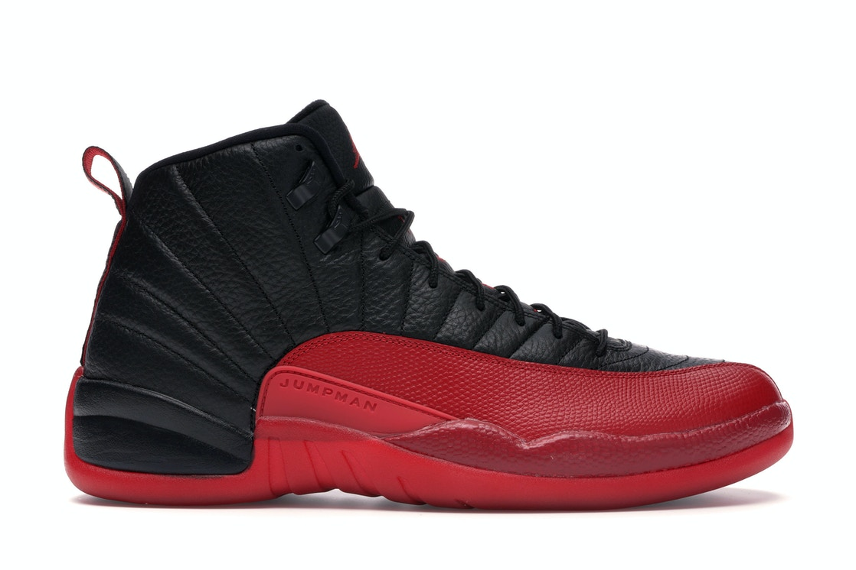
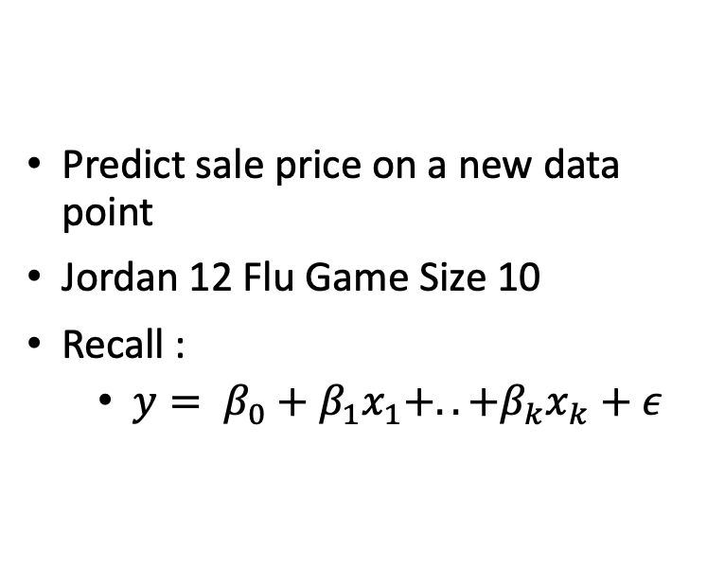
Real World Test
Predict sale price on a new data point
Jordan 12 Flu Game Size 10
Recall :
$y= β_{0}+β_{1}x_{1}+..+β_{k}x_{k}+ε$

Slide 12
Real World Test
Age (Yrs) | Sales Volume | Volatility (%) | Price Premium (%) | Jordan | Predicted Price ($)
4 | 265 | 3.3% | 110% | 1 | $283

Slide 13
Real World Test
Predicted price = $283
Avg actual price = $345
Difference = $(62)
NOT BAD!

Slide 14
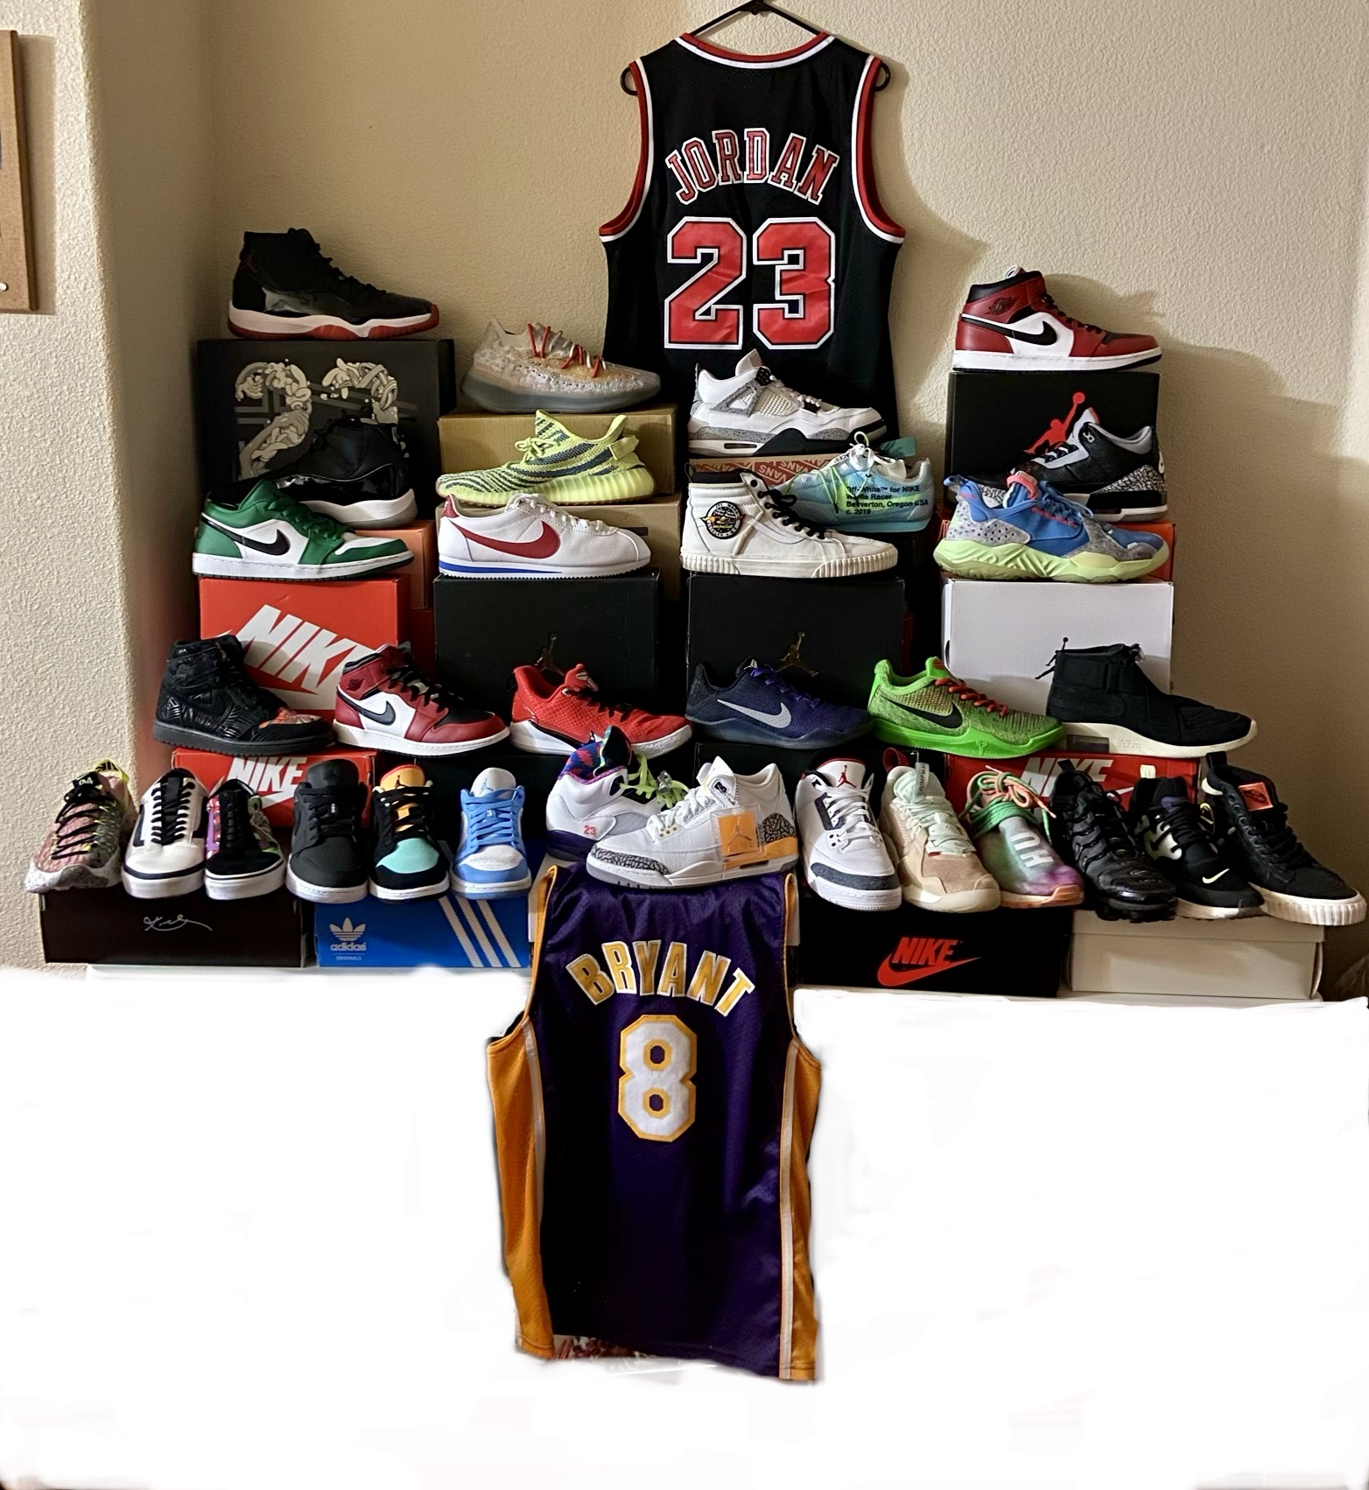
Conclusion
Predicting human behavior is extremely difficult
The model with some complexity tends to be optimal
This can be a great tool for bargaining a reduced price

