Slide 1
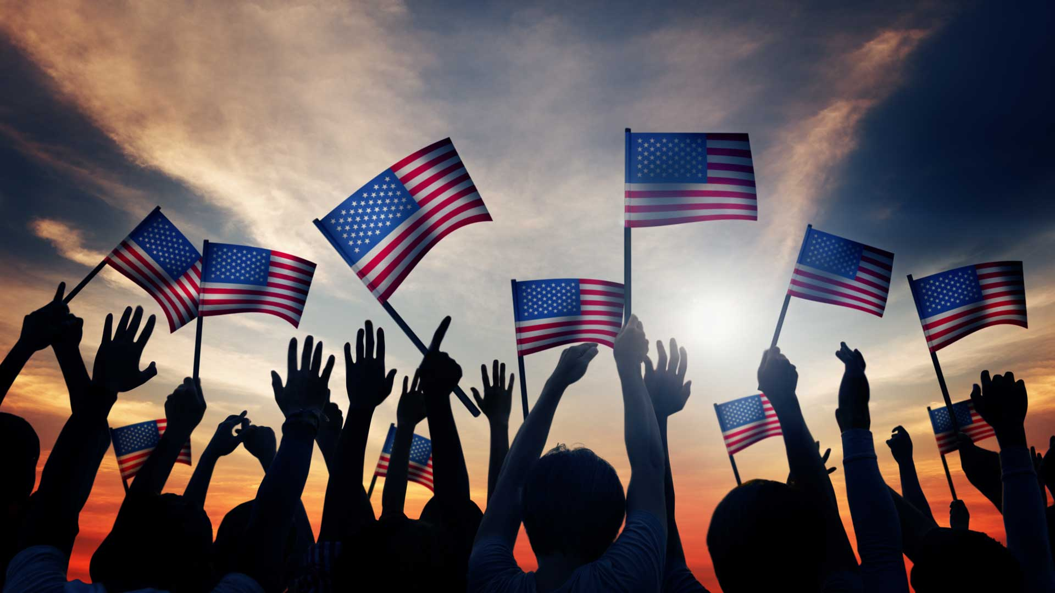
Unifying a Nation: A Data Science Solution
By Marcos Dominguez

Slide 2
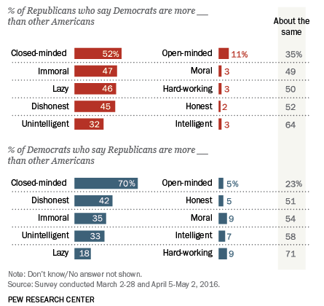
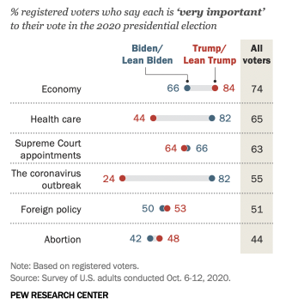
The battle has just begun
2016
2020

Slide 3
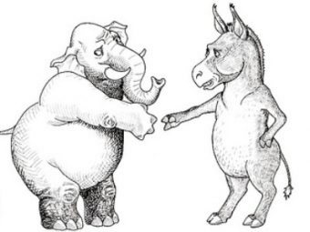
Tailor Biden’s speeches to appeal to opposition
Use Natural Language Processing
Tailor President-elect Biden’s speeches
Bridge the gap

Slide 4
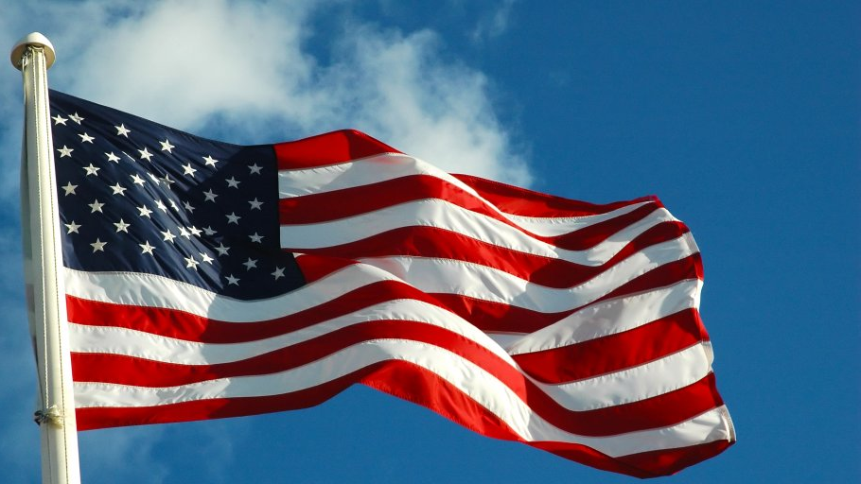
NLP in a nutshell
Trump speech text
Clean, decipher and analyze text
Topic 1
Topic 2
Topic 3

Slide 5

Implementation of NLP
8 Speeches in October 2020
Arizona
Nebraska
Wisconsin
Michigan
Pennsylvania
Analyzed for insights

Slide 6
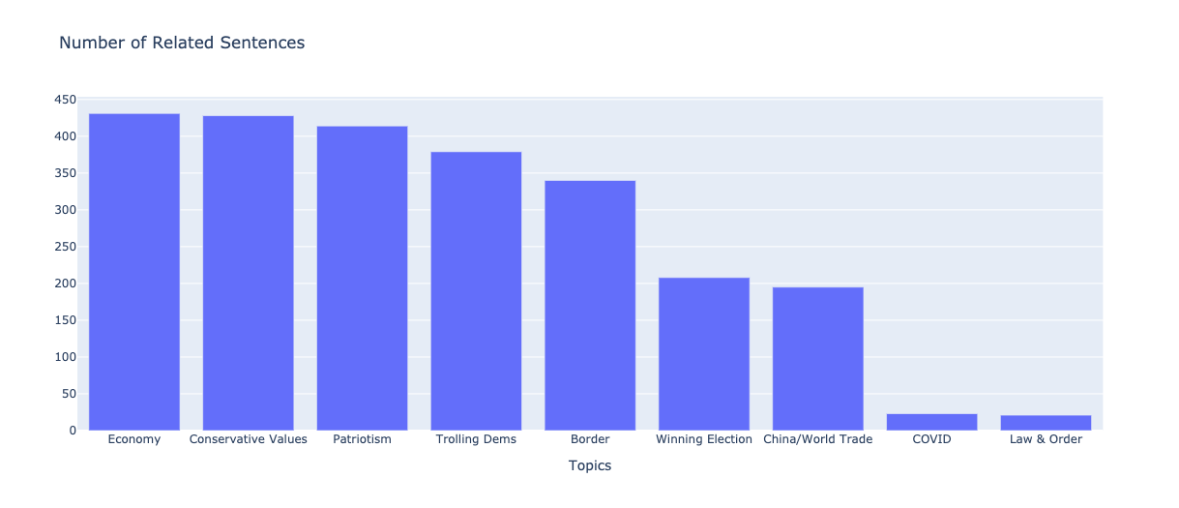
Overall Topics

Slide 7
State Talking Points
State | Topics | Talking Points
Arizona | Conservative Values, Law & Order | “open-carry” gun laws, law enforcement
Nebraska | Law & Order, Economy, COVID | law enforcement, Jobs/taxes, COVID plan
Wisconsin | COVID, Border | COVID plan, immigration reform
Michigan | Economy, COVID, Conservative Values | jobs/taxes, COVID plan, “open-carry” gun laws
Pennsylvania | China/World Trade, Law & Order | tough on China, law enforcement

Slide 8
Future Work
Retrieve speeches from previous crisis-time presidents
Obama (Great Recession)
Franklin Delanor Roosevelt (Great Depression/World War II)
Abraham Lincoln (Civil War)
Determine speech methods used to unite the nation during trying times

Slide 9

Acknowledgments
Open-source:
Python
Pandas, Numpy
Scikit-learn
spaCy
Plotly
Pew Research, 2016 Poll
Pew Research, 2020 Poll
Github repo:
github.com/mdominguez2010/Trump-Speech-NLP

