Slide 1
Anomaly detection
By Marcos Dominguez

Slide 2
What is it?
Detecting unexpected items
Unsupervised Learning
2 basic assumptions:
Anomalies ONLY occur rarely
Their features differ significantly from normal data

Slide 3
How is It used?
Detecting performance outliers
Fraud detection
Extreme price changes (stock trading)

Slide 4
Types of Algorithms
Univariate
Not very informative
Multivariate
More informative
Algorithms:
Cluster-based Local Outlier Factor (CBLOF)
Isolation Forest
K - Nearest Neighbors (KNN)

Slide 5


How does it work?
Outliers!
Largely based on outliers
One of these is not like the others

Slide 6

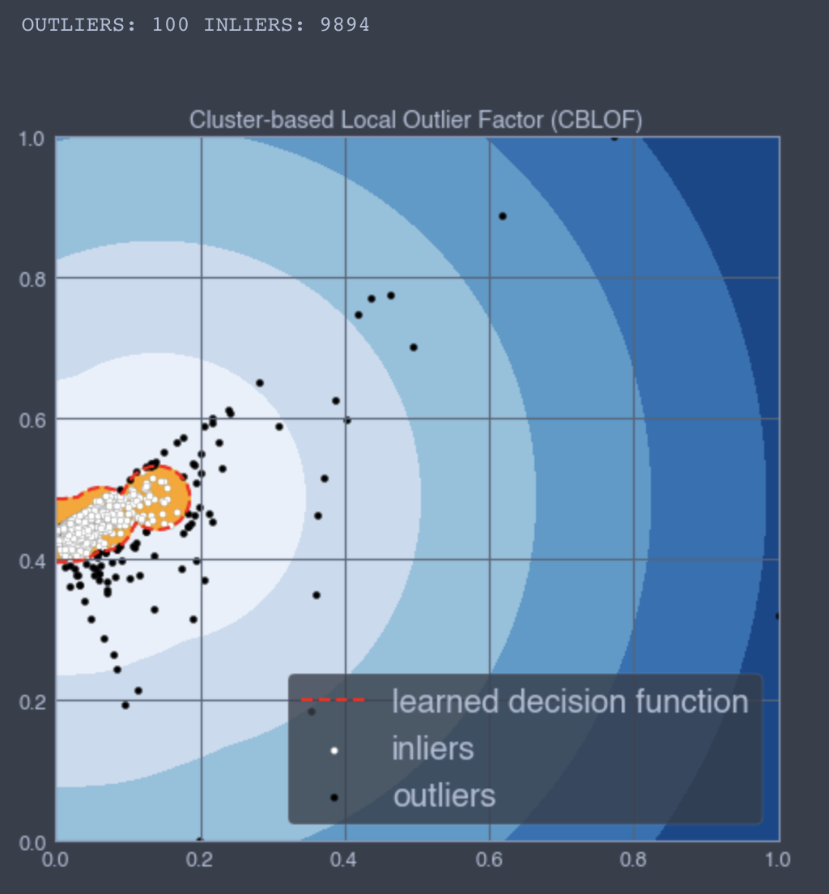
Example: CBLOF

Slide 7
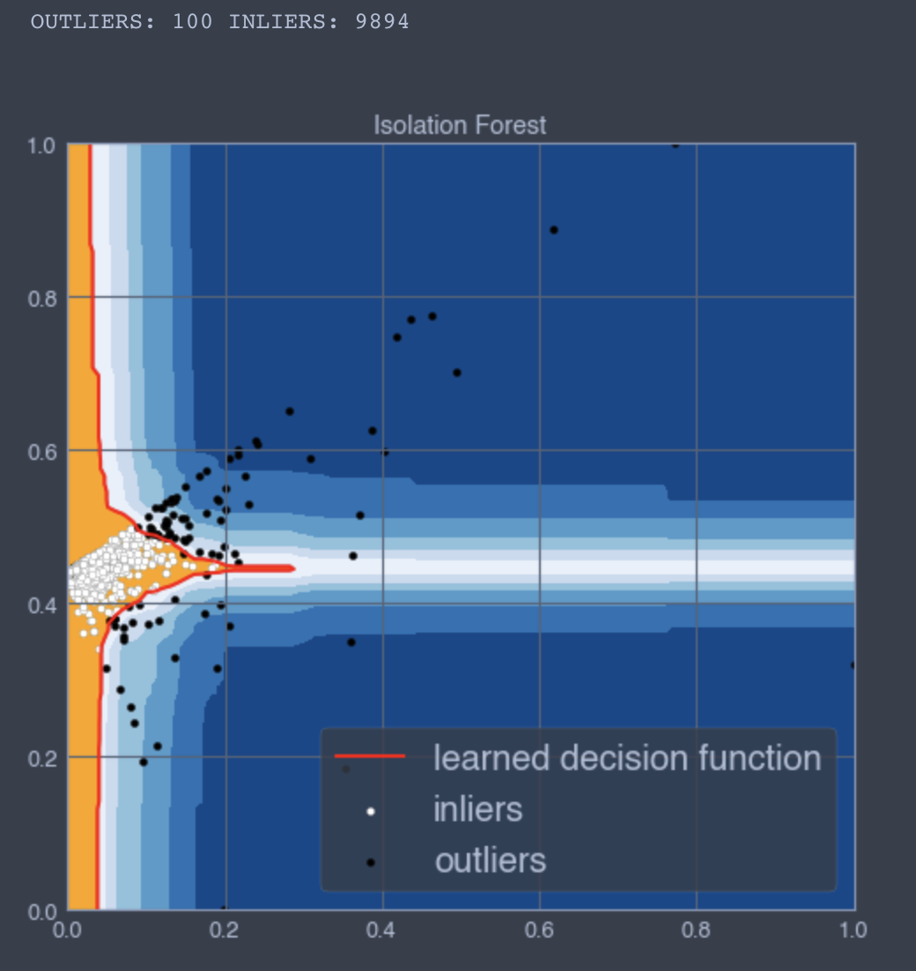
Example: Isolation forest

Slide 8
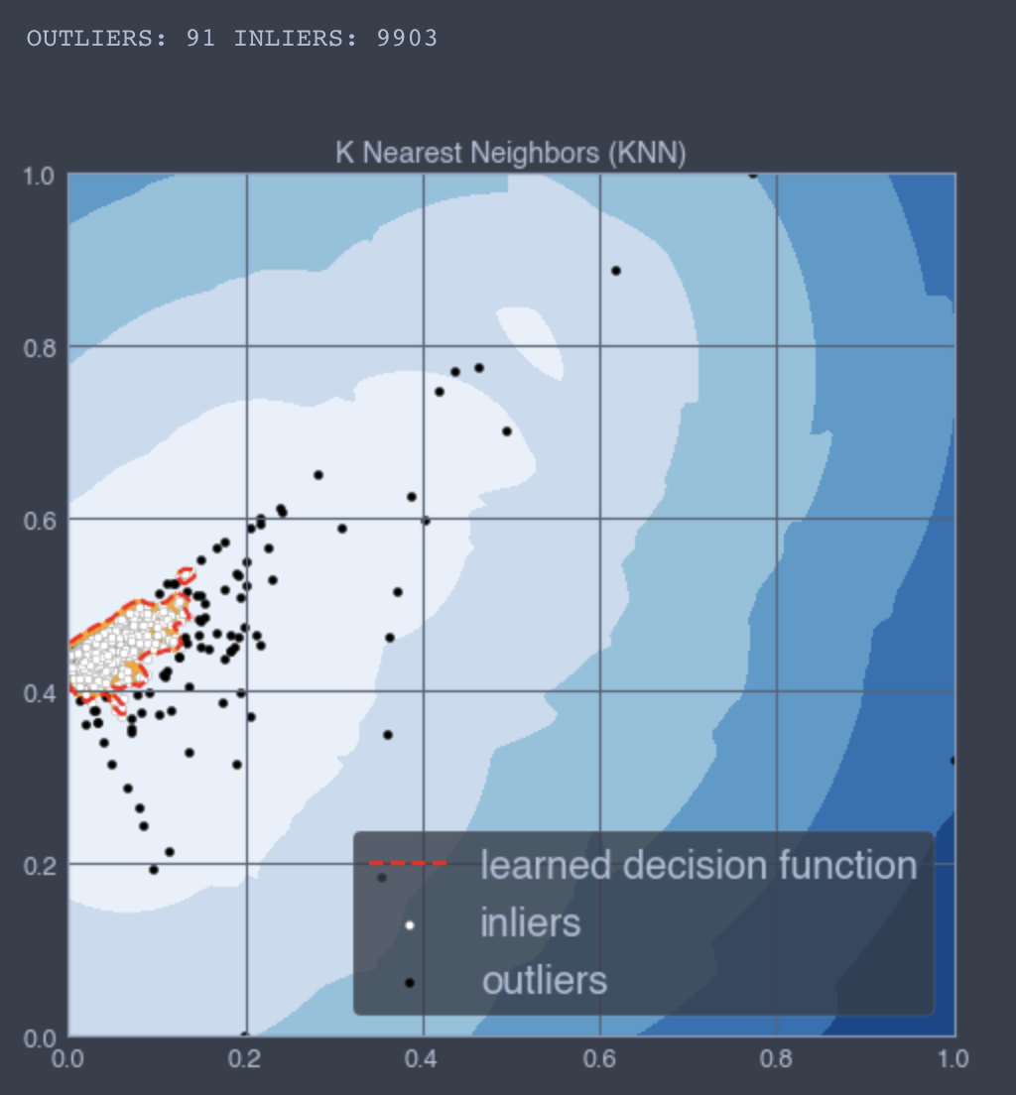
Example: KNN

Slide 9
Acknowledgements
Susan Li, Towards Data Science
Lakshay Arora, AnalyticsVidhya
Scikit-learn
Seaborn, Matplotlib
Python, PyOD
Full code and presentation here

