Slide 1
Anomaly detection
By Marcos Dominguez

Slide 2

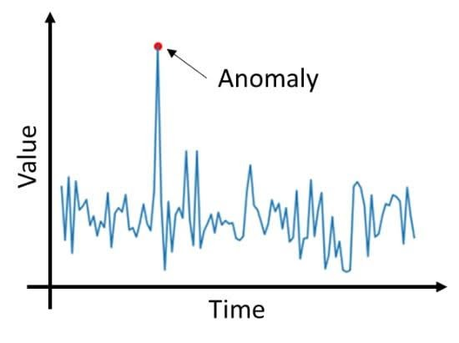
What is it?
Detecting unexpected items
Unsupervised Learning
2 basic assumptions:
Anomalies ONLY occur rarely
Their features differ significantly from normal data

Slide 3
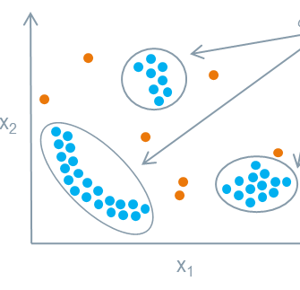
How is It used?
Detecting performance outliers
Fraud detection
Extreme price changes (stock trading)
Detecting a cyber breach

Slide 4
Types of Algorithms
Univariate
Not very informative
Multivariate
More informative
Algorithms:
Cluster-based Local Outlier Factor (CBLOF)
Isolation Forest
K - Nearest Neighbors (KNN)

Slide 5

How does it work?
Outliers!
Entirely based on statistical outliers
Assigning an anomaly score
Compare to threshold

Slide 6
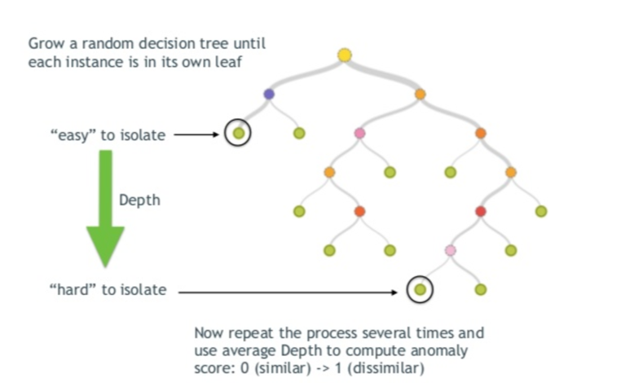
Isolation forest

Slide 7
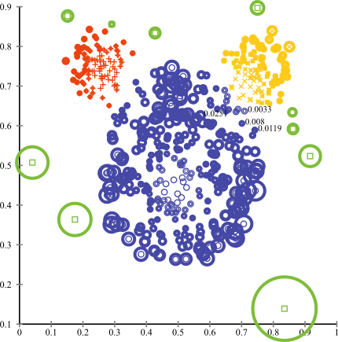
Cluster-based outlier factor
Typically uses K-means clustering
Calc anomaly score based on distance from clusters

Slide 8
Acknowledgements
Susan Li, Towards Data Science
Lakshay Arora, AnalyticsVidhya
Surbhi S, KeyDifferences
Tina Kavacova, Medium article
Stack Exchange
Open-source:
Scikit-learn
Seaborn, Matplotlib
Python, PyOD
Full code and presentation here

