Slide 1

Website Vulnerabilities Scanner: VulnXposer
Thesis/Project Part I (CSE 4192)
Department of Computer Science & Engineering
TMSS Engineering College, Bogura.
(Affiliated with University of Rajshahi)
Submitted by: | Supervised by:
Mohammad Omor Faruk | Mohadeb Kumar
ID:1937820113 | Lecturer (CSE),
Session: 2018-2019 Department of CSE, TMSS Engineering College | TMSS Engineering College, Bogura

Slide 2
Contents
What is Vulnerability
What is Vulnerability Scanner
Project Objective
Tools
Features
Scopes
UI/UX
Future Plan
1

Slide 3

Vulnerability
￼

Slide 4

Vulnerability Scanner

Slide 5
Project Objective:
Identify a Broad Range of Vulnerabilities
Report Vulnerabilities Clearly
Improve Overall Web Security
4

Slide 6
Tools
Node.js
ReactJS
Scripts: Python, Go, and Bash scripting.

Slide 7


Website

Slide 8

Scripts

Slide 9
Features
Port Scanning
Host Identification and DNS Analysis
CVE(Common Vulnerability Exposure) Detection
OWASP Top 10 vulnerability Scanning
User-friendly Web Interface

Slide 10
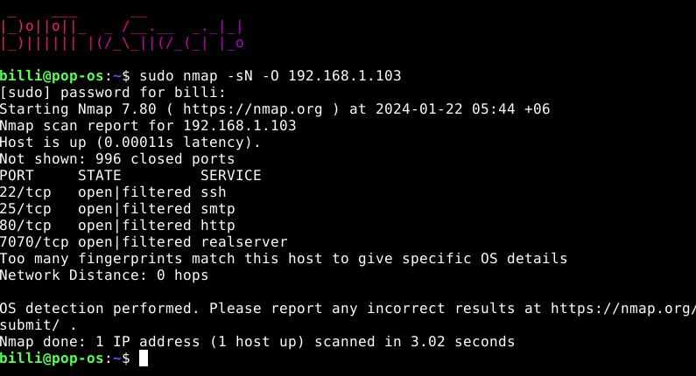
Port Scan

Slide 11
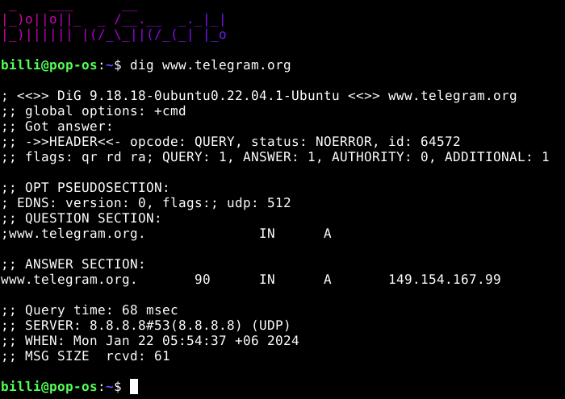
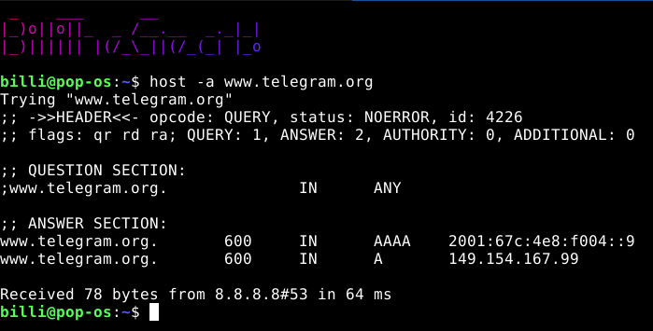
Host & DNS Scan

Slide 12
Scope:
SQL Injection
Broken Authentication
Sensitive Data Exposure
XML External Entities (XXE)
Broken Access Control
Security Misconfigurations
Cross-Site Scripting (XSS)
Using Components with Known Vulnerabilities

Slide 13
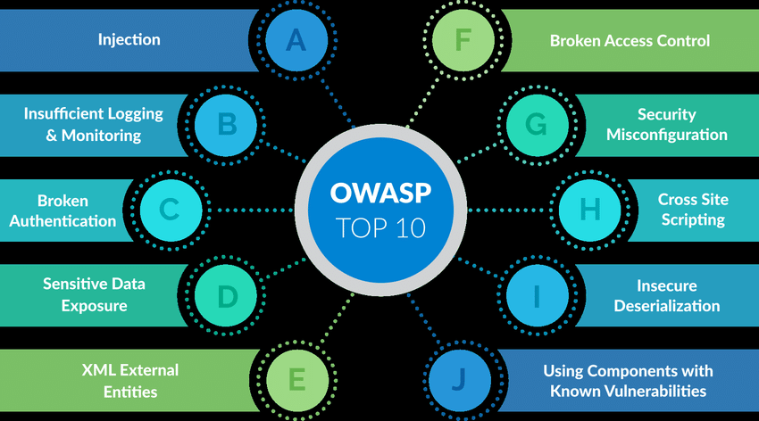

Slide 14
User Interface and User Experience
User Authentication
Intuitive Dashboard
Real-time Progress Updates
Detailed Scan Reports
Historical Scan Data
Alerts and Notifications
User Feedback Mechanism
Responsive Design
3

Slide 15
Future Plan
Subscription Model
We'll offer our tool as a service (SAAS), meaning users can access it online.
Subscription users get extra features that free users don't have access to.

Slide 16
Thank you

