Slide 1

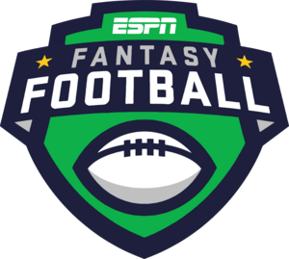




SENTIMENT SEARCH ENGINE FOR FANTASY FOOTBALL
BY Michael D’Orazio
Web & Text Mining

Slide 2
Background – Fantasy Football
To give some context, fantasy football is a game that allows you to be the owner, GM, and coach of your very own football team. [1]
Competing against your friends, you draft a team made up of NFL players and based on their on-field performance in a given week, you score points.
With the regular season running from September through January and the playoffs beginning shortly afterwards, it’s been in full swing for a number of months.
And if your family or friends are anything like mine, you’ll know that it becomes a major talking point and gets very competitive as the season goes on.

Slide 3

Background – Fantasy Points
Kickers (K)
5 pts per 50+ yard FG made
4 pts per 40-49 yard FG made
3 pts per FG made, 39 yards or less
2 pts per rushing, passing, or receiving 2 pt conversion
1 pt per Extra Point made
-2 pts per missed FG (0-39 yds)
-1 pt per missed FG (40-49 yds)
Offense – QB, RB, WR, & TE
6 pts per rushing/receiving TD
6 pts for returning kick/punt for TD
6 pts for returning/recovering a fumble for TD
4 pts per passing TD
2 pts per rushing/receiving 2 pt conversion
2 pts per passing 2 pt conversion
1 pt per 10 yards rushing/receiving
1 pt per 25 yards passing
-2 pts per intercepted pass
-2 pts per fumble lost
Defensive/Special Teams (D)
3 pts per defensive/special teams TD
2 pts interception
2 pts fumble recovery
2 pts blocked punt, PAT, or FG
2 pts per safety
1 pt per sack
All point values shown above follow ESPN’s Standard Scoring System. [2]

Slide 4
Statement of the Problem
As one would expect from a popular topic, opinions run wild during this time of year, with statements made in hindsight often dominating online forums and subreddits alike.
This combined with the experience that insults are often sung a lot more than praises in the sports world (at least with Philly fans), made me ask myself if post-game sentiment is a strong parallel to real-life events.
Therefore, the problem addressed with this research is whether public opinion can be used to assess player performance, and if an effective tool can be made to do this in real-time.

Slide 5
Why People Should Care
People should care about this topic if they have a vested interest in fantasy sports or want to validate their opinions against those felt by others.
This is because fantasy participants could use public sentiment to determine which players should be benched or in their lineups for a given week or to strategically make trades with other members in their league.
Additionally, this problem is of interest to those who want to see how public opinion is influenced by day-to-day events and can be applied to tons of other topics apart from this one.

Slide 6
My Approach to Solving the Problem
At first, I thought that a good way to go about building a tool like this would be to train a sentiment analysis model like BERT, and then use it to test on relevant data.
But given what we learned throughout the semester, I later realized that the best way to do this would be to mine/retrieve relevant information based on a keyword search through a platform like Reddit, and then use that to carry out my analysis in real-time.
When put together, this is where the idea of creating a “Sentiment Search Engine” started to take shape.

Slide 7
My Approach – The Data
My dataset was created through the combination of multiple datasets for sentiment analysis along with data that I mined using Reddit PRAW.
In total, the dataset consists of roughly 270,000 rows of comments along with the corresponding sentiments of Positive, Negative, and Neutral.
Within it, roughly 50,000 comments were mined directly from Reddit across separate days in to help the model better understand language used by Reddit users and Football fans.

Slide 8
My Approach – The Data
The mined data was obtained mostly from the following subreddits:
r/nfl, r/fantasyfootball, r/nflmemes, r/espn and 32 others for each team
This data was also mapped to every team’s corresponding subreddits when a GUI was implemented, but more on that later.
In total, about 50 CSV files were combined to create this portion of the dataset that was used to help train the model on sports-related language.
The rest of the data consisted of separate sentiment datasets of Reddit and Twitter data to help train the model on varied language/topics.

Slide 9
Why I Chose my Design
I chose BERT as my model because of how well it performed during the sentiment contest and I wanted to try it out for myself.
I also really wanted to build a tool that could analyze public opinion in a timely manner, and with the Twitter API no longer being free, Reddit was the best possible alternative I could use as a data source.
Because of that, many design choices like limiting the search to 1,000 comments at a time or deriving timestamps from the average Unix time were the result of working around the Reddit API’s general limitations.

Slide 10
Details of the Process
I wrote a Python script that allowed me to combine multiple datasets saved as CSVs.
Following that, I mined 50 datasets for sports-related language using Reddit PRAW.
After that, I used VADER to classify the mined text into either Positive, Neutral, or Negative sentiment.
I then combined the mined data with the original dataset and trained a model using a version of BERT called DistilBERT.
Finally, I created a search engine that performs a keyword search on a player’s name through the latest 1,000 comments predefined subreddits, while simultaneously evaluating the model on newly mined data.

Slide 11
Details – BERT Model Scores
Epoch | Training Loss | Validation Loss | Accuracy | Precision | Recall | F1 - Score
1 | 22.1% | 21.0% | 92.92% | 93.02% | 92.92% | 92.95%
2 | 19.5% | 18.9% | 94.25% | 94.30% | 94.25% | 94.26%
3 | 4.7% | 20.5% | 94.73% | 94.73% | 94.73% | 94.73%
* By Epoch 3, we have some overfitting going on maybe due to the dataset size.
In total, this model took about 29 hours to train on a GeForce GTX 1070 made in 2016.

Slide 12
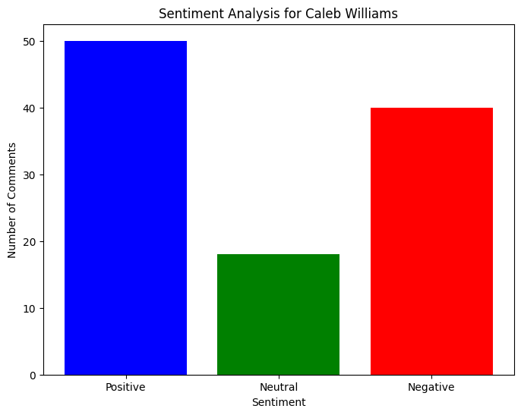
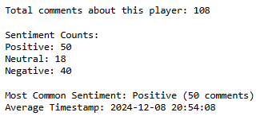
Details – Player #1 Caleb Williams
Position: QB
Team: Chicago Bears
Record Date: 12/08/24
Record Time: 8:54 PM
This Week’s Pts: 17
Prior Week’s Pts: 31
Avg. Pts: 17
Game Result: L 38-13
Stat Source: CBS-Sports [3]

Slide 13
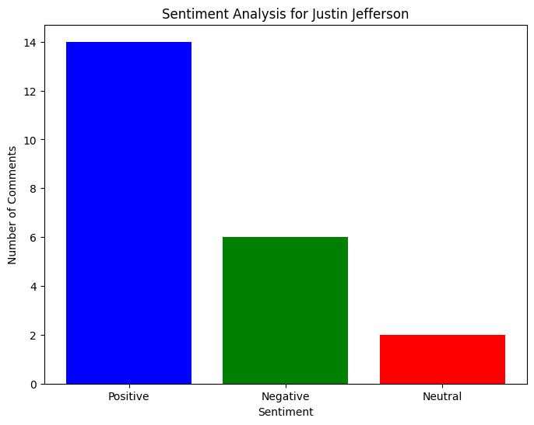
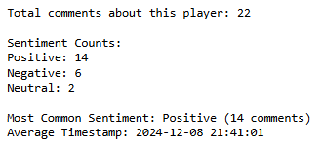
Details – Player #2 Justin Jefferson
Position: WR
Team: Minnesota Vikings
Record Date: 12/08/24
Record Time: 9:41 PM
This Week’s Pts: 25
Prior Week’s Pts: 9
Avg. Pts: 11.7
Game Result: W 42-21
Stat Source: CBS-Sports [3]

Slide 14
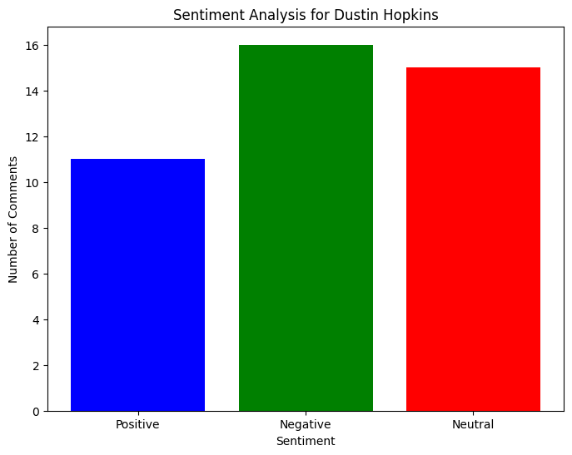
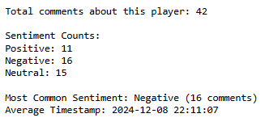
Details – Player #3 Dustin Hopkins
Position: K
Team: Cleveland Browns
Record Date: 12/08/24
Record Time: 10:11 PM
This Week’s Pts: 2
Prior Week’s Pts: 6
Avg. Pts: 5.2
Game Result: L 14-27
Stat Source: NFL Fantasy [4]
* Missed 2 FG on 12/08/24

Slide 15
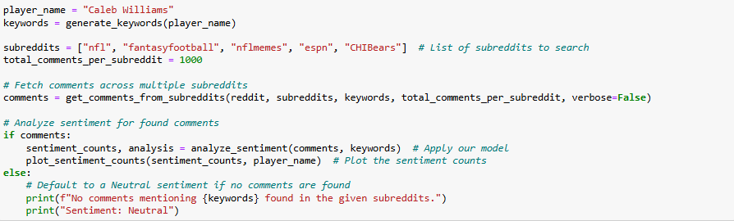
Details – Code Logic

Slide 16
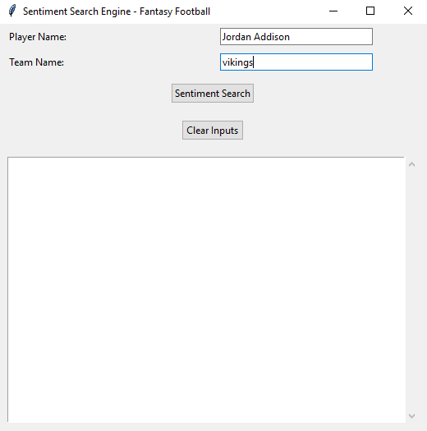
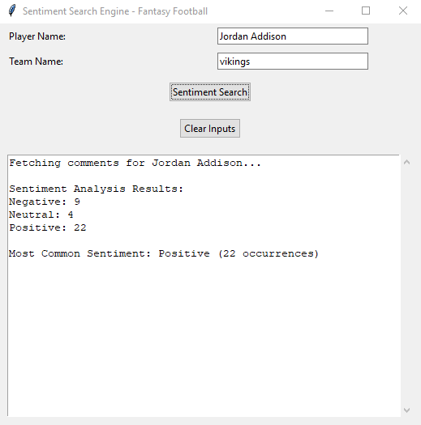
Details - Tkinter Version

Slide 17
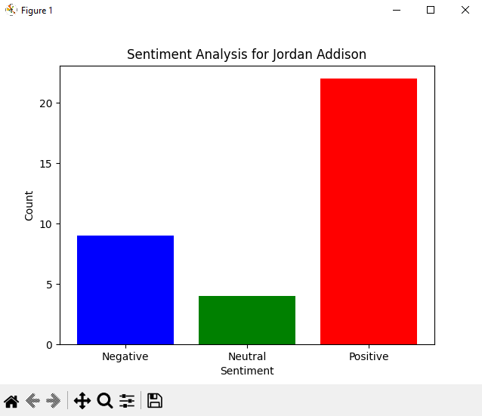
Details - Tkinter Version
Player: Jordan Addison, WR, Vikings.
The output is once again a bar graph.
This specific one was generated on December 9th, 2024.
For context, this is after Jordan Addison recorded 31 fantasy points & 3 touchdowns in a game where the Vikings beat the Falcons 42 to 21. [3]
This game was played on December 8th.
As we can see, the sentiment is majority positive, which strongly aligns with his performance from the day prior.

Slide 18
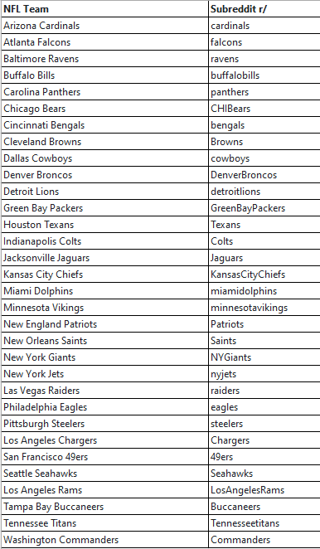
Details – Team Mapping
For the Tkinter version, each team was mapped to its corresponding subreddit.
This was done so that users could just input “Eagles” or “Ravens”, and it would direct the search towards the associated subreddit.
Since there is a total of 32 teams, I created a table to keep track of that information, and then mapped it out within my code.

Slide 19
What is Original About this Research?
This research is original in a few different ways:
1) Creating a sentiment search engine using Reddit PRAW that uses recent posts as test data is a unique application of its existing functionality.
2) Most other analyses in this space involve established test sets rather than evaluating a model on freshly mined data.
3) Applying a keyword search that provides an average date based on Unix time was an original implementation made to work around the Reddit API.

Slide 20
Conclusions/Lessons Learned
The language of Redditors and sports-fans are a bit different to the types of sentences that BERT is used to.
There are cases where it assumes short phrases that a human would read as either Positive or Negative as being Neutral, so maybe limiting an analysis like this to two classes instead of three would help make it better.
Training on a larger dataset where sports-related language is more common may also help it perform better in real-world application.
While it’s not perfect, sentiments generally do reflect real-game results, but the timing is important.

Slide 21
Implications
The implications of this research are very exciting.
A tool like this could be used to develop other search engines into other trending topics across different sectors like cryptocurrency, music, ecommerce, and virtually anywhere you might want to analyze Reddit data.
For a tool like this to reach that level, it could either be topic-specific like how it was done here or trained on relevant language across all subreddits.
If done well, this could even be a valuable feature that either Reddit or other platforms could implement for their users to enjoy.

Slide 22
Topics I Applied from class
1. Web Scraping/Reddit PRAW – Week 2
2. Multi-Class Text Classification – Week 9
3. Sentiment Analysis – Weeks 11 & 12
4. BERT – Week 12
5. Information Retrieval – Week 14

Slide 23

QR CODE to GitHub

Slide 24

Questions?

Slide 25
References
[1] https://www.si.com/fantasy/2020/04/04/fantasy-football-advice-guide-for-beginners
[2] https://www.espn.com/fantasy/football/ffl/story?page=fflrulesstandardscoring
[3] https://www.cbssports.com/nfl/players
[4] https://www.fantasy.nfl.com

Slide 26

Thanks for Watching!

