Slide 1
Need-finding
Airport Edition

Slide 2
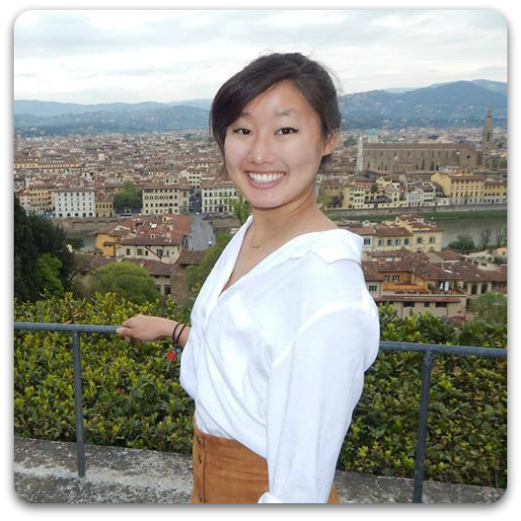
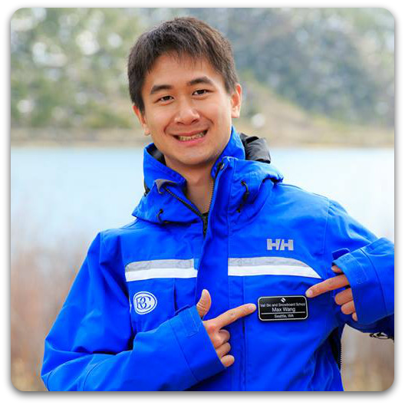
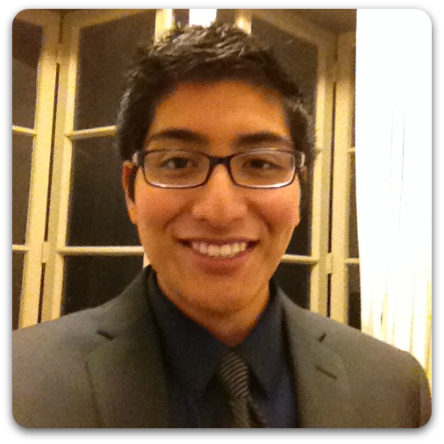
Our Team:
Our Problem Domain:
The intersection between travelers and commuters
Hali
Max
Doshi

Slide 3
Needfinding process
Users who care about mobility
travelers
commuters
Where can we observe both travelers and commuters?
Users who care about mobilityW

Slide 4
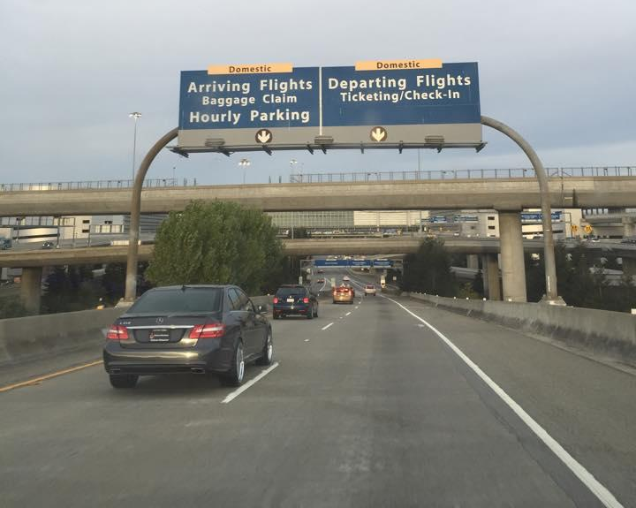
Domestic Terminal of Airport
People who fly in order to travel to new places
People who fly in order to commute between city to city
Notes:
We decided not to try the international terminal because we thought there would be a greater chance of finding commuting travelers for people who fly within the United States.
We wanted to talk to people pre-security to get their pre-flight experiences, and we wanted to talk to people at baggage claim to get their post-flight experience

Slide 5
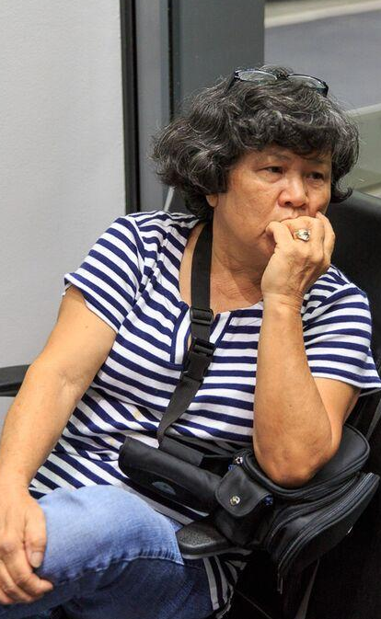
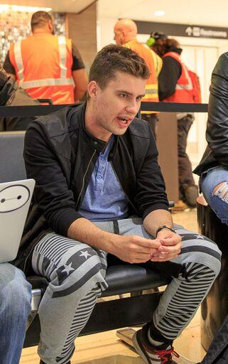
International Travelers
Mariko
64 years old
Japanese-American
Maruk
in his 20s
Polish
Notes:
Mariko is a 64 year old traveler from Japan but now living in South Carolina.
Why we chose: We decided to interview her because she was older and traveling alone.
Highlights: She traveled frequently in her youth and shared many recollections with us that highlighted how travel has changed through time.
Maruk is a Polish traveler in his 20s from Poland.
Why we chose: We chose him because we were looking for a white, young male.
Highlights: He frequently travels internationally to explore new places and thus shared many diverse experiences.
Neither of these people were commuters, but they gave us perspectives on traveling for the sake of new experiences.

Slide 6
Notes prevous
Mariko is a 64 year old traveler from Japan but now living in South Carolina.
Why we chose: We decided to interview her because she was older and traveling alone.
Highlights: She traveled frequently in her youth and shared many recollections with us that highlighted how travel has changed through time.
Maruk is a Polish traveler in his 20s from Poland.
Why we chose: We chose him because we were looking for a white, young male.
Highlights: He frequently travels internationally to explore new places and thus shared many diverse experiences.
Neither of these people were commuters, but they gave us perspectives on traveling for the sake of new experiences.

Slide 7
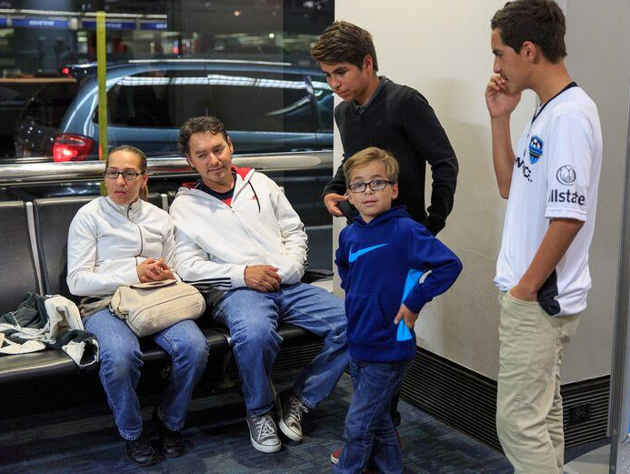
Family
The Campos Family
Mexican-American
Notes:
The Campos family is a family of 5 from Hayward.
Why we chose: We were looking for a family to understand the experience of traveling with children.
Highlights: It turned out only one son, Marcos was traveling, but we were able to ask about their past experiences traveling as a family.

Slide 8
Notes prevous (not in presentation)
The Campos family is a family of 5 from Hayward.
Why we chose: We were looking for a family to understand the experience of traveling with children.
Highlights: It turned out only one son, Marcos was traveling, but we were able to ask about their past experiences traveling as a family.

Slide 9
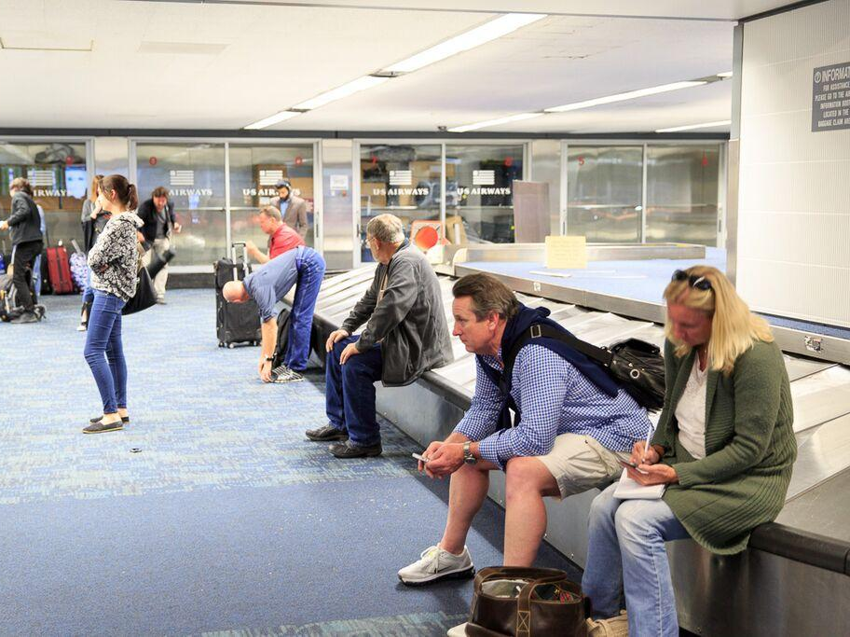
High Frequency Travelers/Experts
Ami - Flight Attendant
Forman - Airline Agent
Mike - Business Traveler
Notes:
Ami is a flight attendant we interviewed over Skype
Why we chose: Flight attendants interact with many travelers and thus experience second-hand many emotions. She is also a frequent traveler because of her job, though her experiences may differ from the average user.
Highlights: Ami gave us many recollections about exceptional travelers.
Forman was a gate agent who works for American Airlines
Why we chose: Gate agents interact with many travelers, especially those who are frustrated. They are seen as an expert in their field, and we were curious about the sort of questions users would ask.
Highlights: Forman told us about encounters with frustrated his travelers and his opinions on preparing for travel.
Mike is a businessman who travels for work
Why we chose: We were looking for a high frequency user who views traveling as a way to commute. We caught him as he was waiting for his bag after his flight ended.
Highlights: Mike gave us a rundown of his traveling process.

Slide 10
Notes previous (not in presentation)
Ami is a flight attendant we interviewed over Skype
Why we chose: Flight attendants interact with many travelers and thus experience second-hand many emotions. She is also a frequent traveler because of her job, though her experiences may differ from the average user.
Highlights: Ami gave us many recollections about exceptional travelers.
Forman was a gate agent who works for American Airlines
Why we chose: Gate agents interact with many travelers, especially those who are frustrated. They are seen as an expert in their field, and we were curious about the sort of questions users would ask.
Highlights: Forman told us about encounters with frustrated his travelers and his opinions on preparing for travel.
Mike is a businessman who travels for work
Why we chose: We were looking for a high frequency user who views traveling as a way to commute. We caught him as he was waiting for his bag after his flight ended.
Highlights: Mike gave us a rundown of his very familiar traveling process.

Slide 11
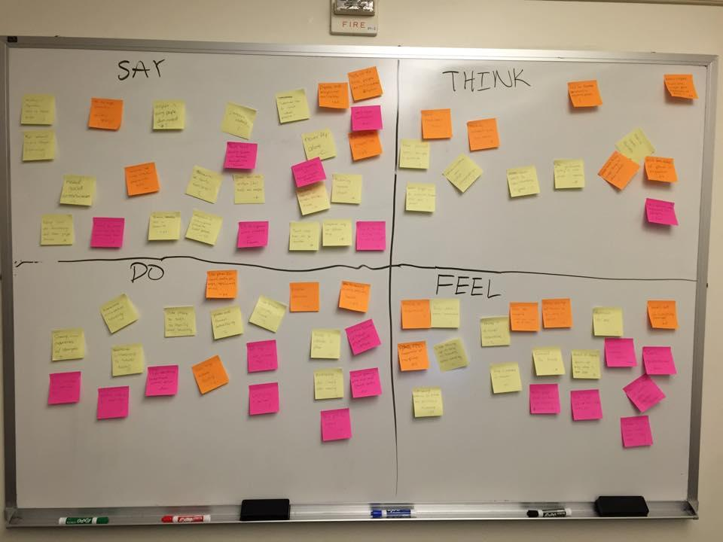
Results
What interview data is relevant?

Slide 12
Surprises
“I’m not a tourist, I’m a traveler.”
Sharing experiences with strangers
Some flight attendants keep travel journals online
“America is not filled with fat people with guns.”
Combine business with travel experience
Food is important in travel… bring own food/water
Notes:
“I’m not a tourist, I’m a traveler” - Maruk regarding his attitude to travel
tourists have a connotation of not belonging and being narrow-minded
“American is not filled with fat people with guns” - Maruk about why he wanted to travel to America - to see if stereotypes are real
surprising because we are American and always talk about this stereotype as a joke, but it’s very real in other countries
Sharing experiences with strangers - An action that is very important to Mariko when she travels
surprising because many people approach traveling as an isolating event - you’re tired and you don’t want to talk to people. Instead Mariko feels like she can learn and gain information by talking to strangers
Combine business with travel experience
Mike found a way to conduct important business while still enjoying himself. Businessmen tend to get too caught up in work and don’t take time to enjoy their stay.
Food is important in travel… bring own food/water
surprising because food is considered culturally important for experiencing a new area, but it is also important for health and maintaining a good lifestyle while traveling
Some flight attendants keep travel journals online
traveling is still something unique to them even though they travel so much

Slide 13
Notes previous (not in presentation)
“I’m not a tourist, I’m a traveler” - Maruk regarding his attitude to travel
tourists have a connotation of not belonging and being narrow-minded
“American is not filled with fat people with guns” - Maruk about why he wanted to travel to America - to see if stereotypes are real
surprising because we are American and always talk about this stereotype as a joke, but it’s very real in other countries
Sharing experiences with strangers - An action that is very important to Mariko when she travels
surprising because many people approach traveling as an isolating event - you’re tired and you don’t want to talk to people. Instead Mariko feels like she can learn and gain information by talking to strangers
Combine business with travel experience
Mike found a way to conduct important business while still enjoying himself. Businessmen tend to get too caught up in work and don’t take time to enjoy their stay.
Food is important in travel… bring own food/water
surprising because food is considered culturally important for experiencing a new area, but it is also important for health and maintaining a good lifestyle while traveling
Some flight attendants keep travel journals online
traveling is still something unique to them even though they travel so much

Slide 14
Tensions
“40% of the time, people are not organized.”
“People that aren’t aware will fumble through life.”
“For my age, change is always hard.”
Afraid to offend people due to language and cultural barriers
Long lines are frustrating and make people nervous
Don’t trust others
Notes:
“40% of the time, people are not organized.” - Forman’s observations of traveler’s checking-in
Travelers come to the airport unprepared and usually have to ask staff for help
“People that aren’t aware will fumble through life.” - Forman’s wise words to the common traveler
People should be aware of current events and research their destination before traveling
“For my age, change is always hard.” - Mariko commenting on changes she has noticed in airports, including the crowd, language, and attire
Mariko was born when only businessmen and wealthy people traveled by plane
Now, everyone travels by plane
Afraid to offend people due to language and cultural barriers
people want to connect with fellow travelers but are afraid they will accidentally offend or annoy the other person
Long lines are frustrating and make people nervous
no one likes waiting in long lines, and people start to get nervous when they’re in a rush
Don’t trust others
not everyone you meet is trustworthy and will manipulate you to accomplish their own interests

Slide 15
Contradictions
Physical map vs. digital map
Never fly alone vs flying alone -> freedom
Magazine/newspaper is useless
Airport is young people dominated
Self-booking vs. travel agent
Notes:
Physical map vs. digital map
Even though anyone with a smartphone has a digital map at their fingertips, some people still prefer to have physical maps when traveling
Never fly alone vs flying alone -> freedom

Slide 16
Notes previous (not in presentation)
Physical map vs. digital map
Even though anyone with a smartphone has a digital map at their fingertips, some people still prefer to have physical maps when traveling
Never fly alone vs flying alone -> freedom

Slide 17
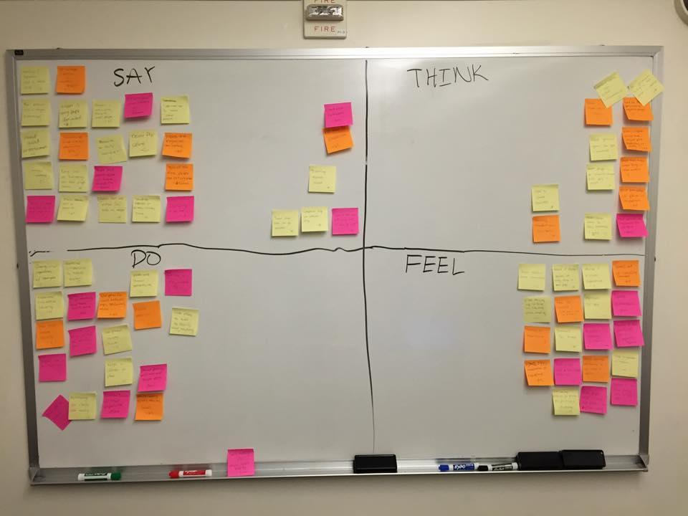
Analysis + Empathy Map
What does our interesting data mean?

Slide 18
Empathy map breakdown (not in presentation)
Think
World is more open now
Traveling braodens horizons
hard for tourists to regulate price
more ways to stay connected is good
communication can yield information
good to lower barriers
people tend to buy cheaper things in other countries
People should do research before going to airport
Personal space is important
Meal options are important
Airport should have unique meeting place
Feel
not be able to go places b/c politics is frustrating
likes staying up to date with reading
flying is a novel experience
food is important to travel
concern for friends
feel experience of new place
fear the unexpected
important to win
afraid of lanugage barriers
want attention
stomach pills are important
family is important
Say
airport is young people dominated
Respect others
learned not to trust other people
never fly alone
no time to exerise
papers and magazines are useless
40% of the time people are not organized
Can’t find bathrooms
Traveling improves oneself
Better early than late
Travel alone go nowhere
Companions help with different things
doesn’t feel safe without weapons
Do
Research city before traveling
Share experiences with strangers
Switched citizenship to travel easier
Use phone to talk to family
routine exercises
Phone for social media, apps, music
flight attendants keep travel journals
Keep calendar on phone
Gossip to pass time
Sleep on planes
Plan around family

Slide 19
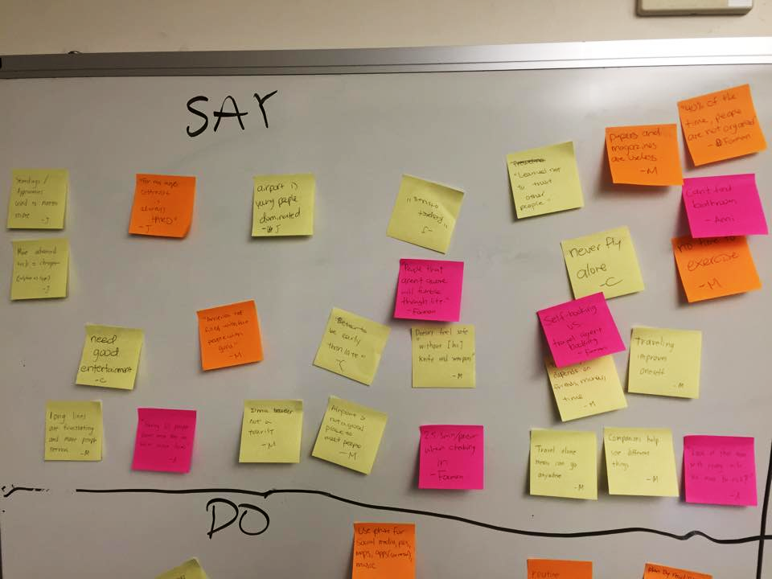
Say
“Respect others”
“I learned not to trust others”
“Traveling improves oneself”
“Airport is not a place to meet people”
Notes:
Say has many perspectives of each individual’s very unique experiences.

Slide 20
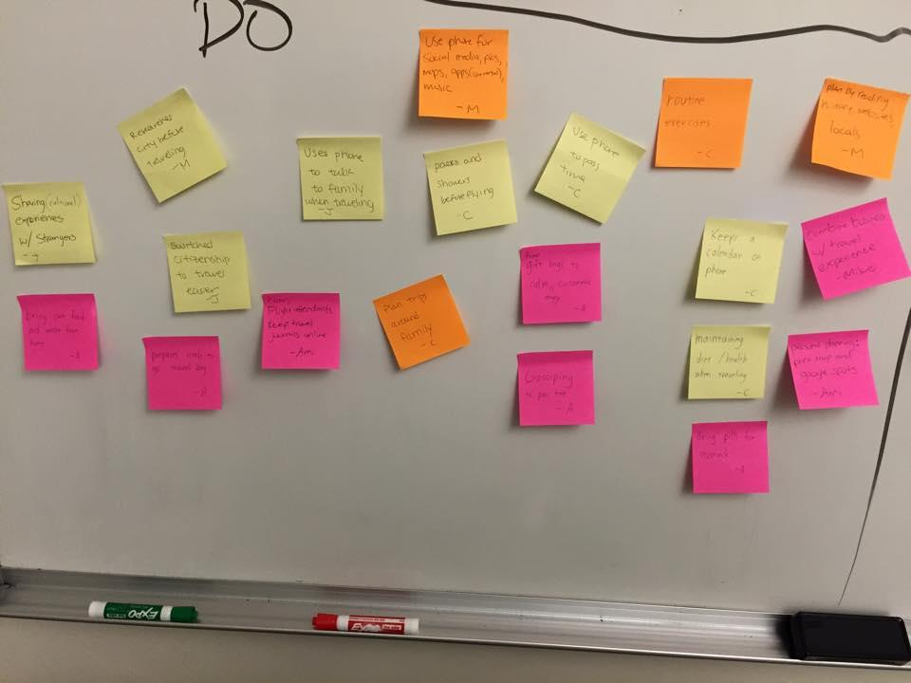
Do
“Pack and shower before flying”
“Switched citizenship to travel easier”
“Use phone to pass time”
“Plan trips around family”
Notes:
Do has many logistical points and reflects the actions people must take when they travel

Slide 21
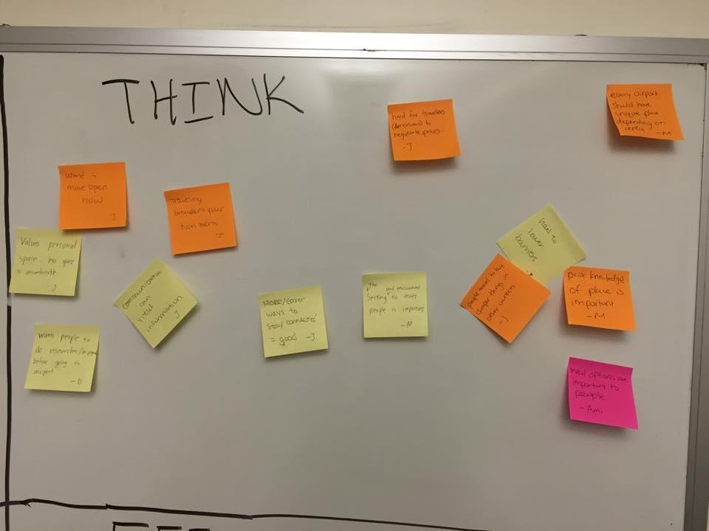
Think
Hard to lower barriers
More ways to stay connected are good
Communication can yield information
World is more open now
Notes:
People are thinking beyond themselves when they travel. There is a very outward mindset.

Slide 22
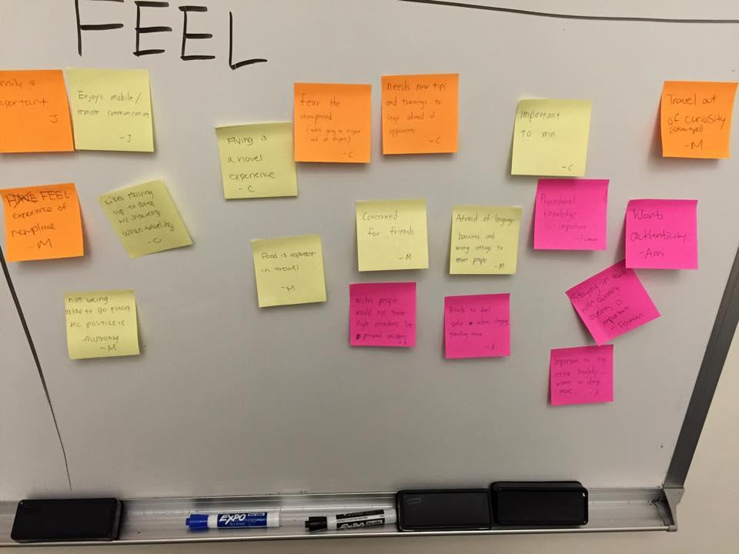
Feel
Wants authenticity
Enjoys staying up to date
Frustration at unprepared people
Curiosity fuels travel
Notes:
People feel a broad range of emotions about travel - from frustrating logistics to excitement of learning something new.

Slide 23
Inferences - We wonder if our data means...
Travel can be a disruption to lifestyle and health
People want to remain connected to friends and family
People seek constant entertainment and current events
People need to feel safe while traveling
Travel requires preparation
An open mind and having respect for others will enrich one’s travel experiences
Notes:
Traveling can disrupt your lifestyle and health so it is important to have backup supplies of food and water, and also to know the locations of restaurants and restrooms at a new place
Maruk likes bringing his own food and struggles to find healthy and cheap places to eat
Marcos needs to maintain his exercise, diet, and hydration regime while traveling
People feel the need to stay connected to their friends and families and will go out of their ways to find ways to communicate with them
Mariko seeks wifi and phone booths so she can call her mother and daughter
Maruk worries about his friends when they travel with him
Angelica misses her son when he is traveling
The Campos family plans traveling around family needs and the entire family came to send a single person off at the airport
People want constant entertainment and current events
Maruk, Mariko, and Forman pass time reading on their electronics on the plane
Marcos and his brother like playing games they have downloaded on their phone. They wish the plane had free wifi.
People need to feel safe while traveling
Maruk carries a knife and stick with him
It is important to be prepared for travel by packing necessities, researching about destinations, and being knowledgeable on required procedures and limitations through the airport
“People that aren’t aware will fumble through life” -- Forman
Maruk reads up on places he goes to on sites such as trip advisor
Mike chooses what he does based on his business destinations
An open mind and having respect for others will enrich one’s travel experiences

Slide 24
Notes prevous (not in presentation)
Traveling can disrupt your lifestyle and health so it is important to have backup supplies of food and water, and also to know the locations of restaurants and restrooms at a new place
Maruk likes bringing his own food and struggles to find healthy and cheap places to eat
Marcos needs to maintain his exercise, diet, and hydration regime while traveling
People feel the need to stay connected to their friends and families and will go out of their ways to find ways to communicate with them
Mariko seeks wifi and phone booths so she can call her mother and daughter
Maruk worries about his friends when they travel with him
Angelica misses her son when he is traveling
The Campos family plans traveling around family needs and the entire family came to send a single person off at the airport
People want constant entertainment and current events
Maruk, Mariko, and Forman pass time reading on their electronics on the plane
Marcos and his brother like playing games they have downloaded on their phone. They wish the plane had free wifi.
People need to feel safe while traveling
Maruk carries a knife and stick with him
It is important to be prepared for travel by packing necessities, researching about destinations, and being knowledgeable on required procedures and limitations through the airport
“People that aren’t aware will fumble through life” -- Forman
Maruk reads up on places he goes to on sites such as trip advisor
Mike chooses what he does based on his business destinations
An open mind and having respect for others will enrich one’s travel experiences

Slide 25
Conclusions
Choices are important - they help people feel in control
Maps are important, especially when there’s no wifi
Authenticity in travel is important
“I’m not a tourist, I’m a traveller”
People want to connect with strangers at a new place but are afraid of inappropriate settings and offending others
Notes:
Inferences
People care about having choices and to feel special, like feeling they’re in control
It is important to be able to reference a map while traveling, especially when there is no wifi
Some people prefer having authenticity when traveling and experiencing a foreign place like locals would
“I’m not a tourist, I’m a traveller”
People want to connect with strangers at a new place but are afraid of inappropriate settings and offending others
Conclusions
Traveling can disrupt your lifestyle and health so it is important to have backup supplies of food and water, and also to know the locations of restaurants and restrooms at a new place
People feel the need to stay connected to their friends and families and will go out of their ways to find ways to communicate with them
People want to be constantly entertained and be up-to-date on current world events
Important to feel safe while traveling
It is important to be prepared for travel by packing necessities, researching about destinations, and being knowledgeable on required procedures and limitations through the airport
“People that aren’t aware will fumble through life”
An open mind and having respect for others will enrich one’s travel experiences

Slide 26
Notes prevous (not in presentation)
Inferences
People care about having choices and to feel special, like feeling they’re in control
It is important to be able to reference a map while traveling, especially when there is no wifi
Some people prefer having authenticity when traveling and experiencing a foreign place like locals would
“I’m not a tourist, I’m a traveller”
People want to connect with strangers at a new place but are afraid of inappropriate settings and offending others
Conclusions
Traveling can disrupt your lifestyle and health so it is important to have backup supplies of food and water, and also to know the locations of restaurants and restrooms at a new place
People feel the need to stay connected to their friends and families and will go out of their ways to find ways to communicate with them
People want to be constantly entertained and be up-to-date on current world events
Important to feel safe while traveling
It is important to be prepared for travel by packing necessities, researching about destinations, and being knowledgeable on required procedures and limitations through the airport
“People that aren’t aware will fumble through life”
An open mind and having respect for others will enrich one’s travel experiences

Slide 27
Questions
How can we develop a product for “travelers” without excluding or focusing on “tourists”?
How can we remove both logistical and cultural barriers that limit people’s travel experiences?
How can we help travelers better prepare so travel feels more natural?

Slide 28
Preliminary Needs → Insights
Needs
Connectivity
Lowered barriers
Better preparation
Insights - We were amazed to realize...
People don’t want to be isolated from their normal lives when traveling
People struggle to overcome cultural, logistical, political barriers
Airport staff find travelers to be very unprepared

Slide 29
Summary
Airport-centric search
6 interview subjects with diverse yet overlapping experiences
Travel connects to: lifestyle, culture, people interactions
Travel brings exceptional experiences, but people don’t want it feel like a disruption.

