Slide 1
O
“The moments that make you go O”
by Trability

Slide 2
Value Proposition + Problem/Solution
Value Proposition: Spontaneity during travel
Problem/Solution Overview: Travelers can become so caught up in hitting every item on their to-do list that they are unable to fully experience their journey. Our solution is to make travelers aware of events in the area that they may not have planned to attend. By attending these spontaneous events, travelers can focus on the rich experiences available in the present.

Slide 3
Three Tasks - Our app enables users to...
Discover spontaneity when traveling (simple)
The user has hit all of the tourist spots but is unsatisfied with how generic and planned her trip feels
She wants to experience lesser-known, local events outside of a normal trip agenda
The app helps her find this spontaneity during her trip
Navigate comfortably in unfamiliar areas (medium)
The user is seeking spontaneity but does not want to be overwhelmed by the unfamiliar
The app lets her reach newfound events without being intimidated by a new place
Share spontaneity with others (complex)
The user wants other people to discover the same experiences she has found through the app
The app helps her share the event so other travelers and locals can also discover it spontaneously

Slide 4
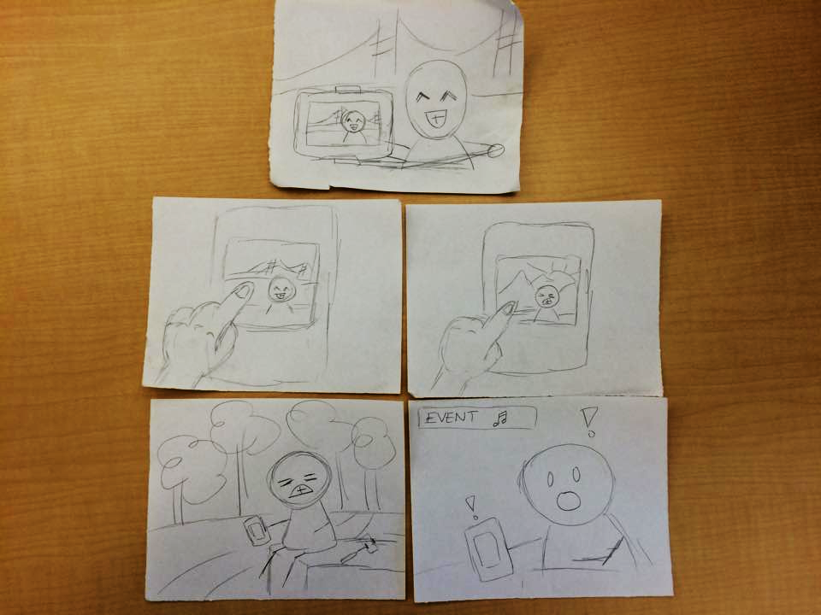
Storyboard
from camera focus on user to focus on phone
Task: discover spontaneity through unplanned events
swiping through photos
unsatisfied w/ trip
app notifies user of new nearby event

Slide 5
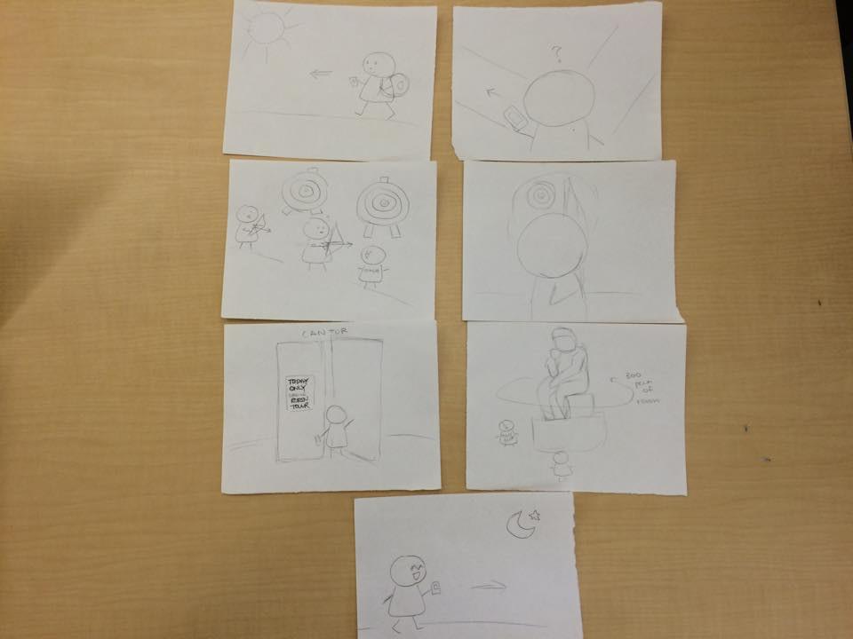
Storyboard
aerial view
stationary camera
Task: navigate comfortably in unfamiliar areas
coach
back view of arrow shot
sign says: “Today only tour”
camera pan
stationary camera

Slide 6
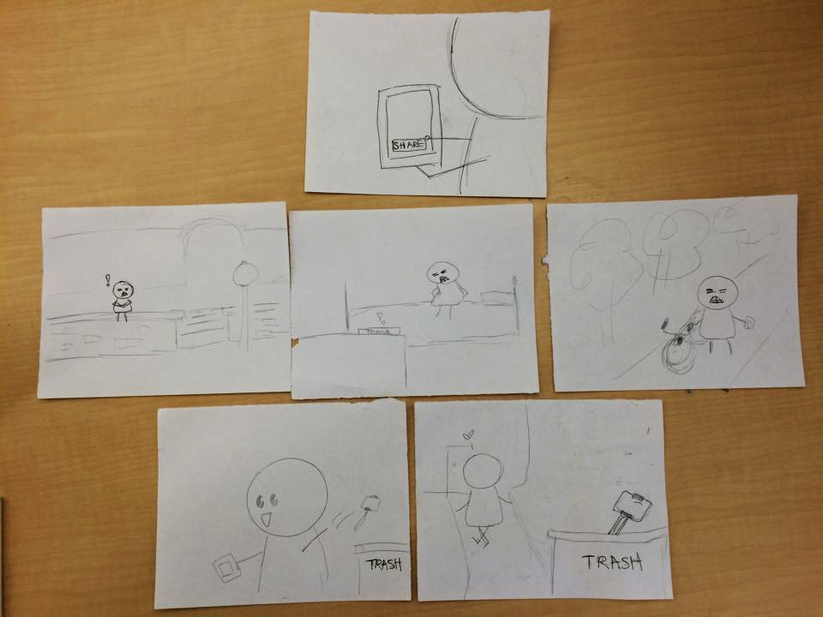
Storyboard
Task: share spontaneity with others
*the button in the first panel says “share”
share
bored stranger
bored stranger
bored stranger
quick cut
quick cut
quick cut
gets notification
gets notification
gets notification
user is now satisfied w/ trip
gradual focus to selfie stick in trash
throws away selfie stick

Slide 7
Video link
https://www.youtube.com/watch?v=2m_trlcfkZM&feature=youtu.be

