Slide 1
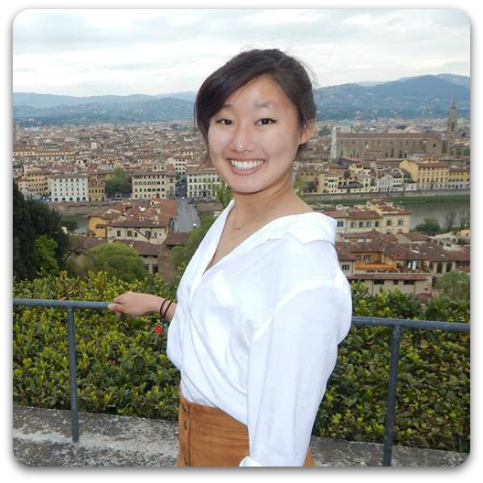
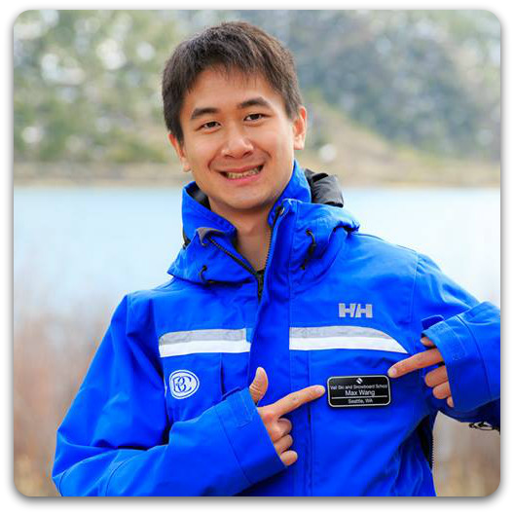

Low-fi Prototyping & Testing
O by Trability
Hali M.
Max W.
Michael D.

Slide 2
Overview
Team mission statement
Interface
Low-fi prototype
Task flows
Experimental method/results
Suggested UI changes
Summary

Slide 3
Mission Statement
“Don’t be a tourist; be a traveler.”

Slide 4
The Battle of Interfaces
App vs. Smartwatch vs. Virtual Reality Website vs. Drone
Drones require more maintenance
Lack of wifi while abroad
Smartwatches are less common
Travelers depend heavily on their phones
Travel should feel natural
Interface complexity and flexibility

Slide 5
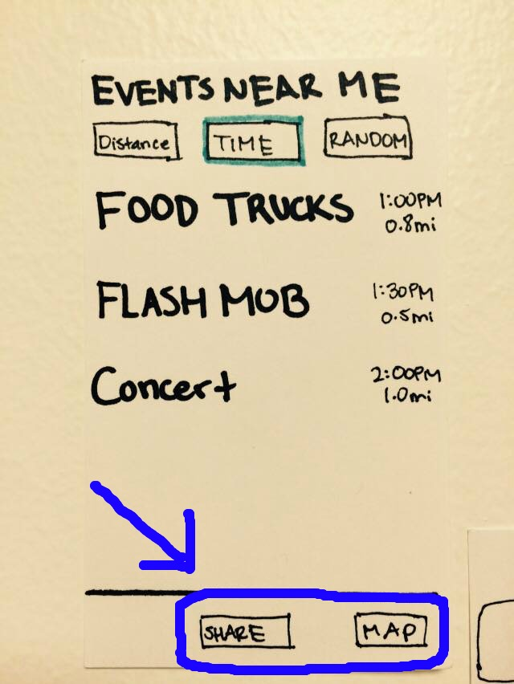
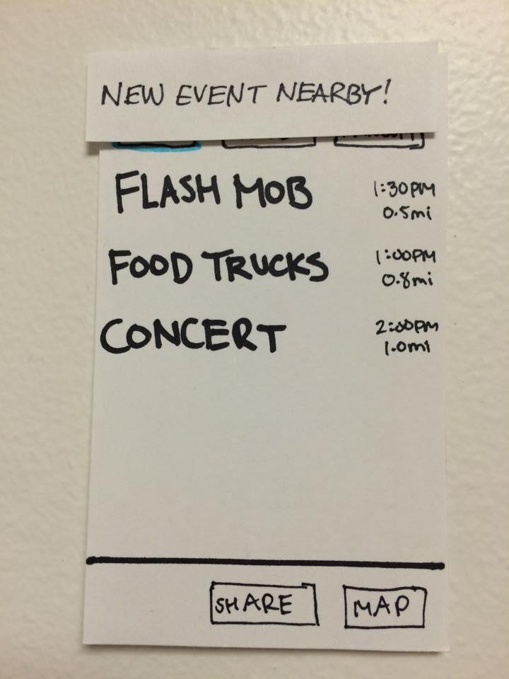
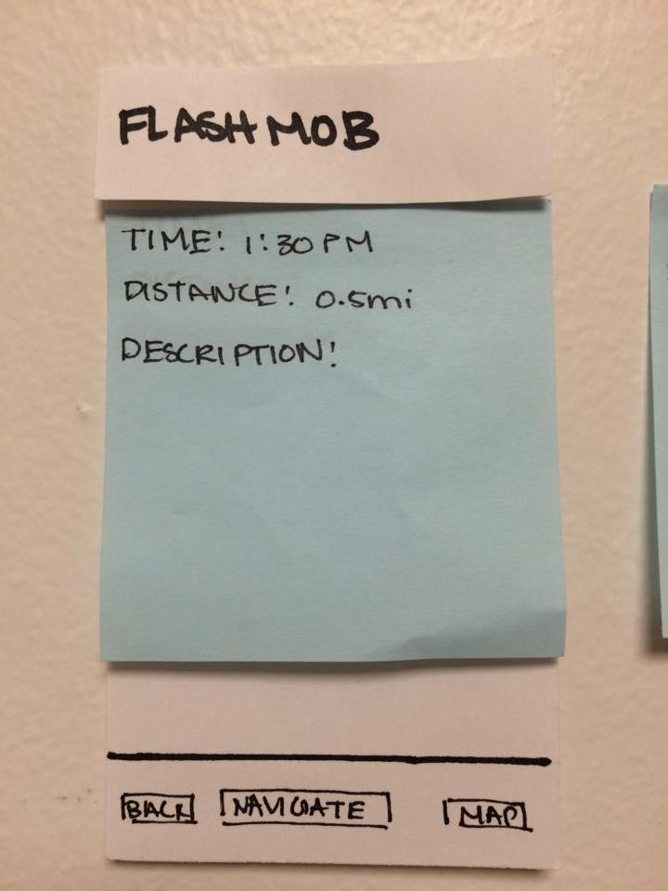
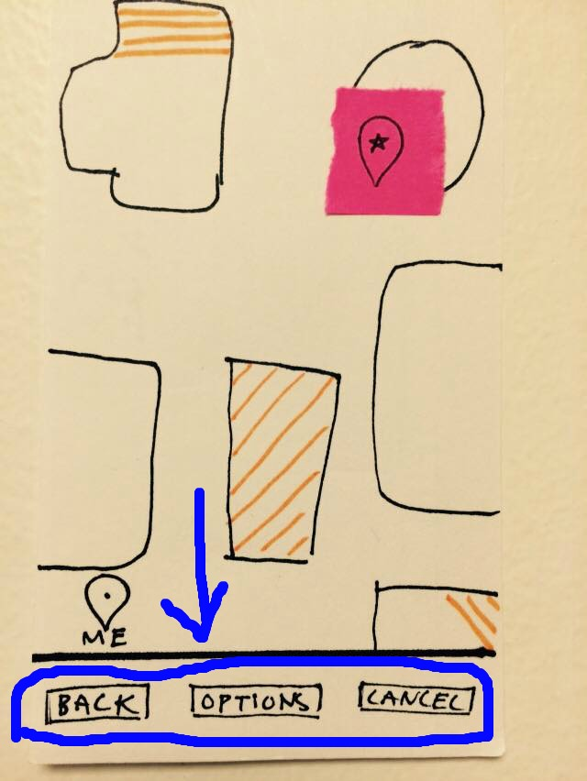
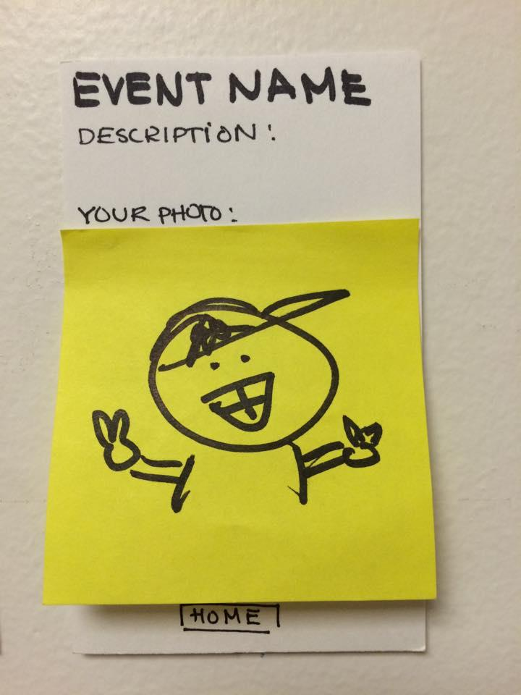
Low-fi Prototype

Slide 6
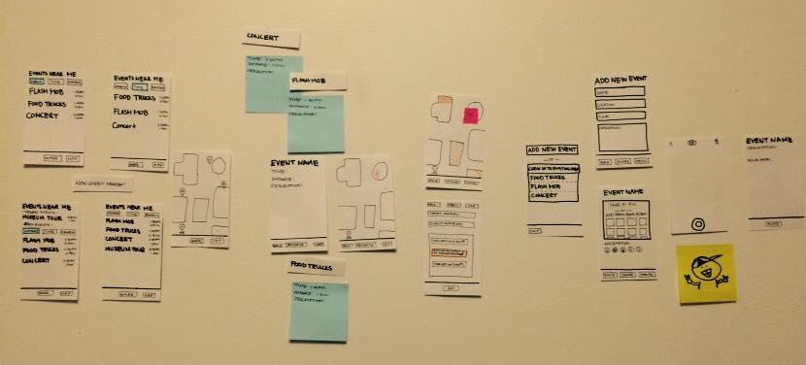

Slide 7
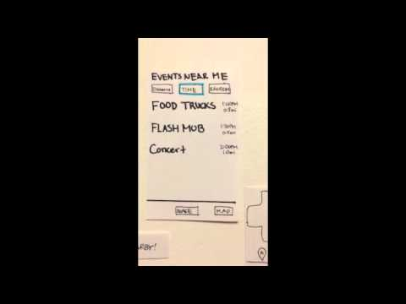
Task #1 - Finding an Event

Slide 8
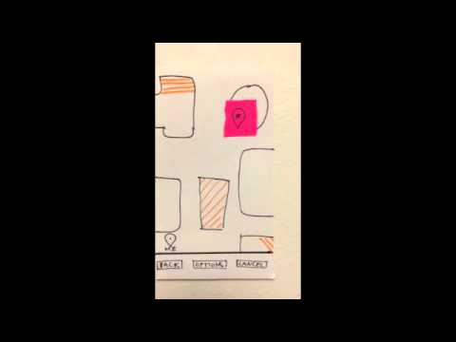
Task #2 - Navigating to an Event

Slide 9
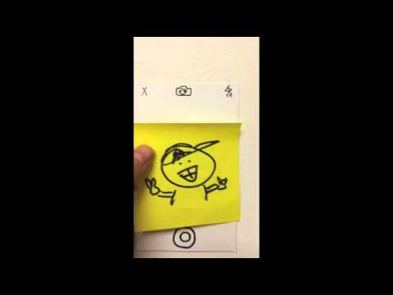
Task #3 - Sharing an Event

Slide 10
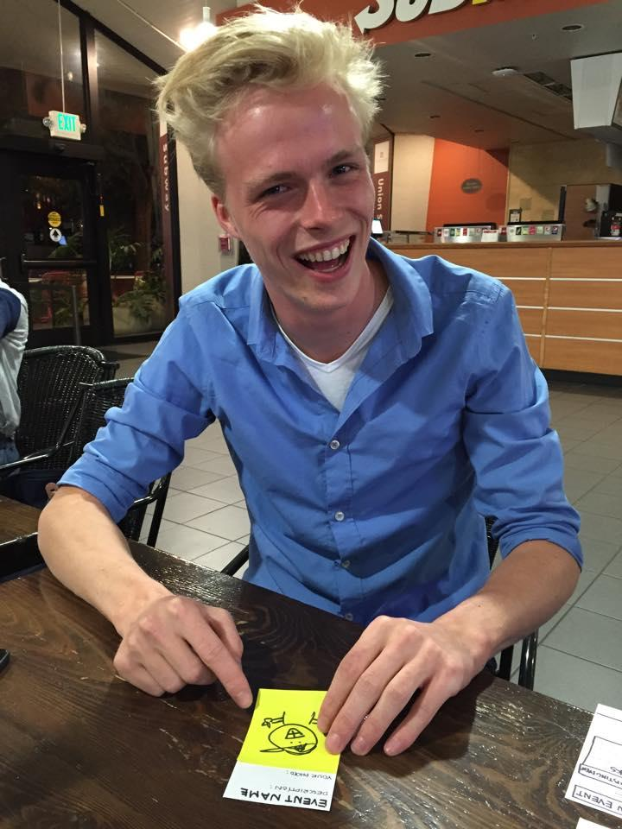
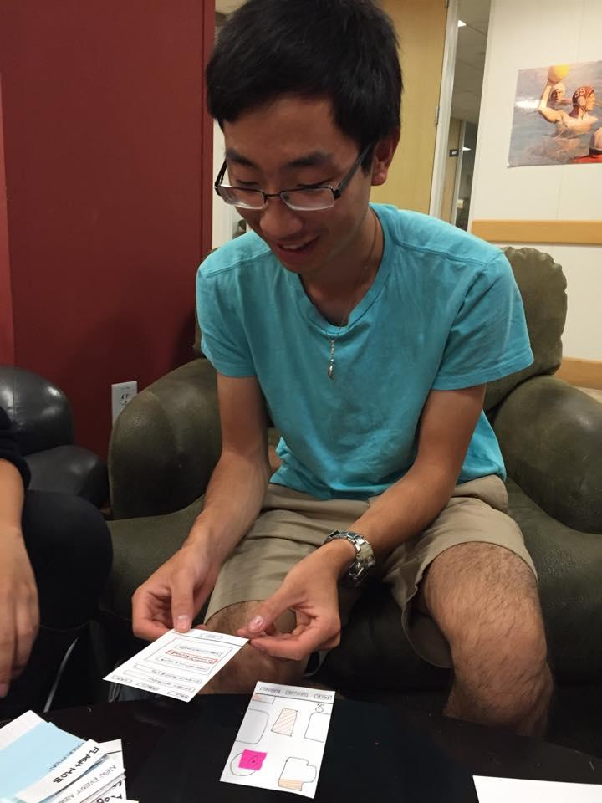
Testing in the Field
Target: users who have traveled abroad
Participant #1
Participant #2
Participant #3

Slide 11
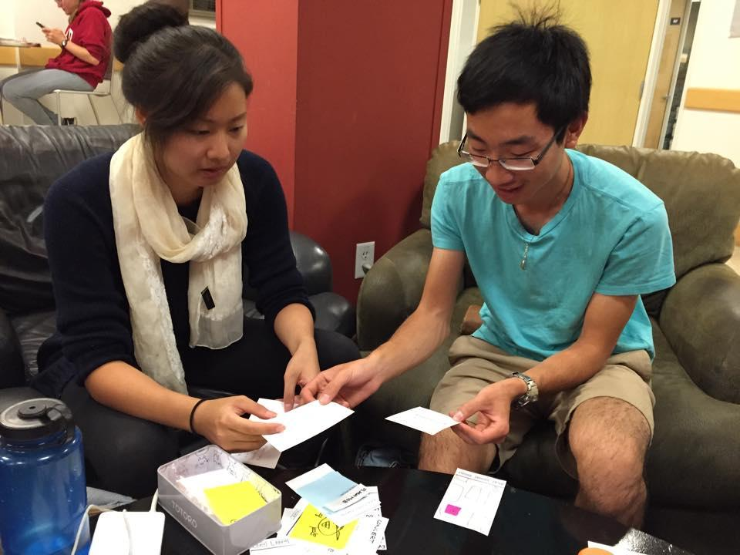
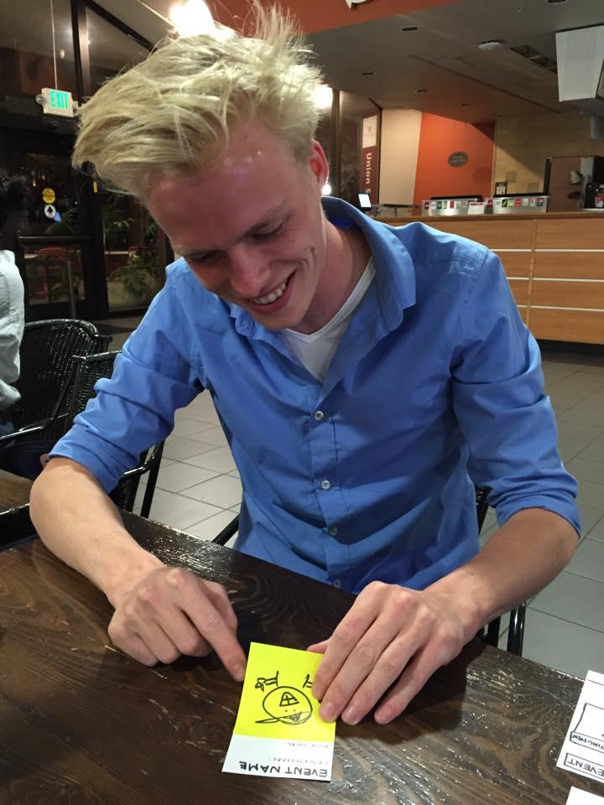
Testing in the Field (cont.)
Hali: facilitator/computer
Michael: note-taker
Max: reaction observer
Script: intro + 3 tasks
~15 min + discussion
Noted users’ reactions and emotions

Slide 12
The Data
Satisfaction Summary: 10 being super excited and 1 being annoyed, 5 being indifferent.
 | Participant #1 | Participant #2 | Participant #3
Task 1 Find | 8 | 10 | 8
Task 2 Navigate | 10 | 7 | 7
Task 3 Share | 7 | 4 | 6

Slide 13
The Data (cont.)
Critical Events
Event Description | Severity: No problem (0 - 4) usability catastrophe
Can’t share from navigation page | 4 - All three users cannot intuitively complete the third task. Participant #2 told us that he would have “given up” at that point
Can’t run navigation in background | 3 - User wants to view other events while navigating to a selected event. The current implementation would require leaving the navigation screen altogether
Pop-up notification is annoying | 2 - Participant #2 felt it disrupted his completion of the first task. Participant #3 was confused when the pop up appeared and had to take some time to decide what to do.
Emojis are not necessarily the best rating system | 1 - Participant #1 thought there would be better ways to provide a quick overview of an event. Participant #2 finds emojis to be annoying in general.

Slide 14
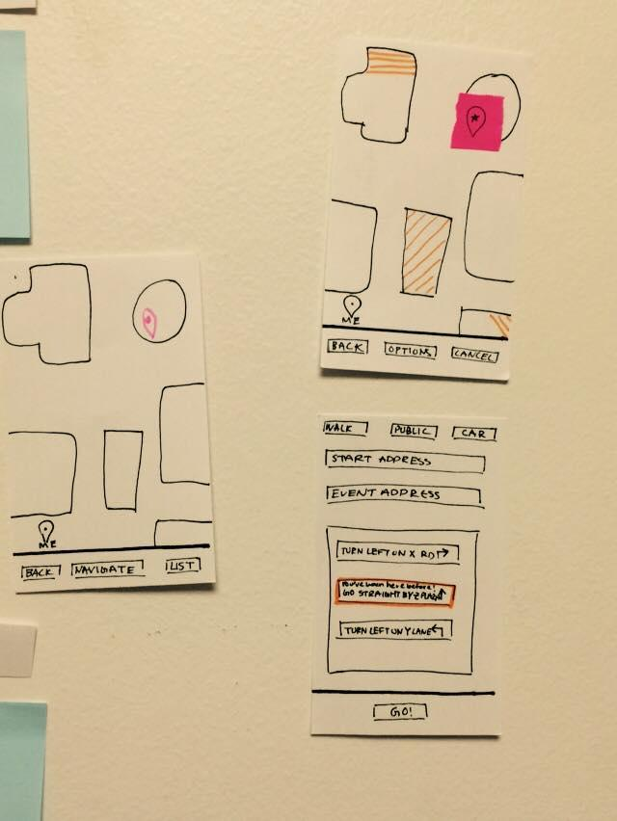
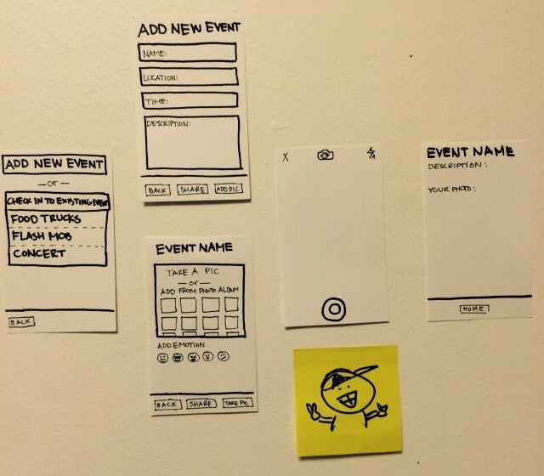
There’s Always Room for Improvement
Observations
Spontaneity didn’t stand out
Plan ahead
Banners annoying
Users wanted to use Google Maps
Familiar
Travel info + options
Indifferent towards sharing
No excitement or complaints
Emotion rating system unuseful

Slide 15
There’s Always Room for Improvement (cont.)
Suggestions
Show future events
Supplement to itinerary
More filtering options
Event categories
More navigation information
Travel time, alternate routes, modes of transportation
Better rating system
Population

Slide 16
Summary
Goal: allow tourists be travelers
App interface
Smartphones ubiquitous and versatile
Prototype and test w/ users who have traveled abroad
Users found app to be cool and would use it
Wide range of bugs/improvements
Improve interface for untraditional features
Testing results do not reflect actual foreign location

