Slide 1
O
Medium Fidelity Prototype

Slide 2
Don’t be a tourist.
Be a traveler.
Problem: Tourists plan too much on hitting the big attractions and end up with a generic experience.
Solution: Allow tourists to become travelers by leading them to spontaneous, local events they may not have experienced otherwise.

Slide 3
Three Event Tasks
Find - Simple
Discover spontaneity through unplanned events.
Navigate - Medium
Navigate comfortably in unfamiliar areas.
Share - Complex
Share spontaneity with others.

Slide 4
Reorganize
homescreen
Users have more control filters while spontaneity remains in a more subtle way

Slide 5
How can we give users control along with spontaneity?
Likes
Critiques
Solution
* Time/distance sort option
* Random option is “cool”
* Pop ups are annoying
* Want more planning options
* Promote spontaneity without using pop ups
* Allow more filtering and sorting

Slide 6
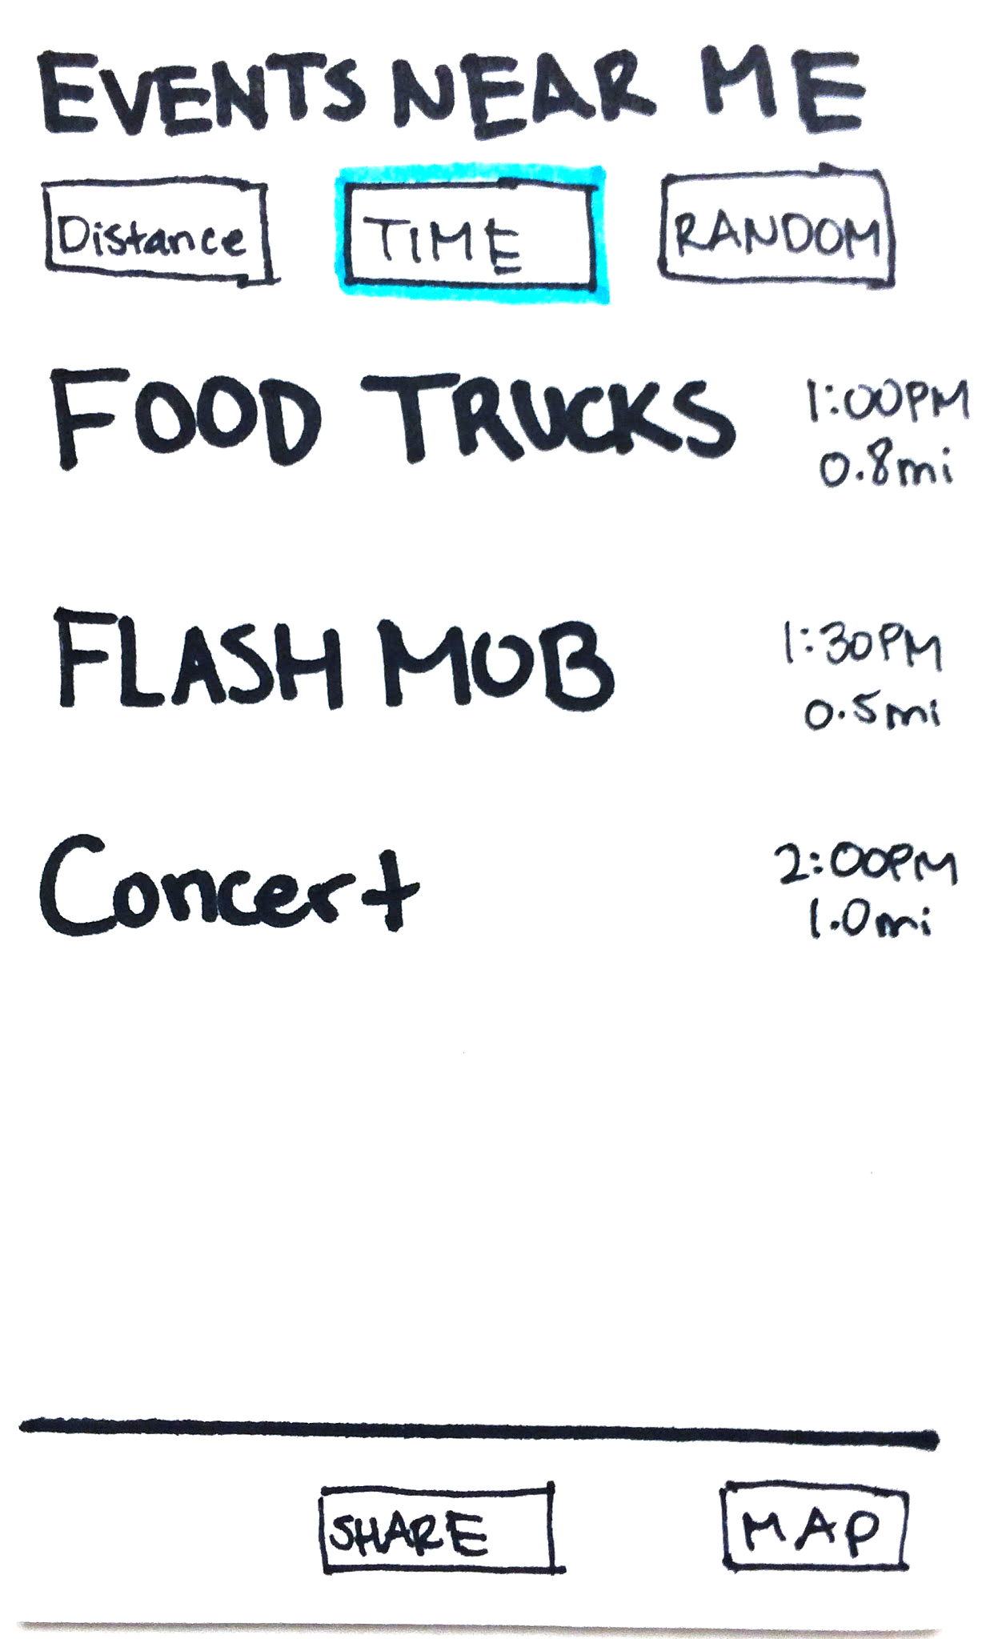
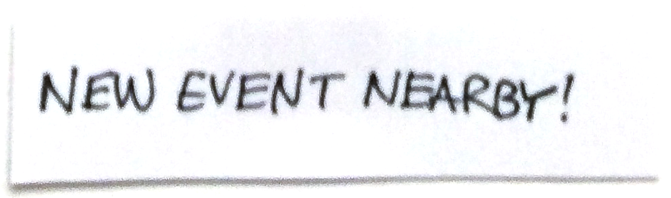
Homescreen Resketch
Deleted pop up
Old

Slide 7
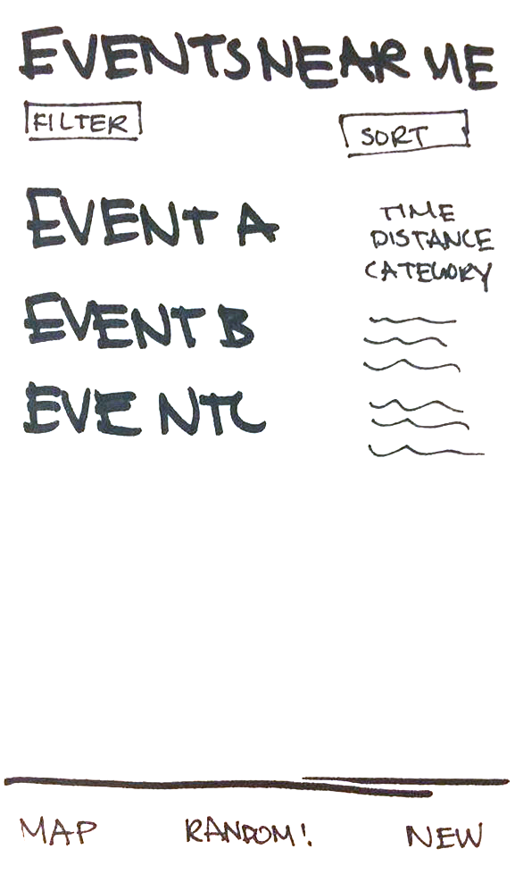
Homescreen Resketch
Old
New

Slide 8
Homescreen Resketch
Reorganized bottom menu bar
Old
New

Slide 9
Homescreen Resketch
Old
New

Slide 10
Homescreen Resketch
Old
New

Slide 11
Homescreen Resketch
Old
New

Slide 12
Homescreen Resketch
New Sort + Filter
Old
New

Slide 13
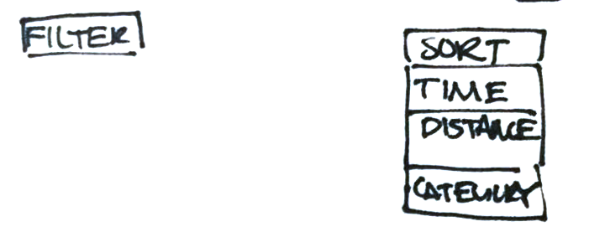
Homescreen Resketch
Sort is a dropdown
Old
New

Slide 14
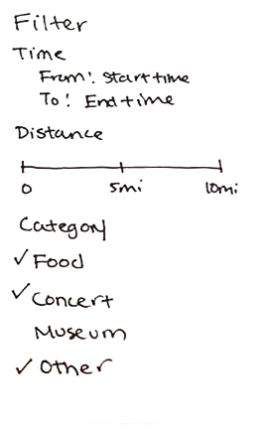
Homescreen Resketch
New menu for filter
Old
New

Slide 15
Transform
‘Share’
Users can check in more easily after navigating

Slide 16
How can we encourage users to share their experience?
Likes
Critiques
Solution
* Adding a picture is fun
* Locals can create “authentic” events
* Hard to share from navigation screen
* Separate sharing and creating
* Check-in on map screen
* Separate “check-in” and “create”

Slide 17
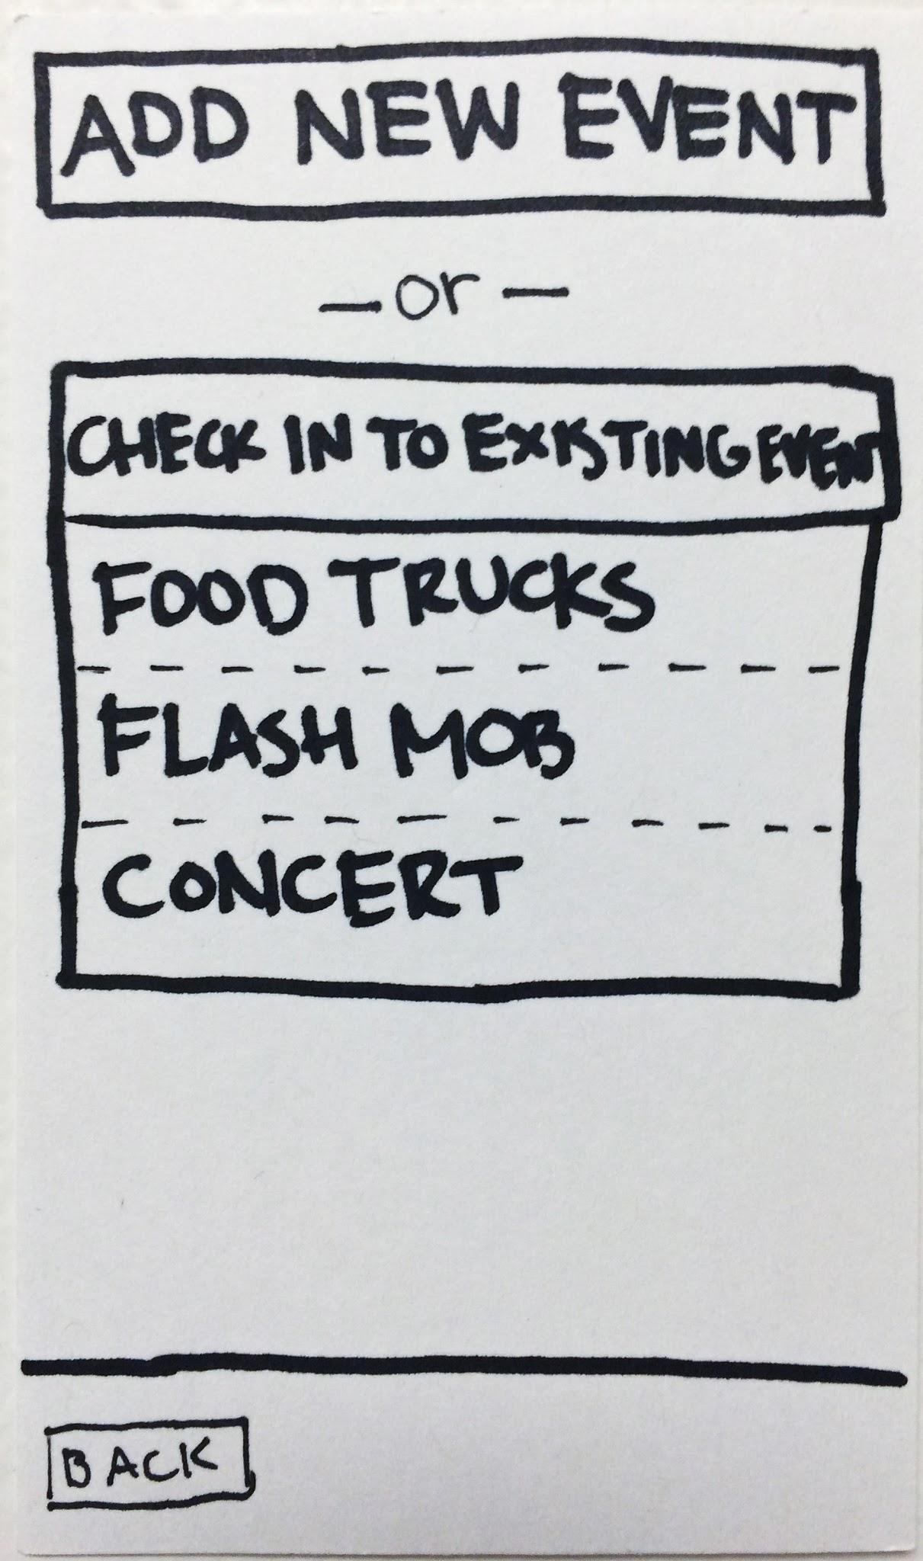
Transform Share
Confusing
Deleted
Old

Slide 18
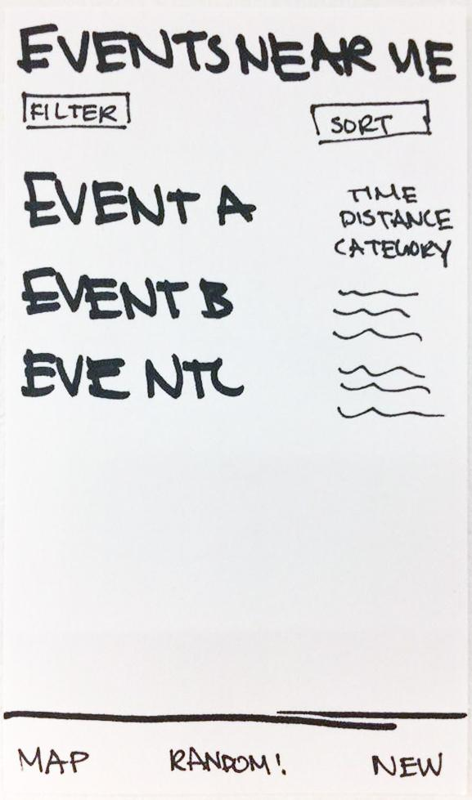
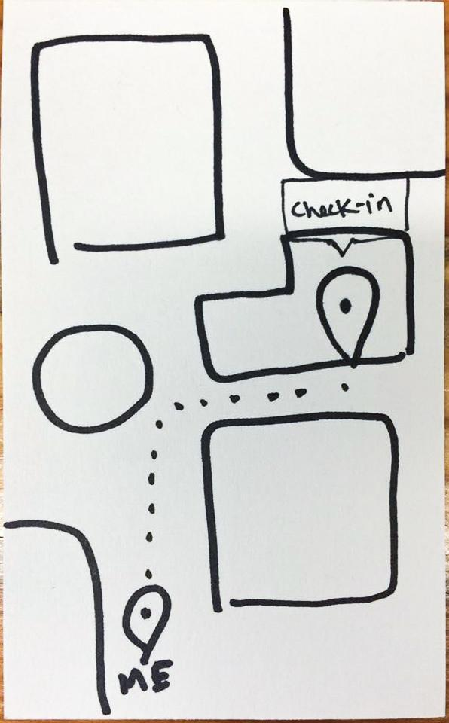
Transform Share
Check in on map
Post new event
New

Slide 19
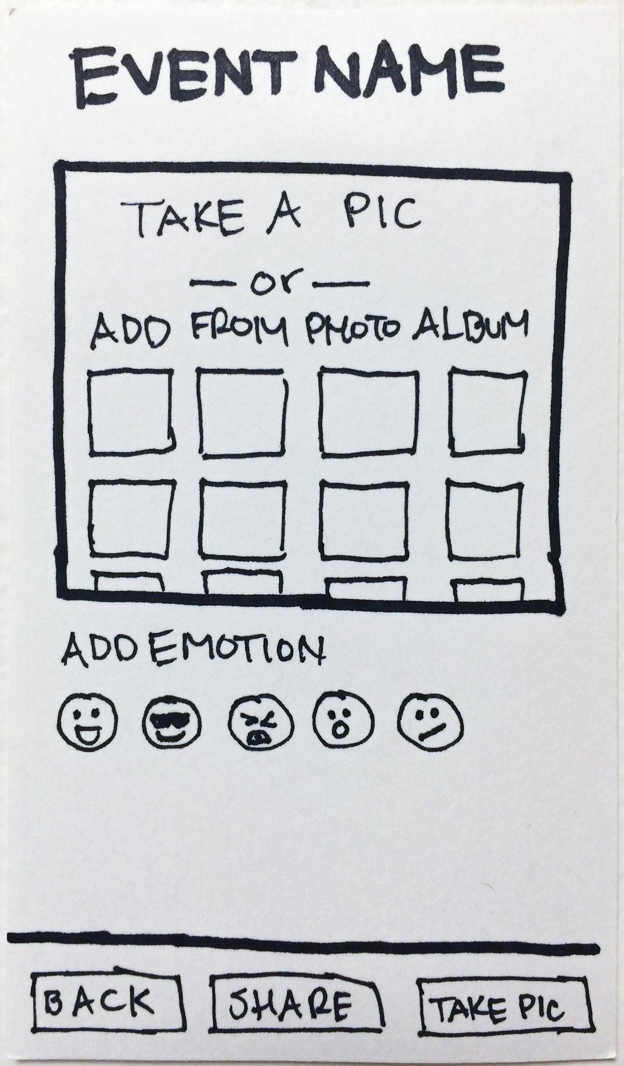
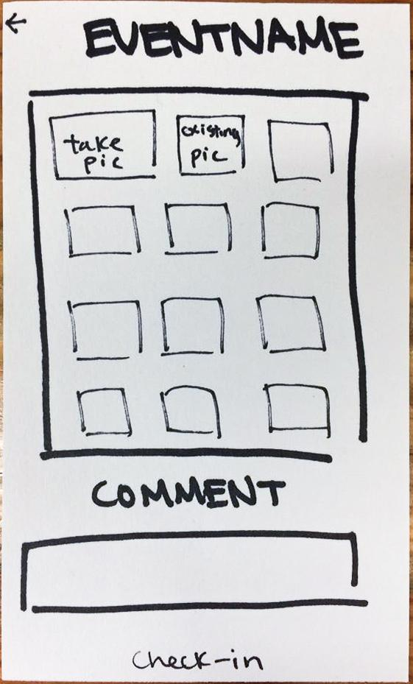
Transform Share - Check In Page
Old
New

Slide 20
Transform Share
Replaced emotion ratings with comments
Old
New

Slide 21
Add
Livestream
Highlight real time, spontaneous nature of event while giving users more information

Slide 22
How can users better gain information about an event?
Likes
Critiques
Solution
* Pictures from actual users are great
* Swiping through pictures feels clunky and static
* Emotion rating
* Real time live feed
* Comments + pictures

Slide 23
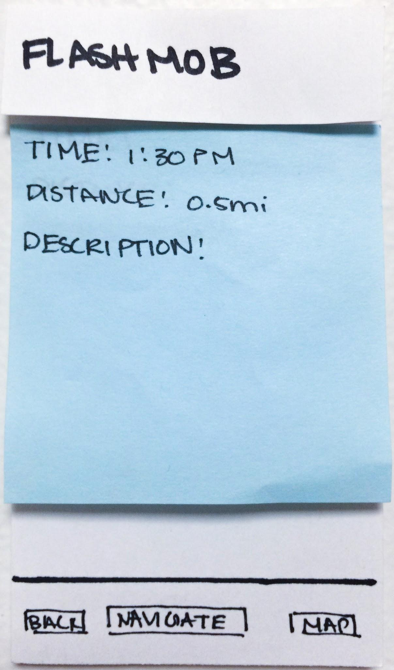
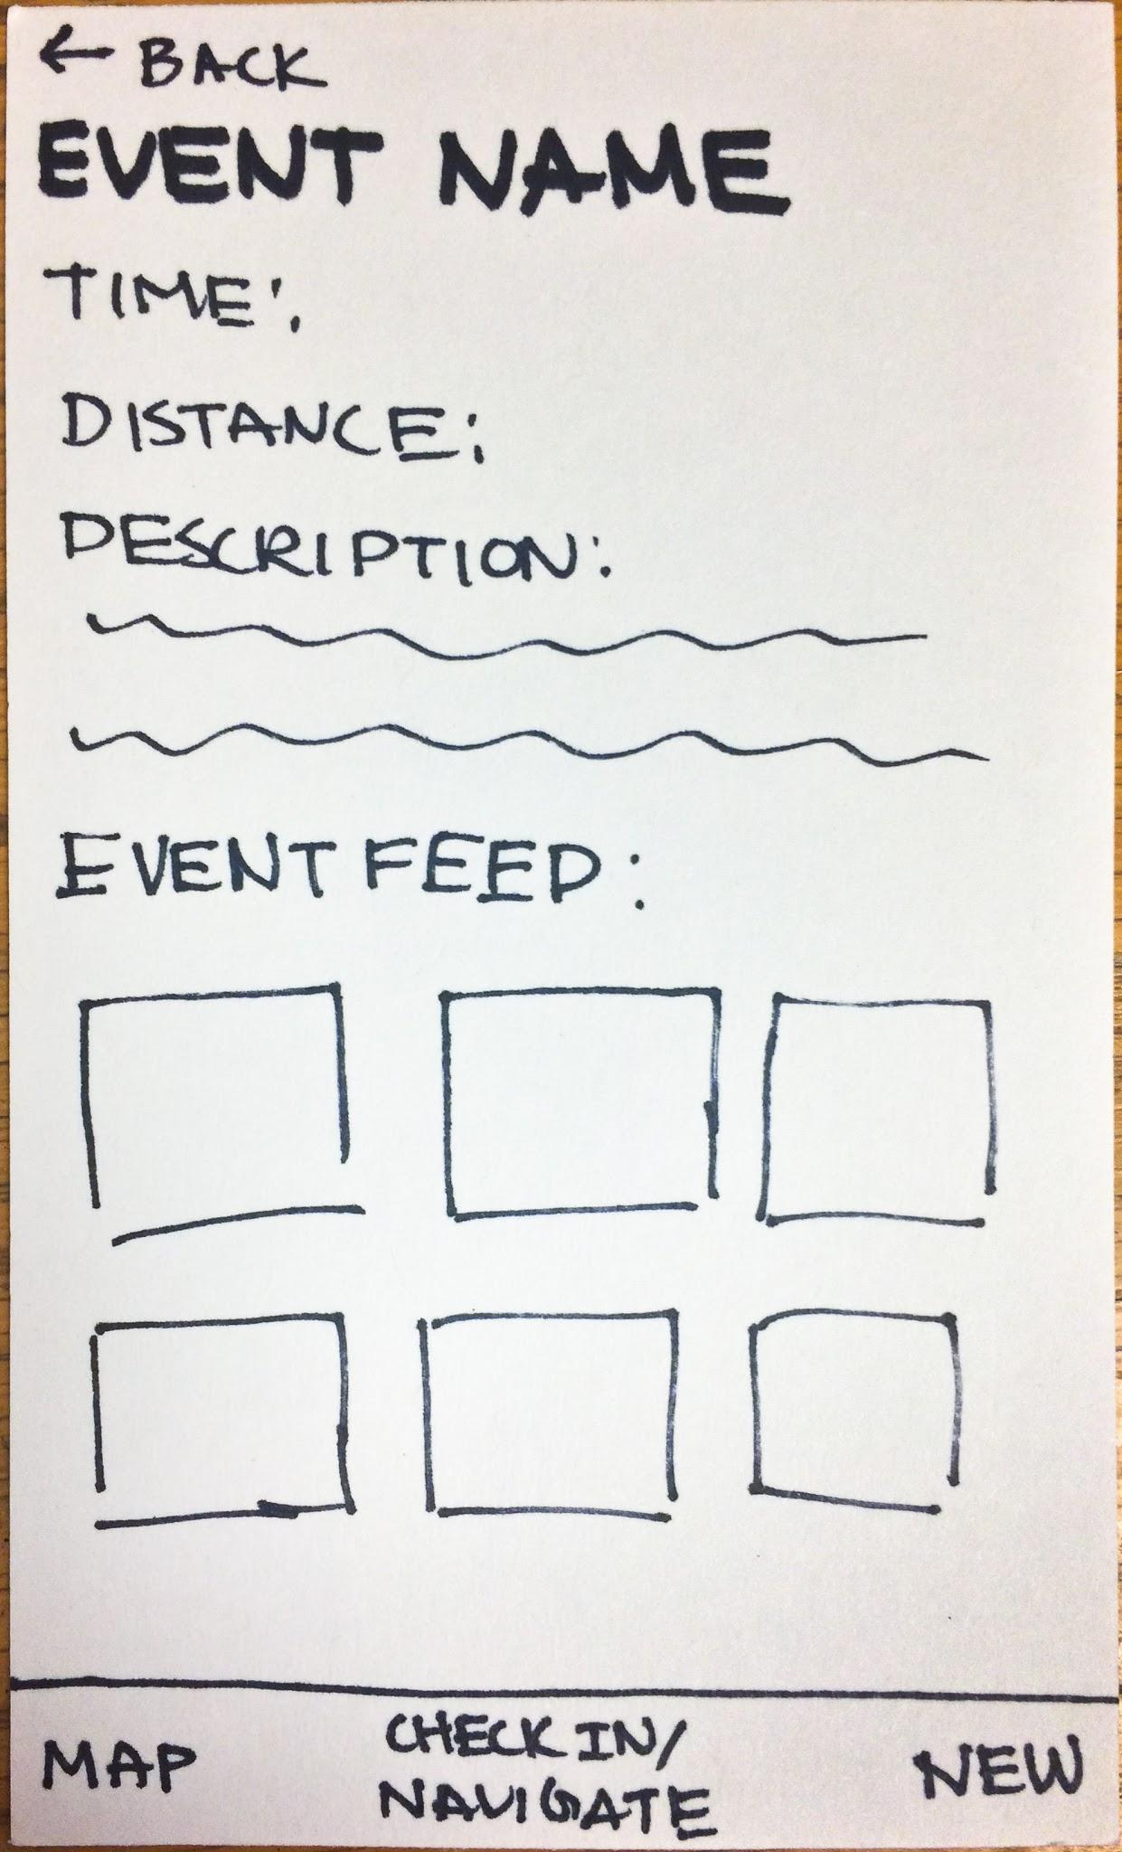
Add livestream
Old
New

Slide 24
Add livestream
New!
Live Feed
Old
New

Slide 25
Live Demo

Slide 26
Tools Used
Sketch
Existing template symbols
Use symbols for universal changes
Gentle learning curve
Marvel
Simple
Accessible from laptop / mobile

Slide 27
Limitations
Sketch
No animations
Marvel
Required too many photos
No variables/objects = WoZ slides
Unable to properly use the “back” button
Unable to show a true map with GPS
Unable to use phone features like slide

Slide 28
Summary
Goals:
Undisruptive spontaneity
More intuitive control
Real time updates
Resketch
Sketch + Marvel = O

Slide 29
Any questions?

