Slide 1

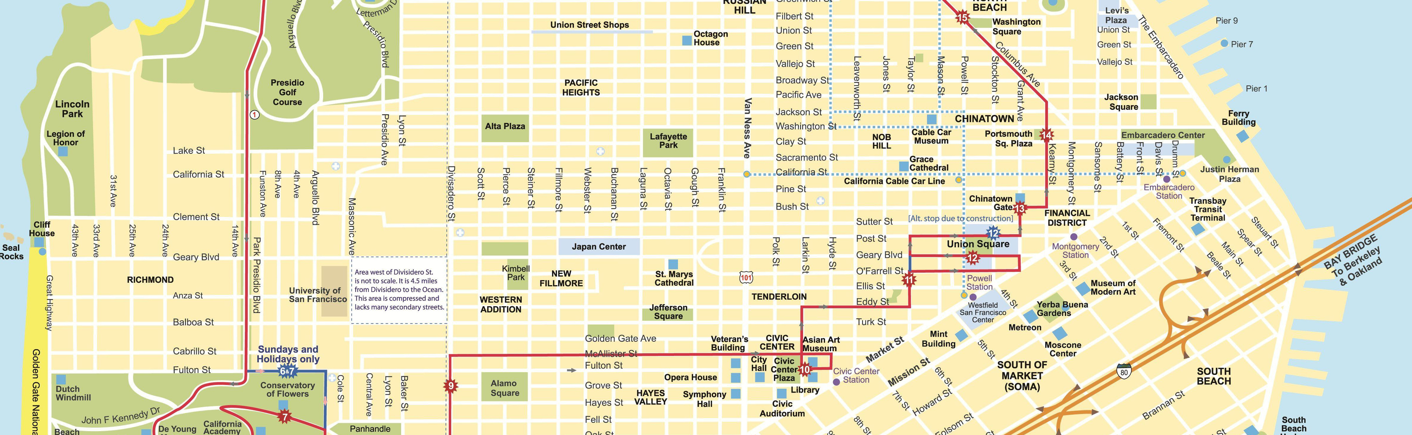







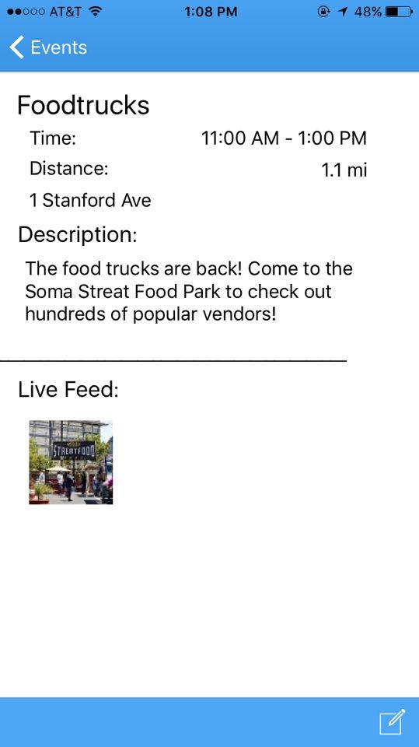
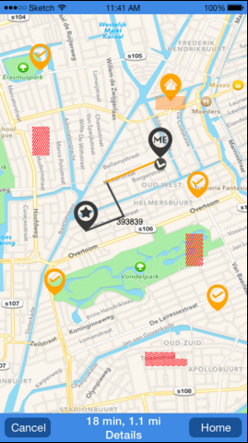
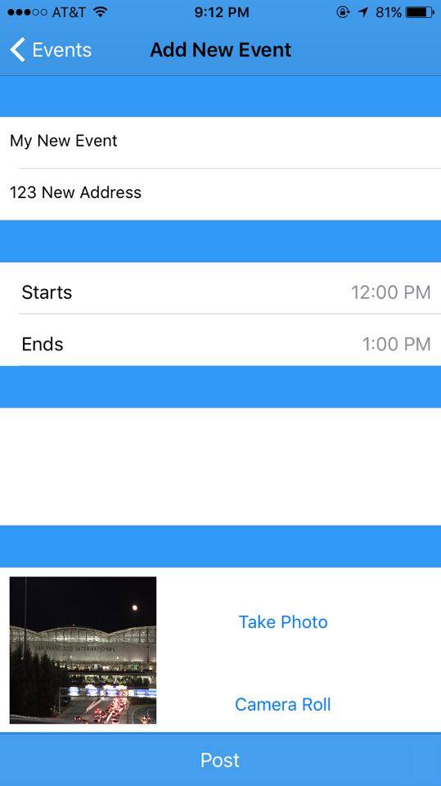
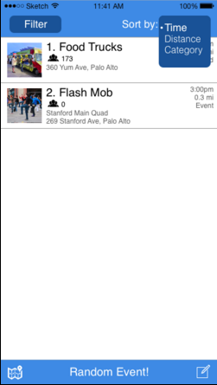
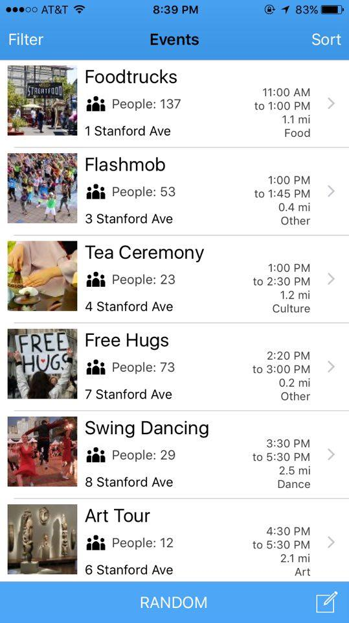
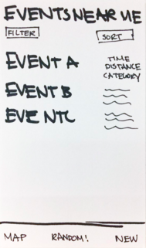
Don’t be a tourist…Be a TRAVELER.
Let the unexpected take you on a road less traveled.
Tourists plan for a generic experience…
SHARE
DISCOVER
NAVIGATE
Travelers allow spontaneity to bring them on a journey.
1
Find unique events nearby
2
Navigate in an unfamiliar area
3
Share spontaneity with other travelers
Constant innovation
Rigorous user testing
A new way to travel in the moment
Team Trabililty: Max Wang . Hali Mo. Michael Doshi
http://web.stanford.edu/class/cs147/projects/mobility/Trability/
CS 147
Autumn 2015

