Slide 1
Getting started with ABL classes

Slide 2
Lesson introduction
Defining data members, constructors, methods, and a destructor for a class
Accessing data members and call methods from within a class
Working with other classes, including how to create class instances, access data members and methods, access class instances dynamically, and delete class instances
Testing an ABL class by writing a test procedure

Slide 3
Learning objectives
When you complete this lesson, you should be able to:
Define the parts of an ABL class, including:
Data members
Constructors
Methods
A destructor
Access data members and call methods within a class.
Work with other classes, including:
Creating instances
Accessing data members and methods
Accessing a class instance dynamically
Deleting instances
Test a class

Slide 4
Prerequisites
Before you begin this lesson, you should meet the following prerequisites:
Create OpenEdge projects in Developer Studio
Experience with ABL procedural programming

Slide 5
Defining ABL classes
These are the tasks you perform to define an ABL class:
Determine the package name.
Determine the class name.
Create the class file using the New ABL Class wizard.
Define the following parts of the class:
Data members
Constructors
Methods
Destructor

Slide 6
Determining the package name
Server
src
BusinessComponent
BusinessEntity
BusinessTask
BusinessWorkflow
DataAccess
DataSource

Slide 7
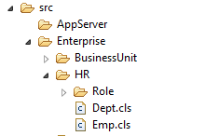
Determining the class name
The name of a class should represent its purpose.
It must begin with a letter and it can contain letters, numbers, underscores, or hyphens.
It must not contain spaces or periods.
The name of the class must be the same as the name of the file with the .cls extension that contains the class definition.

Slide 8
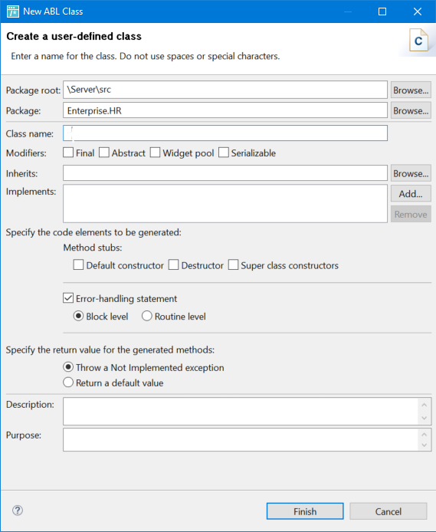
Using the New ABL Class wizard

Slide 9
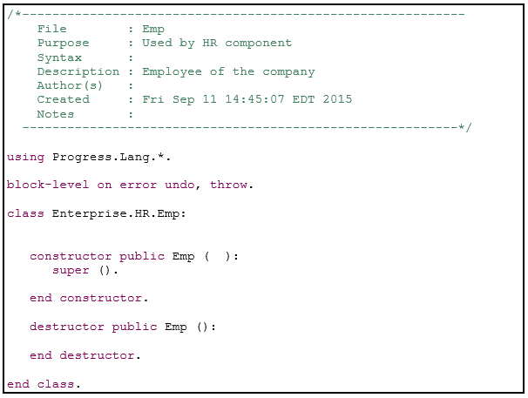
Example: Newly defined class Emp
Here is an example of the code that the New ABL Class wizard generates for the Emp class.

Slide 10
Parts of an ABL class definition
Data Definition
Constructor definition
Method definition
Destructor definition

Slide 11
Data members of a class
The data members of a class are used to hold runtime values for a class instance.
The four types of data members are:
Variable
Property
Temp-table
dataset

Slide 12
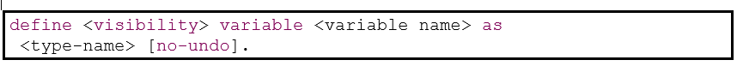
Defining a data member as a variable
Defining a variable for a class is similar to defining a variable for a procedure. The main difference is in the visibility you specify for the variable.
Here is the simplified ABL syntax for defining a variable data member:

Slide 13
Class properties
Like a variable, a property holds a value of a built-in type or user-defined type.
Class properties are accessed using set() and get() accessor methods.

Slide 14
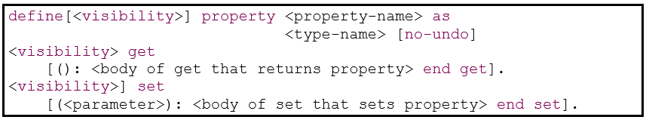
Defining a data member as a property
When you define a property, you specify visibility for the property, and for the get() and set() accessor methods. The visibility for get() and set() must be the same or more restrictive than the visibility for the property.
Note: You must define get() before set(), otherwise your code will not compile.
Here is the simplified syntax for defining a property:

Slide 15
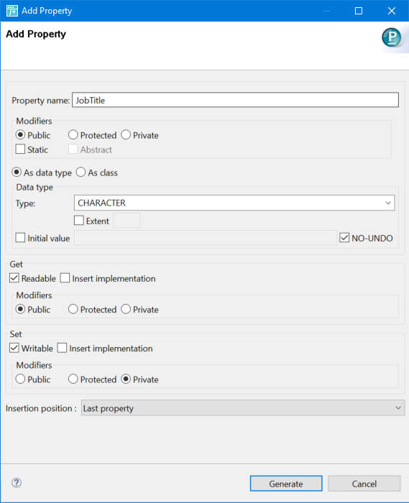
Procedure: Using the Add Property wizard

Slide 16
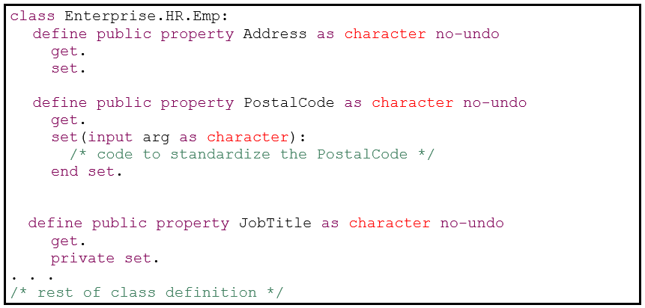
Example: Defining properties
Here is an example of some properties that are part of the Emp class definition.

Slide 17
Class constructors
A class constructor is a special method that creates an instance of a class.
The constructor returns an instance of the class.

Slide 18
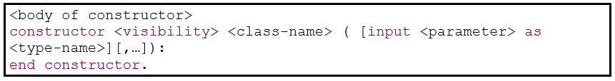
Defining a class constructor
A class definition must contain at least one constructor. The syntax for defining a constructor for a class is:

Slide 19
Class methods
Class methods are used to perform the behavior and functionality of the class.
The methods for the class operate on the data members of the class instance.

Slide 20
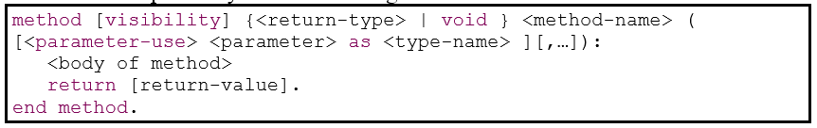
Defining a class method
A method has visibility defined so that the method can be called within a class or from outside the class.
A method can have zero or more parameters. Regardless of whether a method has parameters, it can return a value.

Slide 21
Class destructor
A destructor is an optional method that runs when an instance of a class is deleted or removed from memory.

Slide 22

Defining a class destructor
Here is the simplified syntax for defining a destructor for a class:

Slide 23
Check your understanding – Question 1
What is a package in the context of developing classes?
Choose the best answer.
It represents a directory path in which your class file is located.
It is the compressed file (.zip) created when your export your source code in Developer Studio.
It is the set of r-code files that are used at runtime to test your class.
It is a name for the compiled class file.

Slide 24
Check your understanding – Answer 1
What is a package in the context of developing classes?
Choose the best answer.
It represents a directory path in which your class file is located.
It is the compressed file (.zip) created when your export your source code in Developer Studio.
It is the set of r-code files that are used at runtime to test your class.
It is a name for the compiled class file.

Slide 25
Check your understanding – Question 2
Which of the following can be part of a class definition?
Choose all that apply.
Variable
Procedure
Constructor
Method
Object
Property

Slide 26
Check your understanding – Answer 2
Which of the following can be part of a class definition?
Choose all that apply.
Variable
Procedure
Constructor
Method
Object
Property

Slide 27

Try It 2.1: Defining classes

Slide 28
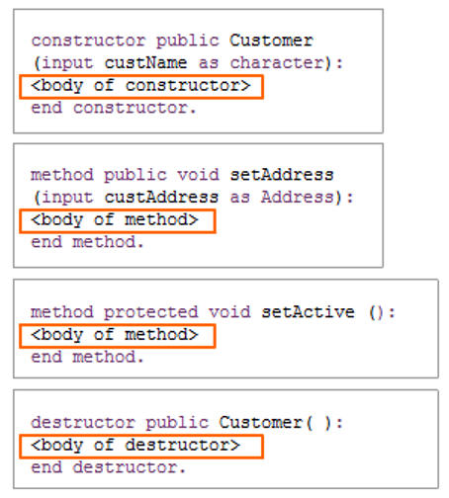
Accessing data members and calling methods within a class

Slide 29
Accessing a data member within a class
In the constructors, methods, or destructor of a class, you can write code to directly access the data members of the class.
Here is the syntax for using a data member from within a class:

Slide 30
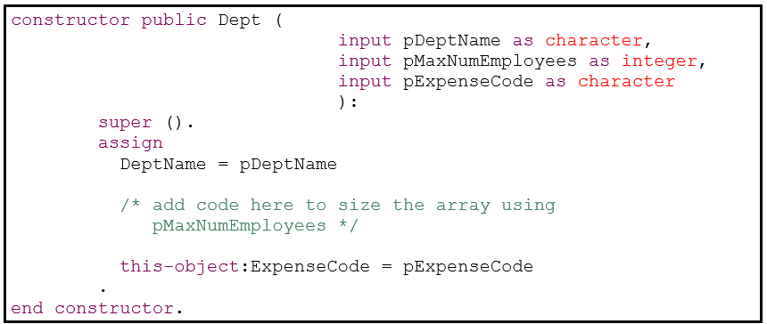
Example: Initializing data members in the constructor
Here is part of the constructor for the Dept class. It takes values from the parameters to the constructor and uses them to set the values of the data members of the class.

Slide 31
Accessing a class method within a class
In the constructors, methods or destructor of a class, you can access any other method defined in the class. If a method returns a value, you can use that value anywhere in your code.
Here is the syntax for calling a class method from within a class:

Slide 32
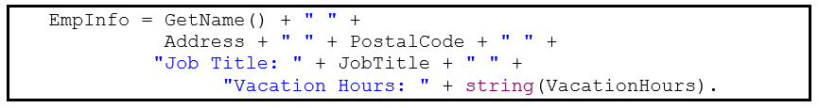
Examples: Accessing class methods from within the class
Here is an example of using the GetName() method, which returns a character value:
If a method does not return a value, you must call it in a separate ABL statement. Then you typically use any returned output parameters in your code.

Slide 33
Accessing data members and calling methods in other classes
To create and access other class instances in your ABL code, you must:
Write the using statement for the class.
Define the data member that will hold the reference to the instance of the class.
Create an instance of the class.
Use the instance to access the public data members and methods of the class.
Delete the instance of the class when you have finished using it.

Slide 34
Writing ABL using statements
The using statements in an ABL source code file are defined at the beginning of the file. The purpose of using statements is to specify which other classes your ABL class (or procedure) requires.
Here is the syntax for the using statement:

Slide 35
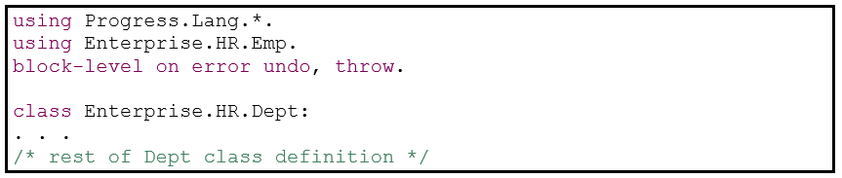
Example: Writing ABL using statements
Here is the using statement we must define at the beginning of the Dept.cls file because we want to access an Emp instance.

Slide 36
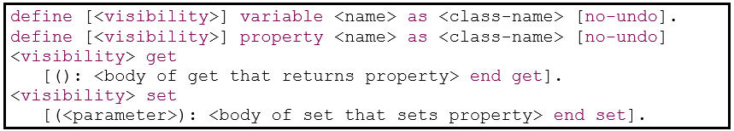
Defining a variable or property of a class type
Here is the simplified syntax for creating a variable or property that holds the reference to a class instance:

Slide 37
Creating an instance of another class
Here is the simplified syntax for calling the default constructor for a class with no parameters:

Slide 38
Accessing a public data member of a class instance
After you have created an instance of another class, you can access any public data member in the class instance. Here is the simplified syntax for accessing a public data member of a class:

Slide 39

Calling a public method of a class instance
After you have created an instance of another class, you can call any public constructor, method, or destructor defined in the class. If a method returns a value, you can use that value anywhere in your code. Here is the simplified syntax for calling a method of a class:

Slide 40
Accessing a class instance dynamically
You use the cast() function to transform a Progress.Lang.Object into a particular type at runtime.
Here is the syntax for the cast() function.

Slide 41
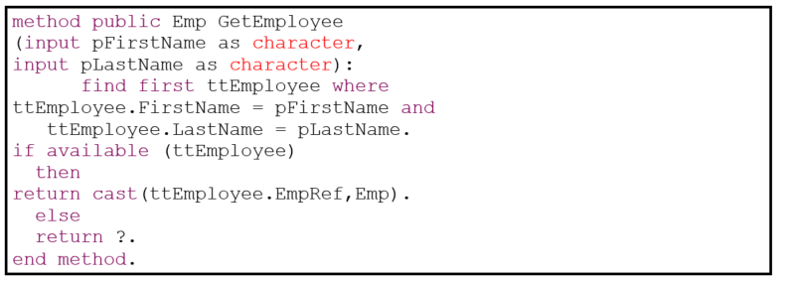
Example: Accessing a class instance dynamically
Here is a simple example of using the ABL cast() function. A temp-table, ttEmployee, has been defined. It contains employee records.

Slide 42
Deleting an instance of a class
When you finish working with an instance of another class, you should delete it. When a class instance is deleted, it calls the destructor, if the class has one defined.

Slide 43
Check your understanding – Question 3
What ABL statement must you add at the beginning of a procedure or class file if the code is to access an instance of another class?
Choose the best answer.
include
block-level
define class
using

Slide 44
Check your understanding – Answer 3
What ABL statement must you add at the beginning of a procedure or class file if the code is to access an instance of another class?
Choose the best answer.
include
block-level
define class
using

Slide 45
Check your understanding – Question 4
Suppose you have defined a variable of class type Dept as follows:
How do you create an instance of the Dept class that will be referenced by the DeptInstance variable?
Choose the best answer.
create object Dept set DeptInstance.
create new DeptInstance as Dept.
DeptInstance = new Dept().
new Dept(DeptInstance).

Slide 46
Check your understanding – Answer 4
Suppose you have defined a variable of class type Dept as follows:
How do you create an instance of the Dept class that will be referenced by the DeptInstance variable?
Choose the best answer.
create object Dept set DeptInstance.
create new DeptInstance as Dept.
DeptInstance = new Dept().
new Dept(DeptInstance).

Slide 47
Try It 2.2: Working with classes

Slide 48
Testing classes
Set up the class test:
Specify a using statement for the class you will test.
Define a variable of the class type.
Open the output file for writing test results.
Test the class:
Create multiple instances of the class, assigning its reference to the variable.
Make sure every constructor is called.
Pass a range of values to fully test the constructors.
Call each method of the class using the reference.
Pass a range of values to fully test the methods.
Write relevant data to the output file.
End the class test:
Delete each instance when you no longer require it.
Close the output file.

Slide 49
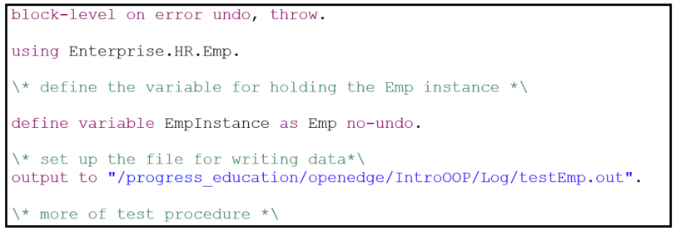
Setting up the class test
Here is the setup code for testing the Emp class. It first specifies the Enterprise.HR.Emp class in a using statement. Then, it defines the variable, EmpInstance that will hold a reference to the Emp class instance. Next, it specifies the file where test output will be written.

Slide 50
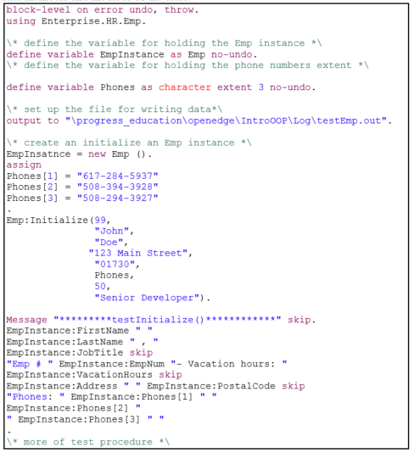
Testing the class

Slide 51
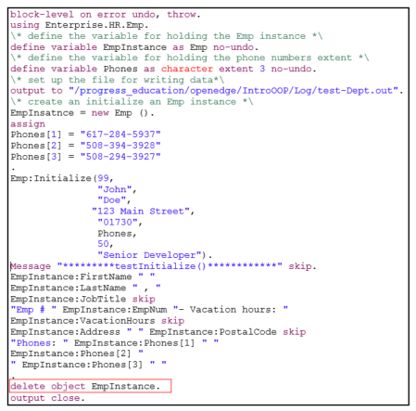
Ending the test

Slide 52
Try It 2.3: Testing classes

Slide 53
Lesson summary
You should now be able to:
Define the parts of an ABL class, including:
Data members
Constructors
Methods
A destructor
Access data members and call methods within a class.
Work with other classes, including:
Creating instances
Accessing data members and methods
Accessing a class instance dynamically
Deleting instances
Test a class

