Slide 1
Using ABL classes in an application

Slide 2
Lesson introduction
Building class inheritance hierarchies to share data members, properties, methods, and events between related classes
Defining a class using an interface class
Creating instances dynamically
Defining and publishing an event and subscribing to it

Slide 3
Learning objectives
When you complete this lesson, you should be able to:
Define and use an inheritance hierarchy
Define and use interface classes
Create singletons (static instances)
Create instances dynamically
Define and use class events

Slide 4
Prerequisites
Before you begin this lesson, you should meet the following prerequisites:
Experience with ABL procedural programming
Creating OpenEdge projects in Developer Studio
Understanding of ABL object-oriented programming concepts
Creating classes and methods

Slide 5
Using inheritance
Classes inherit non-private data and methods
Class hierarchy can contain multiple inherited classes
Can override methods defined in super classes
Can define additional methods in derived classes

Slide 6
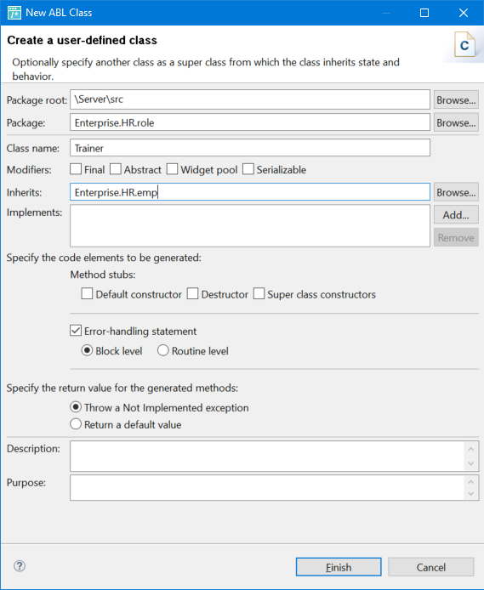
Procedure: Using the New ABL Class wizard to create a derived class

Slide 7
Example: TeamMember class
using Progress.Lang.*.
using Enterprise.HR.Emp.
using Enterprise.HR.Role.TeamMember.
using Enterprise.HR.Role.Manager.
block-level on error undo, throw.
class Enterprise.HR.Role.TeamMember inherits Emp:
define private property Mgr as Manager no-undo
get.
set.
constructor public TeamMember ( input pMgr as Manager ):
super ().
assign
EmpType = "TeamMember"
Mgr = pMgr
.
end constructor.
method public Manager GetManager():
return Mgr.
end method.
method public override character GetInfo( ):
define variable result as character no-undo.
result = super:GetName() + ", Team Member " +
Address + " " + PostalCode + " " +
"Job Title: " + JobTitle + " " +
"Vacation Hours: " + string(VacationHours).
return result.
end method.
end class.

Slide 8

Try It 3.1: Using inheritance

Slide 9
Using interface classes
Defining and developing a class that uses an interface class includes a number of tasks:
Define the interface class that will be used by the class.
Define the class using the interface class.
Implement the constructors, methods, and destructor of the class.

Slide 10
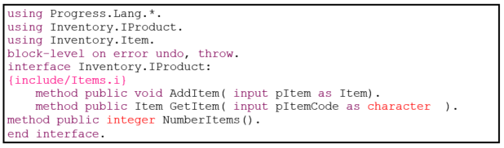
Defining an interface class

Slide 11
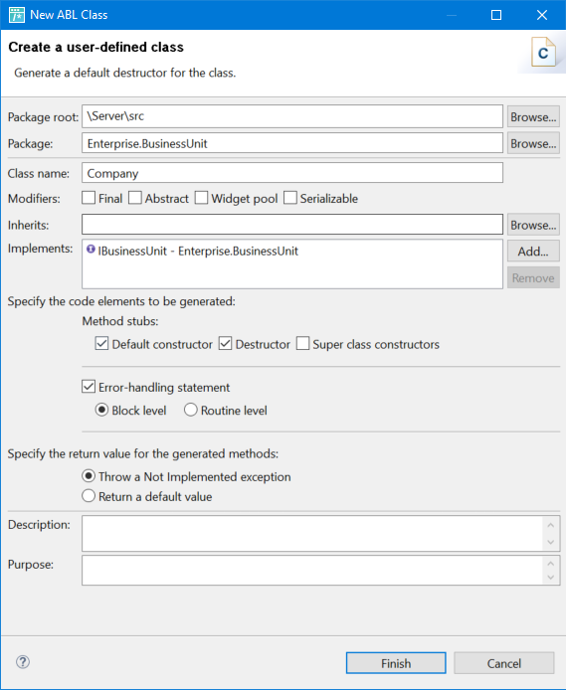
Procedure: Using the New ABL Class wizard to create a class that uses an interface class

Slide 12
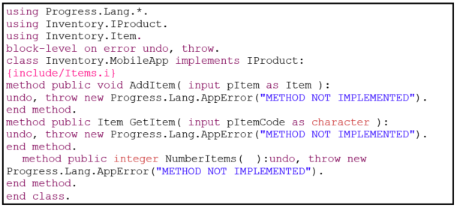
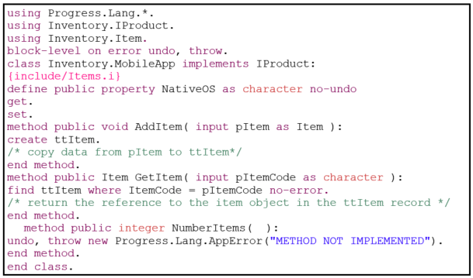
Defining a class that uses an interface class

Slide 13
Check your understanding – Question 1
What items can you define in an interface class?
Choose all that apply:
Public variables
Private variables
Public properties
Private properties
Public methods
Private methods

Slide 14
Check your understanding – Answer 1
What items can you define in an interface class?
Choose all that apply:
Public variables
Private variables
Public properties
Private properties
Public methods
Private methods

Slide 15
Try It 3.2: Using an interface class

Slide 16
Using singletons
You may want to have a global instance that is available to all code running in the ABL Virtual Machine (AVM). You can implement this by defining a class that has a static constructor and static data members.
One of the static data members is used to hold an instance of the class in the AVM. This data member must be public. This single class instance is called a singleton.

Slide 17
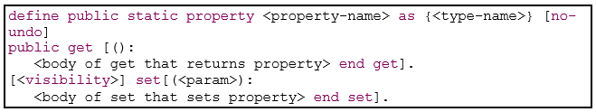

Defining a static data member

Slide 18


Defining a static constructor

Slide 19
Creating class instances dynamically

Slide 20
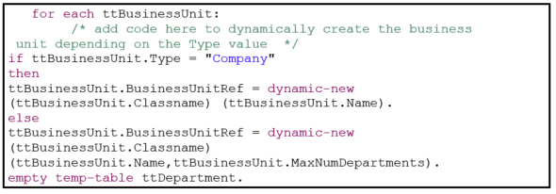
Example: Creating a class instance dynamically

Slide 21
Check your understanding – Question 2
What items can you define in an interface class?
Choose all that apply:
Specify a singleton keyword in the class definition.
A static public data member that will hold a reference to an instance of the class
A private data member that will hold a reference to an instance of the class.
A constructor that takes no arguments.
A static constructor that takes no arguments.
A public Create() method for creating the instance.

Slide 22
Check your understanding – Answer 2
What items can you define in an interface class?
Choose all that apply:
Specify a singleton keyword in the class definition.
A static public data member that will hold a reference to an instance of the class
A private data member that will hold a reference to an instance of the class.
A constructor that takes no arguments.
A static constructor that takes no arguments.
A public Create() method for creating the instance.

Slide 23
Try It 3.3: Using a singleton and creating classes dynamically

Slide 24
Using Events
Event is a condition
Publisher and Subscriber classes
Publisher class:
Defines the event
Method of the class publishes the event
Subscriber class:
Subscribe to event
Must implement an event handler method

Slide 25
Publishing class events

Slide 26
Subscribing and unsubscribing event handlers

Slide 27
Try It 3.4: Using events

Slide 28
Lesson summary
You should now be able to:
Define and use an inheritance hierarchy
Define and use interface classes
Create singletons (static instances)
Create instances dynamically
Define and use class events

