Slide 1
UFO Tracker
Presented By
The UFO Trio

Slide 2
The UFO Trio
Agents
Matt Douglas
Jon Smiley
Chris Platt

Slide 3
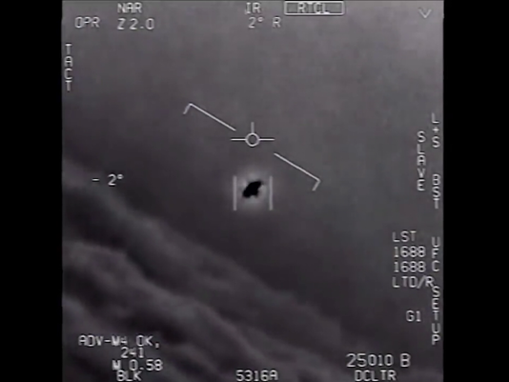
The Project
Inspired by recently released footage from the Pentagon of a Navy jet in pursuit of an unknown object.

Slide 4
The Project
After some research, the team found a public database maintained by NUFORC (National UFO Reporting Center) containing over 80K reported sightings from around the globe.
We decided to use this database as the basis for our project…in our search for the truth.

Slide 5
The Project
The App would have three main functions.
Enable the user to see reported sightings in their current location.
Report new sightings as observed!
Send contact email

Slide 6
The Project
Approach
Use Geolocation to get users position
Use google maps to plot position
Store NUFORC Database in mySql
Utilize Sequellize ORM
Query the database to get sightings
Populate the map with local sightings
Architect software with MVC paradigm
Use PHP to send email.

Slide 7
The Project
Framework
Started with a framework including:
User interface
Geolocation function
Hooks for the map
Form to report new sightings
Build a new Database object

Slide 8
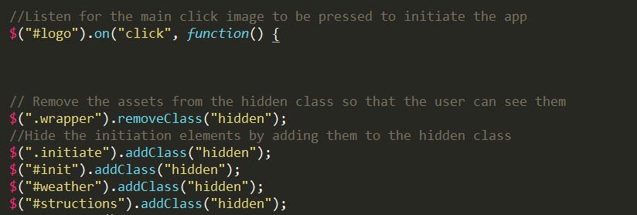
The Project - Framework
Hidden attribute

Slide 9
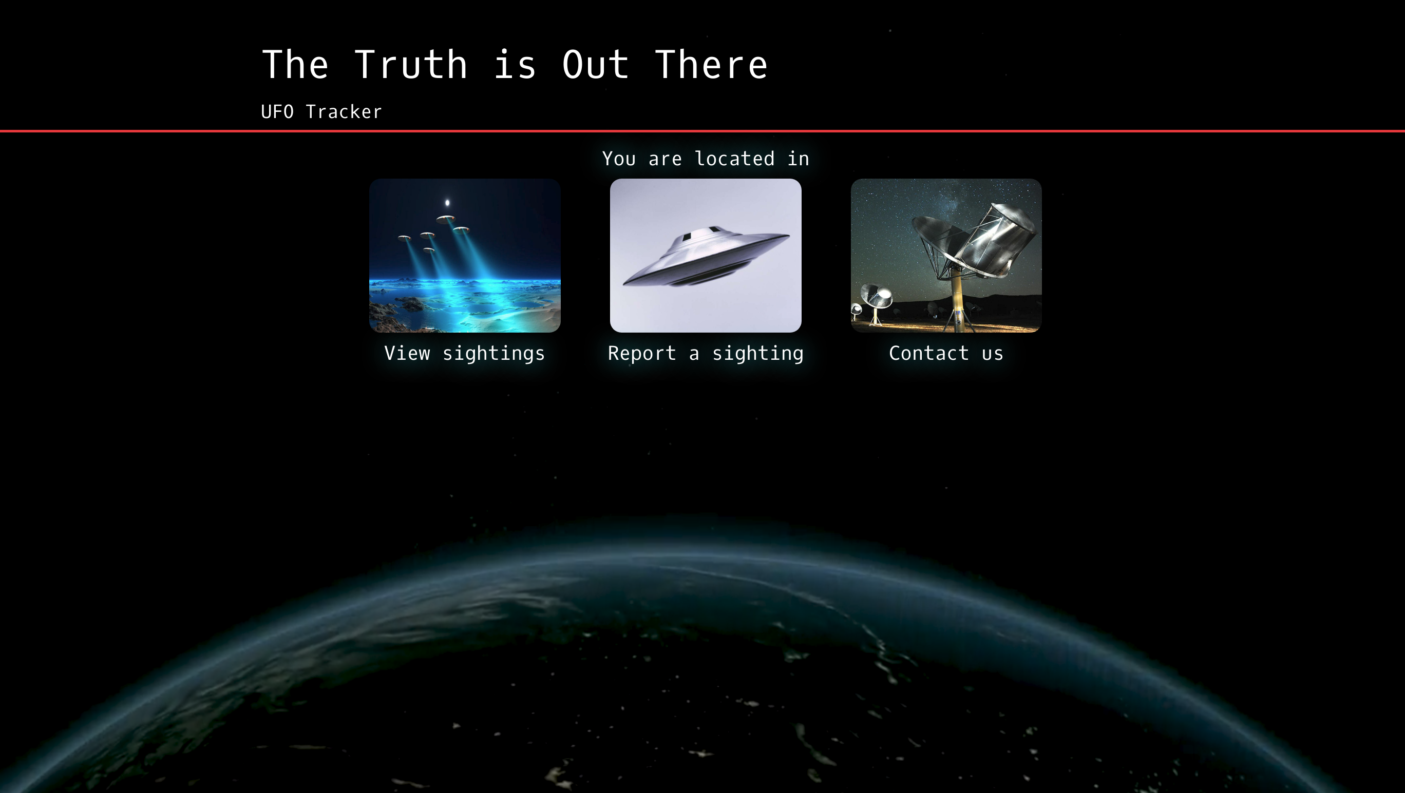
The Project - Framework

Slide 10
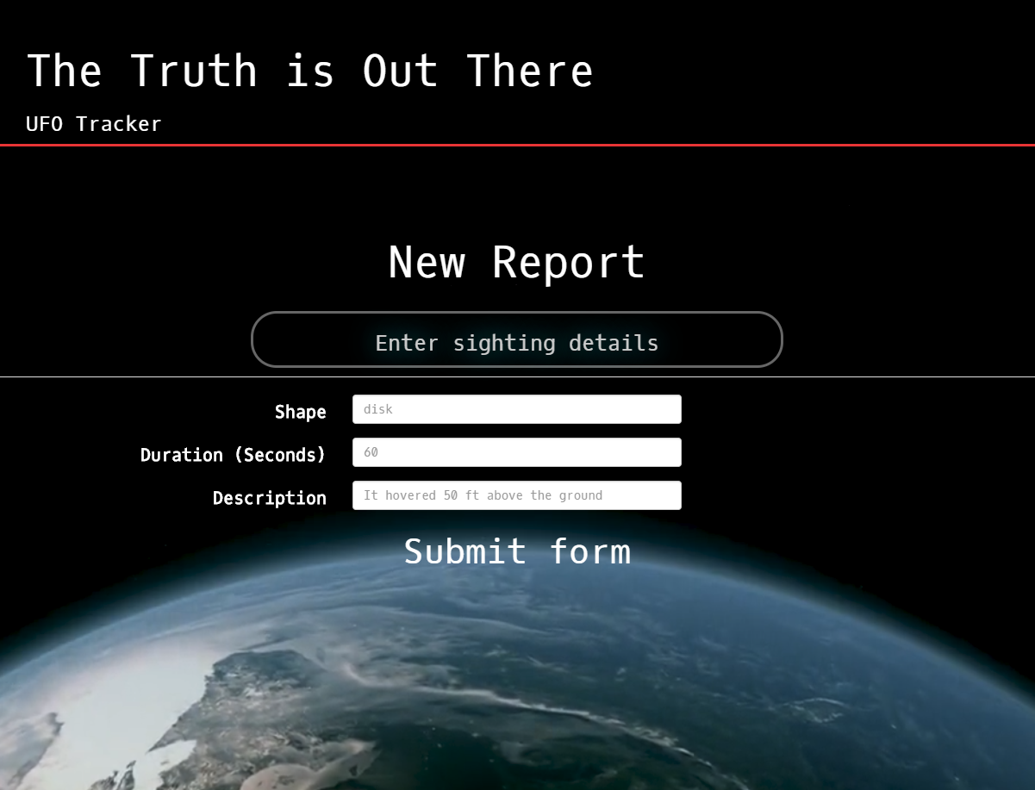
The Project - Framework

Slide 11
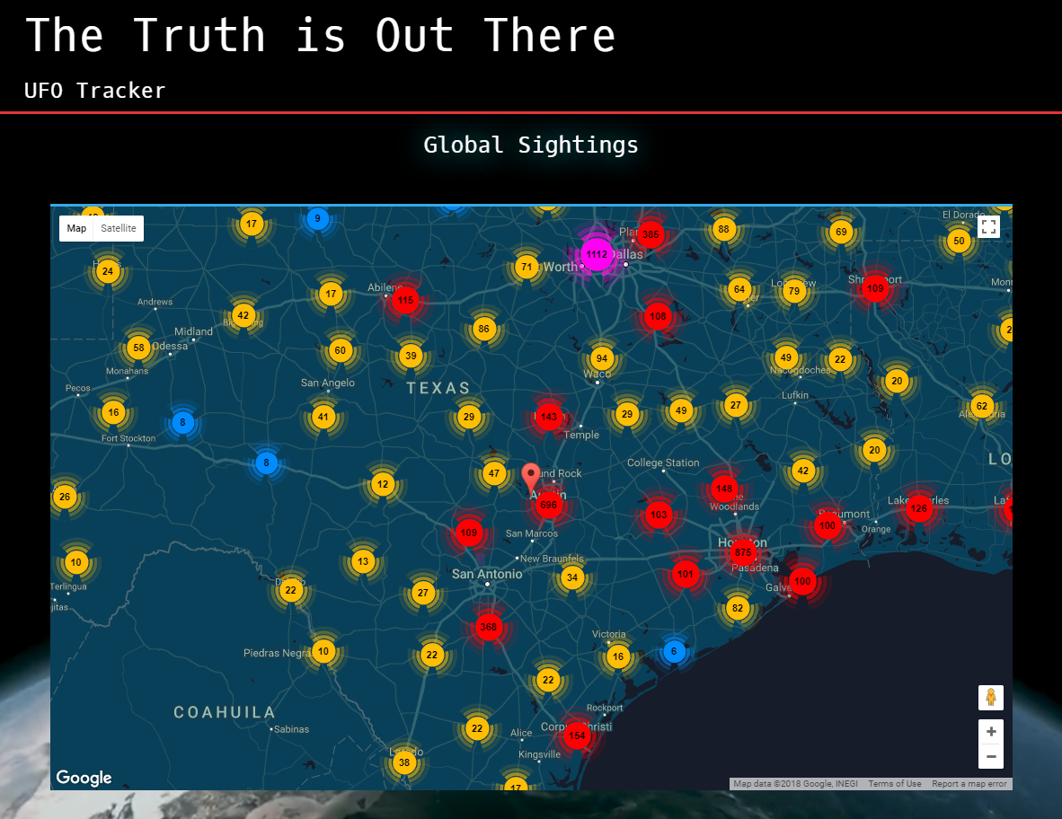
The Project - Framework

Slide 12
Agent Smiley

Slide 13
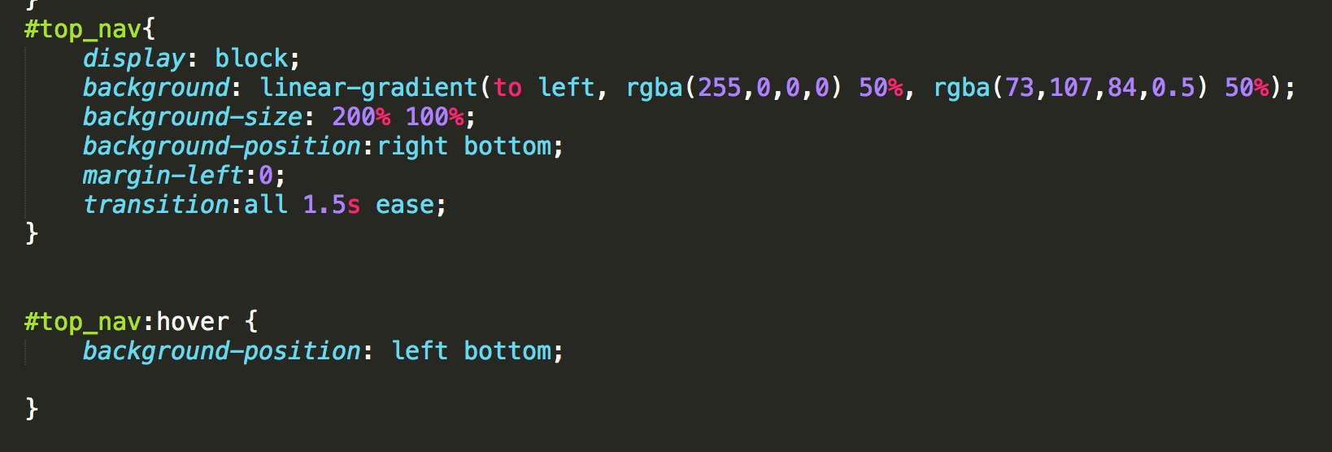
The Project
Front end
Animation
Background video

Slide 14
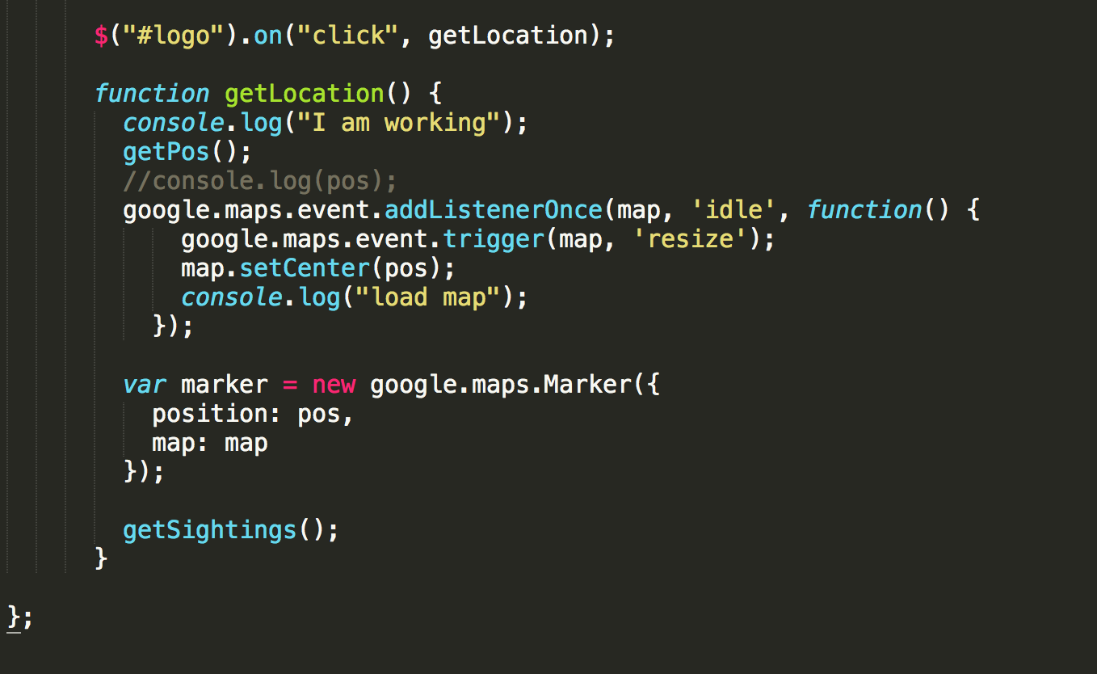
The Project
Google map API
Google Style Wizard
Google Map Listener

Slide 15
The Project
GitHub Organization
Strategy
Heroku
Resolve Conflicts

Slide 16
Agent Douglas

Slide 17
Live Demo

