Slide 1







ARTIFICIAL INTELLIGENCE-PROJECT “SOULSYNC”
PRESENTATION
PRESENTED BY:
OUR TEAM: OWAIS , WILLIS , VAASVI, NITUL, AYMAN

Slide 2



PROBLEM STATEMENT
SoulSync: AI-Powered Personalized Mental Health Companion
Building a technically robust mental-health companion requires integrating emotion detection, empathetic response generation, and crisis safety—capabilities missing in today’s generic chatbots.

Slide 3
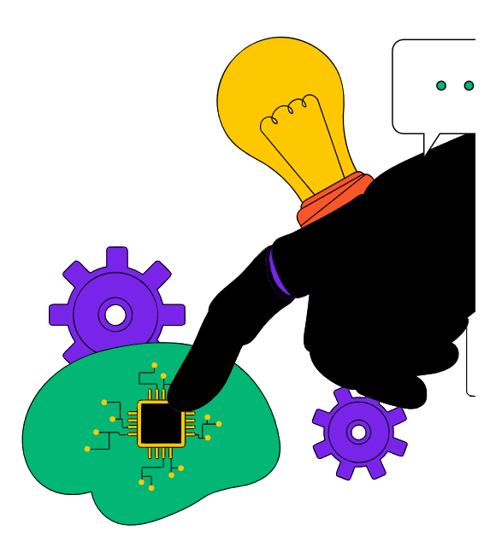

THE MENTAL HEALTH CHALLENGE
The global mental health gap is real and growing.
Over 1B people experience mental health struggles. Access to therapists is limited, especially in underserved regions.
Current digital mental health tools feel generic and robotic. Emotional support is needed outside clinical environments.
Why this matters: There is a rising demand for accessible, personalized emotional support solutions.

Slide 4




OUR SOLUTION : AGENTIC AI MENTAL HEALTH COMPANION
SOUL SYNC IS AN AI MENTAL-HEALTH COMPANION FINE- TUNED ON EMOTIONAL SUPPORT DIALOGUES TO PROVIDE EMPATHETIC AND SAFE CONVERSATIONS.
CORE FEATURES:
FINE-TUNED ON MENTAL-HEALTH ORIENTED CONVERSATION DATASETS DESIGNED TO PROVIDE SUPPORTIVE, HUMAN-LIKE EMOTIONAL RESPONSES INTEGRATED TELEGRAM EMERGENCY ALERT SYSTEM FOR REAL-WORLD SAFETY

Slide 5
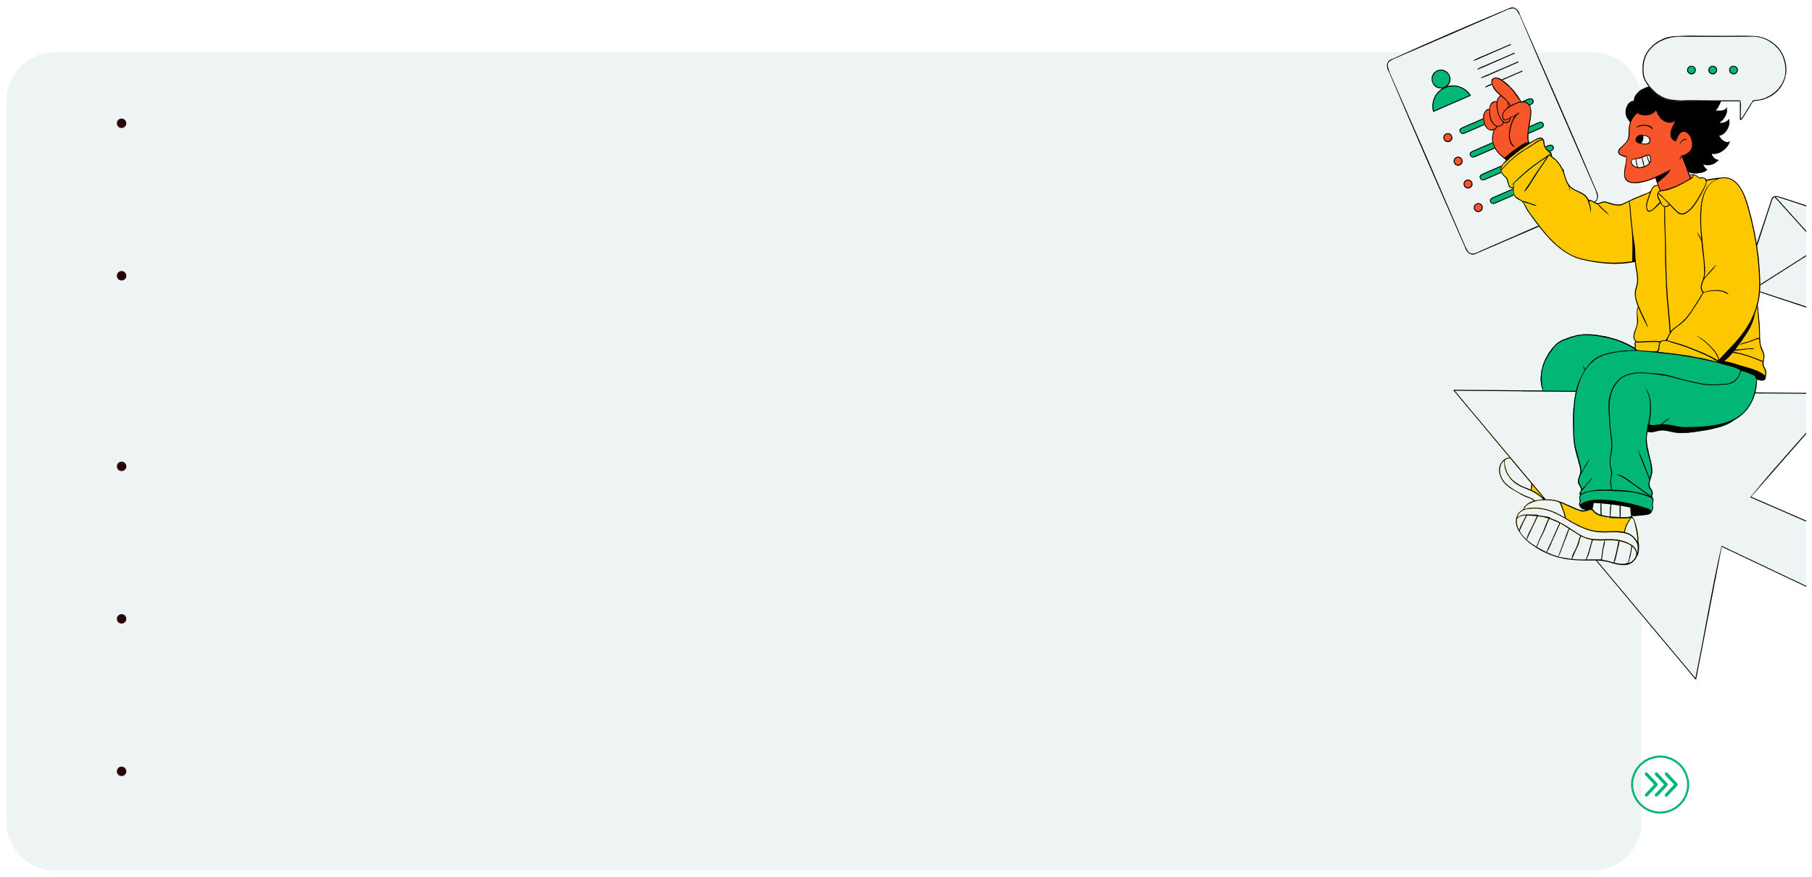
WHAT MAKES SOULSYNC UNIQUE?
Secure Onboarding WithEmergencyContact
Users sign up through the Electron.js desktop app and provide the Telegram chat ID of their closest kin, stored safely for emergency use.
Personalised Responses & Suggestions
Tailored guidance based on the user’s emotional state and conversation patterns.Context-aware suggestions that help users reflect, cope, or improve their wellbeing
Empathy-Tuned Dialogue Model
SoulSync’s LLM is fine-tuned on supportive conversations, delivering warm, safe, and context-aware responses.
Smooth End-to-End System
User → Electron App → API → HuggingFace Model → Response Designed for low-latency, real-time emotional support.
Crisis Detection & Telegram Alerts
If triggering or suicidal content is detected, SoulSync automatically alerts the registered closest kin via the SoulSync Telegram bot.

Slide 6


DATASET OVERVIEW & MODEL TRAINING
Training Pipeline SoulSync uses a 3-model pipeline to detect emotion, generate supportive replies, and personalize them. 1. BERT — Emotion Classifier
Dataset: 50k+ sentiment samples (7 emotions) Purpose: Understand user mood
2. Phi-2 — Response Generator
Dataset: 50k+ mental-health conversations Purpose: Produce empathetic, therapeutic responses
3. Qwen-3 — Personalization Layer
Purpose: Refine and personalize final reply
Outcome: Emotion → Response → Personalization Creates warm, safe, and context-aware conversations.

Slide 7
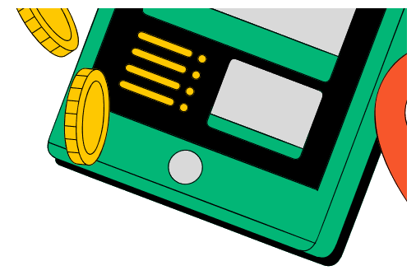


DATASET OVERVIEW FOR SENTIMENT AND CONVERSATIONAL DATA
Dataset Name
Type
Samples
Labels / Classes
Source
Fine-tuned mental health conversations
Conversational Dataset
Prompt-Completion 50,000+
N/A
Anxiety , Depression Open-source
Sentiment Dataset
Text
50,000+
etc.
sentiment corpus

Slide 8

SUMMARY OF FINE-TUNING TECHNIQUES AND MEMORY OPTIMIZATION
Technique
Supervised Fine- Tuning (SFT)
Instruction Fine-
Tuning
Model
Description
Trained on emotion- labeled dataset
Used dialogue-based
empathetic prompts
Trains low-rank
matrices instead of full model
Runs 4-bit quantized
model on Ollama
Benefit
Improved emotional recognition accuracy
Generates emotionally
aligned responses
BERT
Phi-2
Parameter-Efficient
Tuning (LoRA)
BERT / Phi-2
Reduces memory and
training time
Enables fast local
inference on limited GPU
Quantized Inference
Qwen 1.3B

Slide 9


SUMMARY OF ETHICAL SAFEGUARDS AND PRIVACY CONTROLS
Safeguard
Implementation Fine tune models + Local
APIs
Telegram Alert System
Description No cloud dependency;
ensures user privacy
Triggers automatic alert for
distress or crisis
No personal data stored
Local Inference
Emotional Safety
Privacy by Design
Anonymous User IDs

Slide 10


EVALUATION METRICS FOR BERT-BASED EMOTION CLASSIFICATION
Metric Accuracy Precision Recall F1 Score Validation Loss
Score
90.70% 90.80% 90.70% 90.70% 0.23

Slide 11


WHAT WE AIM TO DEVELOP NEXT?
1. Multilingual Support
Expand SoulSync to understand and respond in multiple languages Enable culturally aware emotional responses for diverse users
2. Enhanced Crisis Detection
More accurate multi-class risk classifiers for early warning Smarter triggers combining language cues and emotional intensity
3. Mobile & Cross-Platform Expansion
Android/iOS apps for continuous accessibility Web-based version for lightweight, on-the-go support
4. Voice-Based Interaction
Speech-to-text emotional understanding for natural conversations Calm, supportive AI voice responses for hands-free use

Slide 12
LITERATURE SURVEY
ELIZA (1966)
First conversational agent; showed how rule-based dialogue can simulate empathy. Limitation: No real understanding or emotional intelligence.
Woebot (2017)
CBT-based mental-health chatbot with proven reduction in depression symptoms. Lacked deeper personalization and emotional context awareness.
Transformer Models (BERT, 2018+)
Enabled state-of-the-art emotion and sentiment classification. Foundation for emotion detection systems like SoulSync.
Empathetic Dialogue Research (2019+)
Datasets & models trained for empathy, validation, and supportive responses. Highlighted need for emotionally aligned AI conversations.
Crisis Detection Studies
Show importance of self-harm detection & escalation pathways. Inspired SoulSync’s closest-kin Telegram alert mechanism.

Slide 13
THANK YOU
GITHUB REPO LINK : https://github.com/williskipsjr/SoulSync

