Slide 1
WHY YOU SHOULD START BY LEARNING DATA VISUALIZATION AND MANIPULATION
http://www.sharpsightlabs.com/start-with-data-visualization-manipulation/

Slide 2
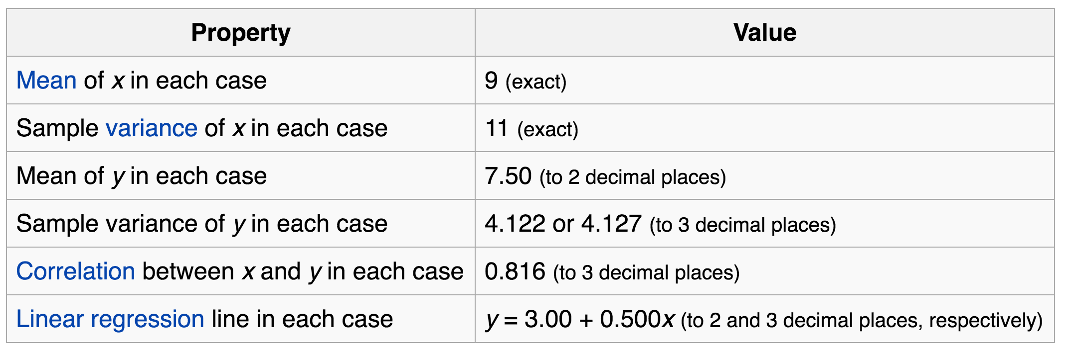
Why visualize data?
Four groups
11 observations (x, y) per group
https://en.wikipedia.org/wiki/Anscombe%27s_quartet

Slide 3
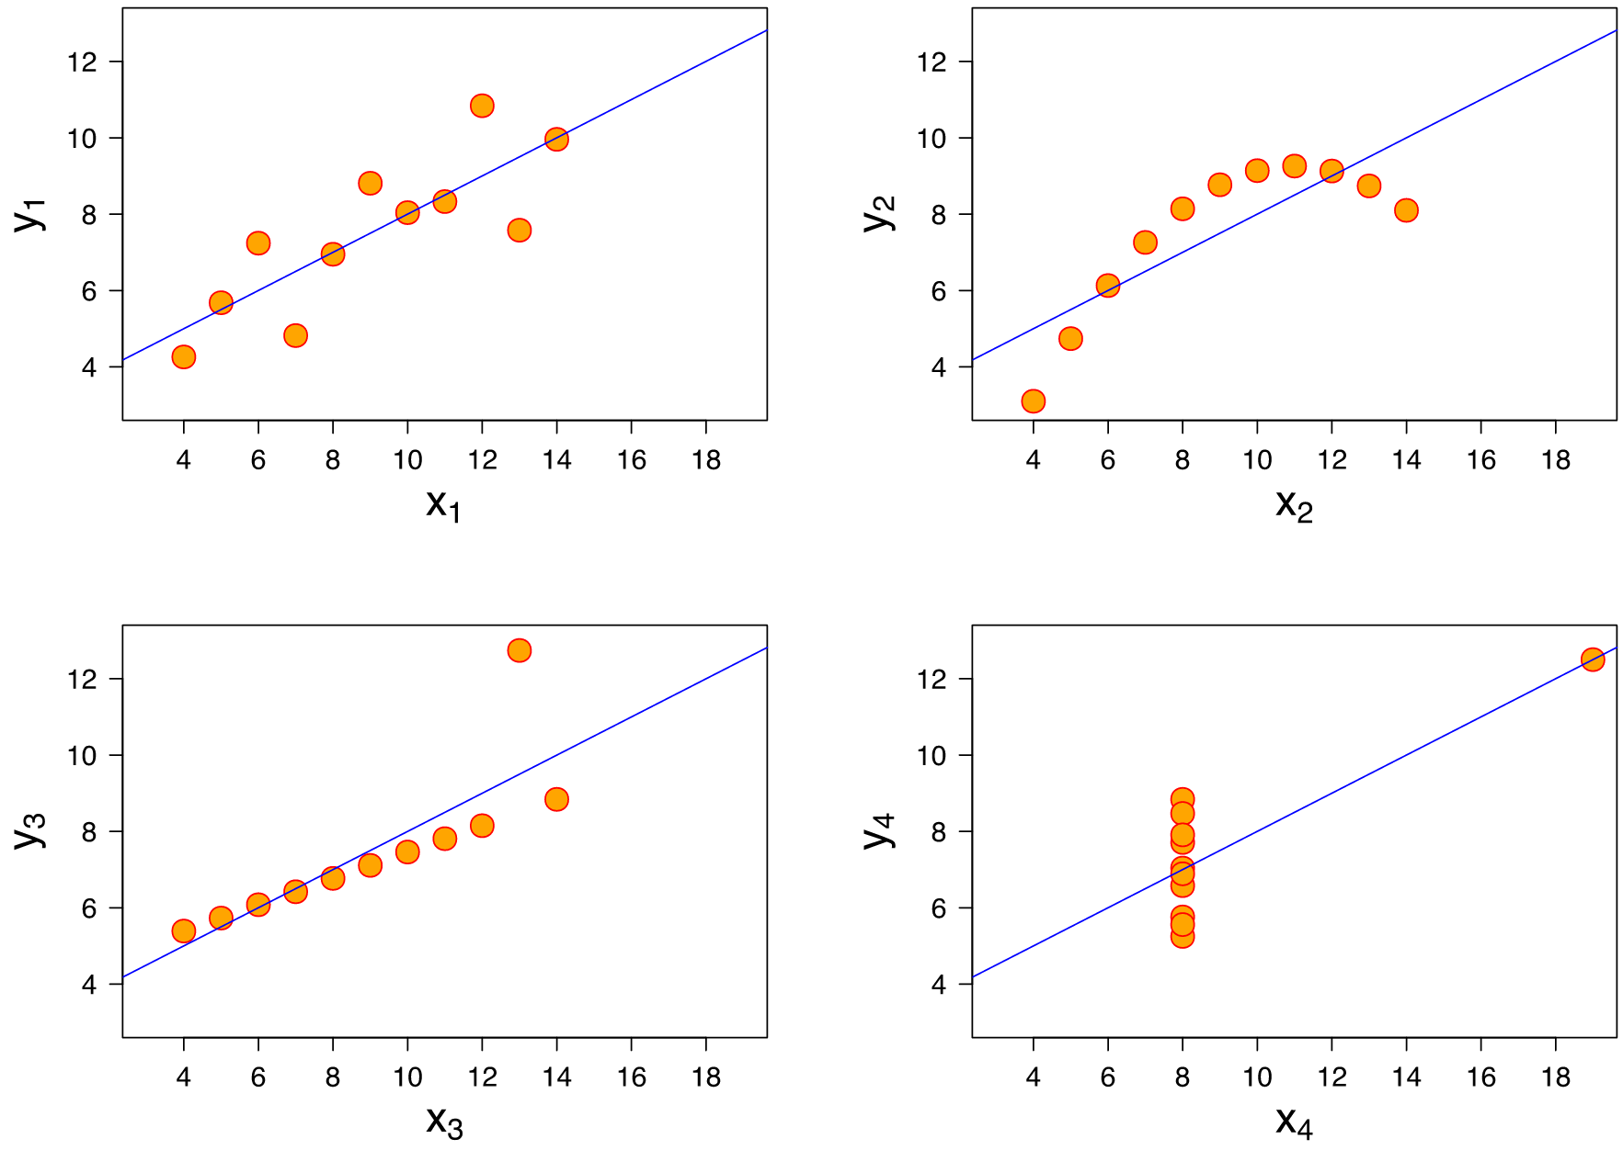
Why visualize data?
Four groups
11 observations (x, y) per group
https://en.wikipedia.org/wiki/Anscombe%27s_quartet

Slide 4
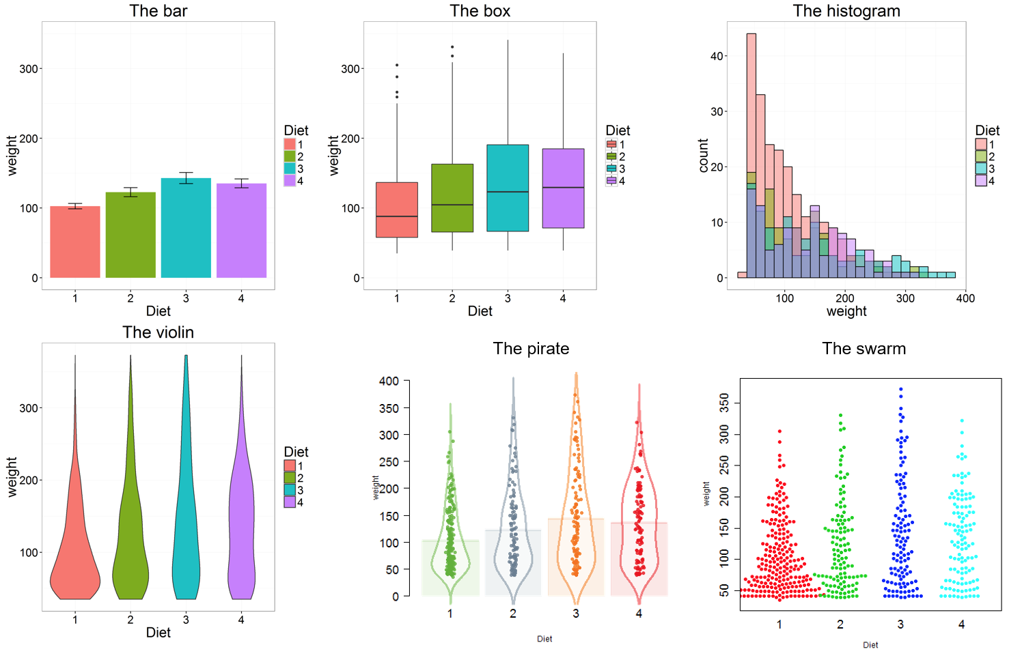
R base graphics
plot() generic x-y plotting
barplot() bar plots
boxplot() box-and-whisker plot
hist() histograms
pie() pie charts
http://manuals.bioinformatics.ucr.edu/home/R_BioCondManual#TOC-Some-Great-R-Functions

Slide 5
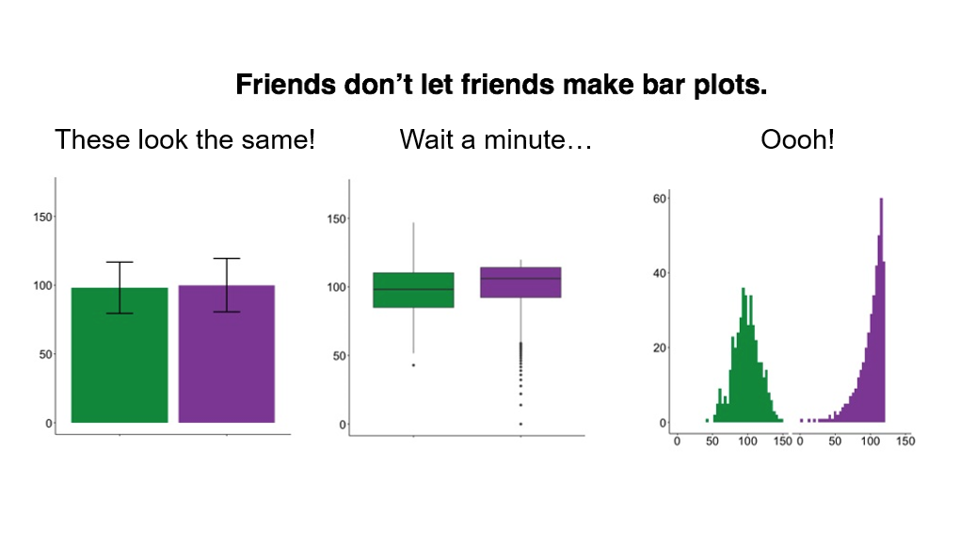
Don’t use Barplots
Weissgerber T et.al., "Beyond Bar and Line Graphs: Time for a New Data Presentation Paradigm", PLOS Biology, 2015 http://journals.plos.org/plosbiology/article?id=10.1371/journal.pbio.1002128
https://cogtales.wordpress.com/2016/06/06/congratulations-barbarplots/

Slide 6

R base graphics
heatmap() heatmap. Alternatives:
qplots::heatmap.2()
pheatmap::pheatmap()
NMF::aheatmap()
qqnorm(), qqline(), qqplot() distribution comparison plots
pairs() pair-wise plot of multivariate data
http://manuals.bioinformatics.ucr.edu/home/R_BioCondManual#TOC-Some-Great-R-Functions

Slide 7
Special plots
vioplot: Violin plot, https://cran.r-project.org/web/packages/vioplot/
PiratePlot: violin plot enhanced. install_github("ndphillips/yarrr”), http://nathanieldphillips.com/
beeswarm: The Bee Swarm Plot, an Alternative to Stripchart, https://cran.r-project.org/web/packages/beeswarm/index.html

Slide 8
Saving plots
Exercise: Save to PDF
pdf(“filename.pdf”, width = 7, height = 5)
plot(1:10, 1:10)
dev.off()
Other formats: bmp(), jpg(), pdf(), png(), or tiff()

Slide 9
https://github.com/nbrgraphs/mro

Slide 10
DATA MANIPULATION

Slide 11
dplyr: data manipulation with R
80% of your work will be data preparation
getting data (from databases, spreadsheets, flat-files)
performing exploratory/diagnostic data analysis
reshaping data
visualizing data
http://www.gettinggeneticsdone.com/2014/08/do-your-data-janitor-work-like-boss.html

Slide 12
dplyr: data manipulation with R
80% of your work will be data preparation
Filtering rows (to create a subset)
Selecting columns of data (i.e., selecting variables)
Adding new variables
Sorting
Aggregating
Joining

Slide 13

Dplyr: A grammar of data manipulation
https://github.com/hadley/dplyr
install.packages("dplyr")

Slide 14
The pipe %>% operator
Pipe output of one command into an input of another command - chain commands together
Think about the “|” operator in Linux
Read as “then”. Take the dataset, then do …
library(dplyr)
head(diamonds)
diamonds %>% head
summary(diamonds$price)
diamonds$price %>% summary(object = .)

Slide 15
dplyr::filter()
Filter (select) rows based on the condition of a column
diamonds %>% head
df.diamonds_ideal <- filter(diamonds, cut == "Ideal")
df.diamonds_ideal <- diamonds %>% filter(cut == "Ideal")

Slide 16
dplyr::select()
Select columns from the dataset by names
df.diamonds_ideal %>% head
select(df.diamonds_ideal, carat, cut, color, price, clarity)
df.diamonds_ideal <- df.diamonds_ideal %>% select(., carat, cut, color, price, clarity)

Slide 17
dplyr::mutate()
Add columns to your dataset
df.diamonds_ideal %>% head
mutate(df.diamonds_ideal, price_per_carat = price/carat)
df.diamonds_ideal <- df.diamonds_ideal %>% mutate(price_per_carat = price/carat)

Slide 18
dplyr::arrange()
Sort your data by columns
df.diamonds_ideal %>% head
arrange(df.diamonds_ideal, price)
df.diamonds_ideal %>% arrange(price, price_per_carat)

Slide 19
dplyr::summarize()
Summarize columns by custom summary statistics
summarize(df.diamonds_ideal, length = n(), avg_price = mean(price))
df.diamonds_ideal %>% summarize(length = n(), avg_price = mean(price))

Slide 20
dplyr::group_by()
Summarize subsets of columns by custom summary statistics
group_by(diamonds, cut) %>% summarize(mean(price))
group_by(diamonds, cut, color) %>% summarize(mean(price))

Slide 21
The power of pipe %>%
arrange(mutate(arrange(filter(tbl_df(diamonds), cut == "Ideal"), price), price_per_carat = price/carat), price_per_carat)
arrange(
mutate(
arrange(
filter(tbl_df(diamonds), cut == "Ideal"),
price),
price_per_carat = price/carat),
price_per_carat)
diamonds %>% filter(cut == "Ideal") %>% arrange(price) %>% mutate(price_per_carat = price/carat) %>% arrange(price_per_carat)

Slide 22
GGPLOT2 - THE GRAMMAR OF GRAPHICS

Slide 23
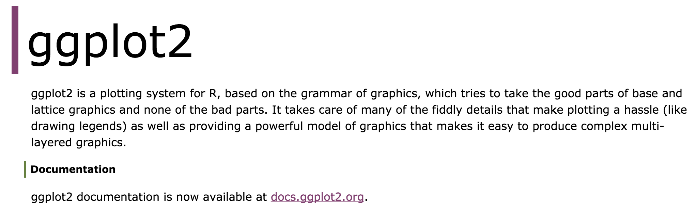
ggplot2 package
http://ggplot2.org/
install.packages("ggplot2")

Slide 24
The basics of ggplot2 graphics
Data mapped to graphical elements
Add graphical layers and transformations
Commands are chained with “+” sign
data +
aesthetic mappings of data to plot coordinates +
geometry to represent the data
Data |  | The raw data that you want to plot
Aethetics | aes() | How to map your data on x, y axis, color, size, shape (aesthetics)
Geometries | geom_ | The geometric shapes that will represent the data

Slide 25
Examples of ggplot2 graphics
diamonds %>% filter(cut == "Good", color == "E") %>%
ggplot(aes(x = price, y = carat)) +
geom_point() # aes(size = price) +
geom_smooth() # method = lm
geom_line()
geom_boxplot()
geom_bar(stat="identity")
geom_histogram()

Slide 26
Fine tuning ggplot2 graphics
Facets | facet_ | Split one plot into multiple plots based on a grouping variable
Scales | scale_ | Maps between the data ranges and the dimensions of the plot
Visual Themes | theme | The overall visual defaults of a plot: background, grids, axe, default typeface, sizes, colors, etc.
Statistical transformations | stat_ | Statistical summaries of the data that can be plotted, such as quantiles, fitted curves (loess, linear models, etc.), sums etc.
Coordinate systems | coord_ | Expressing coordinates in a system other than Cartesian

Slide 27
Putting it all together
diamonds %>% # Start with the 'diamonds' dataset
filter(cut == "Ideal") %>% # Then, filter rows where cut == Ideal
ggplot(aes(price)) + # Then, plot using ggplot
geom_histogram() + # and plot histograms
facet_wrap(~ color) + # in a 'small multiple' plot, broken out by 'color'
ggtitle("Diamond price distribution per color") +
labs(x="Price", y="Count") +
theme(panel.background = element_rect(fill="lightblue")) +
theme(plot.title = element_text(family="Trebuchet MS", size=28, face="bold", hjust=0, color="#777777")) +
theme(axis.title.y = element_text(angle=0)) +
theme(panel.grid.minor = element_blank())

Slide 28
Other resources
Plotly for R, https://plot.ly/r/
GoogleVis for R, https://cran.r-project.org/web/packages/googleVis/vignettes/googleVis_examples.html
ggbio – grammar of graphics for genomic data, http://www.tengfei.name/ggbio/

