Slide 2
R
R
Is an integrated suite of software facilities for data manipulation, simulation, calculation and graphical display.
It handles and analyzes data very effectively and it contains a suite of operators for calculations on arrays and matrices.
In addition, it has the graphical capabilities for very sophisticated graphs and data displays.
It is an elegant, object-oriented programming language.
Started by Robert Gentleman and Ross Ihaka (hence “R”) in 1995
as a free, independent, open-source implementation of the S programming language (now part of Spotfire)
Currently, maintained by the R Core development team – an international group of hard-working volunteer developers
http://www.r-project.org
http://cran.r-project.org/doc/contrib/Owen-TheRGuide.pdf

Slide 3
Bioconductor
Bioconductor
“Is an open source and open development software project to provide tools for the analysis and comprehension of genomic data.”
Goals
To provide widespread access to a broad range of powerful statistical and graphical methods for the analysis of genomic data.
To provide a common software platform that enables the rapid development and deployment of extensible, scalable, and interoperable software.
To further scientific understanding by producing high-quality documentation and reproducible research.
To train researchers on computational and statistical methods for the analysis of genomic data.
http://bioconductor.org/overview

Slide 4
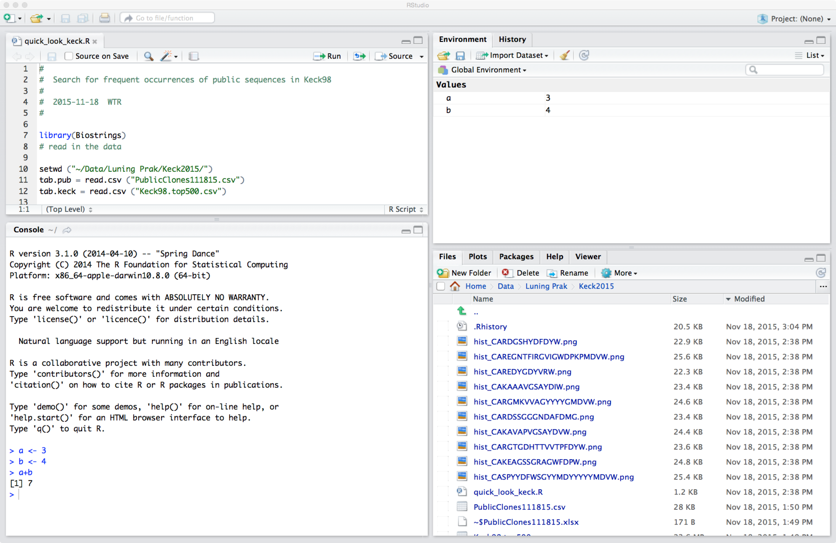
Rstudio
Notes:
Rstudio is an Integrated Development Environment (IDE) for R.

Slide 5
Rstudio
Console

Slide 6
Rstudio
Editor

Slide 7
Rstudio
Env, History

Slide 8
Rstudio
Your best friend

