Slide 1
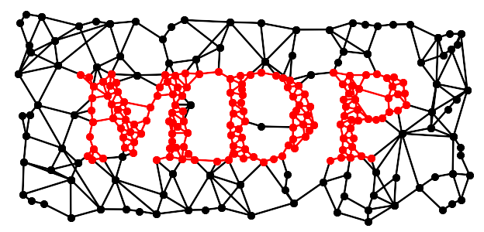
Modular toolkit for Data Processing
a Python data processing framework
Pietro Berkes, Niko Wilbert, Tiziano Zito
NIPS 2008
Workshop on Machine Learning Open Source Software
December 12th, 2008

Slide 2
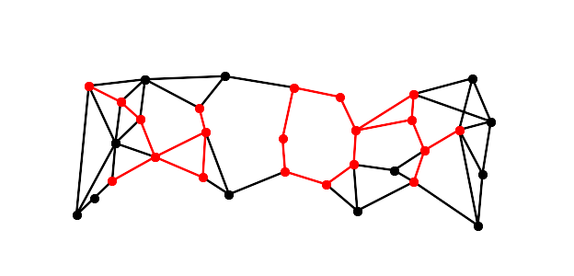

Building blocks: Node
dtype, dimensionality
training: multiple phases,
batch, online, chunks,
supervised, unsupervised
execution
inversion
>>> pca = PCANode(output_dim=0.9, dtype='float32')
>>> for x in data_stream:
... pca.train(x)
>>> out = pca(x)
>>> rec = pca.invert(out)

Slide 3
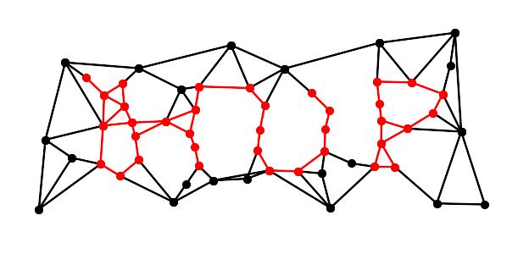
Building blocks: Node
PCA (standard, NIPALS)
ICA (FastICA, CuBICA, JADE, TDSEP)
Locally Linear Embedding
Hessian Locally Linear Embedding
Fisher Discriminant Analysis
Slow Feature Analysis
Independent Slow Feature Analysis
Restricted Boltzmann Machine
Growing Neural Gas
Factor Analysis
Gaussian Classifiers
Polynomial Expansion
Time Frames
Hit Parades
Noise
...

Slide 4
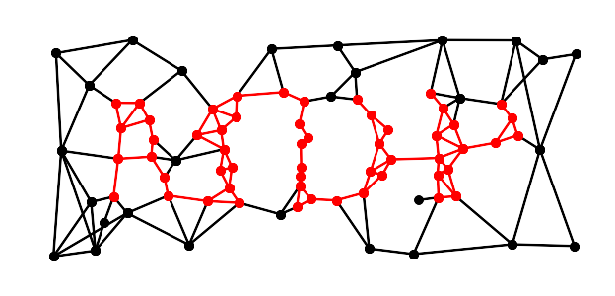
Building blocks: Flow
automatic: training, execution, inversion
sanity checks
Python containers
feed on arrays or iterators
crash recovery, checkpoints
>>> flow = PCANode() + SFANode() + FastICANode()
>>> generator = (chunk for chunk in openfile)
>>> flow.train(generator())
>>> out = flow(x)
>>> rec = flow.invert(out)
>>> flow += HitParadeNode()

Slide 5
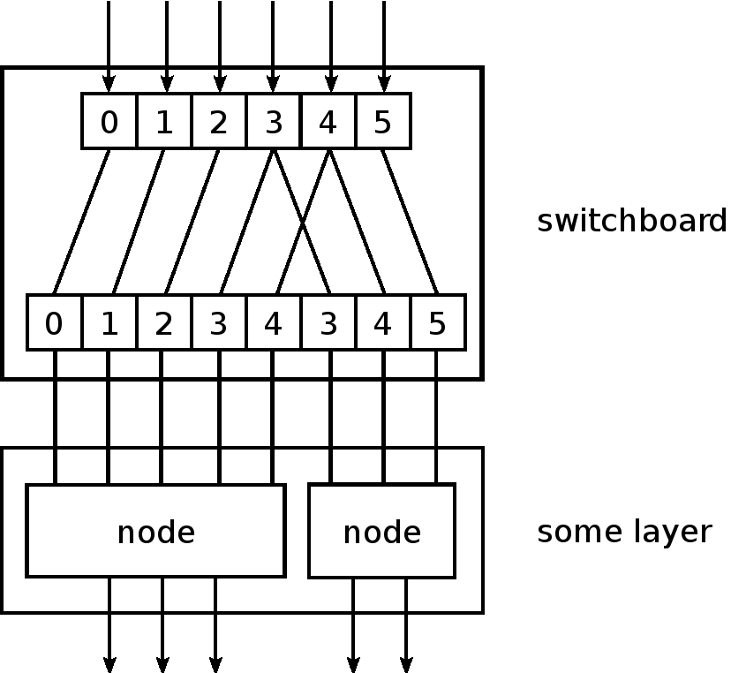
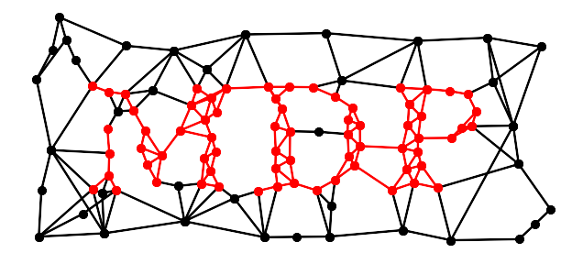
Building blocks: Network
Layer
Switchboard
HTML display
>>> layer = Layer([PCANode(), ICANode(), ...])
>>> switch = Switchboard(input_dim=N,
... connections=[0,3,1,...])
>>> net = switch + layer
>>> net.train(generator())
>>> out = net(x)

Slide 6
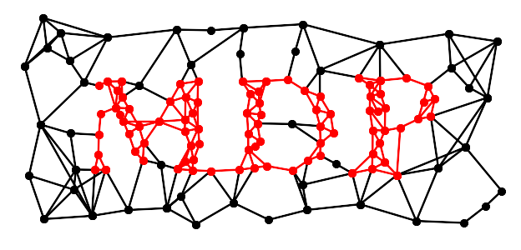
Speed: let's go parallel
embarrassingly parallel problems
scheduler
multiple processors
multiple machines
automatic parallelization of serial flows
abstract scheduler API
support for Parallel Python
>>> flow = PCANode() + SFANode()
>>> scheduler = ProcessScheduler(n_processes=8)
>>> pflow = make_flow_parallel(flow)
>>> pflow.train(data, scheduler)

Slide 7
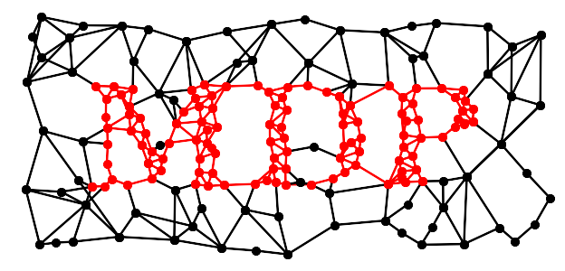

Users
ML and neuroscience (>12K downloads):
modeling, computer vision, pattern recognition,
electrophysiological data analysis, education, ...
comprehensive documentation:
  tutorial covering basic and advanced usage
  public objects doc-strings
  PEP8 compliant, commented, and pylint-clean code
collection of efficient and well
tested (350+ unit tests) algorithms
minimal dependencies: Python + NumPy

Slide 8
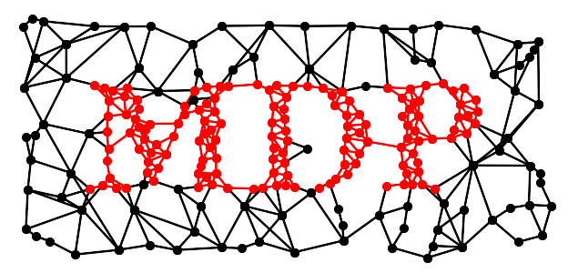
Embedding MDP
input and output just NumPy arrays
API is stable and designed for
straightforward embedding
PyMCA: X-ray fluorescence mapping
PyMVPA: ML framework for neuroimaging data analysis
Chandler: personal organizer application

Slide 9
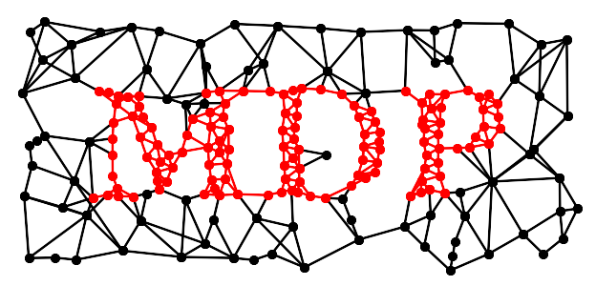
Developers
framework to develop new supervised
and unsupervised algorithms
concentrate on the algorithm,
MDP takes care of the details
use MDP utilities in your nodes
immediately integrate your nodes
with the existing library
contribute your nodes to MDP!
>>> class MyNode(Node):
... def _train(self, x):
... ... training code ...
... def _execute(self, x):
... ... execution code ...
...
>>> flow = PCANode() + MyNode()

Slide 10
Future perspectives
Architecture:
    feedback loops
    Python 3
Algorithms:
  involve more external contributors
  integrate widely used libraries

Slide 11
http://mdp-toolkit.sourceforge.net

