Slide 1
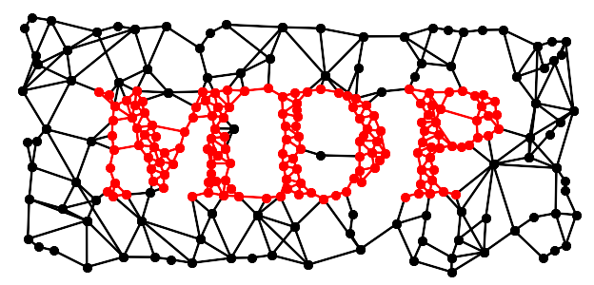


Modular toolkit for Data Processing
a Python data processing framework
Pietro Berkes, Niko Wilbert, Tiziano Zito
CNS 2009
Python in Neuroscience Workshop
July 22th, 2009

Slide 2
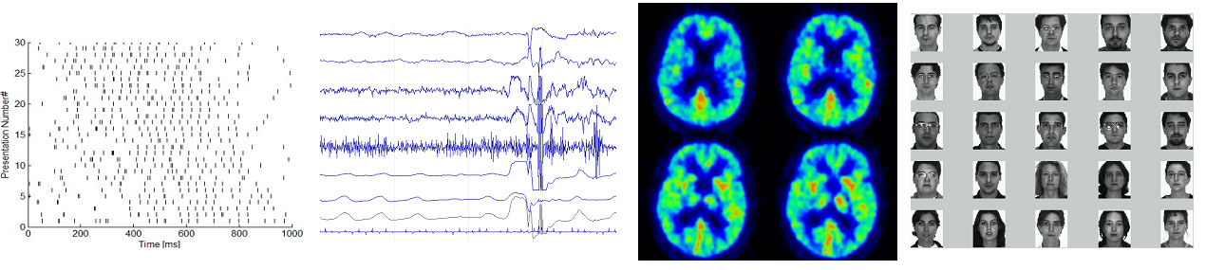

Background
Python module, Object Oriented design
Open Source (LGPL)
first public release 2004
15k+ downloads, available in Debian, Ubuntu,
MacPorts, Python(x,y)
origin in Prof. Wiskott research group...
... but also used outside computational
neuroscience

Slide 3
Contents
MDP basic building blocks:
nodes, flows, networks
Extending MDP
Parallelization
Examples and design considerations
Future development: the BiNet package
Using and embedding MDP
Future perspectives

Slide 4
Building Blocks: Node
fundamental data processing element
Node classes correspond to algorithms
API: train
support for multiple phases, batch,
online, chunks, supervised, unsupervised
API: execute
map n-dim input to m-dim output
API: inverse
inverse of execute mapping
data format: 2-dim numpy arrays
automatic consistency checks and
conversions (dimensions, dtype, ...)

Slide 5
Building Blocks: Node
example: Principal Component Analysis (PCA)
shortcut
>>> pca = PCANode(output_dim=0.9, dtype='float32')
>>> for x in data_stream:
... pca.train(x)
>>> out = pca.execute(x)
>>> rec = pca.invert(out)
>>> pca.explained_variance
0.9012761929
>>> pca.output_dim
45
>>> proj_data = pca(x, output_dim=0.9, dtype='float32')

Slide 6
Building Blocks: Node
PCA (standard, NIPALS)
ICA (FastICA, CuBICA, JADE, TDSEP, XSFA)
Locally Linear Embedding
Hessian Locally Linear Embedding
Linear Regression
Fisher Discriminant Analysis
Slow Feature Analysis
Independent Slow Feature Analysis
Restricted Boltzmann Machine
Growing Neural Gas
Factor Analysis
Gaussian Classifiers
Polynomial Expansion
Time Frames
Hit Parades
Noise
...

Slide 7
Building Blocks: Flow
combine nodes in a pipeline
API: train, execute, inverse
automatic training, execution, inversion
automatic checks: dims and data formats
Flow is a Python container (list)
feed on arrays or iterators
crash recovery, checkpoints
>>> flow = PCANode() + SFANode() + FastICANode()
>>> # DataStream is an iterable and returns
>>> # chunks of data (online or offline)
>>> flow.train([DataStream()]*3)
>>> out = flow.execute(x)
>>> rec = flow.inverse(out)
>>> flow += HitParadeNode()

Slide 8
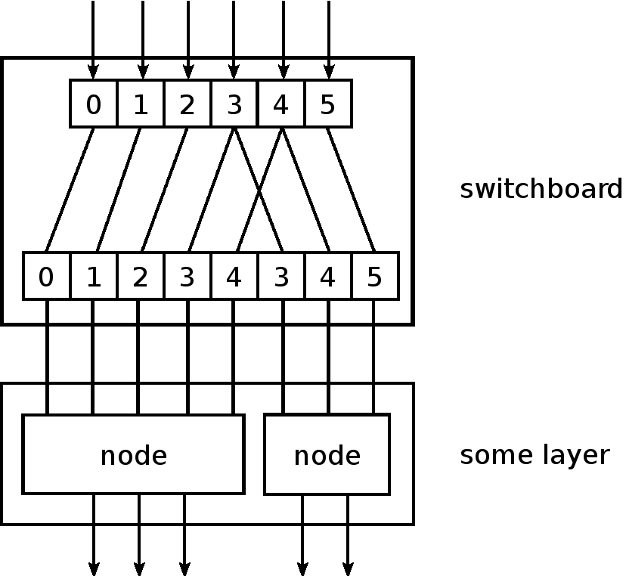
Building Blocks: Network
mdp.hinet: hierarchical networks
Layer: combine nodes horizontally in parallel
Switchboard: routing between layers
FlowNode: encapsulate a Flow into a “super” Node
everything is a Node: combine as you want
all acyclic graphs can be emulated
>>> layer = Layer([PCANode(),
... ICANode(), ...])
>>> switch = Switchboard(input_dim=N,
... connections=[0,3,1,...])
>>> net = switch + layer
>>> net.train(generator())
>>> out = net.execute(x)

Slide 9
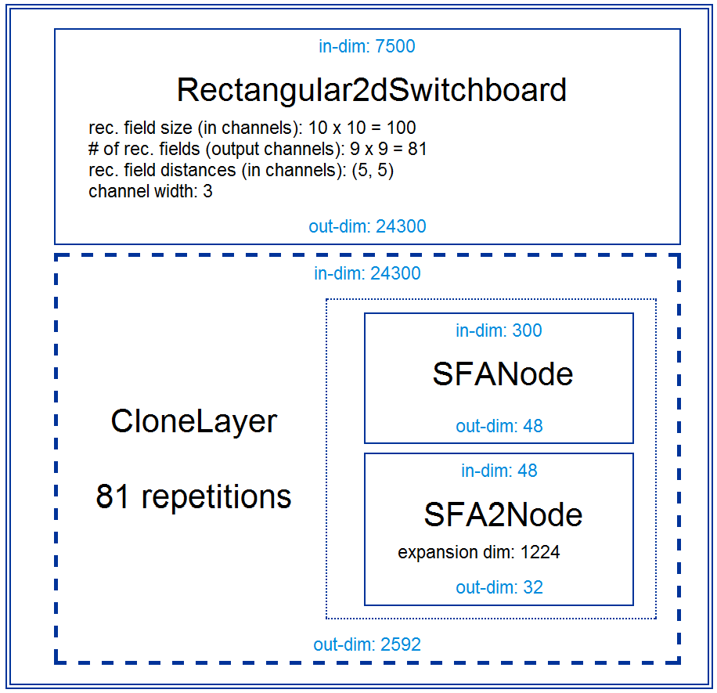
Building Blocks: Network
HTML visualization of your network
Use it for debugging, reports or GUIs
>>> mdp.hinet.show_flow(net)

Slide 10
Extending MDP: Writing Nodes
concentrate on the algorithm,
MDP takes care of the details
use MDP utilities in your nodes
immediately integrate your nodes
with the existing library
contribute your nodes to MDP!
>>> class MyNode(Node):
... def _train(self, x):
... ... training code ...
... def _execute(self, x):
... ... execution code ...
... def _inverse(self, y):
... ... inversion code ...
...
>>> flow = PCANode() + MyNode()

Slide 11
Parallelization
for embarrassingly parallel problems
data chunks can be processed independently
use multiple cores and multiple machines
Parallel Python support
automatic parallelization of serial flows
use abstract scheduler API
write your own adapter
simple API: write your own parallel nodes
implement _fork and _join methods
>>> flow = PCANode() + SFANode()
>>> scheduler = ProcessScheduler(n_processes=8)
>>> pflow = make_flow_parallel(flow)
>>> pflow.train(data, scheduler)

Slide 12

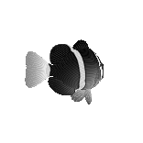
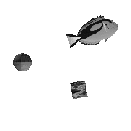
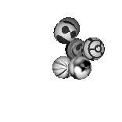
Real World Example
object recognition system
working on 155x155 pixel image sequences
several GBs of training data for each
training phase
hierarchical network with nested nodes
900 “super” nodes on lowest layer
training is distributed over network
[Franzius, Wilbert, Wiskott, 2008]

Slide 13
Software Design Considerations
Networks in MDP are modular. Why?
- flexibility
- distributed complexity = less complexity
- extensions [e.g. parallelization] are independent
from the specific structure of the network
- higher but “once and for all” implementation cost
Comparison with monolithic approach:
- network structure is hard-coded
- quick and dirty, not reusable
- every extension must be hard-coded
- network changes affect low-level code in
different locations

Slide 14
Future Development: the BiNet Package
mdp.binet allows bi-directional data flow
feedback loops, error back-propagation, ...
compatible with mdp.parallel and mdp.hinet
HTML+JS inspector for debugging and
visualization
scheduled for MDP 3.0 (end 2009?)

Slide 15
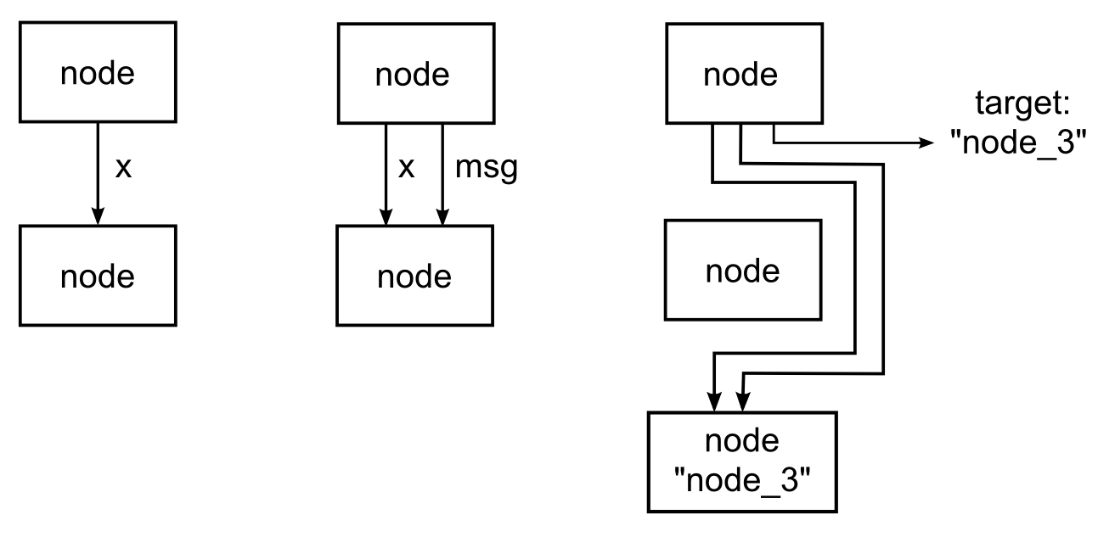
BiNet: Building Blocks
BiNode and BiFlow: backward compatible
BiNode has an ID string and can be accessed
by this name: biflow['PCA_node_3']
pass a “message” dictionary together with data
BiNode can specify a target node [GOTO :)]

Slide 16
BiNet: Features
message content addresses all or specific nodes:
message content accessed by argument names
several additional features, if you need it
it's probably already there ;)
>>> msg = {“status” : general_stuff,
... “fda_node=>labels” : fda_labels}
>>> class BiFDANode(BiNode):
... def _train(self, x, labels):
... ... FDA training code ...

Slide 17
Using MDP
comprehensive documentation:
- tutorial covering basic and advanced usage
- public objects have detailed doc-strings
- PEP8 compliant, commented, and pylint-clean code
- active and responsive user mailing list
collection of efficient and well
tested (390+ unit tests) algorithms
minimal dependencies: Python + NumPy

Slide 18
Embedding MDP
input and output just NumPy arrays
API is stable and designed for
straightforward embedding
PyMCA: X-ray fluorescence mapping
PyMVPA: ML framework for neuroimaging data analysis
Chandler: personal organizer application

Slide 19
Future perspectives
Architecture:
- fully integrate, test, and document BiNet
- Python 3
- plugin system
- GUI
- automatic graph to BiNet translator
Algorithms:
- integrate widely used libraries (e.g. SVM)

Slide 20
Developers:
- Pietro Berkes, Niko Wilbert, Tiziano Zito
Contributors:
- Gabriel Beckers, Alberto Escalante, Farzad Farkhooi,
Mathias Franzius, Yaroslav Halchenko, Michael Hanke,
Konrad Hinsen, Samuel John, Susanne Lezius,
Michael Schmuker, Henning Sprekeler, Jake VanderPlas

