Slide 1
Financial Forecasting Dashboard using Power BI

Slide 2

Table of Contents:
1. Project Statement
8. Conclusion
2. Abstract
3. Introduction to Power BI
4. Components
5.Financial Forecasting
6. Step to Demonstrate Project
7. Visualization

Slide 3
Project Statement:
Forecasting is a prediction with the same level of granularity as the data point used. After importing the dataset, temporal analysis via the built-in option involves using a line chart because it is essential to have a continuous temporal reference on the x-axis. On the y-axis, you will insert the aggregated measure, relative to the data point’s granularity level, for which we want to calculate the forecast.

Slide 4
Abstract
Financial forecasting is a critical component in the decision-making process for businesses, enabling them to predict future financial trends, allocate resources effectively, and mitigate potential risks. This project focuses on utilizing Power BI Desktop, a robust data visualization and analytics tool, to create interactive dashboards for financial forecasting.
The internship involved collecting and preparing historical financial data, applying forecasting techniques, and building visual representations to provide actionable insights. Key features of the project include the implementation of predictive models, such as exponential smoothing, and the use of DAX formulas for dynamic calculations.
The resulting dashboards provide a user-friendly interface for stakeholders to explore financial data trends, understand key metrics, and make informed decisions. This project highlights the significance of leveraging advanced tools like Power BI for enhancing business intelligence and improving strategic planning.
The report outlines the methodologies, challenges faced, and the outcomes achieved, providing a comprehensive understanding of how data visualization can transform financial forecasting into an efficient, data-driven process.

Slide 5
Introduction to Power BI
Defination: Power BI is a Business Intelligence tool used to clean the data, analyse the data and convert the data into visual format.
Key Features:
1. Data Connectivity
2. Data Transformation and Modeling
3. Real-Time Data Streaming
4. Data Analysis Expressions (DAX)
5.Interactive Visualizations

Slide 6
Components
Power BI is a collection of Components :
1. Power Query
2. Power Pivot
3. Power View
4. Power BI Service

Slide 7
Components
1. Power Query :
It is a ETL tool (extract,Transfer(cleaning the data ), Load)
=> Extracting the data , transferring the data and loading the data.
2. Data modeling:
when we have multiple data sources, if we want to connect them, we need to create the relationship between them by using power pivot.
3. Power View:
It can be help us to create 250+ visuals.
Ex: line chat, bar chart ,pie chart, kpi chart ………..etc
4. Power BI Service:
Communicating through reports & Dashboards with clients, colleagues , end users .

Slide 8
Modules
Module1: Data Preparation
Objective: Prepare historical financial data for forecasting.
Tasks completed:
Import and clean historical financial data (e.g., revenue, expenses, profit).
Ensure the data is structured correctly for time series analysis, with proper date formatting.
Module3: Implementing Forecasting Models
Objective: Use Power BI's forecasting tools to predict future financial performance.
Tasks:
Apply built-in forecasting models to predict future revenue and expenses.
Create a custom forecast using DAX and Power Query for more complex scenarios.
Module2: Create time series visualization
Objective: Visualize historical financial data over time.
Tasks completed:
Create line charts to show trends in revenue, expenses, and profit over time.
Add a clustered bar chart to compare quarterly or yearly financial performance.
Use a KPI visual to display key financial metrics like current profit margins.
Module4: Finalizing the Financial Forecasting Dashboard
Objective: Compile visualizations into a final dashboard.
Tasks:
Arrange the forecasted data and historical data in a cohesive layout.
Add interactive elements like slicers to adjust forecasting periods or financial categories.
Include a narrative on how forecasts can guide financial decision-making.

Slide 9
Financial Forecasting
Financial forecasting is the process of estimating or predicting a company's future financial outcomes based on historical data, trends, and assumptions.
Using Power BI for financial forecasting, the process includes:
Importing Historical Data: Bringing in data that contains past financial performance.
Temporal Analysis: Applying a time-based analysis, often using a line chart where the time dimension (e.g., months) is displayed on the x-axis. This time series allows for continuous visualization of data trends over time.
Aggregated Measures: Plotting measures such as revenue or profit on the y-axis, which can then be forecasted to predict future values based on historical patterns.

Slide 10
Step to Demonstrate project
Creating a financial forecasting dashboard in Power BI involves several steps, from importing data to building visualizations.
Step 1: Import Data
1. Connect Data Sources: Open Power BI Desktop and connect to your data sources. We can import data from Excel, SQL databases, online services, or other relevant sources.
Step 2: Transform Data (Data Cleaning and Preparation)
Open Power Query Editor: Once data is imported, open Power Query Editor to clean and transform the data.
Remove Unnecessary Columns: Delete any columns that are not relevant for your analysis to optimize data load and performance.
Format Data: Ensure data types are correct (e.g., dates as Date format, currency values as Decimal, etc.).
Step 3: Define Data Model and Relationships
Build Relationships: By using “Model” view in Power BI and establish relationships between tables (e.g., linking sales data with calendar dates).
Create Measures: Use Data Analysis Expressions (DAX) to create calculated measures, such as revenue growth rate, average sales, etc., for forecasting purposes.

Slide 11
Step 4: Create Visualizations for Temporal Analysis
Add a Line Chart for Forecasting: Place the time-based field (e.g., month, quarter, year) on the x-axis. Place the measure you want to forecast (e.g., revenue, expenses) on the y-axis.
Step 5: Add Additional Visualizations for Insight
1. KPI Visuals: Add KPI visuals to display key metrics (e.g., revenue, profit margin, etc.).
Step 6: Build the Dashboard
Organize Layout: Arrange visuals in a logical and easy-to-understand layout.
Use Slicers and Filters
Step 7: Publish and Share the Dashboard
Step 8: Review and Refine
Test the Dashboard: Ensure all visuals are accurate, interactive, and performing as expected.
Gather Feedback: If possible, share the dashboard with stakeholders and gather feedback for any refinements.
Make Adjustments: Based on feedback, make any necessary changes to improve usability and insights.

Slide 12
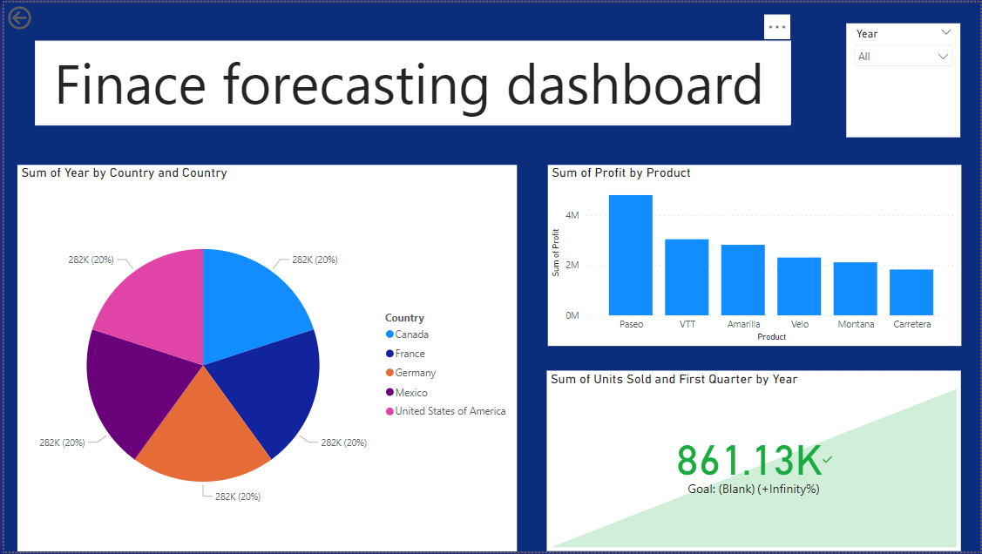
Final Visualization View

Slide 13
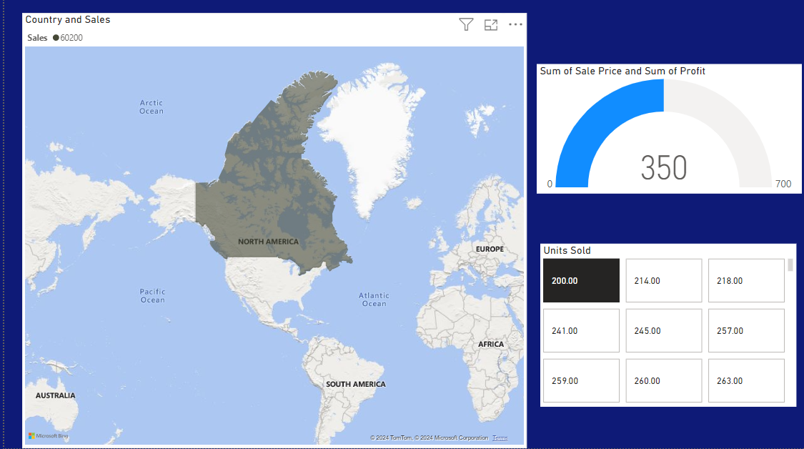
Using Slicer to create dated visualization

Slide 14
Conclusion
The Financial Forecasting Dashboard in Power BI offers an intuitive way to analyze and predict financial trends, helping users make more informed decisions. With its interactive visuals and forecasting features, the dashboard provides valuable insights into future financial outcomes.
Future improvements, like integrating advanced models and real-time data updates, will make the tool even more effective for financial planning and decision-making.

Slide 15
THANK YOU

