Slide 1
Introduction
Java Performance Tuning

Slide 2
Background on tuning
It is said tuning is both a science and an art
Discussions about performance include lots of numbers and measurements and analytics
Applying scientific rigor is a crucial part of achieving maximum performance
Art is really an application of deep knowledge, experience, and intuition.
Our goal is to help with the deep knowledge
Notes:
This knowledge falls into two broad categories. First is the performance of the Java Virtual Machine (JVM) itself: the way in which the JVM is configured affects many aspects of the performance of a program.
The second aspect is to understand how the features of the Java platform affect performance. Note the use of the word platform here: some features (e.g., threading and synchronization) are part of the language, and some features (e.g., XML parsing performance) are part of the standard Java API

Slide 3
Why do we need to tune?
So that programs run faster
Performance of every application can be expected to decrease over time—meaning over new release cycles of the application
As new features are added and new standards adopted programs can be expected to get larger and slower

Slide 4
What are symptoms of a system that needs tuning
With each release program performance can regress by a few percentage points
May hit some resource threshold—a critical point in memory use, or a code cache overflow
Regular performance tests catch a particular regression condition
Interaction between the JVM and other areas of the system

Slide 5
What outcomes should I expect
Optimized Code and Configurations
Less Code
Simple Algorithms
Performance for the most common operations – 80-20 rule
Test results on the actual product in the way the product will be used.

Slide 6
Java Virtual Machine Architecture

Slide 7
Overview of Java as a platform
Java and the JVM are open source
Different Java and JVM implementations
Oracle HotSpot Java Virtual Machine and the Java Platform, Standard Edition (Java SE) and Enterprise Edition (Java EE) , versions 7 and 8
All JVM implementations have one or more garbage collectors, but the flags to tune each vendor’s GC implementation are product specific

Slide 8
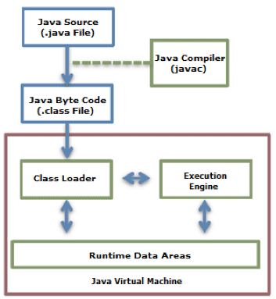
Java Virtual Machine Architecture
Notes:
The JRE is composed of the Java API and the JVM. The role of the JVM is to read the Java application through the Class Loader and execute it along with the Java API.

Slide 9
Key Components of the Java Virtual Machine
Stack-based virtual machine
Class Loader
Byte-Code Verifiers
Garbage collection
Runtime Data Areas – Heap
Execution Engine

Slide 10
Byte-code verifiers
When a class loader presents the bytecodes of a newly loaded Java platform class to the virtual machine, these bytecodes are first inspected by a verifier.
The verifier checks that the instructions cannot perform actions that are obviously damaging.
All classes except for system classes are verified.
You can, however, deactivate verification with the undocumented -noverify optio
Notes:
A compiler translates Java programs into a machine-independent bytecode representation. A bytecode verifier is invoked to ensure that only legitimate bytecodes are executed in the Java runtime. It checks that the bytecodes conform to the Java Language Specification and do not violate Java language rules or namespace restrictions. The verifier also checks for memory management violations, stack underflows or overflows, and illegal data typecasts. Once bytecodes have been verified, the Java runtime prepares them for execution.

Slide 11
Checks that the verifier carries out
Variables are initialized before they are used.
Method calls match the types of object references.
Rules for accessing private data and methods are not violated.
Local variable accesses fall within the runtime stack.
The runtime stack does not overflow.

Slide 12
Class loaders
Hierarchical Structure
Delegation mode
Visibility limit
Unload is not allowed
Notes:
Hierarchical Structure: Class loaders in Java are organized into a hierarchy with a parent-child relationship. The Bootstrap Class Loader is the parent of all class loaders.
Delegation mode: Based on the hierarchical structure, load is delegated between class loaders. When a class is loaded, the parent class loader is checked to determine whether or not the class is in the parent class loader. If the upper class loader has the class, the class is used. If not, the class loader requested for loading loads the class.
Visibility limit: A child class loader can find the class in the parent class loader; however, a parent class loader cannot find the class in the child class loader.
Unload is not allowed: A class loader can load a class but cannot unload it. Instead of unloading, the current class loader can be deleted, and a new class loader can be created.

Slide 13
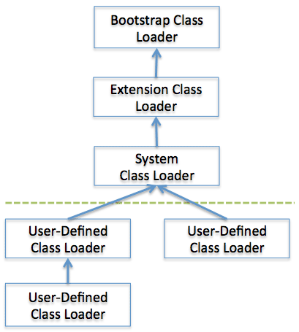
Class Loader Delegation Model
Notes:
When a class loader is requested for class load, it checks whether or not the class exists in the class loader cache, the parent class loader, and itself, in the order listed. In short, it checks whether or not the class has been loaded in the class loader cache. If not, it checks the parent class loader. If the class is not found in the bootstrap class loader, the requested class loader searches for the class in the file system.
Bootstrap class loader: This is created when running the JVM. It loads Java APIs, including object classes. Unlike other class loaders, it is implemented in native code instead of Java.
Extension class loader: It loads the extension classes excluding the basic Java APIs. It also loads various security extension functions.
System class loader: If the bootstrap class loader and the extension class loader load the JVM components, the system class loader loads the application classes. It loads the class in the $CLASSPATH specified by the user.
User-defined class loader: This is a class loader that an application user directly creates on the code.

Slide 14
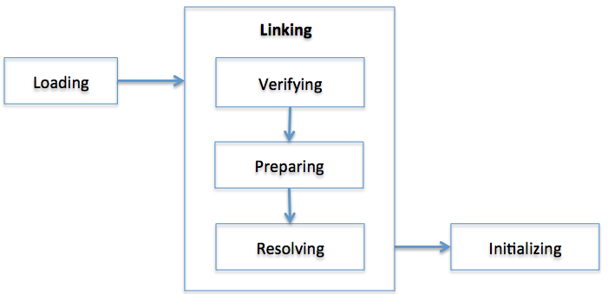
Class Load Stage
Notes:
Loading: A class is obtained from a file and loaded to the JVM memory.
Verifying: Check whether or not the read class is configured as described in the Java Language Specification and JVM specifications. This is the most complicated test process of the class load processes, and takes the longest time. Most cases of the JVM TCK test cases are to test whether or not a verification error occurs by loading wrong classes.
Preparing: Prepare a data structure that assigns the memory required by classes and indicates the fields, methods, and interfaces defined in the class.
Resolving: Change all symbolic references in the constant pool of the class to direct references.
Initializing: Initialize the class variables to proper values. Execute the static initializers and initialize the static fields to the configured values.

Slide 15
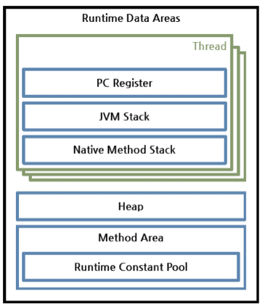
Runtime Data Areas Configuration
Notes:
Runtime Data Areas are the memory areas assigned when the JVM program runs on the OS. The runtime data areas can be divided into 6 areas. Of the six, one PC Register, JVM Stack, and Native Method Stack are created for one thread. Heap, Method Area, and Runtime Constant Pool are shared by all threads.
PC register: One PC (Program Counter) register exists for one thread, and is created when the thread starts. PC register has the address of a JVM instruction being executed now.
JVM stack: One JVM stack exists for one thread, and is created when the thread starts. It is a stack that saves the struct (Stack Frame). The JVM just pushes or pops the stack frame to the JVM stack. If any exception occurs, each line of the stack trace shown as a method such as printStackTrace() expresses one stack frame.
Native method stack: A stack for native code written in a language other than Java. In other words, it is a stack used to execute C/C++ codes invoked through JNI (Java Native Interface). According to the language, a C stack or C++ stack is created.
Method area: The method area is shared by all threads, created when the JVM starts. It stores runtime constant pool, field and method information, static variable, and method bytecode for each of the classes and interfaces read by the JVM. Oracle Hotspot JVM calls it Permanent Area or Permanent Generation (PermGen).
Runtime constant pool: An area that corresponds to the constant_pool table in the class file format. This area is included in the method area; however, it plays the most core role in JVM operation. Therefore, the JVM specification separately describes its importance. As well as the constant of each class and interface, it contains all references for methods and fields. In short, when a method or field is referred to, the JVM searches the actual address of the method or field on the memory by using the runtime constant pool.
Heap: A space that stores instances or objects, and is a target of garbage collection. This space is most frequently mentioned when discussing issues such as JVM performance. JVM vendors can determine how to configure the heap or not to collect garbage.

Slide 16
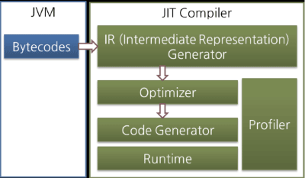
Execution Engine
Notes:
The JIT compiler converts the bytecode to an intermediate-level expression, IR (Intermediate Representation), to execute optimization, and then converts the expression to native code.
Oracle Hotspot VM uses a JIT compiler called Hotspot Compiler. It is called Hotspot because Hotspot Compiler searches the 'Hotspot' that requires compiling with the highest priority through profiling, and then it compiles the hotspot to native code. If the method that has the bytecode compiled is no longer frequently invoked, in other words, if the method is not the hotspot any more, the Hotspot VM removes the native code from the cache and runs in interpreter mode. The Hotspot VM is divided into the Server VM and the Client VM, and the two VMs use different JIT compilers.

Slide 17
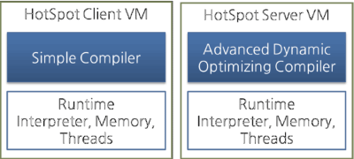
Hotspot Client VM and Server VM
Notes:
The client VM and the server VM use an identical runtime; however, they use different JIT compilers, as shown in the above figure. The client VM and the server VM use an identical runtime, however, they use different JIT compilers as shown in the above figure. Advanced Dynamic Optimizing Compiler used by the server VM uses more complex and diverse performance optimization techniques.

Slide 18
Security
Cryptography
Public Key Infrastructure
Authentication
Secure Communication
Access Control
Permissions
Policy
Notes:
Implementation independence
Applications do not need to implement security themselves. Rather, they can request security services from the Java platform. Security services are implemented in providers, which are plugged into the Java platform via a standard interface. An application may rely on multiple independent providers for security functionality.
Implementation interoperability
Providers are interoperable across applications. Specifically, an application is not bound to a specific provider, and a provider is not bound to a specific application.
Algorithm extensibility
The Java platform includes a number of built-in providers that implement a basic set of security services that are widely used today. However, some applications may rely on emerging standards not yet implemented, or on proprietary services. The Java platform supports the installation of custom providers that implement such services.

Slide 19
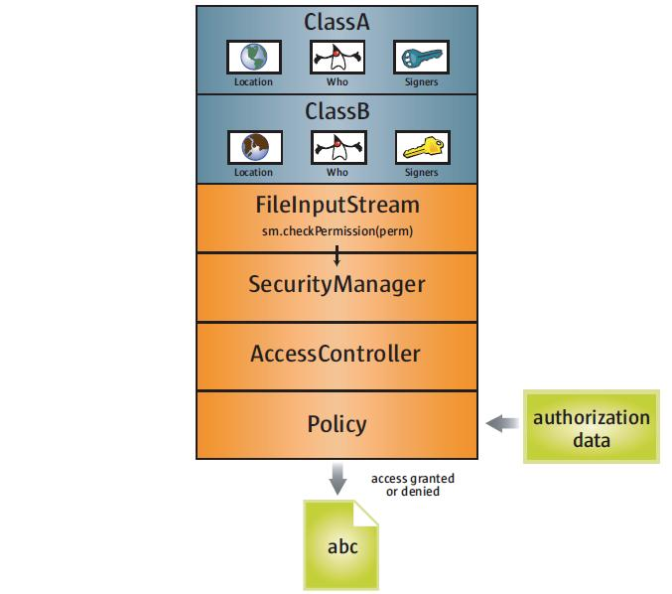
Controlling access to resources
Notes:
The access control architecture in the Java platform protects access to sensitive resources (for example, local files) or sensitive application code (for example, methods in a class). All access control decisions are mediated by a security manager, represented by the java.lang.SecurityManager class. A SecurityManager must be installed into the Java runtime in order to activate the access control checks.
Java applets and Java™ Web Start applications are automatically run with a SecurityManager installed. However, local applications executed via the java command are by default not run with a SecurityManager installed. In order to run local applications with a SecurityManager, either the application itself must programmatically set one via the setSecurityManager method (in the java.lang.System class), or java must be invoked with a -Djava.security.manager argument on the command line.
Permissions
When Java code is loaded by a class loader into the Java runtime, the class loader automatically associates the following information with that code:
Where the code was loaded from
Who signed the code (if anyone)
Default permissions granted to the code
Policy
As mentioned earlier, a limited set of default permissions are granted to code by class loaders. Administrators have the ability to flexibly manage additional code permissions via a security policy.
The Java platform encapsulates the notion of a security policy in the java.security.Policy class. There is only one Policy object installed into the Java runtime at any given time. The basic responsibility of the Policy object is to determine whether access to a protected resource is permitted to code (characterized by where it was loaded from, who signed it, and who is executing it). How a Policy object makes this determination is implementation-dependent. For example, it may consult a database containing authorization data, or it may contact another service.

Slide 20
Garbage collection
GC consists of finding objects that are no longer in use, and freeing the memory associated with those objects
The JVM starts by finding objects that are no longer in use (garbage objects)
Then frees memory occupied by these objects making the memory available
Compacts the memory to prevent fragmentation
Notes:
The JVM must periodically search the heap for unused objects. When it finds unused objects, the JVM can free the memory occupied by those objects and use it to allocate additional objects. However, it is usually insufficient simply to keep track of that free memory and use it for future allocations; at some point, memory must be coalesced to prevent memory fragmentation.

Slide 21
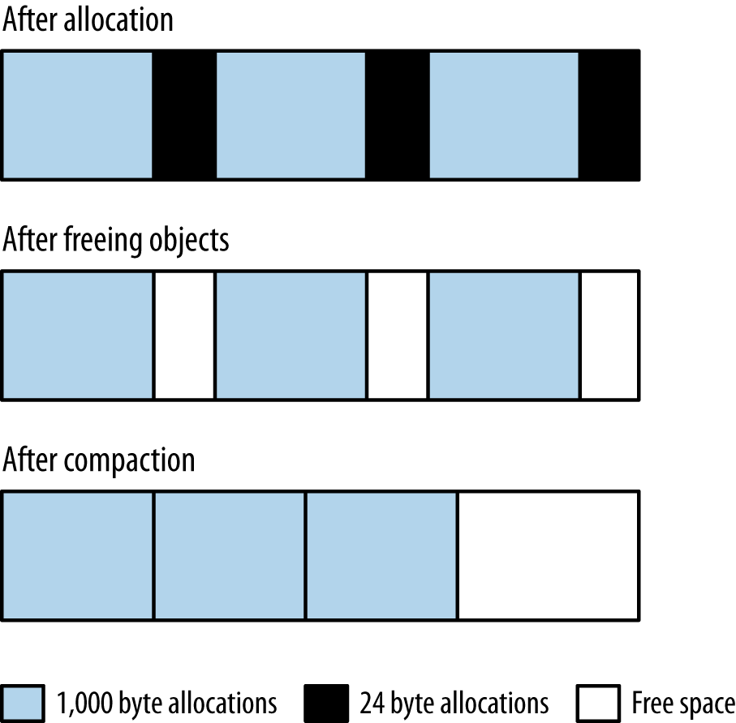
GC heap during collection
Notes:
Consider the case of a program that allocates an array of 1,000 bytes, then one of 24 bytes, and repeats that process in a loop. When that process fills up the heap, it will appear like the top row in Figure: the heap is full, and the allocations of the array sizes are interleaved.
When the heap is full, the JVM will free the unused arrays. Say that all the 24-byte arrays are no longer in use, and the 1,000-byte arrays are still all in use: that yields the second row in Figure. The heap has free areas within it, but it can’t actually allocate anything larger than 24 bytes—unless the JVM moves all the 1,000-byte arrays so that they are contiguous, leaving all the free memory in a region where it can be allocated as needed (the third row in Figure).

Slide 22
Java Tuning Tools

Slide 23
Basic tools
The basic set of monitoring tools that come with the operating system.
On Unix-based systems, these are sar (System Accounting Report) and its constituent tools like vmstat, iostat, prstat, and so on.
On Windows, there are graphical resource monitors as well as command-line utilities like typeperf.

Slide 24
Basic Data for Analysis
Whenever performance tests are run, data should be gathered from the operating system.
At a minimum, information on CPU, memory, and disk usage should be collected
If the program uses the network, information on network usage should be gathered
If performance tests are automated, this means relying on command-line tools

Slide 25
Basic VM Information
JVM tools can provide basic information about a running JVM process:
how long it has been up
what JVM flags are in use
JVM system properties
JVM version
JVM command line
JVM tuning flags
jcmd can be used to find the basic JVM information—including the value of all the tuning flags—for a running application.
Notes:
Uptime
The length of time the JVM has been up can be found via this command:
% jcmd process_id VM.uptime
System properties
The set of items in System.getProperties() can be displayed with either of these commands:
% jcmd process_id VM.system_properties
or
% jinfo -sysprops process_id
This includes all properties set on the command line with a -D option, any properties dynamically added by the application, and the set of default properties for the JVM.
JVM version
The version of the JVM is obtained like this:
% jcmd process_id VM.version
JVM command line
The command line can be displayed in the VM summary tab of jconsole, or via
jcmd:
% jcmd process_id VM.command_line
JVM tuning flags
The tuning flags in effect for an application can be obtained like this:
% jcmd process_id VM.flags [-all]

Slide 26
Working with tuning flags
There are hundreds of JVM tuning flags, and most of them are very obscure
Figuring out which flags are in effect is a frequent task when diagnosing performance issues, and the jcmd commands can do that for a running JVM
To get the the platform-specific defaults for a particular JVM the -XX:+PrintFlagsFinal option on the command line is useful
jinfo is useful for inspecting (and in some cases changing) individual flags.
Notes:
A useful way to determine what the flags are set to on a particular platform is to execute this command:
% java other_options -XX:+PrintFlagsFinal -version
...Hundreds of lines of output
Another way to see this information for a running application is with jinfo. The advantage to jinfo is that it allows certain flag values to be changed during execution of the program. Here is how to retrieve the values of all the flags in the process:
% jinfo -flags process_id
With the -flags option, jinfo will provide information about all flags; otherwise it prints only those specified on the command line

Slide 27
Thread Information
jconsole and jvisualvm display information (in real time) about the number of threads running in an application.
It can be very useful to look at the stack of running threads to determine if they are blocked.
The stacks can be obtained via jstack
Notes:
The stacks can be obtained via jstack:
% jstack process_id
... Lots of output showing each thread's stack ...
Stack information can also be obtained from jcmd:
% jcmd process_id Thread.print
... Lots of output showing each thread's stack ...

Slide 28
Class Information
Information about the number of classes in use by an application can be obtained from jconsole or jstat.
jstat can also provide information about class compilation.

Slide 29
Live GC Analysis
jconsole displays live graphs of the heap usage
jcmd allows GC operations to be performed
jmap can print heap summaries or information on the permanent generation or create a heap dump; and jstat produces a lot of different views of what the garbage collector is doing

Slide 30
Heap Dump Postprocessing
Heap dumps can be captured from the jvisualvm GUI, or from the command line using jcmd or jmap.
The heap dump is a snapshot of the heap that can be analyzed with various tools, including jvisualvm and jhat.
Heap dump postprocessing can be done using the Eclipse Memory Analyzer Tool

Slide 31
Timing tools
JUnitPerf
Write custom instrumentation code using Java Instrumentation API
Use aspect-oriented programming (AOP) to inject code into the start and end of specified methods
Use Profilers

Slide 32
Load Testing Tools and Techniques
Faban
Grinder
Jmeter

Slide 33
JVM Profiling Tools (Profilers)
jvisualvm
Java Mission Control
YourKit
JProfiler
Jprobe
XRebel
Prefix

Slide 34
Sampling-based profilers
Sampling-based profilers are the most common kind of profiler.
Because of their relatively low profile, sampling profilers introduce fewer measurement artifacts.
Different sampling profiles behave differently; each may be better for a particular application.

Slide 35
Instrumented Profilers
Instrumented profilers are much more intrusive than sampling profilers
Instrumented profilers work by altering the bytecode sequence of classes as they are loaded (inserting code to count the invocations, and so on).
Instrumented profilers yield more information about an application, but can possibly have a greater effect on the application

Slide 36
Native Profilers
Native profilers provide visibility into both the JVM code and the application code.
If a native profiler shows that time in GC dominates the CPU usage, then tuning the collector is the right thing to do.
If it shows significant time in the compilation threads, however, that is usually not affecting the application’s performance.

Slide 37
Java Mission Control
The commercial releases of Java 7 (starting with 7u40) and Java 8 include a new monitoring and control feature called Java Mission Control
The Java Mission Control program (jmc) starts a window that displays the JVM processeson the machine and lets you select one or more processes to monitor

Slide 38
Java Flight Recorder
The key feature of Java Mission Control is the Java Flight Recorder (JFR).
JFR data is a history of events in the JVM that can be used to diagnose the past performance and operations of the JVM.
Has Different Views
General
Memory
Code
Threads
I/O
System
Events
Notes:
The basic operation of JFR is that some set of events are enabled (for example, one event is that a thread is blocked waiting for a lock). Each time a selected event occurs, data about that event is saved (either in memory or to a file). The data stream is held in a circular buffer, so only the most recent events are available. Java Mission Control can then display those events—either taken from a live JVM or read from a saved file—and you can perform analysis on those events to diagnose performance issues.
Enabling JFR
In the commercial version of the Oracle JVM, JFR is initially disabled. To enable it, add the flags -XX:+UnlockCommercialFeatures -XX:+FlightRecorder to the command line of the application. This enables JFR as a feature, but no recordings will be made until the recording process itself is enabled. That can occur either through a GUI, or via the command line.

Slide 39
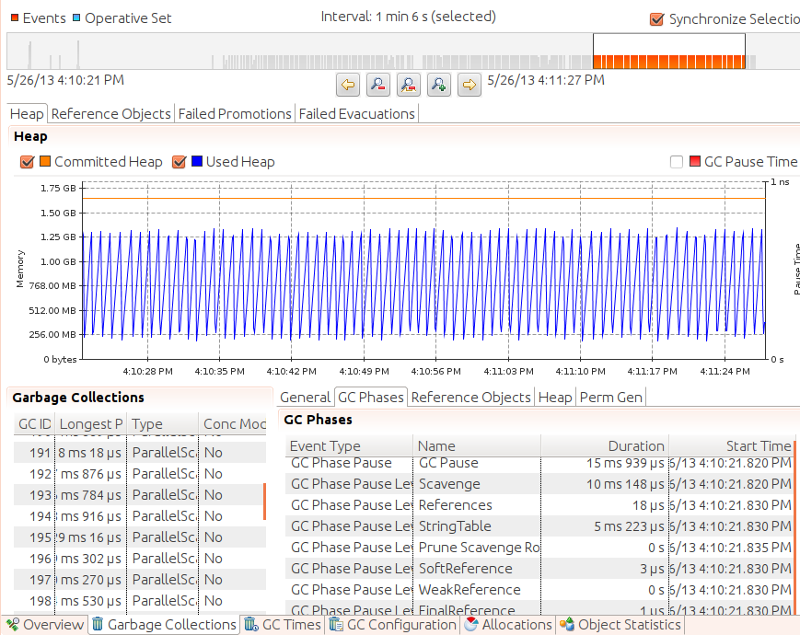
Memory Management and Monitoring

Slide 40
Network Monitoring tools
On Unix systems, the basic network monitoring tool is netstat
On Windows, typeperf can be used in scripts to monitor the network usage
Windows resource monitor will display a graph showing what percentage of the network is in use
On Unix systems, one popular command-line tool is nicstat
Notes:
Tools such as typeperf or netstat will report the amount of data read and written, but to figure out the network utilization, you must determine the bandwidth of the interface and perform the calculation in your own scripts. Be sure to remember that the bandwidth is measured in bits per second (bps), although tools generally report bytes per second (Bps). A 1,000-megabit network yields 125 megabytes (MB) per second. For example, if 0.22 MBps are read and 0.16 MBps are written; adding those and dividing by 125 yields a 0.33% utilization rate.

Slide 41
Application Performance Management (APM) tools
used for monitoring applications live in production environments.
New Relic
AppDynamics
Stackify Retrace
Dynatrace

Slide 42
Java Tuning Process

Slide 43
Java Runtime Environment and System constraints
In the non-Java world, testing is straightforward: the application is written, and the time of its execution is measured.
In the Java world, there is one wrinkle to this: justin-time compilation
It takes a few minutes (or longer) for the code to be fully optimized and operate at peak performance.
Performance is measured after the code in question has been executed long enough for it to have been compiled and optimized
Notes:
Warming up an application is most often discussed in terms of waiting for the compiler to optimize the code in question, but there are other factors that can affect the performance of code based on how long it has run.
JPA, for example, will typically cache data it has read from the database the second time that data is used, the operation will often be faster since the data can be obtained from the cache rather than requiring a trip to the database. Similarly, when an application reads a file, the operating system typically pages that file into memory.
A test that subsequently reads the same file (e.g., in a loop to measure performance) will run faster the second time, since the data already resides in the computer’s main memory and needn’t actually be read from disk.
In general, there can be many places—not all of them obvious—where data is cached, and where a warm up period matters.

Slide 44
Java Runtime Environment and System constraints
JVM uses some memory and CPU for executing the java code
Garbage Collection has its impact on application response time and CPU usage
Monitoring of Memory Use and GC Activity is very important
Allocating objects in Java is relatively inexpensive
But allocations can quickly become a choke point when a lot of concurrent threads are involved
Notes:
Allocations can quickly become a choke point when a lot of concurrent threads are involved. Reasons include memory fragmentation, more frequent GCs due to too many allocations, and synchronization due to concurrent allocations. Although you should refrain from implementing object pools for the sole sake of avoiding allocations, not allocating an object is the best optimization.
The key is to optimize your algorithms and avoid making unnecessary allocations or allocating the same object multiple times. For instance, we often create temporary objects in loops. Often it is better to create such an object once prior to the loop and just use it. This might sound trivial, but depending on the size of object and the number of loop recursions, it can have a high impact. And while it might be the obvious thing to do, a lot of existing code does not do this. It is a good rule to allocate such temporary "constants" prior to looping, even if performance is no consideration.

Slide 45
Calculating & Measuring JVM / JRE overheads
Need to measure CPU usage, disk usage, network usage, memory usage etc.
Analyze logs from the application—both those the application produces, and the logs from the garbage collector.
Ideally analye Java Flight Recorder (JFR) recordings or other low-impact profiling information, periodic thread stacks, and other heap analysis data like histograms or full heap dumps

Slide 46
Calculating and Measuring Hardware and OS Constraints
Multiple applications may run at the same time on the same hardware
Many aspects of the JVM are tuned by default to assume that all machine resources are available to them, and if those JVMs are tested in isolation, they will behave well.
If they are tested when other applications are present their performance will be quite different as memory and CPU may be limited
There may also be OS level constraints like max processes, max open files, max sockets open, support for large or huge files etc.

