Slide 1
Java Performance Tuning
- Identify garbage
- Clean garbage
(which type of garbage algorithm should be used differs per app)
Eg. Concurrent GC is better for 24/7 app
-Thread Pool
Instead of serialization – repeatable read
Yahoo’s tool to use - http://yslow.org/
Cache few things during high traffic scenario
Web Server ( Apache)
Enable gzip
Allows 256 simultaneous requests
Add browser cache directives (https://www.digitalocean.com/community/tutorials/how-to-configure-apache-content-caching-on-centos-7 )
https://httpd.apache.org/docs/2.2/mod/mod_disk_cache.html

Slide 2
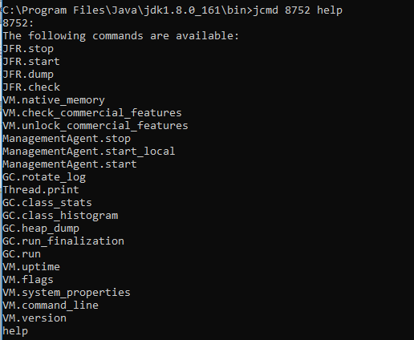
Tools
Jcmd (C:\Program Files\Java\jdk1.8.0_161\bin>jcmd 8752 help)

Slide 3
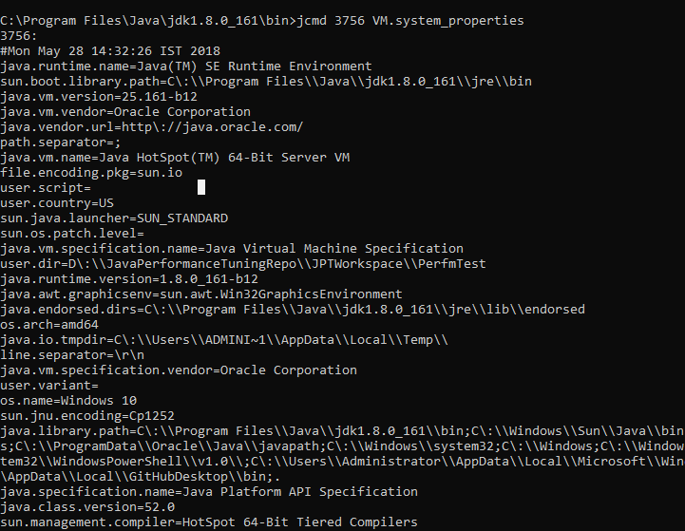

Slide 4
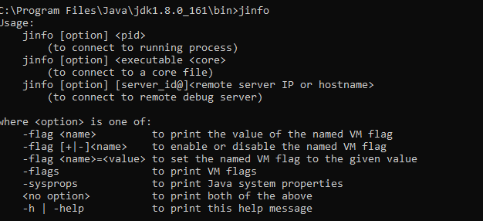
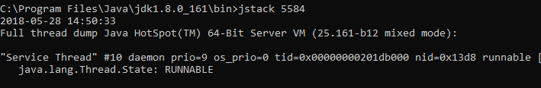
jinfo
- Used to change the flags for running process for certain flags
jstack
Use thread dumps at regular intervals to identify how long particular thread is waiting

Slide 5
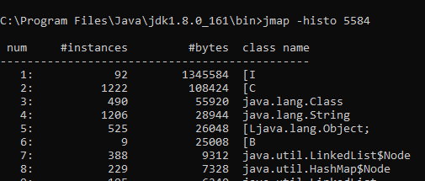
Heap_dump
- Objects created during the process can be exported to a file
Jmap will provide histogram of all the created objects

Slide 6
Spring petclinic tool
1. For any out of memory error
-XX:+HeapDumpOnOutOfMemoryError –XX:HeapDumpPath=./ petclinicdump.hprof
-jar D:\JavaPerformanceTuningRepo\spring-petclinic-2.0.0.jar
2.Flight recorder (https://docs.oracle.com/javase/8/docs/technotes/guides/troubleshoot/tooldescr004.html )
"C:\Program Files\Java\jdk1.8.0_161\bin\java" -XX:+HeapDumpOnOutOfMemoryError –XX:HeapDumpPath=./petclinicdump.hprof -XX:+UnlockCommercialFeatures -XX:+FlightRecorder -XX:FlightRecorderOptions=defaultrecording=true,disk=true,repository=./,maxage=15m,settings=profile -jar D:\JavaPerformanceTuningRepo\spring-petclinic-2.0.0.jar
https://docs.oracle.com/javacomponents/jmc-5-4/jfr-runtime-guide/run.htm#JFRUH177
jcmd 8852 JFR.dump filename=D:\JavaPerformanceTuningRepo\petjcmd.jfr recording=0

Slide 7
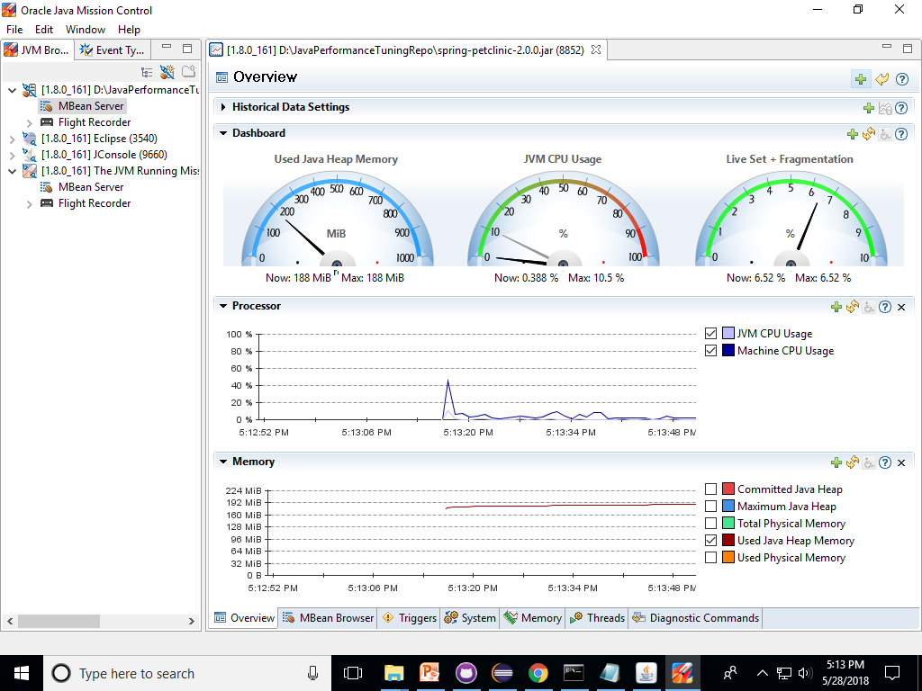
Mbean analysis

Slide 8
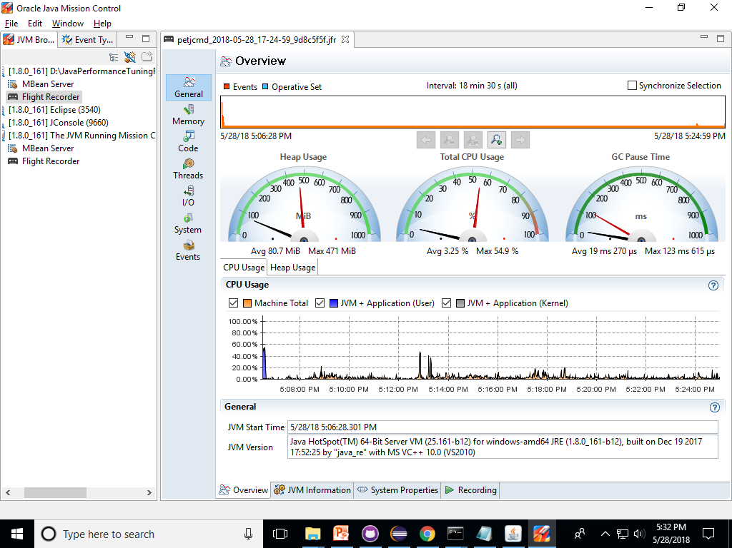
Flight Recording

Slide 9
Garbage Collection
Heap
1.Identify,
2.Clean,
3.Compaction
Freed up memory
Garbage
Garbage
Serial GC runs on only one thread
All gc will put a pause to running applications
Young and Old Space( heap memory).. On which the if old is full it will be handled by Full GC
Parallel GC ( throughput alogorithm) – uses multiple thread and uses parallel CPU Process , it collects only the young most of the time
CMS – Concurrent Mark and Sweep GC Algorithm – continuously cms process will be running - recommended for web applications – it may lead to concurrent mode failure ( which in turn trigger stop the world full gc will happen)
G1 – recommended for heap size more than 4GB – gc happens in smaller region by segregating the young and old space – concurrent mode failure is lesser than cms

Slide 10
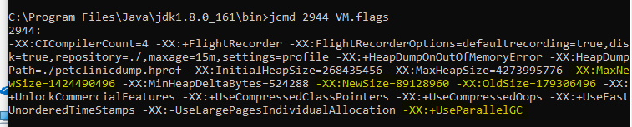
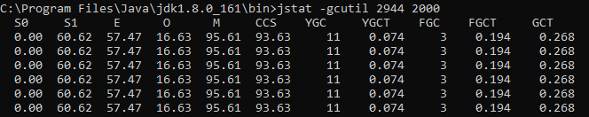
In java 8 permgen space is called as meta space
jstat - Java Virtual Machine Statistics Monitoring Tool
Gc log
Where to write
What format we need
http://www.oracle.com/technetwork/articles/java/vmoptions-jsp-140102.html

Slide 11
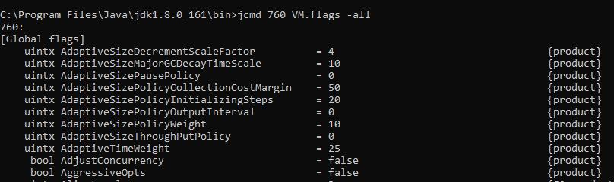
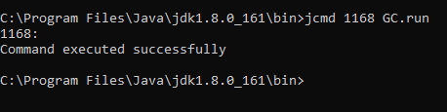

Young and old Space in heap
Young -> Eden (after minor gc )- > survivor -> old ( after threshold) -> full gc ( if parallel gc)
GCViewer Tool
https://sourceforge.net/projects/gcviewer/
To avoid explicit GC.run.
Use -XX:+DisableExplicitGC

Slide 12
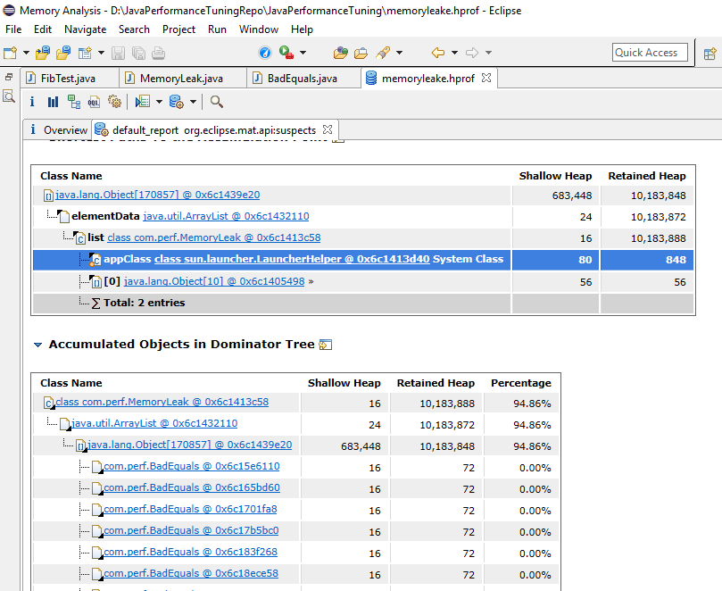
Memory Analyzer tool
https://www.eclipse.org/mat/
http://download.eclipse.org/mat/1.7/update-site/

Slide 13
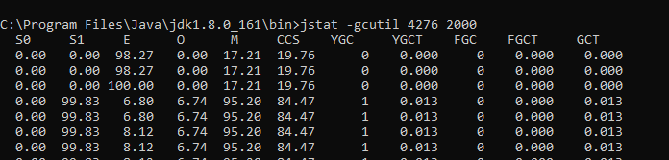
For Memory Leak Jstat info
Threads (http://winterbe.com/posts/2015/04/07/java8-concurrency-tutorial-thread-executor-examples/ )
Thread deadlock
Latency ( waiting for other resources to end)
Thread Dump Tool
http://samuraism.jp/samurai/en/index.html
http://www.java2s.com/Code/Jar/s/Downloadsamuraijar.htm
Java Reference
https://stackoverflow.com/questions/9809074/java-difference-between-strong-soft-weak-phantom-reference
https://community.oracle.com/blogs/enicholas/2006/05/04/understanding-weak-references

Slide 14
