Slide 1
Java Performance Tuning
- Identify garbage
- Clean garbage
(which type of garbage algorithm should be used differs per app)
Eg. Concurrent GC is better for 24/7 app
-Thread Pool
Instead of serialization – repeatable read
Yahoo’s tool to use - http://yslow.org/
Cache few things during high traffic scenario
Web Server ( Apache)
Enable gzip
Allows 256 simultaneous requests
Add browser cache directives (https://www.digitalocean.com/community/tutorials/how-to-configure-apache-content-caching-on-centos-7 )
https://httpd.apache.org/docs/2.2/mod/mod_disk_cache.html

Slide 2
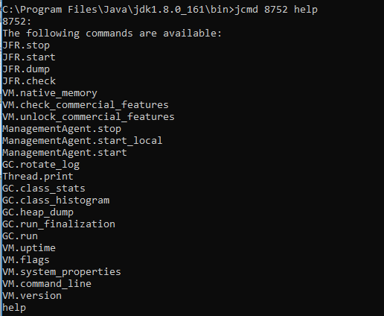
Tools
Jcmd (C:\Program Files\Java\jdk1.8.0_161\bin>jcmd 8752 help)

Slide 3
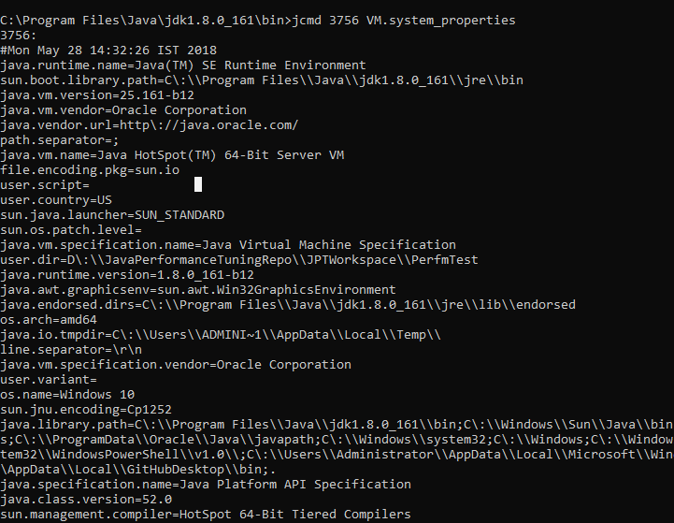

Slide 4
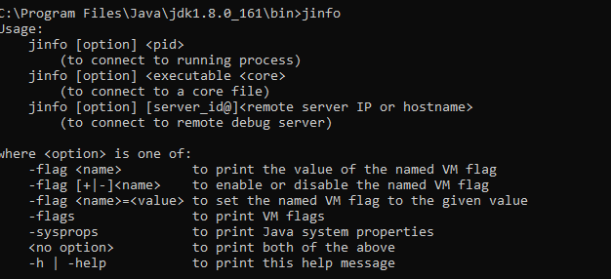
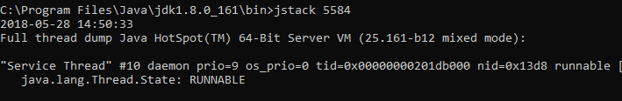
jinfo
- Used to change the flags for running process for certain flags
jstack
Use thread dumps at regular intervals to identify how long particular thread is waiting

Slide 5
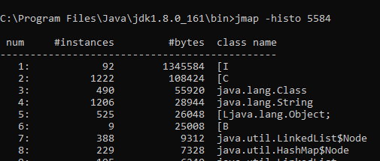
Heap_dump
- Objects created during the process can be exported to a file
Jmap will provide histogram of all the created objects

Slide 6
Spring petclinic tool
1. For any out of memory error
-XX:+HeapDumpOnOutOfMemoryError –XX:HeapDumpPath=./ petclinicdump.hprof
-jar D:\JavaPerformanceTuningRepo\spring-petclinic-2.0.0.jar
2.Flight recorder (https://docs.oracle.com/javase/8/docs/technotes/guides/troubleshoot/tooldescr004.html )
"C:\Program Files\Java\jdk1.8.0_161\bin\java" -XX:+HeapDumpOnOutOfMemoryError –XX:HeapDumpPath=./petclinicdump.hprof -XX:+UnlockCommercialFeatures -XX:+FlightRecorder -XX:FlightRecorderOptions=defaultrecording=true,disk=true,repository=./,maxage=15m,settings=profile -jar D:\JavaPerformanceTuningRepo\spring-petclinic-2.0.0.jar
https://docs.oracle.com/javacomponents/jmc-5-4/jfr-runtime-guide/run.htm#JFRUH177
jcmd 8852 JFR.dump filename=D:\JavaPerformanceTuningRepo\petjcmd.jfr recording=0

Slide 7
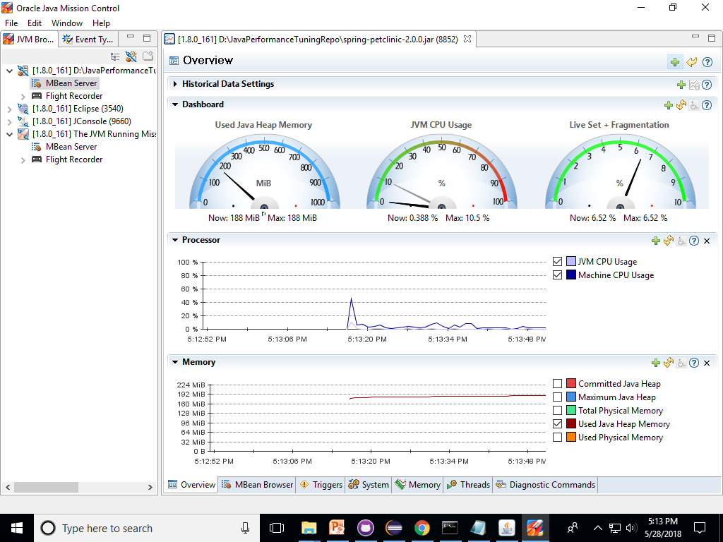
Mbean analysis

Slide 8
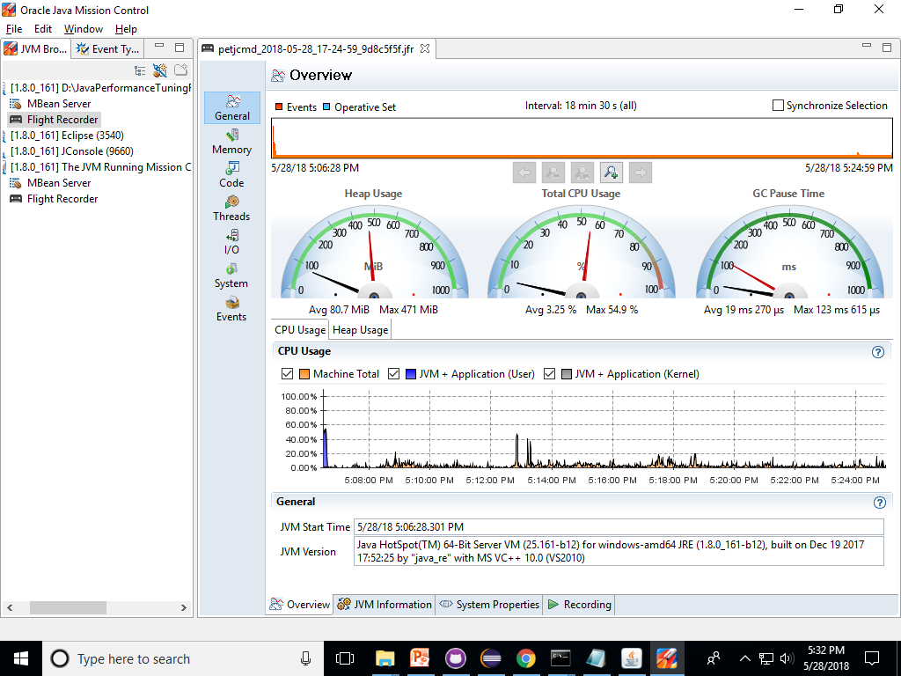
Flight Recording

Slide 9
Garbage Collection
Heap
1.Identify,
2.Clean,
3.Compaction
Freed up memory
Garbage
Garbage
Serial GC runs on only one thread
All gc will put a pause to running applications
Young and Old Space( heap memory).. On which the if old is full it will be handled by Full GC
Parallel GC ( throughput alogorithm) – uses multiple thread and uses parallel CPU Process , it collects only the young most of the time
CMS – Concurrent Mark and Sweep GC Algorithm – continuously cms process will be running - recommended for web applications – it may lead to concurrent mode failure ( which in turn trigger stop the world full gc will happen)
G1 – recommended for heap size more than 4GB – gc happens in smaller region by segregating the young and old space – concurrent mode failure is lesser than cms

Slide 10
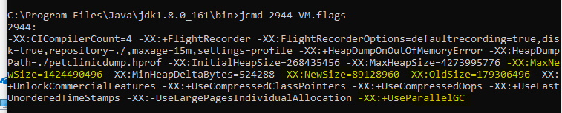
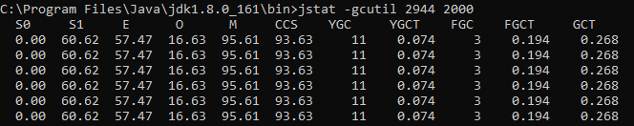
In java 8 permgen space is called as meta space
jstat - Java Virtual Machine Statistics Monitoring Tool
Gc log
Where to write
What format we need
http://www.oracle.com/technetwork/articles/java/vmoptions-jsp-140102.html

Slide 11
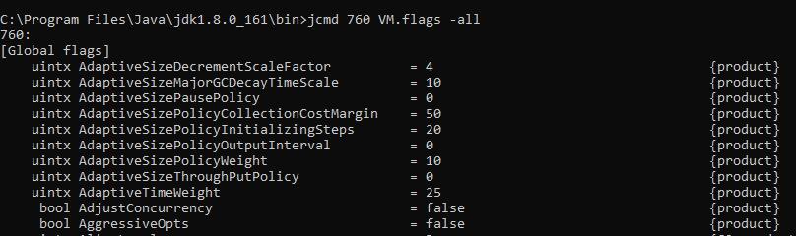
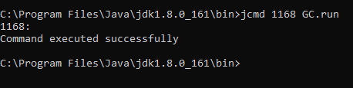

Young and old Space in heap
Young -> Eden (after minor gc )- > survivor -> old ( after threshold) -> full gc ( if parallel gc)
GCViewer Tool
https://sourceforge.net/projects/gcviewer/
To avoid explicit GC.run.
Use -XX:+DisableExplicitGC

Slide 12
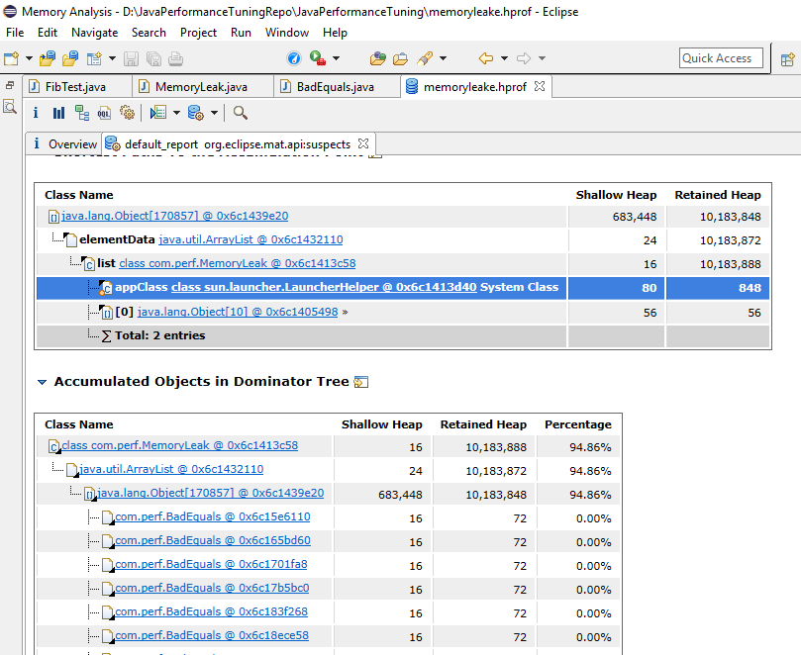
Memory Analyzer tool
https://www.eclipse.org/mat/
http://download.eclipse.org/mat/1.7/update-site/

Slide 13
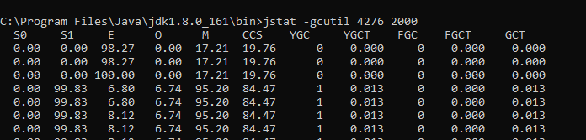
For Memory Leak Jstat info
Threads (http://winterbe.com/posts/2015/04/07/java8-concurrency-tutorial-thread-executor-examples/ )
Thread deadlock
Latency ( waiting for other resources to end)
Thread Dump Tool
http://samuraism.jp/samurai/en/index.html
http://www.java2s.com/Code/Jar/s/Downloadsamuraijar.htm
Java Reference
https://stackoverflow.com/questions/9809074/java-difference-between-strong-soft-weak-phantom-reference
https://community.oracle.com/blogs/enicholas/2006/05/04/understanding-weak-references

Slide 14
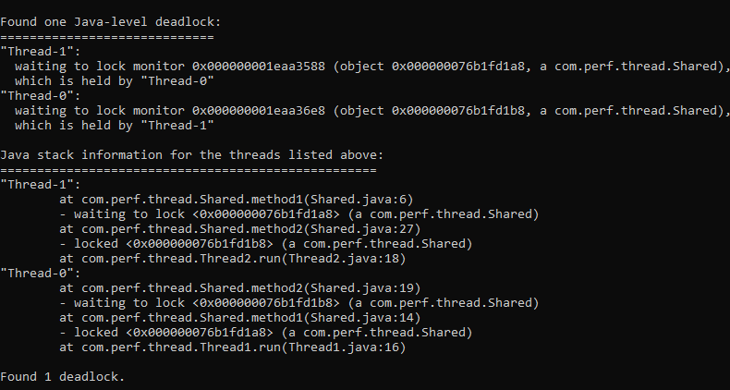

Slide 15

.class -> ByteCode executes in jvm irrespective of source language like Groovy, Scala, Jython
ByteCode
Bootstrap class loader
Extension class loader
System class loader
Ear class loader -> War class loader
Class loader
load
verify – verify the bytecode from security perspective and
resolve -
Initialize – static variables and method will be created and it will be part of perm gen space not in the heap
Note : To load the application faster we have to enable lazy loading

Slide 16
Class loader
It will not compile everything to native code only the essential codes
Two variants client and server JIT compiler
-client → single JIT compiler – to make use of faster startup
-server –x64 → for better performance
-tiered compilation → initially starts faster and provide optimistic performance gradually – it is the default compiler in later java versions
Warm up time – code gets optimized by JVM
JIT Compiler
(Hotspot)
Cache
OSR – On Stack Replacement – execution can be controlled
(the jvm will replace the newly compiled)
Code cache – it has default memory space
In general, Just-in-time compilation refers to compiling native code at runtime and executing it instead of (or in addition to) interpreting. Some VMs, such as Google V8, don't even have an interpreter; they JIT compile every function that gets executed (with varying degrees of optimization).
On Stack Replacement (OSR) is a technique for switching between different implementations of the same function. For example, you could use OSR to switch from interpreted or unoptimized code to JITed code as soon as it finishes compiling.
OSR is useful in situations where you identify a function as "hot" while it is running. This might not necessarily be because the function gets called frequently; it might be called only once, but it spends a lot of time in a big loop which could benefit from optimization. When OSR occurs, the VM is paused, and the stack frame for the target function is replaced by an equivalent frame which may have variables in different locations.
OSR can also occur in the other direction: from optimized code to unoptimized code or interpreted code. Optimized code may make some assumptions about the runtime behavior of the program based on past behavior. For instance, you could convert a virtual or dynamic method call into a static call if you've only ever seen one type of receiver object. If it turns out later that these assumptions were wrong, OSR can be used to fall back to a more conservative implementation: the optimized stack frame gets converted into an unoptimized stack frame. If the VM supports inlining, you might even end up converting an optimized stack frame into several unoptimized stack frames.
https://stackoverflow.com/questions/9105505/differences-between-just-in-time-compilation-and-on-stack-replacement

Slide 17
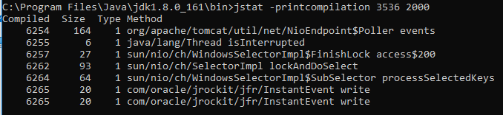
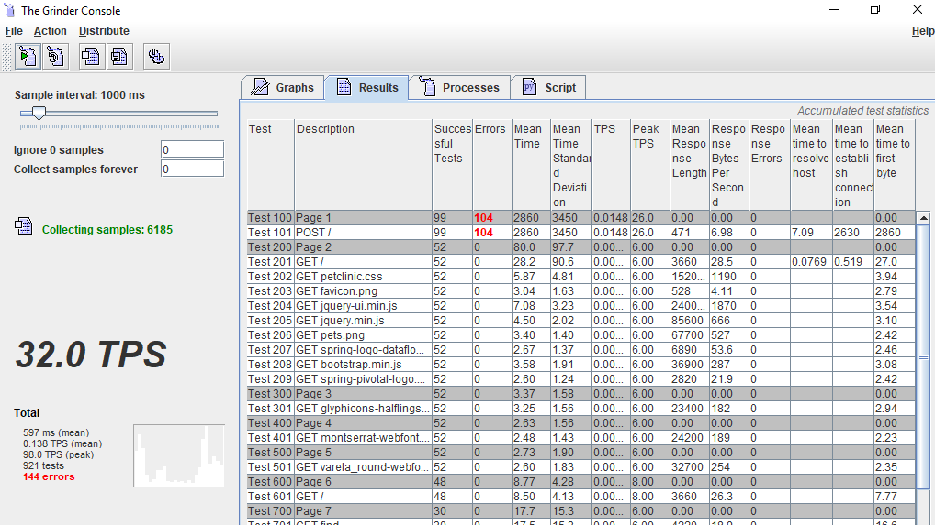
Print Compilation
Load Testing
https://jmeter.apache.org/
http://grinder.sourceforge.net/

Slide 18
Junit Performance
Best suited for testing remote API endpoints or component/integration testing
https://github.com/noconnor/JUnitPerf
JMH – Benchmark
http://www.baeldung.com/java-microbenchmark-harness

