Slide 1
Java Performance Tuning
- Identify garbage
- Clean garbage
(which type of garbage algorithm should be used differs per app)
Eg. Concurrent GC is better for 24/7 app
-Thread Pool
Instead of serialization – repeatable read
Yahoo’s tool to use - http://yslow.org/
Cache few things during high traffic scenario
Web Server ( Apache)
Enable gzip
Allows 256 simultaneous requests
Add browser cache directives (https://www.digitalocean.com/community/tutorials/how-to-configure-apache-content-caching-on-centos-7 )
https://httpd.apache.org/docs/2.2/mod/mod_disk_cache.html

Slide 2
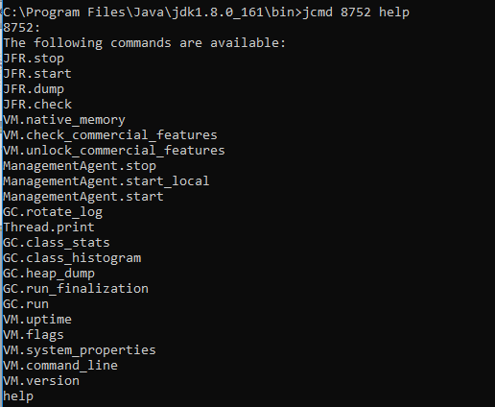
Tools
Jcmd (C:\Program Files\Java\jdk1.8.0_161\bin>jcmd 8752 help)

Slide 3
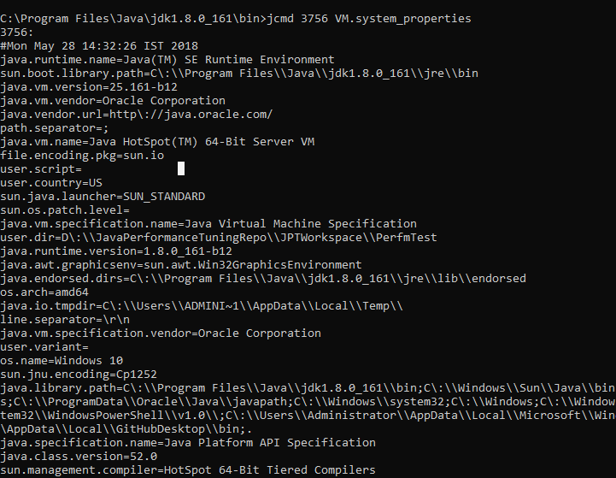

Slide 4
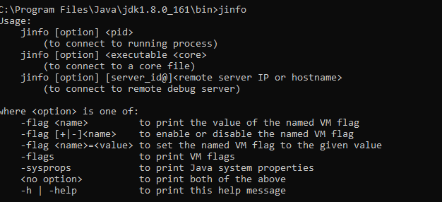
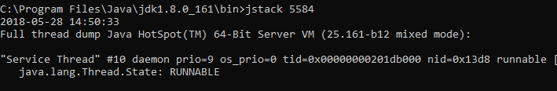
jinfo
- Used to change the flags for running process for certain flags
jstack
Use thread dumps at regular intervals to identify how long particular thread is waiting

Slide 5
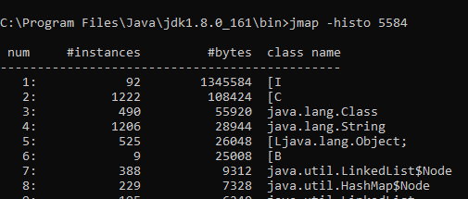
Heap_dump
- Objects created during the process can be exported to a file
Jmap will provide histogram of all the created objects

