Slide 1
Spring Boot Documentation

Slide 2
What is Spring Framework ? https://goo.gl/gzcKCE
is a integration framework
To develop enterprise java application
is kind of replacement for EJB ( session, entity, mdb)
loosely coupled components
design patterns
Spring Core Container- Singleton/Prototype Pattern
JDBC/Hibernate – Template Pattern
Spring framework Techniques
Dependency Injection
AOP
Spring Boot 1.5.7 – recommended 1.8
Spring 4.3.11 – Java 1.8

Slide 3
IOC
Before IOC ,Manually instantiate the dependent objects
Spring container
Instantiates the dependent objects
Initialization
Manages the lifecycle
Constructor or Setter using DI Pattern
DI Configuration
Xml
Annotation ( metadata for container)
Pure Java Configuration (eg, Spring Boot)
XML Configuration
<beans> … </beans>
Xsd’s ( eg, beans schema)
Annotation
@Resource ( Java 5)
@Inject
@Autowire ( Spring) ( default by type)
Use Spring framework
Jars ( add to classpath)
Maven ( build tool)
pom.xml
Gradle (json based build tool)
<bean id=“bean name” class=“class name”>
<constructor.. />
<property ref=“bean id”.. />
</bean>

Slide 4
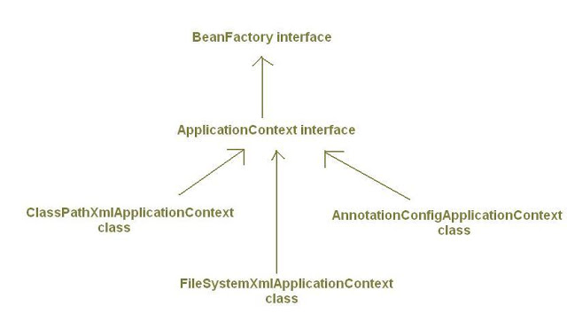
XML
- <beans>.. </beans>
Annotation
Stereotype annotation
@Component – class level
@Controller – web mvc, rest api
@Service – business class
@Repository – db
@Rest Controller ( Spring 4)
Pure Java
@Configuration
@Bean ( External classes )
Spring Container Implementation
Bean Factory
Instantiation
Manage Lifecycle
DI
Application Context
Events
Managing resources ( .properties)
http://java-journal.blogspot.in/2012/08/what-is-appl icationcontext-what-are-its.html

Slide 5
SpringBoot Usage
Spring Tool Suite ( STS) – Spring Starter Project
Spring Boot Command Line Interface (CLI) – will generate groovy scripts
Spring Initializer – web page developed by Spring Boot Team
We use Blank Maven Project
https://docs.spring.io/spring-boot/docs/current-SNAPSHOT/reference/htmlsingle/
spring-boot-starter-parent
default configurations
1.5.2 ( all related 4.3.7 spring jars
+ third party jars will be decided
+ fasterXML )
https://docs.spring.io/spring-boot/docs/current-SNAPSHOT/reference/htmlsingle/#using-boot-starter
Conventions over configuration ( base on 80% of use case as of today)
Dependencies ( jars + versions )
Default beans ( DispatcherServlet, RestController)
Default server ( tomcat server)
Ready starter poms/pre-constructed poms that are managing dependencies as well as transitive dependencies
Standalone (Executebale jar eg, SpringBootApplication.0.0.1-SNAPSHOT.jar <external configuration>)
Spring Boot + Tomcat – XML
No XML Or No code generation
Production ready application
Added non-functional features - security, actuator (health in terms of metrics – beans, connection pool, controllers)
@EnableAutoConfiguration using @Conditional matching of beans to loaded based on the POM

Slide 6
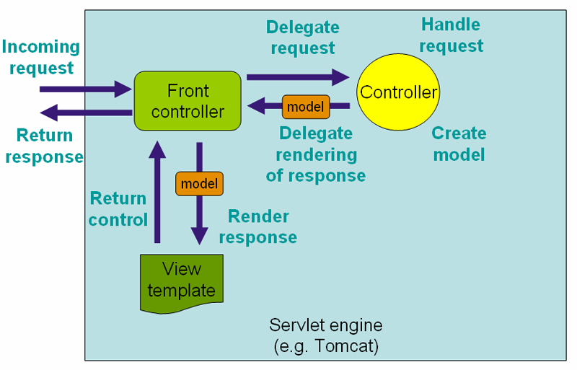
@Controller will be called by dispatcher servlet
@Bean – to configure external beans
You can define beans external to your application classes by using Java rather than XML files. @Configuration @Bean @Import and @Depends On
MessageApp eg. WebClient -> @RestController -> @Component -> Bean
Example for Externalized Bean
@Bean
public Message createMsg() {
Message msg = new Message();
msg.setText("Msg from exernal bean");
return msg;
}
Example of Reading Properties from application.properties
msg.text=This is externalized text message
@Value("${msg.text}")
private String msgText;
Spring MVC uses
Front Controller Pattern
Spring MVC

Slide 7
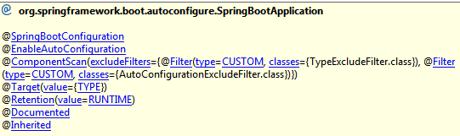
Data Persistence
JDBCTemplate class – based on SQL commands
JPARepository – based on ORM
https://docs.spring.io/spring/docs/current/spring-framework-reference/html/jdbc.html
Jdbc template For SpringBoot
Look out for pom inclusion ( spring-boot-starter-jdbc)
Eg. queryForObject(“select * from persom wjere personid=? and name=?”,
new Object[]{10,”Rock”}, new RowMapper(…));
Spring Boot Default in-memory database
Derby
H2 ( Spring boot support – h2 console)
HSQLDB
Create Interactive Spring Boot App
http://start.spring.io/
@SpringBootApplication – contains (@EnableAutoconfiguration , @ComponentScan… )
JDBC
Register the drivers - fixed
Providing the connection details - fixed
Getting the connection object - fixed
Create the statement / prepared statement - fixed
Forming the query – change
Getting the result set object - fixed
Iterating through the result set – partially fixed
Handling the SQLExceptions - fixed

Slide 8
H2 DB
Enable h2 console in the application.properties
# H2
spring.h2.console.enabled=true
spring.h2.console.path=/h2
spring.datasource.url=jdbc:h2:~/test
spring.datasource.schema=classpath:load.sql ( all schema files of the application)
Spring JPA
Not based on jdbc
https://docs.spring.io/spring-data/jpa/docs/current/reference/html/#repositories.core-concepts
Paging in JPA
Supported from @RequestMapping from 4.3
Eg. PagingAndSortingRepository<Person, Long> add to your repository
Page<Person> page = repository.findAll(new PageRequest(1, 2, Direction.ASC, "firstName"));
for(Person person : page) {
System.out.println(person.getId() + " " + person.getFirstName());
}
Named Queries
Search

Slide 9
Rest API
Web Service
Is a service exposed over a network ( commonly used is http protocol)
Advantage of re-usability
JAX-RS from Java
@Path
@PathParam
@Resource
@Get, @Post, @Delete
@Produce
@Consume
For Provider and Consumer
Implementation of JAX-RS is Jersey
Spring container is not directly calling JAX-RS, but through Apache CXF
JBOSS is implemented JAX-RS, RestEasy
Spring REST implements JAX-RS ??have to verify
SOAP
Is a standard
JAX-WS
Apache CXF is based on JAX-WS and JAX-RS
----
Roy Fielding
Discovery of Rest API
Set principles of Rest API
Java
Dot Net
Representational state transfer (REST) is a style of software architecture. As described in a dissertation by Roy Fielding, REST is an "architectural style" that basically exploits the existing technology and protocols of the Web.
RESTful is typically used to refer to web services implementing such an architecture.
----

Slide 10
Rest Operation
Create
Update
Delete
Read
URI : Uniform Resource Identifier ( Logical mappings , to identify a method)
URL : Urinform Resource Locator
( Phsical pages rendered to the client )
URI should be nouns
Understands the url no need to use request params with ‘?’
Objects in the server is called as Resources
Method names should follow the CRUD operations
Represent the state to the client ( JSON, XML, HTML, ATOM, TEXT)
- xsd is a URI which we write in spring configurations( eg. Tags in java)
https://spring.io/guides/gs/convert-jar-to-war/
Rest Template
Headers
MIME-TYPE
Entities
Exchange
url : http://url/persons
HTTP Method
Class

Slide 11
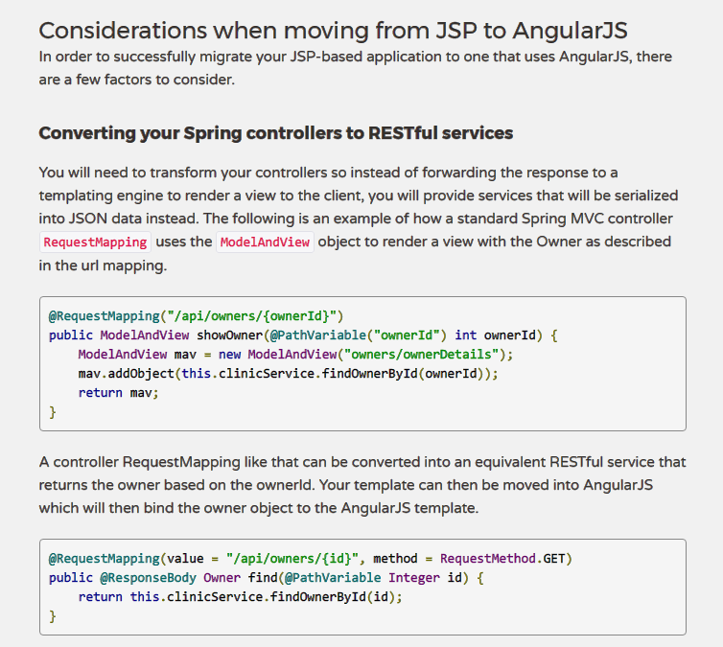
https://spring.io/blog/2015/08/19/migrating-a-spring-web-mvc-application-from-jsp-to-angularjs

Slide 12
@ResponseEntinty
Can set HTTP status
@ModelAttribute
- Can be used for Form submission
- Provided by Spring MVC
Swagger Api
http://www.baeldung.com/swagger-2-documentation-for-spring-rest-api
https://dzone.com/articles/spring-boot-restful-api-documentation-with-swagger
Swagger UI - http://localhost:8080/swagger-ui.html
//Configuraiton
@Configuration
//Enable Swagger
@EnableSwagger2
public class SwaggerConfiguration {
// Bean - Docket
// All the paths
@Bean
public Docket api() {
return new Docket(DocumentationType.SWAGGER_2);
}
}
Description for properties can be achieved using @ApiModelProperty
Security for swagger ?
Securityscheme ,
securityContext,
defaultAuth

Slide 13
Microservices
It is just an architecture ( like client-server, SOA)
Distributed architecture, layered architecture
Complete application
Decompose of single system to small services
Every service can run as a independent process
Intercommunicate via open protocols
( HTTP , JMS … )
Separately, written, deployed, scaled and maintained
Potentially in different languages
Services are independently replaceable and upgradable
Services encapsulate business capability
Martin Flower
A big contributor to spring framework
Describes microservice as suite of small services, Each running its own process and communicating with Lightweight mechanisms often an http resource api
Client
Consider a monolithic shopping cart app
Web / Mobile
Functions
Search for product
Product catalog
Inventory management
Shopping cart
Check out
fulfillment
Controller
Services
DAO’s
DB

Slide 14
Spring
Spring Cloud
Spring Pivotal Cloud
Spring cloud config
Ribbon ( for scaling)
Zuul
Eureka

Slide 15
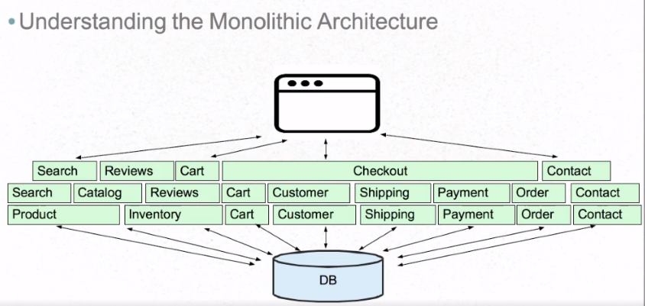
Monolithic Challenges

Slide 16
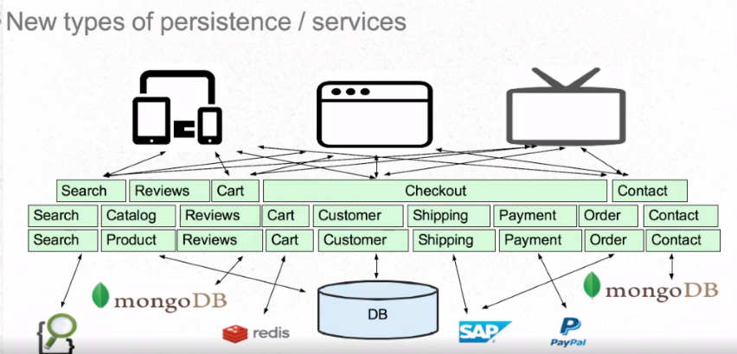
Monolithic Challenges

Slide 17
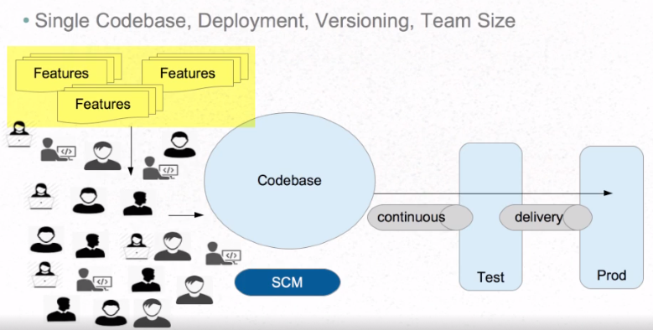
Monolithic Challenges

Slide 18
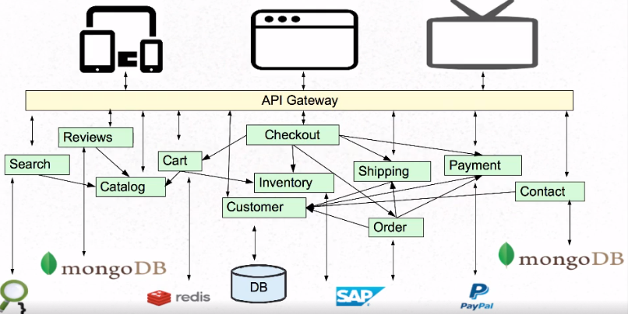
Microservices Architecture

Slide 19
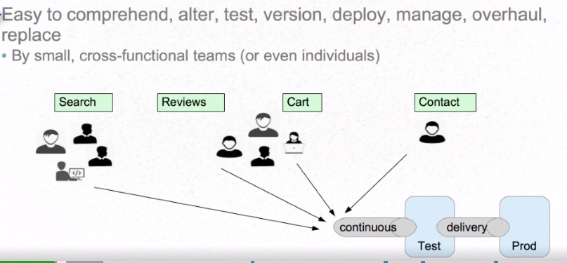
Services easily managed

Slide 20
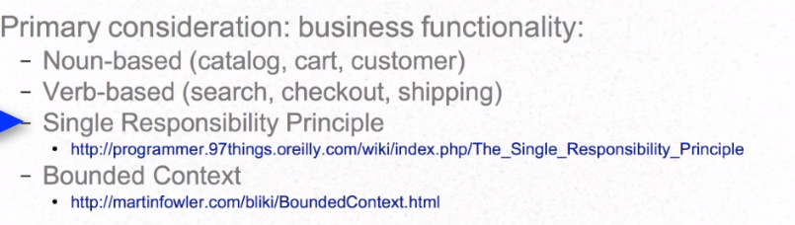
Microservice principles
https://spring.io/blog/2015/07/14/microservices-with-spring
Trainer - pgawada@gmail.com

Slide 21
Microservice example
Customer-backend
Order-backend
Product-backend
Using Jersey library
@Named // Similar to @Bean
static class JerseyConfig extends ResourceConfig {
public JerseyConfig() {
this.packages("com.citi.rest");
}
}
http://www.java2novice.com/
Deploy spring boot microservice to Pivotal Web Services
https://console.run.pivotal.io
https://spring.io/guides/gs/sts-cloud-foundry-deployment/

Slide 22
Spring 3 - security configuration in xml
Spring 4 - security configuration using annotation
Security
Authentication
Who are you ( username, password)
Authorization
What you can and can’t ( Roles)
Authentication Manager
Basic Authentication Manager
LDAP
In Memory Authentication Manager
JDBC Authentication Manager

