Slide 1

Zero Effort Spring: Spring Boot
April 2014
This document is confidential and contains proprietary information, including trade secrets of CitiusTech. Neither the document nor any of the information contained in it may be reproduced or disclosed to any unauthorized person under any circumstances without the express written permission of CitiusTech.

Slide 2
Agenda
Introduction to SpringBoot
Why We need SpringBoot
Primary Goals of Spring Boot
Understanding Starter POMS
Configuration Classes
Creating Restful services using Spring Boot
Micro services Architecture
Creating Micro services using Spring Boot
Template Engine Support
Caching Support
Spring Boot VS SpringMVC
External Configuration with SpringBoot
Working with SQL Databases in Spring Boot
SpringData JPA
Spring Actuator
Spring Security

Slide 3
Agenda
Introduction to SpringBoot
Why We need SpringBoot
Primary Goals of Spring Boot
Understanding Starter POMS
Configuration Classes
Creating Restful services using Spring Boot
Micro services Architecture
Creating Micro services using Spring Boot
Template Engine Support
Caching Support
Spring Boot VS SpringMVC
External Configuration with SpringBoot
Working with SQL Databases in Spring Boot
SpringData JPA
Spring Actuator
Spring Security

Slide 4
Introduction to SpringBoot
Spring Boot is approach to develop Spring based application with very less configuration. It leverages existing Spring projects as well as Third party projects to develop production ready applications.
Spring Boot makes it easy to create stand-alone, production-grade Spring based Applications that you can “just run”.
We take an opinionated view of the Spring platform and third-party libraries so you can get started with minimum fuss. Most Spring Boot applications need very little Spring configuration.
You can use Spring Boot to create Java applications that can be started using java -jar or more traditional war deployments
Spring Boot will get rid of all the fuss involved on configuring the dependencies for building the enterprise applications.
Here as we know that configurations are fully loaded with bunch of XML files (Spring was first introduced the full fledged XML configurations), now they don’t like it. They don’t want anything to be configured or maintained in a file which is extra work for the developers.
Notes:
Expressing Strong belief or ju

Slide 5
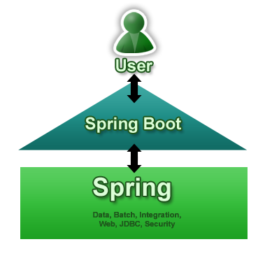
Introduction to SpringBoot
Focused Attention
Spring boot is an opinionated library that allows to create executable Spring applications with a convention over configuration approach
The magic behind this framework lies in the @EnableAutoConfiguration annotation which will trigger automatic loading of all the beans the application requires depending on what Spring Boot finds in the classpath.
Notes:
The primary motivation behind developing Spring Boot is to simplify the process for configuring and deploying the spring applications.
Spring Boot will get rid of all the fuss involved on configuring the dependencies for building the enterprise applications.
Here as we know that configurations are fully loaded with bunch of XML files (Spring was first introduced the full fledged XML configurations), now they don’t like it. They don’t want anything to be configured or maintained in a file which is extra work for the developers.

Slide 6
Why we Need SpringBoot ?
Spring Boot is next generation attempt to easy spring setup.
Spring Boot’s main benefit is configuring the resources based on what it finds in the classpath.
If your Maven POM includes JPA dependencies and a MYSQL driver, then Spring Boot will setup a persistence unit based on MySQL. If you’ve added a web dependency, then you will get Spring MVC configured with defaults.
When we talk about defaults, Spring Boot has its own opinions. If you are not specifying the details, it will use its own default configurations. If you want persistence, but don’t specify anything else in your POM file, then Spring Boot configures Hibernate as a JPA provider with an HSQLDB database.

Slide 7
Primary Goals of Spring Boot
Primary Goal is :
Provide a radically faster and widely accessible getting started experience for all Spring development.
Be opinionated out of the box, but get out of the way quickly as requirements start to diverge from the defaults.
Provide a range of non-functional features that are common to large classes of projects (e.g. embedded servers, security, metrics, health checks, externalized configuration).
Absolutely no code generation and no requirement for XML configuration.

Slide 8
Understanding Starter POMS
Starter POMs are a set of convenient dependency descriptors that you can include in your application.
You get a one-stop-shop for all the Spring and related technology that you need, without having to hunt through sample code and copy paste loads of dependency descriptors.
For example, if you want to get started using Spring and JPA for database access, just include the spring-boot-starter-data-jpa dependency in your project, and you are good to go
The starters contain a lot of the dependencies that you need to get a project up and running quickly and with a consistent, supported set of managed transitive dependencies.
All official starters follow a similar naming pattern;
spring-boot-starter-*, where * is a particular type of application.

Slide 9
Understanding Starter POMS
Apart from Starter Pom’s Gradle can also be used build files which one can use to add required dependencies and also facilitate auto configuration.
Maven users can inherit from the spring-boot-starter-parent project to obtain sensible defaults. The parent project provides the following features:
Java 1.6 as the default compiler level.
A Dependency Management section, allowing you to omit <version> tags for common dependencies, inherited from the spring-boot-dependencies POM.
Sensible plugin configuration (exec plugin, surefire, Git commit ID, shade).
Sensible resource filtering for application.properties and application.yml including profile-specific files (e.g. application-foo.properties andapplication-foo.yml)
To configure your project to inherit from the spring-boot-starter-parent simply set the parent:
<parent>
<groupId>org.springframework.boot</groupId>
<artifactId>spring-boot-starter-parent</artifactId>
<version>1.4.0.BUILD-SNAPSHOT</version>
</parent>
Notes:
https://maven.apache.org/plugins/maven-resources-plugin/examples/filter.html

Slide 10
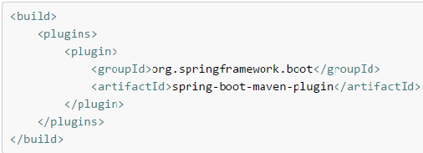
Understanding Starter POMS
Using the Spring Boot Maven plugin
Spring Boot includes a Maven plugin that can package the project as an executable jar. Add the plugin to your <plugins> section if you want to use it:

Slide 11
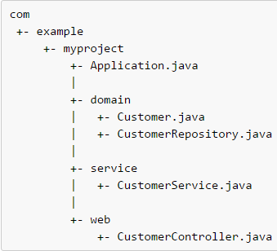
Structuring your code
Spring Boot does not require any specific code layout to work, however, there are some best practices that help.
Locating the main application class
We generally recommend that you locate your main application class in a root package above other classes.
The @EnableAutoConfiguration annotation is often placed on your main class, and it implicitly defines a base “search package” for certain items.
Using a root package also allows the @ComponentScan annotation to be used without needing to specify a basePackage attribute.

Slide 12
Configuration classes
Spring Boot favors Java-based configuration
It is recommend that your primary source is a @Configuration class. Usually the class that defines the main method is also a good candidate as the primary @Configuration.
You don’t need to put all your @Configuration into a single class. The @Import annotation can be used to import additional configuration classes.
Alternatively, you can use @ComponentScan to automatically pick up all Spring components, including @Configuration classes.
If you absolutely must use XML based configuration, we recommend that you still start with a @Configuration class. You can then use an additional @ImportResource annotation to load XML configuration files.

Slide 13
Configuration classes
Auto-configuration:
Spring Boot auto-configuration attempts to automatically configure your Spring application based on the jar dependencies that you have added.
You need to opt-in to auto-configuration by adding the @EnableAutoConfiguration or @SpringBootApplication annotations to one of your @Configuration classes.
If you need to find out what auto-configuration is currently being applied, and why, start your application with the --debug switch
Gradually replacing auto-configuration :
Auto-configuration is noninvasive, at any point you can start to define your own configuration to replace specific parts of the auto-configuration.
For example, if you add your own DataSource bean, the default embedded database support will back away.
Disabling specific auto-configuration
If you find that specific auto-configure classes are being applied that you don’t want, you can use the exclude attribute of @EnableAutoConfiguration to disable them. @EnableAutoConfiguration(exclude={DataSourceAutoConfiguration.class})

Slide 14
SpringApplication
SpringApplication app = new SpringApplication(MyApplication.class); app.setShowBanner(false);
app.run(args);
Gets a running Spring ApplicationContext
Uses EmbeddedWebApplicationContext for web apps
Can be a single line: SpringApplication.run(MyApplication.class, args)
Or customized (see later)...

Slide 15
@EnableAutoConfiguration
@Configuration @EnableAutoConfiguration
public class MyApplication { }
Attempts to auto-configure your application
Backs off as you define your own beans
Regular @Configuration classes
Usually with @ConditionalOnClass(activates a configuration only if one or several classes are present on the classpath ) and @ConditionalOnMissingBean(enables a bean definition only if the bean wasn't previously defined)

Slide 16
Packaging For Production
Maven plugin (using spring-boot-starter-parent):
<plugin>
<groupId>org.springframework.boot</groupId>
<artifactId>spring-boot-maven-plugin</artifactId>
</plugin>
$ mvn package
Gradle plugin:
apply plugin: 'spring-boot'
$ gradle repackage

Slide 17
Packaging For Production
$ java -jar yourapp.jar
Easy to understand structure
No unpacking or start scripts required
Typical REST app ~10Mb
Cloud Foundry friendly (works & fast to upload)

Slide 18
Spring Boot Modules
Spring Boot - main library supporting the other parts of Spring Boot
Spring Boot Autoconfigure - single @EnableAutoConfiguration annotation creates a whole Spring context
Spring Boot Starters - a set of convenient dependency descriptors that you can include in your application.
Spring Boot CLI - compiles and runs Groovy source as a Spring application
Spring Boot Actuator - common non-functional features that make an app instantly deployable and supportable in production
Spring Boot Tools - for building and executing self-contained JAR and WAR archives
Spring Boot Samples - a wide range of sample apps

Slide 19
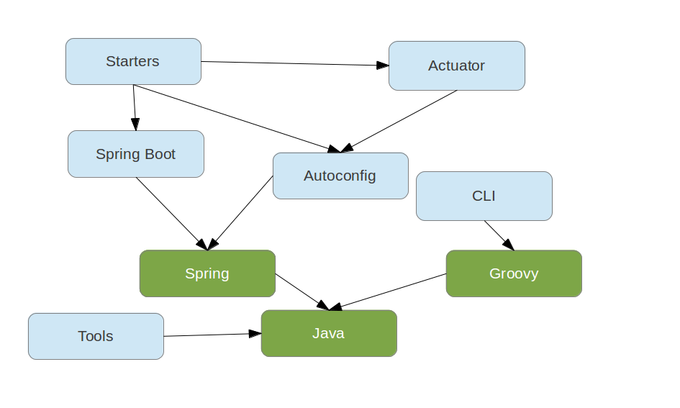
Spring Boot Module Relations

Slide 20
Not a Web Application?
CommandLineRunner is a hook to run application-specific code after the context is created
@Component
public class Startup implements CommandLineRunner {
@Override public void run(String... args) throws Exception { System.out.println("Hello World");
}
}

Slide 21
SpringApplicationBuilder
Flexible builder style with fluent API for building SpringApplication with more complex requirements.
new SpringApplicationBuilder(ParentConfiguration.class) .profiles("adminServer", "single") .child(AdminServerApplication.class) .run(args);

Slide 22
Environment and Profiles
Every ApplicationContext has an Environment
Spring Environment available since 3.1
Abstraction for key/value pairs from multiple sources
Used to manage @Profile switching
Always available: System properties and OS ENV vars

Slide 23
Command Line Arguments
SpringApplication adds command line arguments to the Spring Environment so you can refer inject them into beans:
@Value("${name}")
private String name;
$ java -jar yourapp.jar --name=Dave
You can also configure many aspects of Spring Boot itself:
$ java -jar target/*.jar --server.port=9000

Slide 24
Externalizing Configuration to Properties
Just put application.properties in your classpath or next to you jar, e.g.
application.properties
server.port: 9000
Properties can be overridden (command line arg > file > classpath)

Slide 25
Using YAML
Just include snake-yaml.jar and put application.yml in your classpath
application.yml
server: port: 9000
Both properties and YAML add entries with period-separated paths to the Spring Environment.

Slide 26
Binding Configuration To Beans
MyProperties.java
@ConfigurationProperties(prefix="mine")
public class MyPoperties {
private Resource location;
private boolean skip = true;
// ... getters and setters }
application.properties
mine.location: classpath:mine.xml mine.skip: false

Slide 27
Data Binding to @ConfigurationProperties
Spring DataBinder so does type coercion and conversion where possible
Custom ConversionService additionally discovered by bean name (same as ApplicationContext)
Ditto for validation
configurationPropertiesValidator bean if present
JSR303 if present
ignoreUnkownFields=true (default)
ignoreInvalidFields=false (default)
Uses a RelaxedDataBinder which accepts common variants of property names (e.g. CAPITALIZED,camelCased or with_underscores)
Also binds to SpringApplication

Slide 28
Customizing Configuration Location
Set
spring.config.name - default application, can be comma-separated list
spring.config.location - a Resource path, overrides name
e.g.
$ java -jar target/*.jar --spring.config.name=production

Slide 29
Spring Profiles
Activate external configuration with a Spring profile
file name convention e.g. application-development.properties
or nested documents in YAML:
application.yml
defaults: etc... --- spring: profiles: development,postgresql other: stuff: more stuff...
Set the default spring profile in external configuration, e.g:
application.properties
spring.profiles.active: default, postgresql

Slide 30
Logging
Spring Boot provides default configuration files for 3 common logging frameworks: logback, log4j and java.util.logging
Starters (and Samples) use logback with colour output
External configuration and classpath influence runtime behavior
LoggingApplicationContextInitializer sets it all up

Slide 31
Adding some Autoconfigured Behavior
<dependency> <groupId>org.springframework</groupId> <artifactId>spring-jdbc</artifactId> </dependency> <dependency> <groupId>org.hsqldb</groupId> <artifactId>hsqldb</artifactId> </dependency>
Extend the demo and see what we can get by just modifying the classpath, e.g.
Add an in memory database
Add a Tomcat connection pool

Slide 32
Adding Static Resources
Easiest: use classpath:/static/**
Many alternatives:
classpath:/public/**
classpath:/resources/**
classpath:/META-INF/resources/**
Normal servlet context / (root of WAR file, see later)
i.e. src/main/webapp if building with Maven or Gradle
static/**
public/**
set documentRoot in EmbeddedServletContextFactory (see later)
Special treatment for index.html (in any of the above locations)

Slide 33
Adding A UI with Thymeleaf
Add Thymeleaf to the classpath and see it render a view
Spring Boot Autoconfigure adds all the boilerplate stuff
Common configuration options via spring.thymeleaf.*, e.g.
spring.thymeleaf.prefix:classpath:/templates/ (location of templates)
spring.thymeleaf.cache:true (set to false to reload templates when changed)
Extend and override, just add beans:
Thymeleaf IDialect
thymeleafViewResolver
SpringTemplateEngine
defaultTemplateResolver

Slide 34
Currently Available Autoconfigured Behaviour
Embedded servlet container (Tomcat or Jetty)
JDBC: DataSource and JdbcTemplate
JPA, JMS, AMQP (Rabbit), AOP
Websocket
Spring Data JPA (scan for repositories) and Mongodb
Thymeleaf
Mobile
Batch processing
Reactor for events and async processing
Actuator features (Security, Audit, Metrics, Trace)
Please open an issue on github if you want support for something else

Slide 35
The Actuator
Adds common non-functional features to your application and exposes MVC endpoints to interact with them.
Security
Secure endpoints: /metrics, /health, /trace, /dump, /shutdown, /beans, /env
/info
Audit
If embedded in a web app or web service can use the same port or a different one (management.port) and/or a different network interface (management.address) and/or context path (management.context_path).

Slide 36
Adding Security
Use the Actuator
Add Spring Security to classpath, e.g. with spring-boot-starter-security
Application endpoints secured via security.basic.enabled=true (on by default)
Management endpoints secure unless individually excluded

Slide 37
Adding a Remote SSH Server
Use the Actuator
Add spring-boot-starter-shell-remote to classpath
Application exposed to SSH on port 2000 by default

Slide 38
Building a WAR
We like launchable JARs, but you can still use WAR format if you prefer. Spring Boot Tools take care of repackaging a WAR to make it executable.
If you want a WAR to be deployable (in a "normal" container), then you need to useSpringBootServletInitializer instead of or as well as SpringApplication.

Slide 39
Customizing Business Content
Remember, it's just Spring...
Add @Bean definitions
Use @Autowired, @Value and @ComponentScan
Groovy CLI auto-imports common DI annotations
Even use old-fashioned XML if you like

Slide 40
Customizing the ApplicationContext
Directly on the SpringApplication instance (spring.main.*)
Add external configuration (System properties, OS env vars, config file, command line arguments)
Add SpringApplicationInitializer implementations and enable in META-INF/spring.factories

Slide 41
Customizing @EnableAutoConfiguration
Disable specific feature @EnableAutoConfiguration(disable={WebMvcAutoConfiguration.class})
Write you own...
Add JAR with META-INF/spring.factories entry for EnableAutoConfiguration
All entries from classpath merged and added to context

Slide 42
Customizing the CLI
Uses standard Java META-INF/services scanning
CompilerAutoConfiguration: add dependencies and imports
CommandFactory: add commands via a custom CommandFactory in META-INF/services
E.g. can add script commands (written in Groovy)
$ spring foo ...
Looks for foo.groovy in ${SPRING_HOME}/bin and ${SPRING_HOME}/ext by default

Slide 43
Customizing Servlet Container Properties
Some common features exposed with external configuration, e.g. server.port (seeServerProperties bean)
Add bean of type EmbeddedServletContainerCustomizer - all instances get a callback
Add bean of type EmbeddedServletContainerFactory (replacing auto-configured one)

Slide 44
Spring Boot Loader
Motivation: existing solutions for executable JAR are not very robust; executable WAR is very tricky to create.
Response: JarLauncher and WarLauncher with specialized ClassLoader and JarFile implementations that can find resources in nested JARs (e.g. lib/*.jar or WEB-INF/lib/*.jar)

Slide 45
How We Load Nested Jars
Each regular JAR file is sequence of JarEntries
yourapp.original.jar
+----+----+----+------- | A1 | A2 | A3 | ... +----+----+----+-----
spring-core.jar
+----+----+----+------- | S1 | S2 | S3 | ... +----+----+----+-----

Slide 46
Pain Areas of Monolithic
This approach works well for relatively small applications. However, the monolithic architecture becomes unwieldy for complex applications.
A large monolithic application can be difficult for developers to understand and maintain. It is also an obstacle to frequent deployments.
To deploy changes to one application component you have to build and deploy the entire monolith, which can be complex, risky, time consuming, require the coordination of many developers and result in long test cycles.
A monolithic architecture also makes it difficult to trial and adopt new technologies. It’s difficult, for example, to try out a new infrastructure framework without rewriting the entire application, which is risky and impractical.
In other words, the monolithic architecture doesn’t scale to support large, long-lived applications.

Slide 47
Microservices
The big idea behind microservices is to architect large, complex and long-lived applications as a set of cohesive services that evolve over time.
The term microservices strongly suggests that the services should be small.
However, while it’s desirable to have small services, that should not be the main goal. Instead, you should aim to decompose your system into services to solve the kinds of development and deployment problems.
It has even been called lightweight or fine-grained SOA. And indeed, one way to think about microservice architecture is that it’s SOA without the commercialization and perceived baggage of WS* and ESB

Slide 48
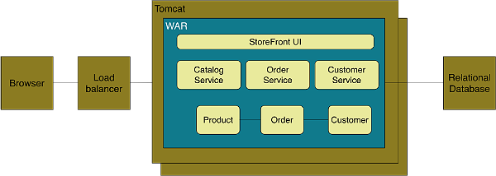
Monolithic way

Slide 49
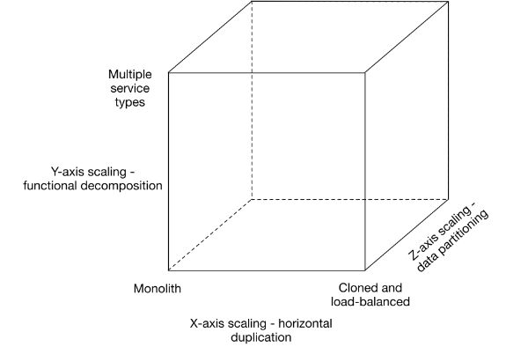
Decomposing applications into services
Decomposing applications into services
Z-axis scaling, like X-axis scaling, improves the application’s capacity and availability. However, neither approach solves the problems of increasing development and application complexity. To solve those problems we need to apply Y-axis scaling.
Notes:
X-axis scaling (horizontal duplication): In this model, the commonly used approach of scaling an application by running multiple identical copies of the application behind a load balancer is known as X-axis scaling. That’s a great way of improving the capacity and the availability of an application.
Z-axis scaling (Data partitioning ):When using Z-axis scaling each server runs an identical copy of the code. In this respect, it’s similar to X-axis scaling. The big difference is that each server is responsible for only a subset of the data. Some component of the system is responsible for routing each request to the appropriate server.
Y-axis scaling (functional decomposition):The 3rd dimension to scaling is Y-axis scaling or functional decomposition. Where as Z-axis scaling splits things that are similar, Y-axis scaling splits things that are different.
At the application tier, Y-axis scaling splits a monolithic application into a set of services. Each service implements a set of related functionality such as order management, customer management etc.
Partitioning approach is to partition the system by nouns or resources. This kind of service is responsible for all operations that operate on entities/resources of a given type. For example, later on you will see how it makes sense for the online store to have a Catalog service, which manages the catalog of products.
Ideally, each service should have only a small set of responsibilities. (Uncle) Bob Martin talks[PDF] about designing classes using the Single Responsible Principle (SRP). The SRP defines a responsibility of class as a reason to change, and that a class should only have one reason to change. It make sense to apply the SRP to service design as well.

Slide 50
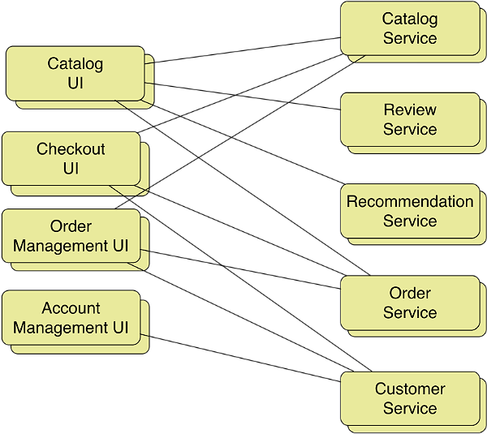
Y-axis decomposition
If we apply Y-axis decomposition to the example application we get the architecture shown in:
Notes:
The decomposed application consists of various frontend services that implement different parts of the user interface and multiple backend services.
The front-services include the Catalog UI, which implements product search and browsing, and Checkout UI, which implements the shopping cart and the checkout process.
The backend services include the same logical services that were described at the start of this article. We have turned each of the application’s main logical components into a standalone service.

Slide 51
Communication mechanisms in a microservice architecture
In a microservice architecture, the patterns of communication between clients and the application, as well as between application components, are different than in a monolithic application.

Slide 52
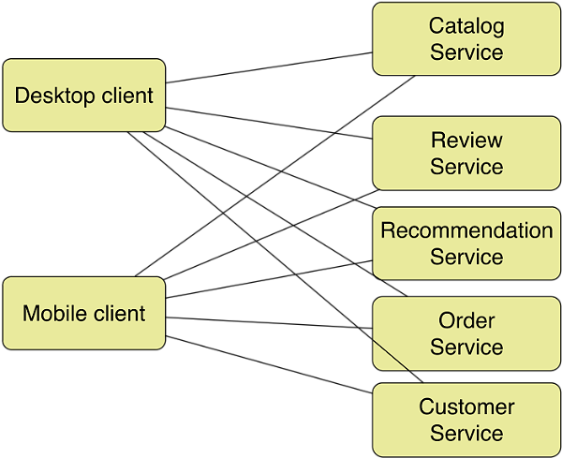
API gateway pattern
In a monolithic architecture, clients of the application, such as web browsers and native applications, make HTTP requests via a load balancer to one of N identical instances of the application.
But in a microservice architecture, the monolith has been replaced by a collection of services. Consequently, a key question we need to answer is what do the clients interact with? An application client, such as a native mobile application, could make RESTful HTTP requests to the individual services as
Notes:
On the surface this might seem attractive. However, there is likely to be a significant mismatch in granularity between the APIs of the individual services and data required by the clients.
For example, displaying one web page could potentially require calls to large numbers of services. Amazon.com, for example, describes how some pages require calls to 100+ services. Making that many requests, even over a high-speed internet connection, let alone a lower-bandwidth, higher-latency mobile network, would be very inefficient and result in a poor user experience.

Slide 53
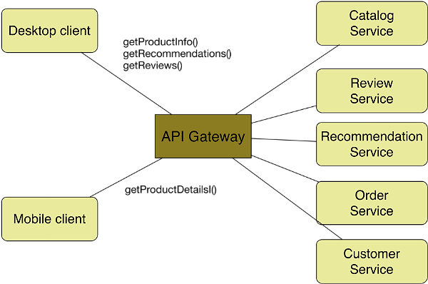
API gateway pattern
A much better approach is for clients to make a small number of requests per-page, perhaps as few as one, over the Internet to a front-end server known as an API gateway, which is shown in
Notes:
The API gateway sits between the application’s clients and the microservices. It provides APIs that are tailored to the client. The API gateway provides a coarse-grained API to mobile clients and a finer-grained API to desktop clients that use a high-performance network. In this example, the desktop clients makes multiple requests to retrieve information about a product, where as a mobile client makes a single request.
The API gateway handles incoming requests by making requests to some number of microservices over the high-performance LAN. Netflix, for example, describes how each request fans out to on average six backend services. In this example, fine-grained requests from a desktop client are simply proxied to the corresponding service, whereas each coarse-grained request from a mobile client is handled by aggregating the results of calling multiple services.
Not only does the API gateway optimize communication between clients and the application, but it also encapsulates the details of the microservices. This enables the microservices to evolve without impacting the clients. For examples, two microservices might be merged. Another microservice might be partitioned into two or more services. Only the API gateway needs to be updated to reflect these changes. The clients are unaffected.

Slide 54
Benefits of Monolithic architecture
Monolithic applications are simple to develop since IDEs and other development tools are oriented around developing a single application.
They are easy to test since you just need to launch the one application.
Monolithic applications are also simple to deploy since you just have to copy the deployment unit – a file or directory – to a machine running the appropriate kind of server.
This approach works well for relatively small applications. However, the monolithic architecture becomes unwieldy for complex applications.
A microservice architecture makes continuous deployment feasible. If the developers responsible for a service need to deploy a change that’s local to that service they do not need to coordinate with other developers. They can simply deploy their changes.
The microservice architecture also improves fault isolation. For example, a memory leak in one service only affects that service.
Last but not least, the microservice architecture eliminates any long-term commitment to a technology stack. I

Slide 55
Drawbacks
Developers must deal with the additional complexity of creating a distributed system.
Developers must implement an inter-process communication mechanism. Implementing use cases that span multiple services without using distributed transactions is difficult.
Writing automated tests that involve multiple services is challenging.

