Slide 1
Spring Boot Documentation

Slide 2
What is Spring Framework ? https://goo.gl/gzcKCE
is a integration framework
To develop enterprise java application
is kind of replacement for EJB ( session, entity, mdb)
loosely coupled components
design patterns
Spring Core Container- Singleton/Prototype Pattern
JDBC/Hibernate – Template Pattern
Spring framework Techniques
Dependency Injection
AOP
Spring Boot 1.5.7 – recommended 1.8
Spring 4.3.11 – Java 1.8

Slide 3
IOC
Before IOC ,Manually instantiate the dependent objects
Spring container
Instantiates the dependent objects
Initialization
Manages the lifecycle
Constructor or Setter using DI Pattern
DI Configuration
Xml
Annotation ( metadata for container)
Pure Java Configuration (eg, Spring Boot)
XML Configuration
<beans> … </beans>
Xsd’s ( eg, beans schema)
Annotation
@Resource ( Java 5)
@Inject
@Autowire ( Spring) ( default by type)
Use Spring framework
Jars ( add to classpath)
Maven ( build tool)
pom.xml
Gradle (json based build tool)
<bean id=“bean name” class=“class name”>
<constructor.. />
<property ref=“bean id”.. />
</bean>

Slide 4
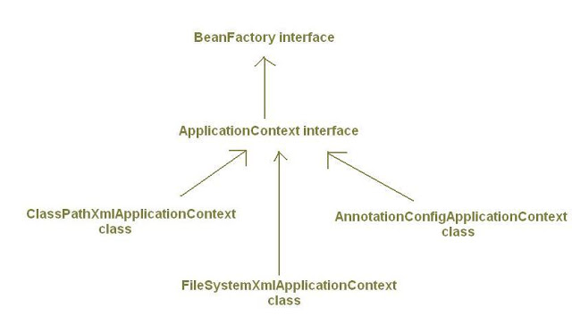
XML
- <beans>.. </beans>
Annotation
Stereotype annotation
@Component – class level
@Controller – web mvc, rest api
@Service – business class
@Repository – db
@Rest Controller ( Spring 4)
Pure Java
@Configuration
@Bean ( External classes )
Spring Container Implementation
Bean Factory
Instantiation
Manage Lifecycle
DI
Application Context
Events
Managing resources ( .properties)
http://java-journal.blogspot.in/2012/08/what-is-appl icationcontext-what-are-its.html

Slide 5
SpringBoot Usage
Spring Tool Suite ( STS) – Spring Starter Project
Spring Boot Command Line Interface (CLI) – will generate groovy scripts
Spring Initializer – web page developed by Spring Boot Team
We use Blank Maven Project
https://docs.spring.io/spring-boot/docs/current-SNAPSHOT/reference/htmlsingle/
spring-boot-starter-parent
default configurations
1.5.2 ( all related 4.3.7 spring jars
+ third party jars will be decided
+ fasterXML )
https://docs.spring.io/spring-boot/docs/current-SNAPSHOT/reference/htmlsingle/#using-boot-starter
Conventions over configuration ( base on 80% of use case as of today)
Dependencies ( jars + versions )
Default beans ( DispatcherServlet, RestController)
Default server ( tomcat server)
Ready starter poms/pre-constructed poms that are managing dependencies as well as transitive dependencies
Standalone (Executebale jar eg, SpringBootApplication.0.0.1-SNAPSHOT.jar <external configuration>)
Spring Boot + Tomcat – XML
No XML Or No code generation
Production ready application
Added non-functional features - security, actuator (health in terms of metrics – beans, connection pool, controllers)
@EnableAutoConfiguration using @Conditional matching of beans to loaded based on the POM

Slide 6
@Controller will be called by dispatcher servlet
@Bean – to configure external beans
You can define beans external to your application classes by using Java rather than XML files. @Configuration @Bean @Import and @Depends On
MessageApp eg. WebClient -> @RestController -> @Component -> Bean
Example for Externalized Bean
@Bean
public Message createMsg() {
Message msg = new Message();
msg.setText("Msg from exernal bean");
return msg;
}
Example of Reading Properties from application.properties
msg.text=This is externalized text message
@Value("${msg.text}")
private String msgText;

Slide 7
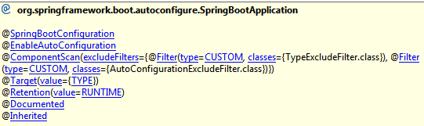
Data Persistence
JDBCTemplate class – based on SQL commands
JPARepository – based on ORM
https://docs.spring.io/spring/docs/current/spring-framework-reference/html/jdbc.html
Jdbc template For SpringBoot
Look out for pom inclusion ( spring-boot-starter-jdbc)
Eg. queryForObject(“select * from persom wjere personid=? and name=?”,
new Object[]{10,”Rock”}, new RowMapper(…));
Spring Boot Default in-memory database
Derby
H2 ( Spring boot support – h2 console)
HSQLDB
Create Interactive Spring Boot App
http://start.spring.io/
@SpringBootApplication – contains (@EnableAutoconfiguration , @ComponentScan… )
JDBC
Register the drivers - fixed
Providing the connection details - fixed
Getting the connection object - fixed
Create the statement / prepared statement - fixed
Forming the query – change
Getting the result set object - fixed
Iterating through the result set – partially fixed
Handling the SQLExceptions - fixed

Slide 8
H2 DB
Enable h2 console in the application.properties
# H2
spring.h2.console.enabled=true
spring.h2.console.path=/h2
spring.datasource.url=jdbc:h2:~/test
spring.datasource.schema=classpath:load.sql ( all schema files of the application)
Spring JPA
Not based on jdbc
https://docs.spring.io/spring-data/jpa/docs/current/reference/html/#repositories.core-concepts

