Slide 1
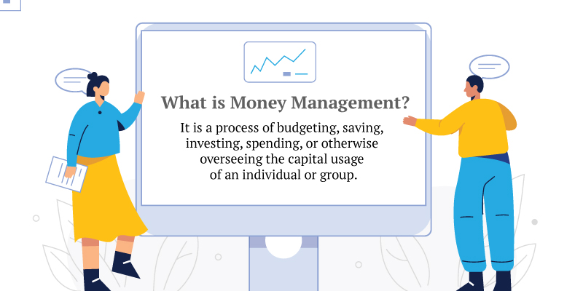
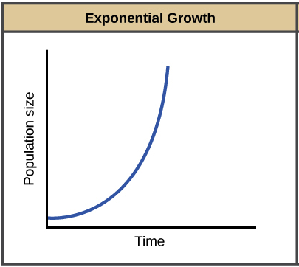
Model Validator
UML Collaboration
Levels of money management
SRN model
Performance SRN model
money transformation
model Synchronization
money management model
money in this Generation
what type of money management people want
Financial wellness

