Slide 1
PROJECT FINAL PRESENTATION
Project Title: ClassConnect
Course No.: 0613-306
Course: Markup and Scripting Language Lab
By Md. Parvez Ahmed
Roll: 04
Batch: D-82
Instructor: Md. Manirujjaman Lecturer,
Department of CSE, DIU

Slide 2



Outlines
Project Overview
Implementation Sreenshots
Objectives
Database Design
System Architecture / Workflow
Challenges and Learning Outcomes
Key Features
Future Enhancement and Conclusion
Technology Stack
References

Slide 3


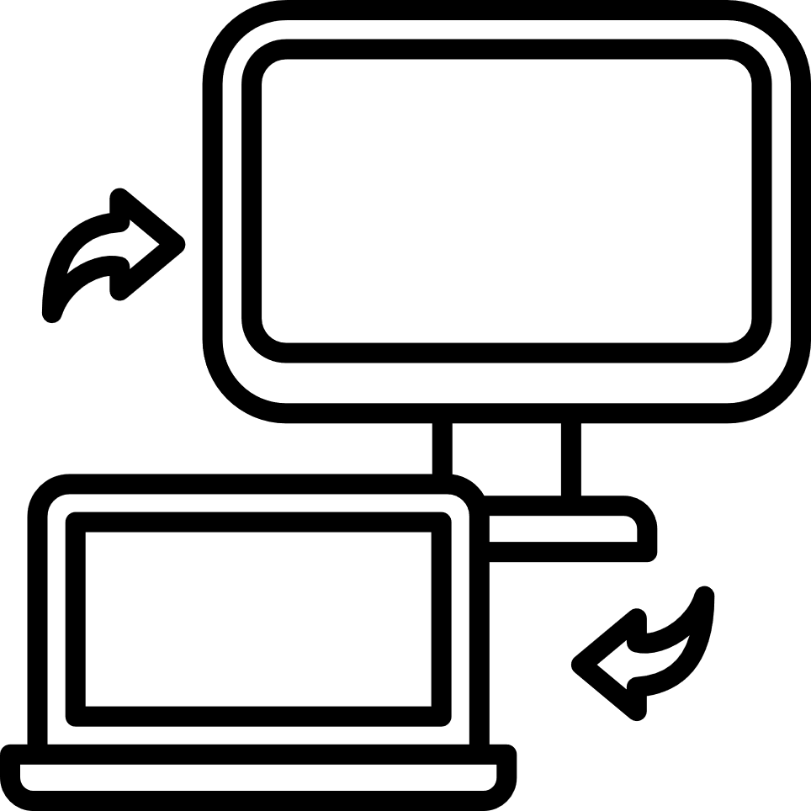
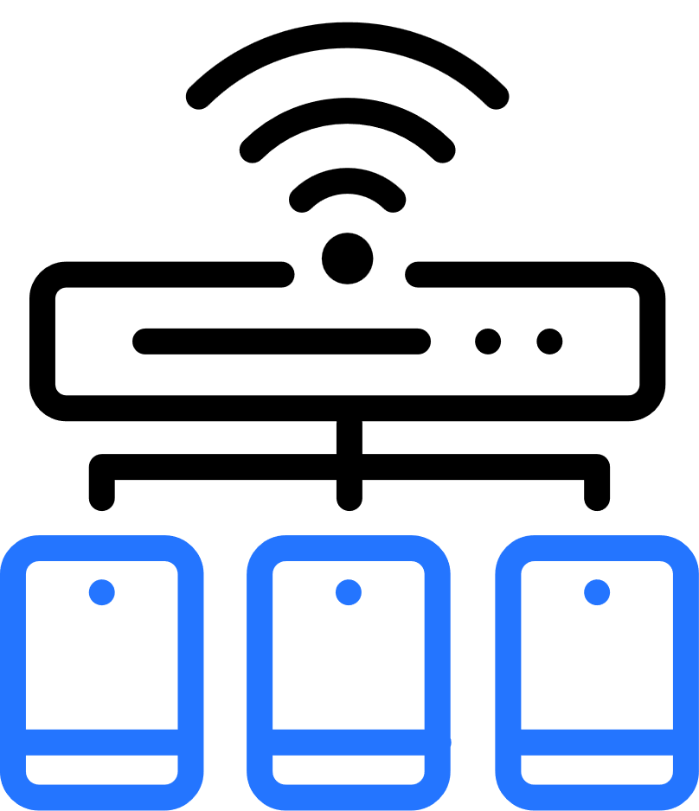


Project Overview
ClassConnect is a local offline web-based system designed to assist teachers in classroom environments by enabling:
Screen share
Local Wifi
Instant screen sharing from laptop to classroom PC
Works on local Wi-Fi — no internet or login required
File sharing
No Pendrive
Secure file sharing (upload / download / delete)
Eliminates pendrive dependency & setup delays

Slide 4




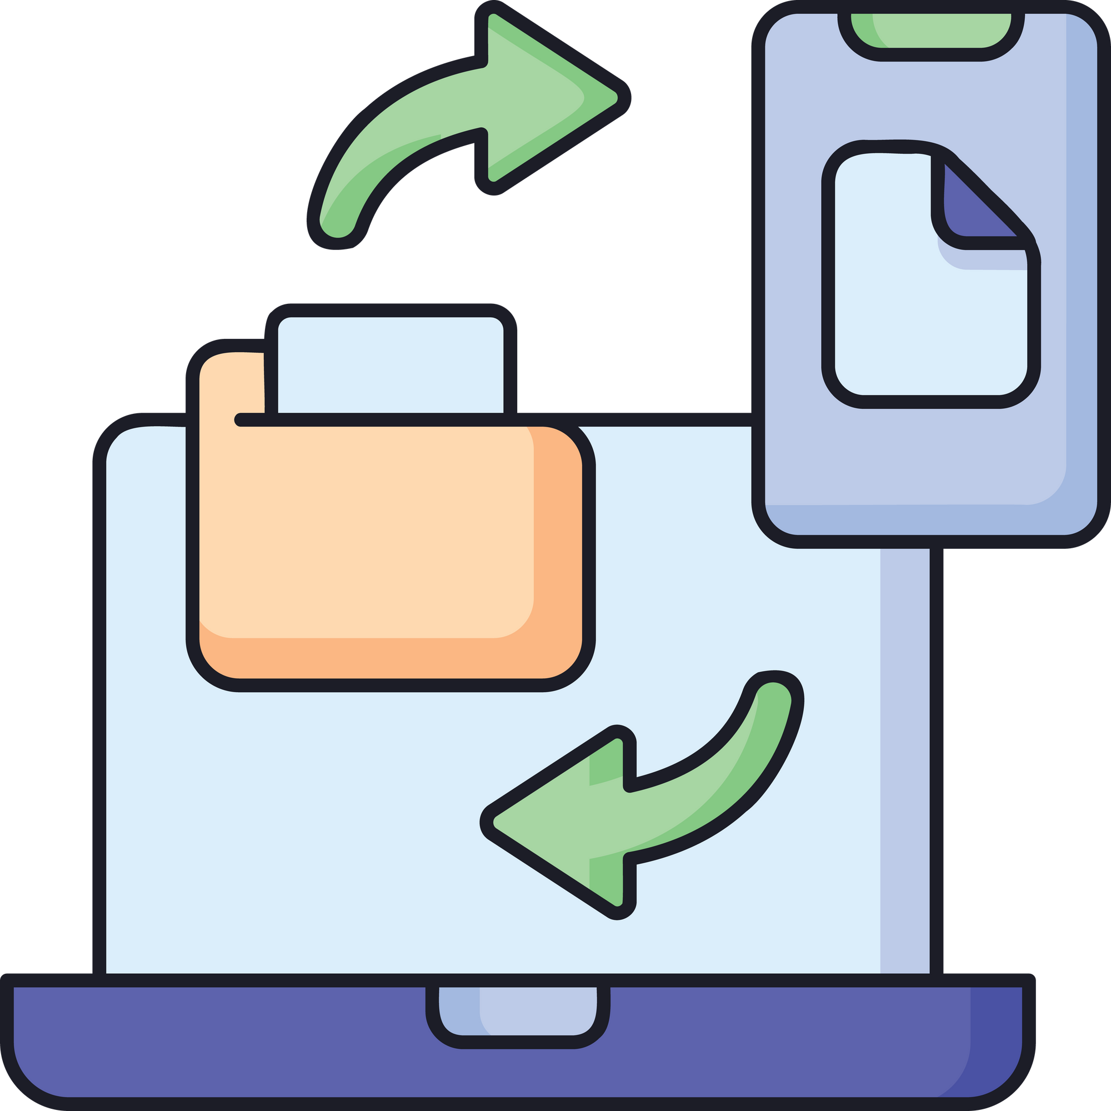


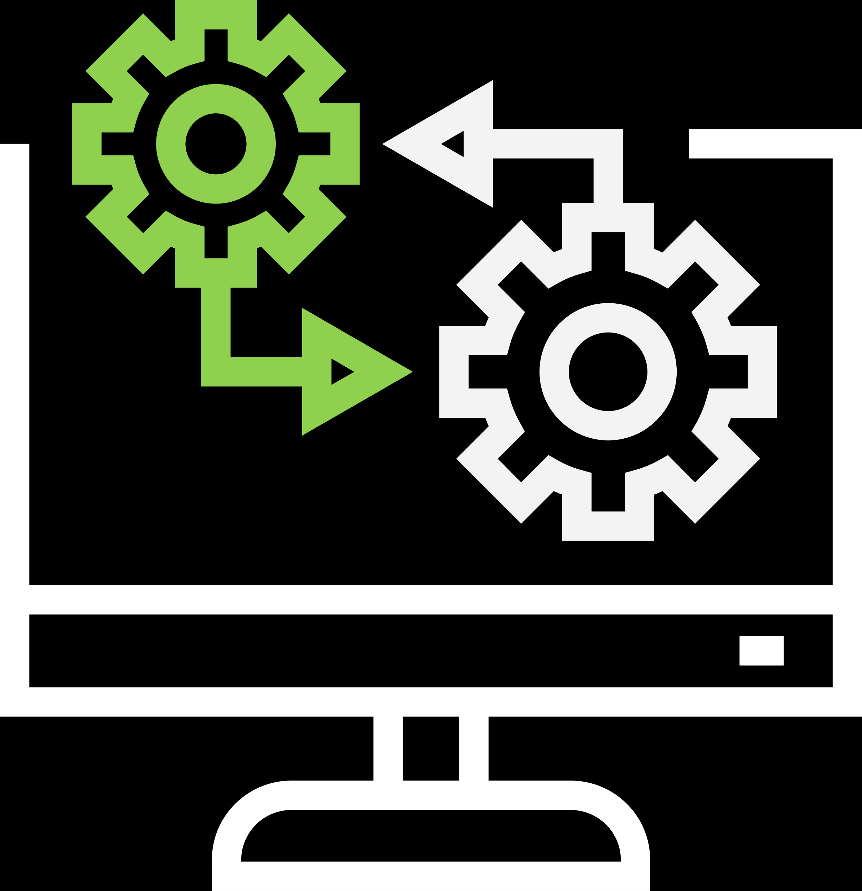


OBJECTIVES
Offilne Screen sharing
Simple UI
Provide offline classroom screen sharing
Create a simple and lightweight UI
File transfer over LAN
Save Time
Enable fast and safe file transfer over LAN
Improve class flow and save teaching time
No virus Risk
Modular system
Remove pendrive virus risks
Build a scalable modular system

Slide 5











System Architecture / Workflow
Real-time communication
Classroom PC
enters IP in browser
Via WebRTC + WebSocket
Step 01
Step 02
Step 03
Step 04
Teacher starts server → gets local IP
Teacher chooses:
Share screen
Upload/download files

Slide 6


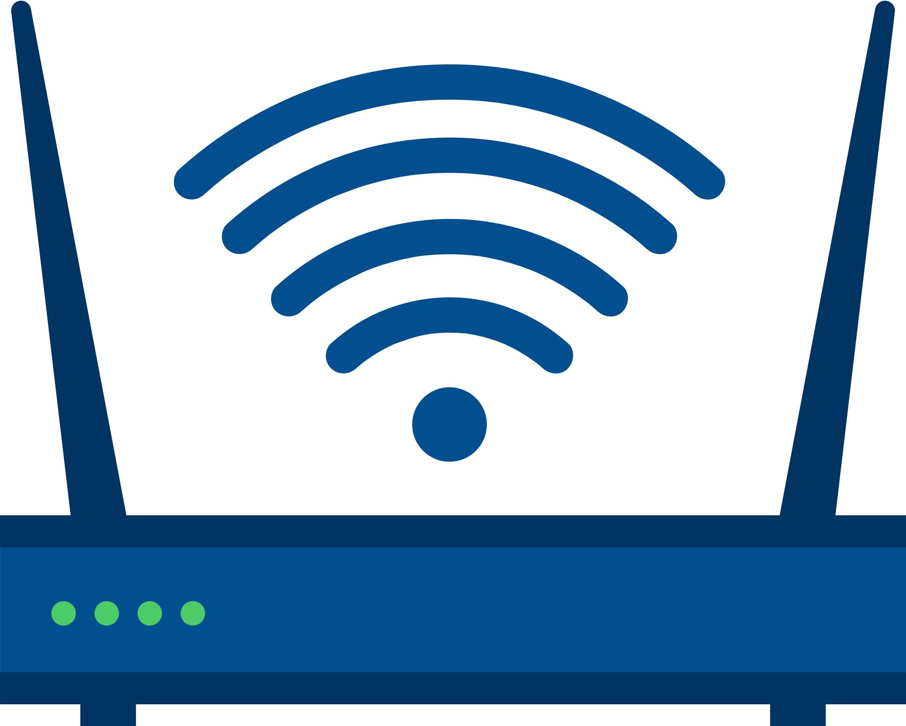

System Architecture / Workflow
Teacher’s PC
Classroom’s PC
Hosts the server
shows the teacher’s screen
Student
Local Wifi
Student
Download/Share file
Download/Share file

Slide 7













Key Features
Fast, secure, and simple local classroom collaboration system
Prevents virus-infected USB dependency
Offline LAN-based screen sharing
Simple and minimal interface
File upload, download & delete
Device-independent -works on browser
No external software installation on classroom PC

Slide 8


















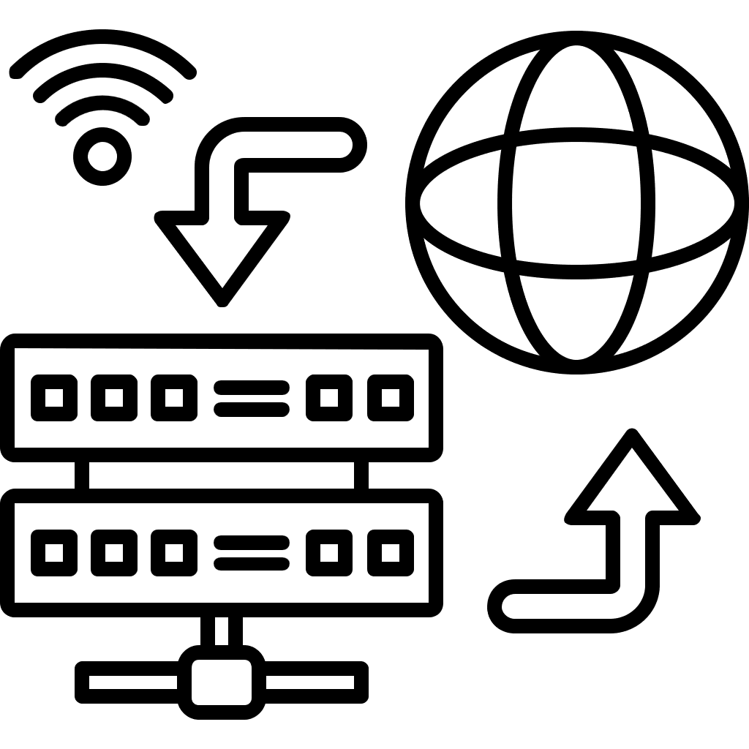
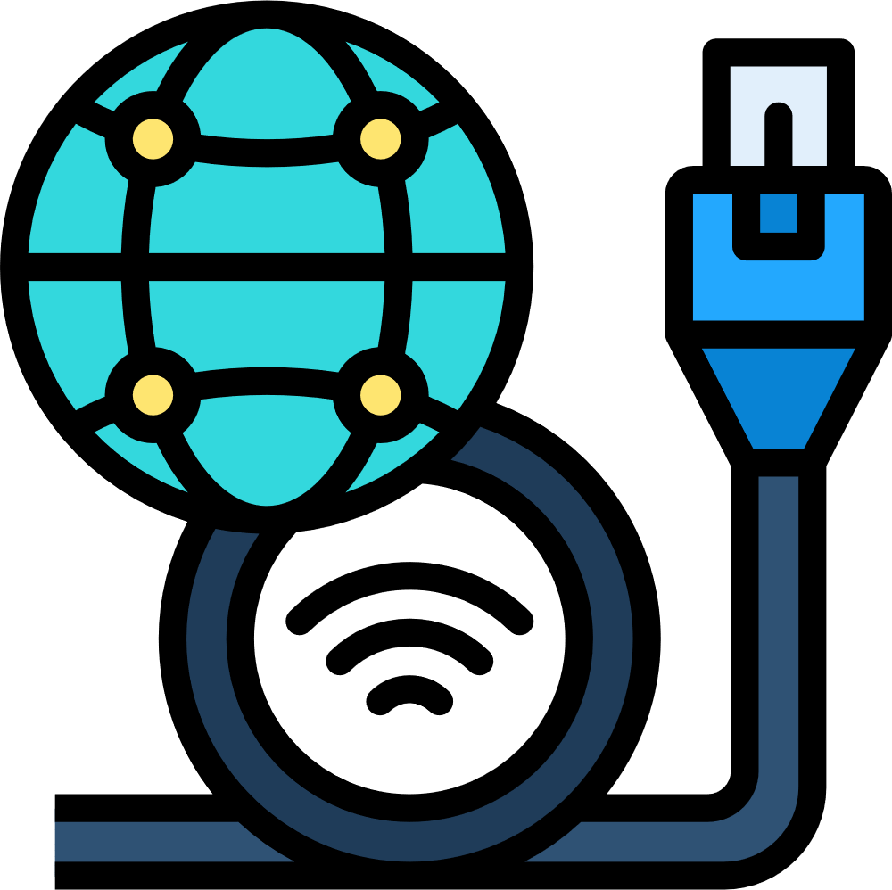
Frontend
Backend
HTML, CSS, JavaScript
Django (Python)
Real-Time Communication
Database
SQLite
Django Channels, WebRTC
TECHNOLOGY STACK
Hosting
Local Streaming
Local Wi-Fi network (offline)
WebRTC Peer-to-Peer

Slide 9
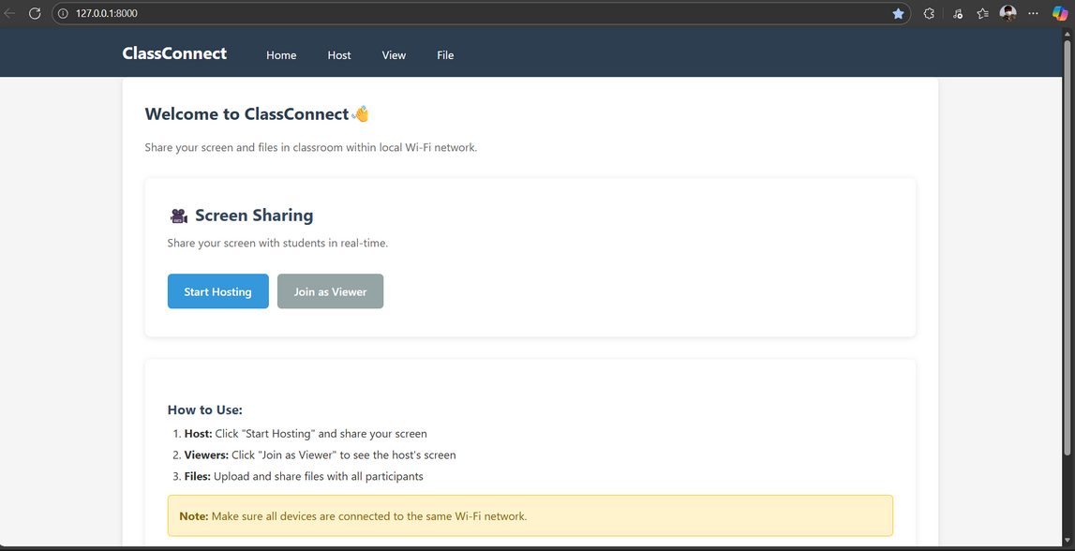
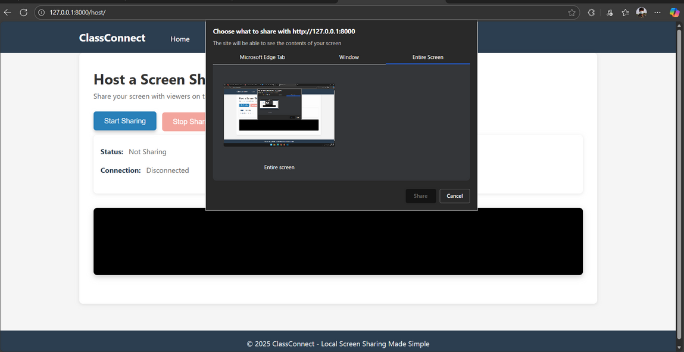
Implementation Screenshots
Home Page
Screen share

Slide 10
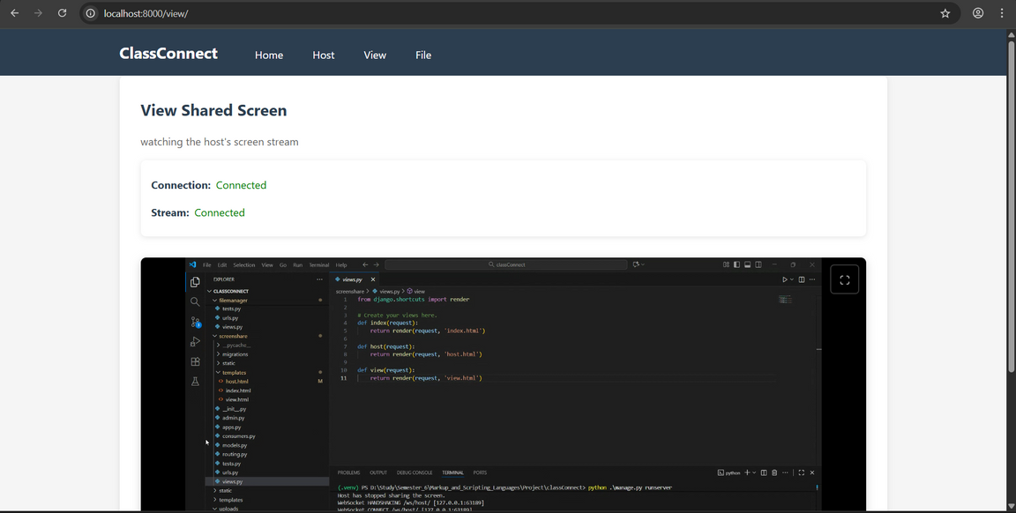
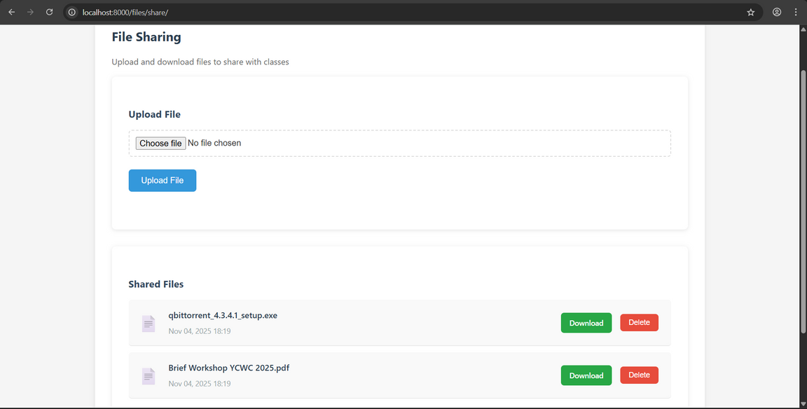
Implementation Screenshots
View Page
File Share Page

Slide 11







Database Design
ID
file_name
file_path
upload_time
Integer (PK)
File ID
Text
Original file name
DateTime
Timestamp
Text
Server file location

Slide 12











Challenges & Learning Outcomes
Challenges
Learning Outcomes
WebRTC signaling setup over LAN
Real-time WebSocket communication
Cross-device testing on different OS & browsers
WebRTC screen sharing implementation
Handling local IP & WebSocket configuration
Django Channels integration

Slide 13






01
Classroom multi-viewer screen sharing
02
Chat feature for communication
Future Enhancements & Conclusion
03
Recording shared screen
Future Enhancements
04
QR-code based quick connection
05
Add real-time live annotation on shared screen (drawing, highlighting, pointer tools)

Slide 14




CONCLUSION
ClassConnect successfully provides a fast, secure, offline classroom sharing system, improving teaching experience by eliminating USB issues and reducing setup time.
A simple idea - built to solve a real university problem!

Slide 15
REFERENCES
DJANGO DOCUMENTATION
WEBRTC MDN DOCS
DJANGO CHANNELS DOCS
STACKOVERFLOW & GITHUB COMMUNITY EXAMPLES
FIRESHIP (YOUTUBE.COM)

Slide 16


