Slide 1
Git Primer

Slide 2
Distributed Version Control Means We're All Equals.

Slide 3
Starting a new local repository.
  git config --global user.name "Dan Patrick"
    Set your name
  git config --global user.email dan@mdpatrick.com
    Set your email
  cd ~/my-website
    Enter your directory of files not currently under version control
  git init
    Initiate empty repository in folder
  git add .
    Begin tracking all new files in the current working directory
  git commit
    You've made your first commit!

Slide 4
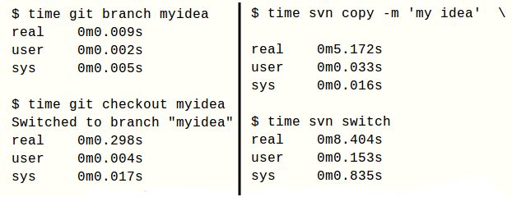
Branching Time: svn versus git
git: ~1/3rd of a second
svn: ~13 seconds (ouch)
Borrowed from: http://thinkvitamin.com/code/why-you-should-switch-from-subversion-to-git/

Slide 5
Super Simple Git Deployment
Production Server Setup
  mkdir /var/www/mywebsite.com/.git
  cd /var/www/mywebsite.com/.git
  git init --bare
  mv hooks/post-receive.sample hooks/post-receive
Add the following lines to the top of post-receive file in hooks folder:
#!/bin/sh
GIT_WORK_TREE=/var/www/mywebsite.com git checkout -f

Slide 6
Super Simple Git Deployment
Local Repository Setup
  git remote add production ssh://MYLOGIN@myserver.com/var/www/mywebsite.com/.git
  git push web +master:refs/heads/master

Slide 7
Useful git links
  github.com
    Free repository hosting for public repos.
  gitref.org
    Covers all of the basics in-depth. Excellent.
  thinkvitamin.com
    Excellent articles on git, among other things.
  help.github.com/set-up-git-redirect
    Help installing git.
  toroid.org/ams/git-website-howto
    Simple production deployment
Useful packages
  gitk
    Visual graph of commit history, etc. in gui format.
  git-gui
    A gui for everything else.

