Slide 1
Brandix
Intelligent Strategic Planning Synchronization System
Information Retrieval
MSc. Data Science
Coventry University, UK
M.D.P. Wijesuriya
Student ID (Coventry Uni.): 15764609
Student ID (NIBM): comscds241p-002
2024 Batch

Slide 2
Problem & Motivation
The Challenge:
Organizations struggle to align 5-year strategic plans with annual action plans
Manual verification is time-consuming and subjective
Gaps discovered too late
Brandix Case:
179 strategic objectives (2025-2030)
Different actions in multiple annual action plans
Need automated, objective alignment measurement
Solution: AI-powered semantic analysis system

Slide 3
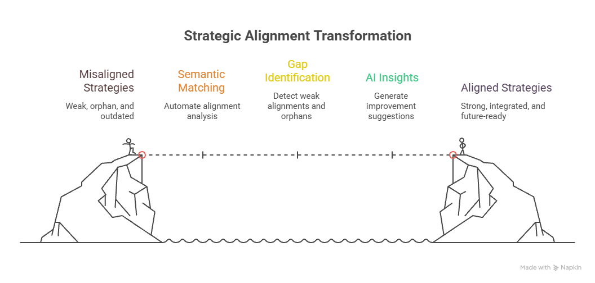
System Objectives
What ISPS Does:
Automates alignment analysis - Semantic similarity matching
Identifies strategic gaps - Detects weak alignments and orphans
Generates AI insights - Improvement suggestions and summaries
Tracks multi-year progress - Compare 2026-2030
Key Innovation: Privacy-first local AI deployment with comprehensive testing

Slide 4
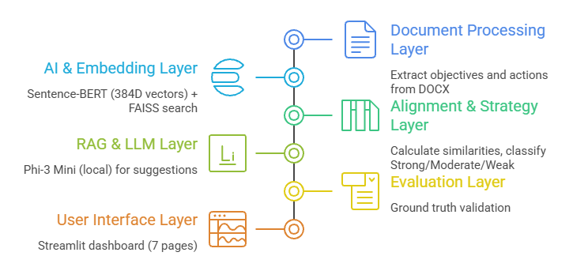
Architecture
6-Layer System:

Slide 5
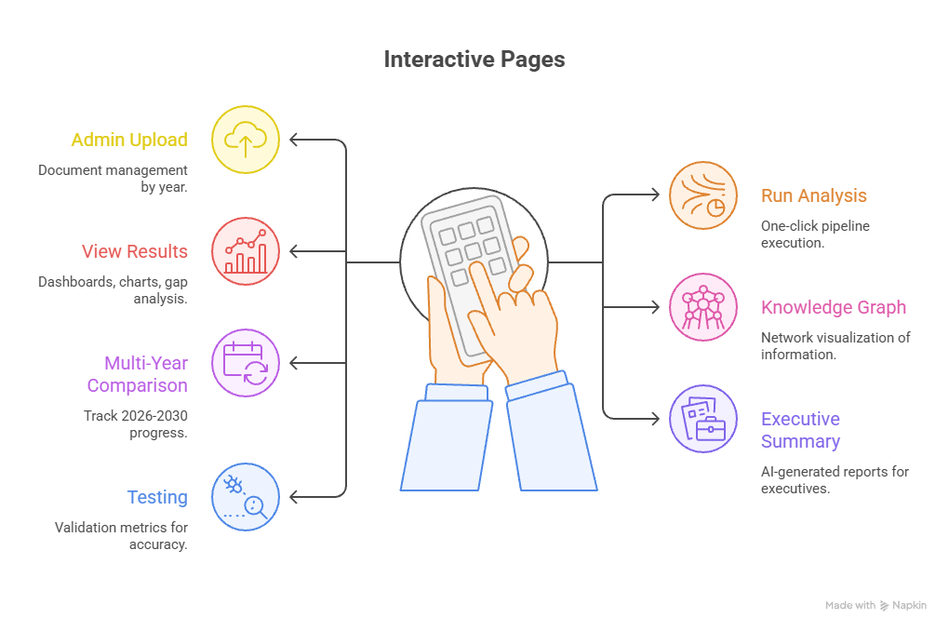
User Interface

Slide 6
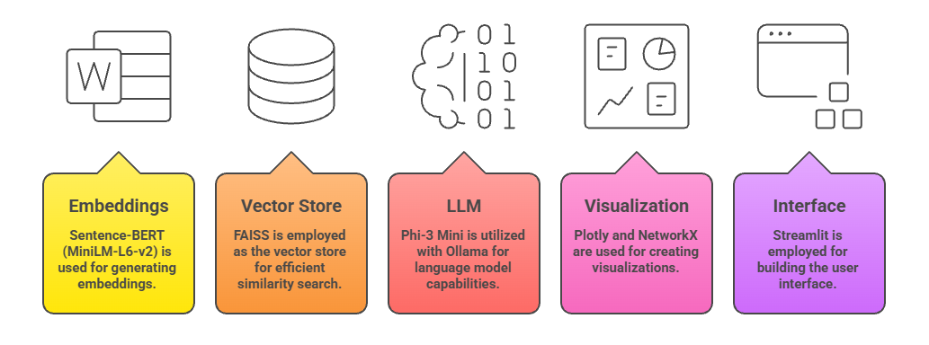
Technology Stack

Slide 7
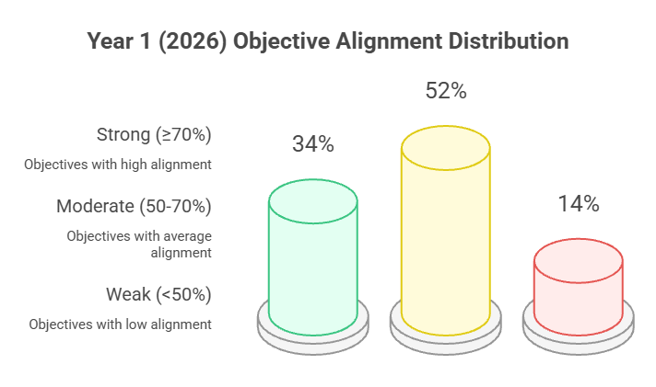
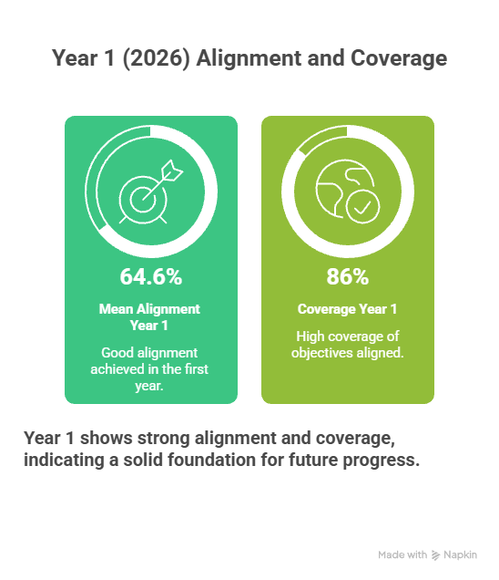
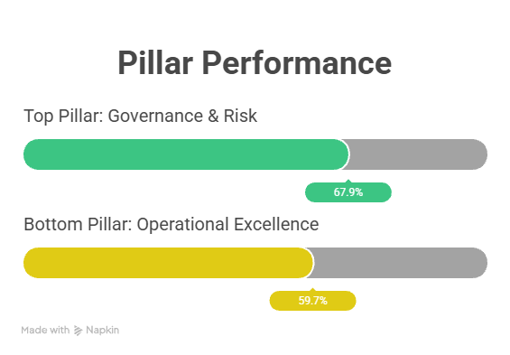
Analysis Results

Slide 8
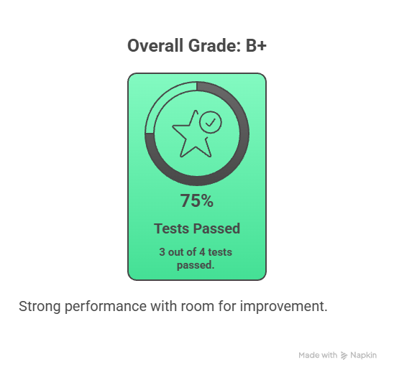
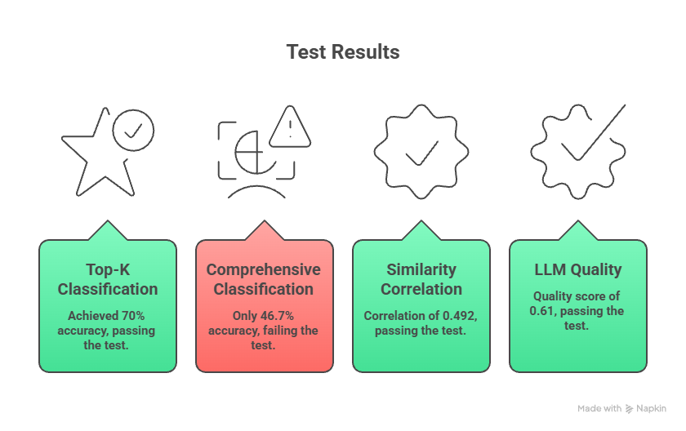
System Evaluation Results
Critical Finding: System struggles with weak alignment detection (10% recall)

Slide 9
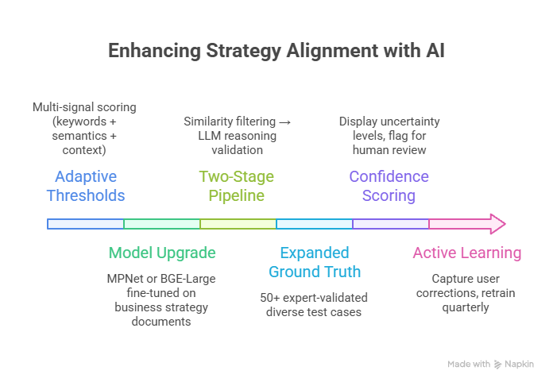
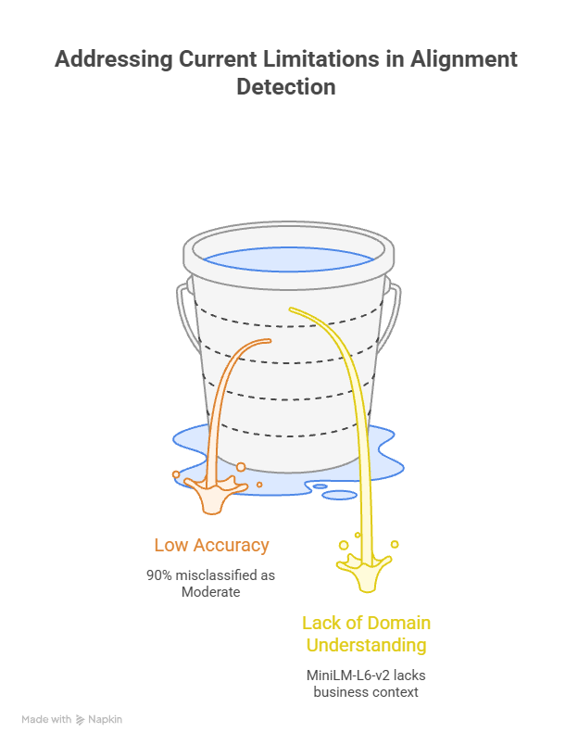
Limitations & Future Work

Slide 10
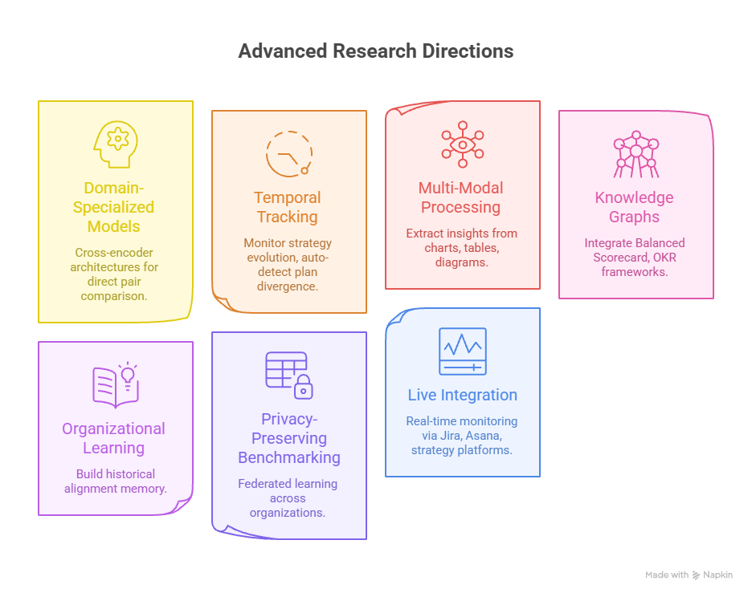
Limitations & Future Work

Slide 11
Appendix
Deliverables:
Strategic & Action Plans - 1. Strategic and Action Plans
Application Prototype - https://msc-ir-cw-v4ys66njic6dv7qjtvgrry.streamlit.app/
System Architecture Diagram - System Architecture Diagram
Dashboard Design - Dashboard Design
Testing & Evaluation Results - Testing & Evaluation Results
Final PDF Report – Uploaded to NIBM LMS
Presentation Slides & Recording - 7. Presentation Slides and Recording
Github Repo – https://github.com/mdpw/msc-ir-cw

Slide 12
Thank You

