Slide 1

MONTHLY SALES FORCASTING GROUP ASSIGNMENT
MSc Data Science, Coventry University UK
(2024 Batch)
Group-1

Slide 2

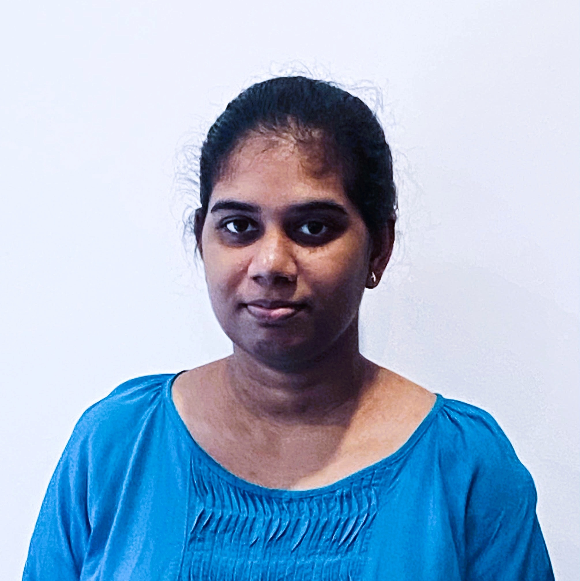

THE TEAM
Tharinda
COMScDS241P-001
Dinesh
COMScDS241P-002
Dinushi
COMScDS241P-003
Arosha
COMScDS241P-004
Osanda
COMScDS241P-019

Slide 3

OUR AIM
We are tasked with analyzing the past sales and some other data collected by the ABC Marketing Company Pvt (Ltd) and build a forecasting model to help the company to improve their sales performance.

Slide 4

COMPANY OUTLOOK
Stores | Departments
45 Stores Island Wide | 99 Different Departments

Slide 5
DATASETS: Feature
Additional data related to the store, department, and regional activity for the given dates
Store: Store Number
Date: Dates of the data from 2010 February 05th - 2013 July 26th
Temperature: Temperature in Fahrenheit
Fuel Price: Price of Fuel on that day
Markdown1, Markdown2, Markdown3, Markdown4, Markdown5: Data related to promotional markdowns at ABC which are anonymous
CPI: The consumer price index which measures the monthly changes in prices paid by consumers
Unemployment: Rate of Unemployment
IsHoliday: Whether a particular day is a holiday or not
8190
12
Total Records
Total Columns
Summary Statistics
Statistic | Store | Temperature | Fuel Price | Markdown1 | Markdown2 | Markdown3 | Markdown4 | Markdown5 | CPI | Unemployment
Count | 8190 | 8190 | 8190 | 4032 | 2921 | 3613 | 3464 | 4050 | 7605 | 7605
Mean | 23 | 59.356 | 3.406 | 7032.372 | 3384.177 | 1760.1 | 3292.936 | 4132.216 | 172.461 | 7.827
Std Dev | 12.988 | 18.679 | 0.431 | 9262.747 | 8793.583 | 11276.46 | 6792.33 | 13086.69 | 39.738 | 1.877
Min | 1 | -7.29 | 2.472 | -2781.45 | -265.76 | -179.26 | 0.22 | -185.17 | 126.064 | 3.684
25% | 12 | 45.903 | 3.041 | 1577.533 | 68.88 | 6.6 | 304.688 | 1440.828 | 132.365 | 6.634
50% (Median) | 23 | 60.71 | 3.513 | 4743.58 | 364.57 | 36.26 | 1176.425 | 2727.135 | 182.764 | 7.806
75% | 34 | 73.88 | 3.743 | 8923.31 | 2153.35 | 163.15 | 3310.008 | 4832.555 | 213.932 | 8.567
Max | 45 | 101.95 | 4.468 | 103185 | 104519.5 | 149483.3 | 67474.85 | 771448.1 | 228.976 | 14.313

Slide 6
DATASETS: Train
Historical training data
Store: Store Number
Dept: Department Number
Date: Dates of the data from 2010–02–05 to 2012-10-26
Weekly_Sales: Weekly sales of the store in a particular department
IsHoliday: Whether a particular day is a holiday
421570
5
Total Records
Total Columns
Summary Statistics
Statistic | Store | Dept | Weekly Sales
Count | 421570 | 421570 | 421570
Mean | 22.201 | 44.26 | 15981.26
Std Dev | 12.785 | 30.492 | 22711.18
Min | 1 | 1 | -4988.94
25% | 11 | 18 | 2079.65
50% (Median) | 22 | 37 | 7612.03
75% | 33 | 74 | 20205.85
Max | 45 | 99 | 693099.4

Slide 7
DATASETS: Store
Information about the 45 stores, indicating the type and size of the store
Store: Store Number
Type: The type pf the Store which can be A,B,C
Size: Size of the Store
45
3
Total Records
Total Columns
Summary Statistics
Statistic | Store | Size
Count | 45 | 45
Mean | 23 | 130287.6
Std Dev | 13.13393 | 63825.27
Min | 1 | 34875
25% | 12 | 70713
50% (Median) | 23 | 126512
75% | 34 | 202307
Max | 45 | 219622

Slide 8


ASSUMPTIONS
Assumed that the datasets have sufficient data.
External influences have been excluded for the prediction
Correlation of certain features may not always imply causation.
Certain noisy data has been assumed to be tolerable

Slide 9
LIMITATIONS
Limited External Data
The dataset lack certain information on external factors that may influence sales
Events
Economic factors
Weather Conditions
Consumer Behavior
Consumer preferences and purchasing patterns changes rapidly due to trends or events

Slide 10

CHALLENGES
Data Quality
Seasonality and Trends
Scalability
Missing data due to incomplete records for certain time periods
Outliers in sales of certain stores could skew the analysis and model performance
Sales data are often influenced by seasonal patterns which may affect the model accuracy
Processing and analyzing large-scale data require significant computational resources

Slide 11
Github Repository
https://github.com/mdpw/msc-pds-group

Slide 12

THANK YOU!

