Slide 1

Plain Text Enrichment Using Tweets And Emojis
Marin Drabić, Dora Marković, Luka Suman
Fakultet elektrotehnike i računarstva, Zagreb
15. lipnja, 2018.

Slide 2
Content
Introduction
Two-step solution
Dataset
Models
Results
BLSTM example
Conclusion

Slide 3
Introduction
Emoji
a small digital image or icon
used for expression
part of everyday communication
Our problem
find a way to predict emoji associated to the text

Slide 4
1.Emoji location prediction 2.Emoji type prediction
Two-step solution

Slide 5
Dataset
SemEval 2018 Task 2 - Multilingual Emoji Prediction
500k tweets, Oct 2015 to Feb 2018
Extracting and cleaning
emojis removed
hyperlinks removed
all textual content lowercased
consecutive punctuations reduced
Tweets with one or multiple emoji types, but are not followed one by another
Emojis labeled from 0 to 20, labels uniform in size (31)

Slide 6


-With punctuations and hashtags
Corpora :
+With punctuations and without hashtags
Went to Sleep in LA , Woke Up in Vegas!!!! #Life
Without hashtags
Input
went to sleep in la , woke up in vegas ! 0000010000010000000000000000000
0000070000010000000000000000000
With hashtags
Location Type
Input Location Type
went to sleep in la , woke up in vegas ! #life
0000010000001000000000000000000
0000070000001000000000000000000

Slide 7
Models
MFC baseline
High accuracy and low recall
SVM
The fastest
2-k (k=3) input array using TD-IDF features
C is fine-tuned using testing
AdaBoost
Better results than SVM
Optimized using grid search on 5 folds
BLSTM
GloVe embeddings, vector size of 200
Pretrained embeddings fine-tuned
The best performance

Slide 8
Results
Emoji location prediction
Model | Accuracy | Precison | Recall | F1
Baseline | 0.8491 | 0.0831 | 0.0840 | 0.0836
SVM | 0.5936 | 0.7419 | 0.1362 | 0.2302
AdaBoost | 0.6919 | 0.7164 | 0.1707 | 0.2758
BLSTM | 0.8707 | 0.7805 | 0.1735 | 0.2839

Slide 9
Results
Emoji type prediction
Model | Accuracy | Precison | Recall | F1
Baseline | 0.9534 | 0.0125 | 0.0125 | 0.0125
SVM | 0.9560 | 0.0215 | 0.0109 | 0.0115
AdaBoost | 0.9289 | 0.0779 | 0.0186 | 0.0175
BLSTM | 0.9392 | 0.1958 | 0.02389 | 0.0329

Slide 10
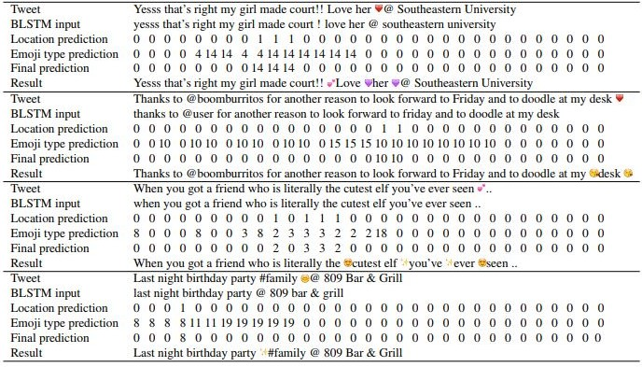
BLSTM example

Slide 11
Conclusion
Problem proved to be very difficult
Tweets are unstructured and diverse
Even humans could have a hard time predicting emojis in tweets
Our model gives meaningful results

Slide 12
Thank you!

