Slide 1
DeepHunter: A Coverage-Guided Fuzz Testing Framework for Deep Neural Networks
Authors: ﻿
Xiaofei Xie, Lei Ma, Felix Juefei-Xu, Hongxu Chen, Minhui Xue, Bo Li, Yang Liu, Jianjun Zhao, Jianxiong Yin, Simon See.
Published in ﻿ISSTA 2019 - Proceedings of the 28th ACM SIGSOFT International Symposium on Software Testing and Analysis
Keywords: ﻿ Deep learning testing, metamorphic testing, coverage-guided fuzzing

Slide 2
Introduction
﻿DL has attained impressive success in many intelligent applications.
i.e. image classification, speech recognition, natural language processing, etc.
However, the DL software could exhibit incorrect result caused by hidden defects.
In safety-critical scenarios, these erroneous behaviors could be severe accidents and losses.
i.e. automatic car driving, medical assisting, etc.
Therefore, testing DNNs and finding defects in DNNs have received great attention to researchers.
Notes:
DL has attained impressive success in many intelligent applications such that image classification, speech recognition, natural language processing, etc. However, like the traditional software, the DNNs could also exhibit incorrect result caused by hidden defects. In safety-critical scenarios this erroneous behaviors could be a severe accidents and losses (i.e. automatic car driving, medical assisting, etc.). Therefore, testing DNNs and finding defects in DNNs have received great attention to researchers. The recent studies on testing DL software depicts some fundamental challenges: (a) the coverage of traditional software is source code based while the coverage of DL software is neuron based. (b) there is no obvious oracle for testing DNNs. In this paper, authors propose DeepHunter, a coverage-guided fuzz testing framework for detecting potential defects in DNNs.

Slide 3
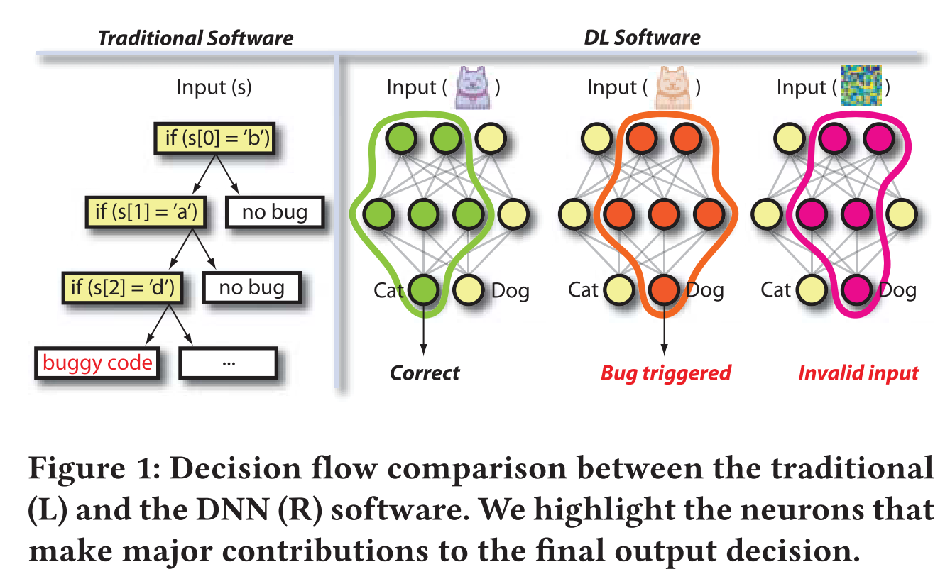
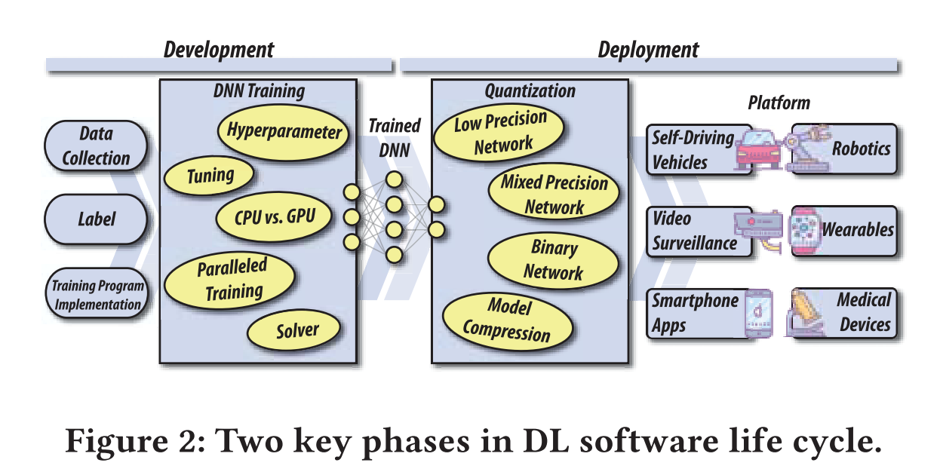
Motivation
﻿The recent studies on testing DL software depict some fundamental challenges:
The coverage of DL software is mostly neuron based, rather than source code based.
There is no obvious oracle for testing DNNs.
﻿In this paper, authors propose DeepHunter, a coverage-guided fuzz testing framework for detecting potential defects in DNNs.
Notes:
DL has attained impressive success in many intelligent applications such that image classification, speech recognition, natural language processing, etc. However, like the traditional software, the DNNs could also exhibit incorrect result caused by hidden defects. In safety-critical scenarios this erroneous behaviors could be a severe accidents and losses (i.e. automatic car driving, medical assisting, etc). Therefore, testing DNNs and finding defects in DNNs have received great attention to researchers. The recent studies on testing DL software depicts some fundamental challenges: (a) the coverage of traditional software is source code based while the coverage of DL software is neuron based. (b) there is no obvious oracle for testing DNNs. In this paper, authors propose DeepHunter, a coverage-guided fuzz testing framework for detecting potential defects in DNNs.

Slide 4
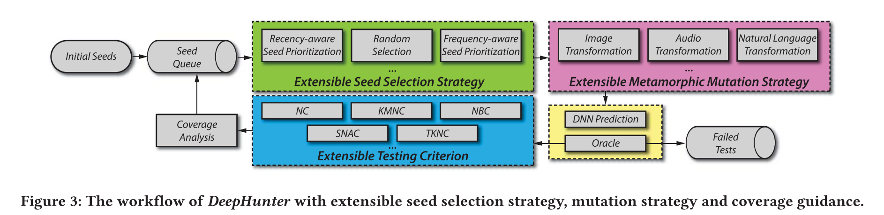
Workflow of DeepHunter (1/2)

Slide 5
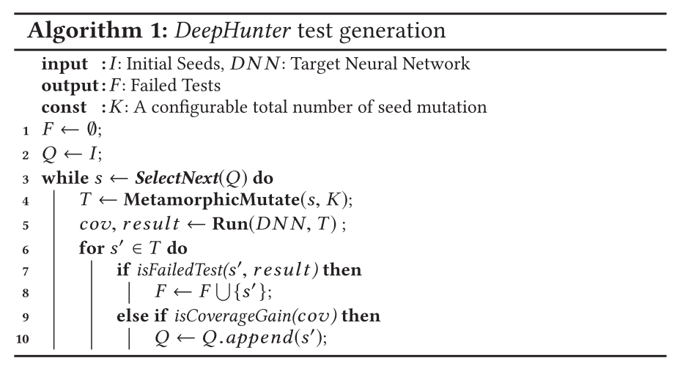
Workflow of DeepHunter (2/2)
Steps:
Start with an initial set of seeds.
Select seeds from the seed queue.
Mutate the seed K times to generate new tests.
Run the DNN against the newly generated tests.
For each new test:
Report failed test if crash is detected.
Save passed test into queue if maximizes coverage.
Otherwise ignore the seed.

Slide 6
DeepHunter Component: Extensible Seed Selection (1/3)
Seed Selection:
Random Testing (RT) without coverage guidance: selects a seed randomly from the queue.
DeepHunter + Uniform (DH+UF): selects a seed randomly from the queue.
DeepHunter + Probability (DH+Prob): selects a seed based on the number of times it has been fuzzed.
DeepTest: selects the last seed from the queue (add new coverage-gained seed to the end, otherwise remove).
TensorFuzz: selects a seed randomly from the ﻿reservoir (random 1 + last n-1) constructed from the queue.
Notes:
[ Orange: without coverage guidance. Green: with coverage guidance. ]
Approaches where the fuzzer is implemented with/without coverage guidance.
﻿(1) Random testing (RT) without coverage guidance. We use this as a baseline to compare with the coverage-guided strategies.
(2) DeepHunter+Uniform (DH+UF). Different from RT, this strategy guides RT using different testing criteria as feedback. A new test is put back to the seed queue if it improves the coverage.
(3) DeepHunter+Probability(DH+Prob), adopts the probabilistic seed prioritization strategy in DeepHunter with coverage guidance.
(4) DeepTest seed selection strategy with coverage guidance. In each iteration, the last seed is picked from the queue, based on which new tests are generated. A new test is added to the end of the queue if it improves the coverage. For a selected seed, if all of the generated tests cannot improve the coverage, the seed will be removed from the queue. Note that the seed queue may become empty in this strategy when the coverage is not improved with all the tests.
(5) TensorFuzz seed selection strategy with coverage guidance. Suppose the size of the queue is n > 0. In each iteration, the strategy first constructs a reservoir of m ≤ n seeds, which contains one seed randomly selected from the whole queue and other m − 1 seeds picked from the rear of the queue. Then a seed is randomly selected from the reservoir for further test generation. Our evaluation follows the default configuration of m in TensorFuzz (i.e., m = 6).

Slide 7
DeepHunter Component: Extensible Metamorphic Mutation (2/3)
Image Transformation:
Pixel Value transformation, P: (used multiple times)
image contrast, image brightness, image blur, and image noise.
Affine transformation, G: (used at most one)
image translation, image scaling, image shearing, and image rotation.
Mutation with only one affine transformation will not affect the semantics and the pixel value transformation can be used multiple times for increasing the changeability.

Slide 8
DeepHunter Component: Extensible Testing Criterion (3/3)
Coverage Analysis:
Neuron Coverage (NC)
k-Multisection Neuron Coverage (KMNC)
Neuron Boundary Coverage (NBC)
Strong Neuron Activation Coverage (SNAC)
Top-k Neuron Coverage (TKNC)
Notes:
Testing Criteria:
• ﻿Neuron Coverage (NC): NC bisects a neuron’s state into activated and non-activated. Given an input, a neuron is activated if its output value is above a predefined threshold. NC measures the ratio of activated neurons of a DNN.
• k-Multisection Neuron Coverage (KMNC): For each neuron, the range of its values (obtained from training data) are partitioned into k sections. An input covers a section of a neuron if the output value falls into the corresponding value section range. KMNC measures the ratio of all covered sections of all neurons of a DNN.
• Neuron Boundary Coverage (NBC): Similar to KMNC, NBC analyzes the value range of a neuron covered by training data, and measures to what extent the corner-case regions outside major functional range of a neuron [31] are covered.
• Strong Neuron Activation Coverage (SNAC): Similar to NBC, for each neuron, SNAC considers the value range that is above the maximum value seen during training. SNAC measures how the upper corner-case regions of neurons are covered.
• Top-k Neuron Coverage (TKNC): TKNC is a layer level testing criterion, which measures the ratio of neurons that have once been the most active k neurons of each layer on a given test set.

Slide 9
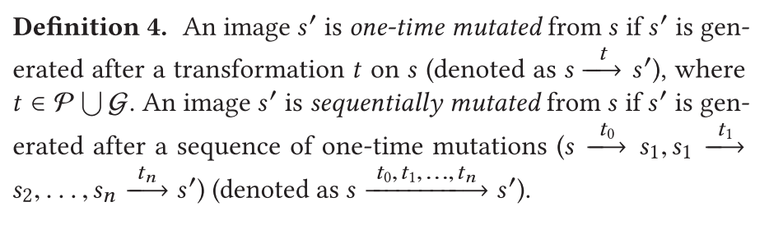
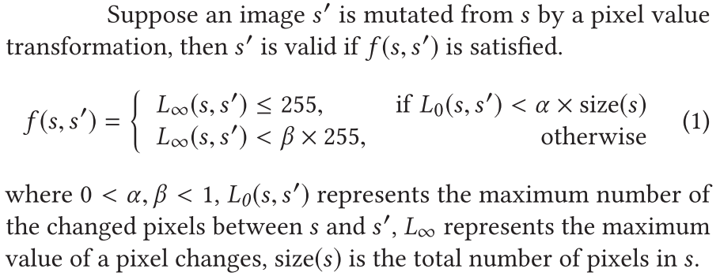
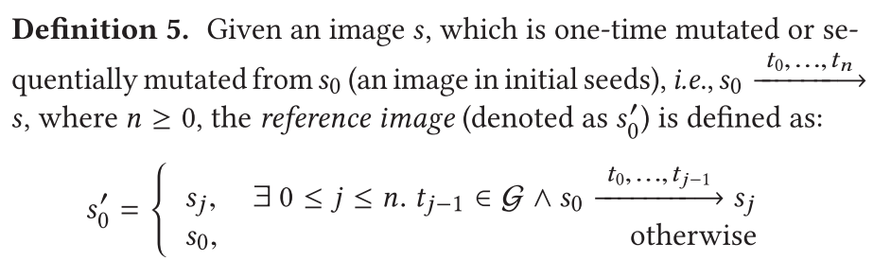
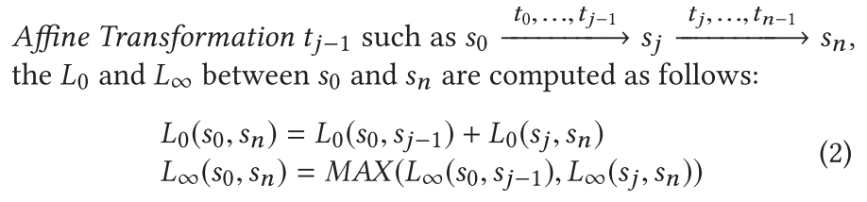
Test Oracle for Transformation

Slide 10
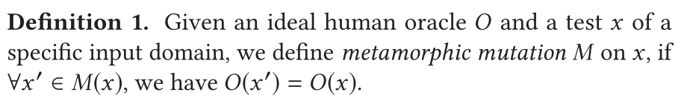
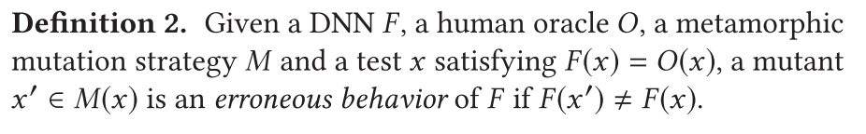
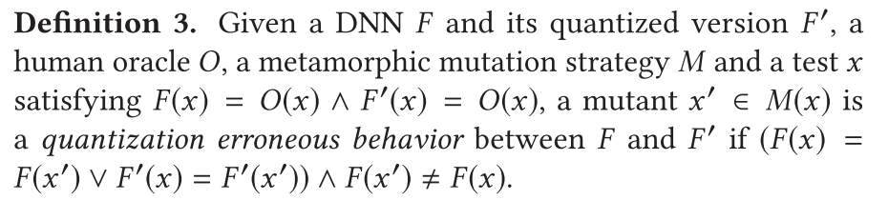
Test Oracle for Erroneous Behaviors
Notes:
﻿Quantization:
Optimizing model (to improve the computation efficiency, reduce memory consumption, and storage size) while maintaining same level of accuracy.
Once the DNN model is built, sometimes software and hardware specific customization is required to adopt in an end-user platform. (Platform Migration)
﻿Quantization reduces the precision of a DL model so as to improve the computation efficiency, reduce memory consumption, and storage size.
Previous studies have shown that quantizing the weights to lower bits (e.g., from 32-bit floating to 16-bit, 8-bit) greatly reduces the model size and energy consumption, while maintaining a similar level of accuracy.

Slide 11
Evaluation (1/2)
RQ1 (Metamorphic Mutation): How effective are different mutation strategies for generating semantic-preserving images?
RQ2 (Coverage): How effective are different testing criteria and seed selection strategies for improving coverage of DNNs?
RQ3 (Error Detection): How effective are different testing criteria and seed selection strategies for detecting erroneous behaviors of DNNs?
RQ4 (Platform Migration): Is DeepHunter applicable to detect the specific defects introduced by DNN quantization during platform migration?
Notes:
Authors ﻿of this paper leverage DeepHunter to answer the following research questions:
The RQx is about ‘xxx’ where they address how ‘yyy’.
RQ1 (Metamorphic Mutation): How effective are different mutation strategies for generating images that keep the same semantics with the original image from a human’s perspective?
RQ2 (Coverage): As DNN-based models are fundamentally different from traditional software, compared with random testing, is the CGF still effective for improving coverage in DNN testing? How effective are the different seed selection strategies for improving coverage under different criteria?
RQ3 (Error Detection): How different are the existing criteria for guiding erroneous behaviors detection? How effective are different seed selection strategies for detecting erroneous behaviors of DNNs? How diverse are the erroneous behaviors detected by different strategies?
RQ4 (Platform Migration): Is DeepHunter applicable to detect the specific defects introduced by DNN quantization during platform migration?
﻿Quantization:
Optimizing model (to improve the computation efficiency, reduce memory consumption, and storage size) while maintaining same level of accuracy.
Once the DNN model is built, sometimes software and hardware specific customization is required to adopt in an end-user platform. (Platform Migration)
﻿Quantization reduces the precision of a DL model so as to improve the computation efficiency, reduce memory consumption, and storage size.
Previous studies have shown that quantizing the weights to lower bits (e.g., from 32-bit floating to 16-bit, 8-bit) greatly reduces the model size and energy consumption, while maintaining a similar level of accuracy.

Slide 12
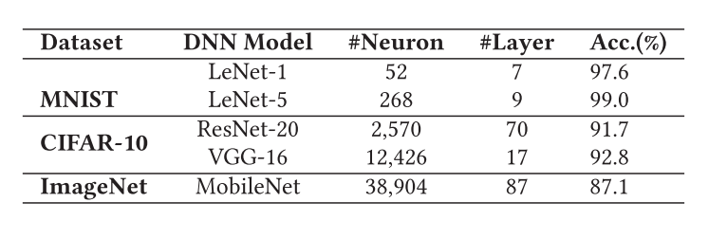
Evaluation (2/2)
Data and DNN models:
DeepHunter vs State-of-the-art:
Random Testing (as baseline)
DeepTest
TensorFuzz

Slide 13
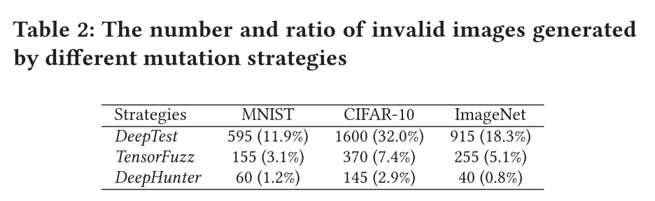
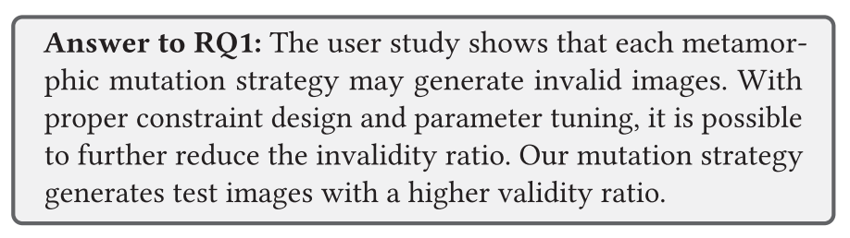
RQ1. User Study on Metamorphic Mutation
Observations:
﻿DeepTest generates many invalid images without constraints.
TensorFuzz reduces the invalid images generation ratio with transformation constraint.
﻿The conservative setting in DeepHunter confines the invalidity ratio to be even lower.
The invalidity rate of CIFAR-10 is generally higher than MNIST and ImageNet as the resolution of CIFAR-10 is relatively low.
Notes:
Settings:
3 mutation strategies
3 datasets
30 seed images
5,000 mutated images
Finally, 9 sets, with a total of 45,000 test images (= 3 datasets x 3 strategies x 5,000 generations) are generated.
These generated image is marked invalid if it either could not be manually perceived by a ﻿participant.

Slide 14
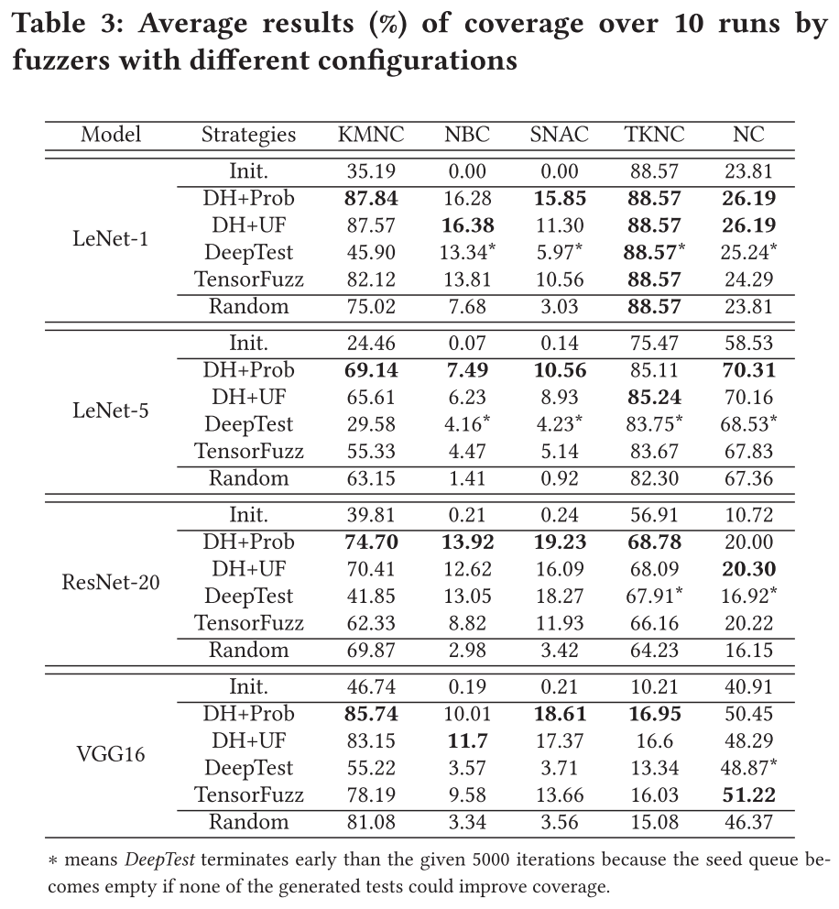
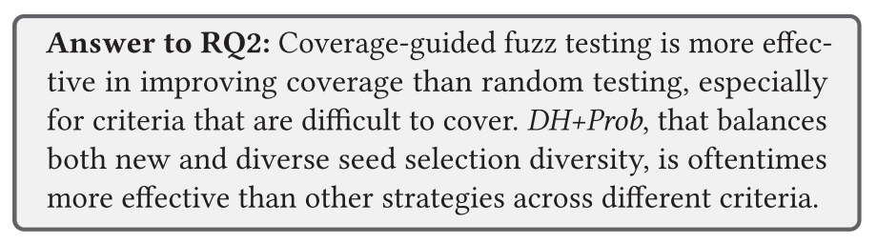
RQ2. ﻿Results of Coverage Increase
Observations:
﻿CGF is effective to maximize coverage than RT.
﻿DH obtains higher coverage than Tensorfuzz and DeepTest as DH ﻿selects diverse seeds while latter two prefer new generated seeds.
It is relatively easier to improve coverage for KMNC/TKNC/NC (measure the major behaviors) than NBC/SNAC (represent the corner-regions).
Notes:
﻿Despite fundamentally different from traditional software, CGF is still effective to maximize coverage than random testing, especially for those criteria that are difficult to cover.
﻿Different from fuzzers oftraditional software that usually prioritize selecting newly generated tests, sampling diverse seeds from the queue is also important in DNN testing.
﻿The difficulty in enhancing coverage ofdifferent criteria is different.
Settings:
30 different fuzzers: 5 testing criteria × 6 seed selection strategies. (Init. = ﻿initial seeds only).
﻿To counter the randomness effect, repeat the execution of each fuzzer 10 times and average the results.

Slide 15
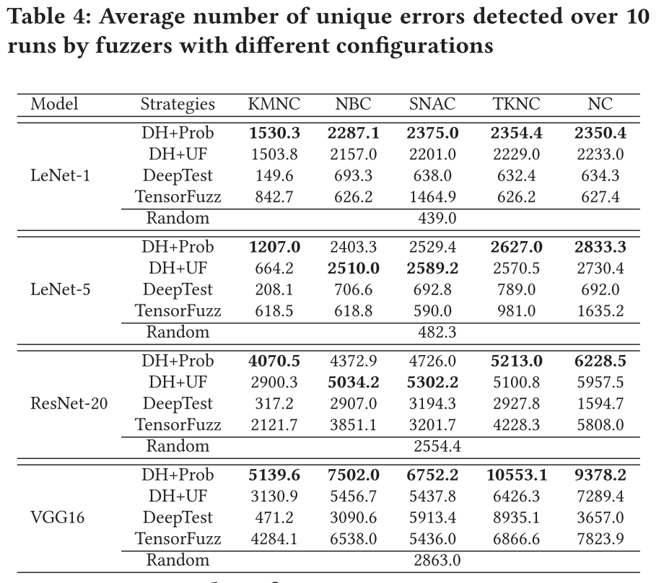
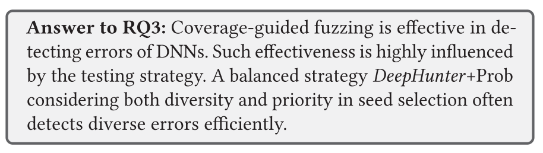
RQ3. ﻿ ﻿Results of Error Detection (Unique)
Observations:
﻿CGF is effective in detecting more unique errors than RT.
﻿CGF detects more unique errors when ﻿model becomes more complex (i.e. ﻿VGG16).
KMNC is less effective as it mainly considers the major functional behavior coverage.
DH+Prob detects more unique errors than the other strategies for most cases.
Notes:
Settings:
21 different fuzzers (5 testing criteria × 4 seed selection strategies + 1 RT with no coverage guidance).
To counter the randomness effect, repeat the execution of each fuzzer 10 times and average the results.

Slide 16
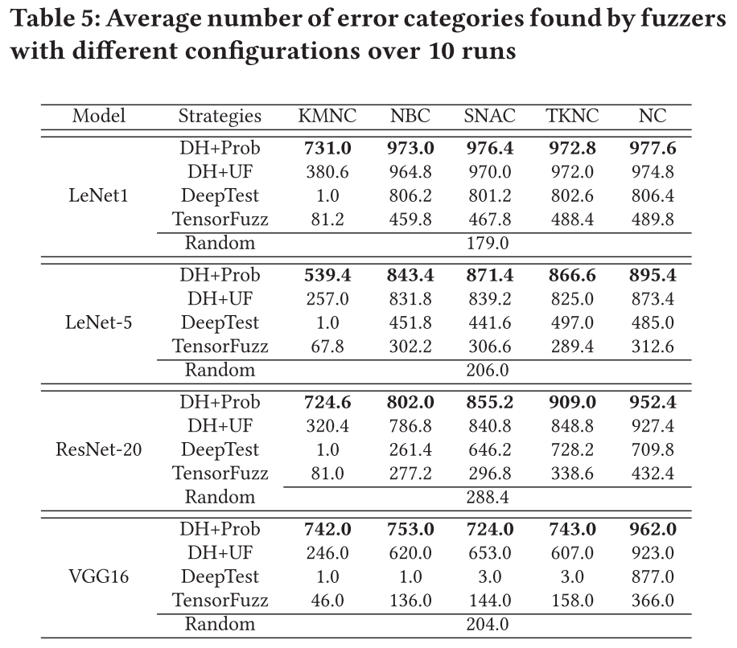
RQ3. ﻿ ﻿Results of Error Detection (Diverse)
Observations:
﻿CGF is effective in detecting more ﻿diverse errors than RT.
﻿CGF detects more diverse errors when ﻿model becomes more complex (i.e. ﻿VGG16).
KMNC is less effective as it mainly considers the major functional behavior coverage.
DH+Prob detects more diverse errors than the other strategies for most cases.
Notes:
Settings:
21 different fuzzers (5 testing criteria × 4 seed selection strategies + 1 RT with no coverage guidance).
To counter the randomness effect, repeat the execution of each fuzzer 10 times and average the results.

Slide 17
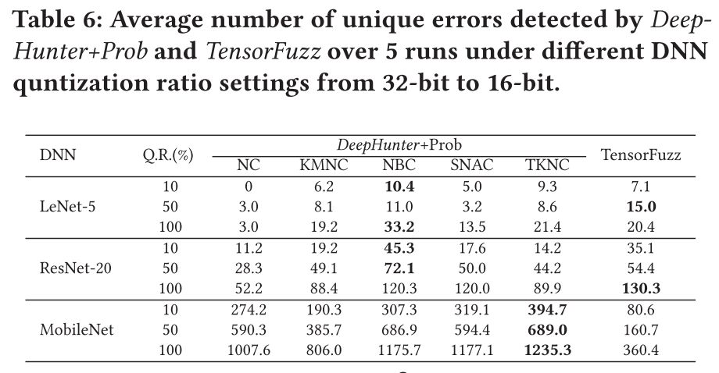
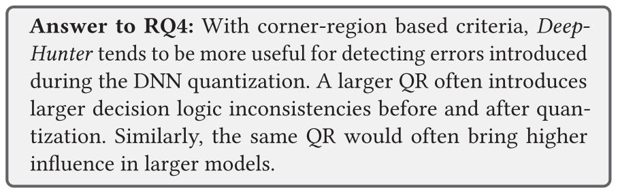
﻿RQ4. Error Detection for Quantization
Observations:
﻿The number of unique errors found by DeepHunter with different coverage guidance is different.
﻿Corner-region based criteria (NBC/SNAC/TKNC) is more useful to capture quantization errors.
﻿The number of unique errors tends to increase while QR increases and highest for 100%.
﻿Same QR would reduce the precision of more weights in a larger model (i.e. MobileNet).
Notes:
Settings:
﻿We select one DNN model for each of the three datasets (i.e.,LeNet-5, ResNet-20, and MobileNet).
For each model (originally in 32-bit floating point precision), we perform quantization with 3 con- figurations: (1) randomly sampling 10% ofweights and truncating 32-bit floating point to 16-bit, (2) randomly sampling 50% weights and truncating 32-bit floating point to 16-bit, and (3) truncating all weights from 32-bit floating point to 16-bit.
﻿To reduce the effect of the randomness during the mixed precision quantization, we randomly generate 10 different quantized models for each of the 10% and 50% sampling cases.
At runtime, we allocate 10 hours for test generation on each original unquantized model.
In addition, we repeat each configuration 5 times and average the results.

Slide 18
Conclusion
﻿ ﻿This paper proposed DeepHunter, a general coverage-guided fuzz testing framework for DNNs.
DeepHunter is designed to be extensible, which currently integrates four seed selection strategies and five testing criteria.
The large-scale comparative study demonstrated the effectiveness of DeepHunter.
DeepHunter can benefit on constructing high quality DNN software.

Slide 19
Thank you

