Slide 1
﻿Evaluating Fuzz Testing
Authors: George, Andrew, Benji, Shiyi, Michael.
Keywords: fuzzing, evaluation, security.
Published in 2018 ACM SIGSAC Conference
on Computer and Communications Security (CCS'18)

Slide 2
What experimental setup is needed to produce trustworthy results?
Dataset?
Timeout?
Effectiveness?
Version?
Machine?
Configuration?
Random?
?
Why should we care for trustworthy results?

Slide 3
Introduction
Fuzzing to find bugs.
Various techniques and algorithms.
Key questions:
Produce trustworthy results?
What experimental setup is needed?
Authors surveyed recent fuzzing papers.
Guideline to improve the experimental evaluations.

Slide 4
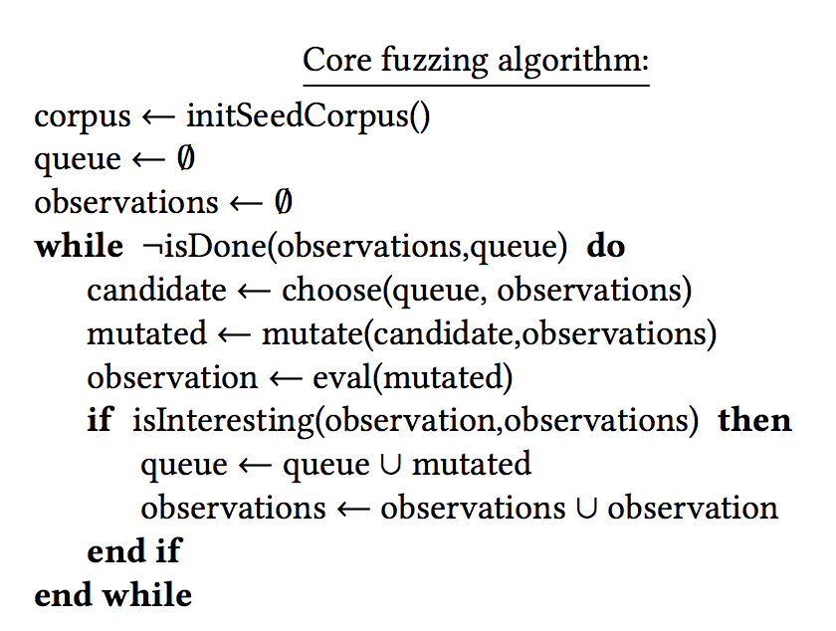
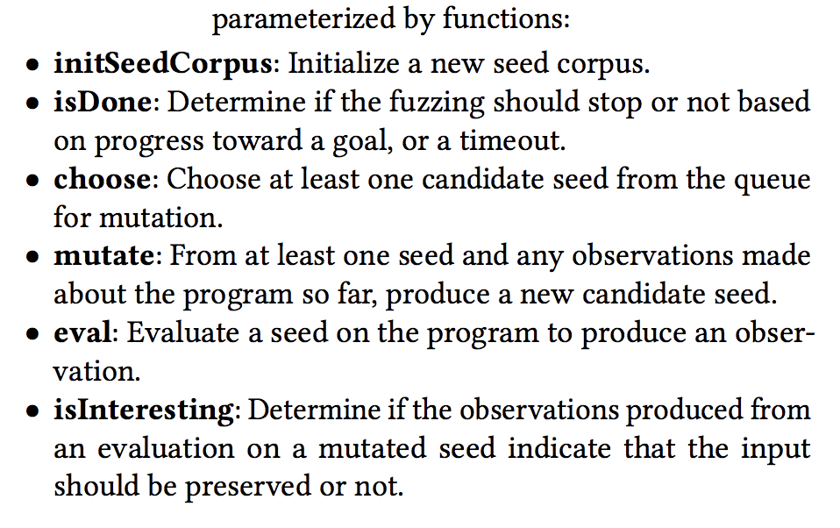
Fuzzing Procedure

Slide 5
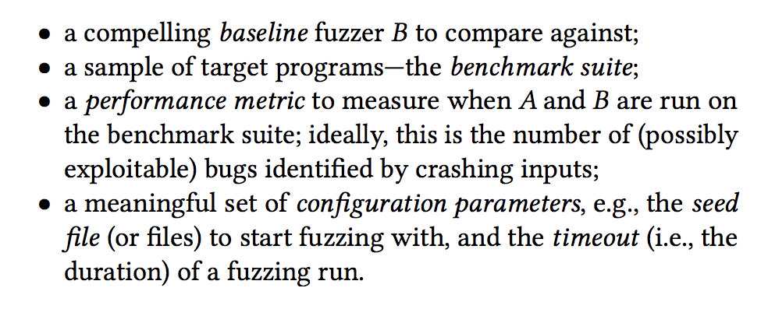
Why do researchers think fuzzers work?
When a researcher develops a new fuzzer algorithm (call it A), they must empirically demonstrate that it provides an advantage over the status quo.
To do this, they must choose:

Slide 6
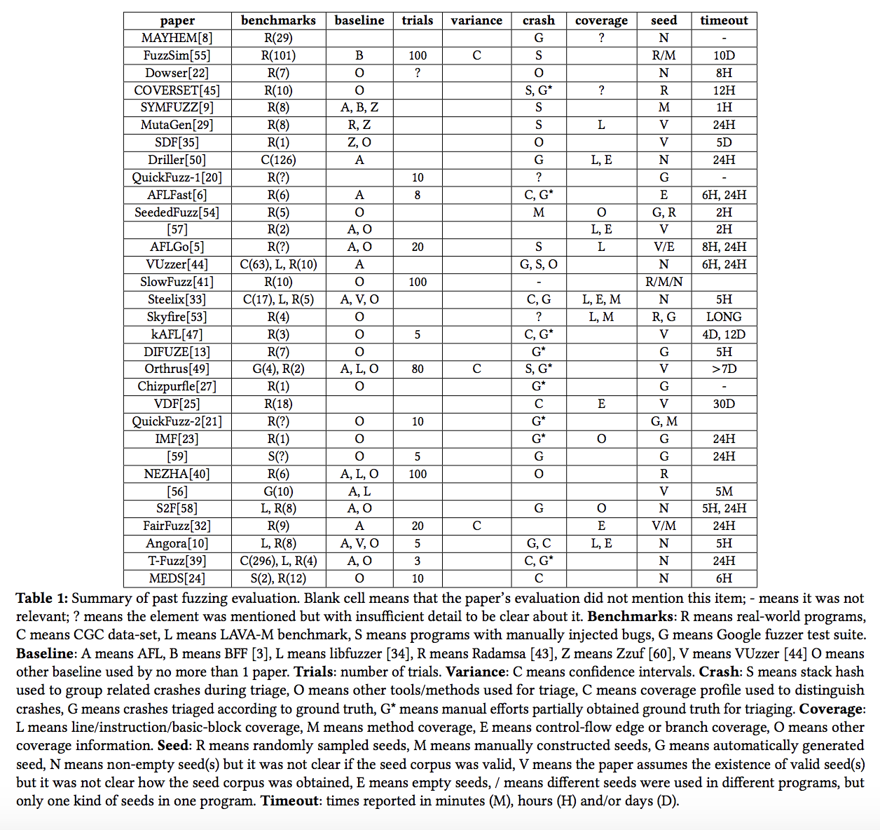
Survey the recent 32 fuzzing papers

Slide 7
Survey and Observation: Run
Fuzzing performance under the same configuration can vary from run to run.
Example on ‘nm’:
Run just one time:
AFL found just over 1200 crashes.
AFLFast found around 800 crashes.
By comparing the median of 30 runs:
AFL found 400 crashes.
AFLFast found closer to 1250 crashes.
2/3 of the examined papers does not give the details information about runs.
Few runs may paint a misleading picture, its better to run multiple times.

Slide 8
Survey and Observation: Timeout
Fuzzing performance can vary over the course of running time.
Example on ‘gif2png’ when using the empty seed:
After13 hours: AFL found no crashes but AFLFast had found nearly 40.
After 24 hours: AFL had found 39 and AFLFast had found 52.
11 of the examined papers used less than 5 or 6 hours running time.
Less than 5 or 6 hours is not good, it may conclude incomplete result.

Slide 9
Survey and Observation: Seeds
Fuzzing performance can vary based on the seeds used.
Example on ‘nm’:
AFLFast found more than 1000 crashes with an empty seed.
But found only 24 for a small non-empty seed.
Example on ‘FFmpeg’ with 24 hours timeout:
AFL & AFLFast found more crashes than AFLNaive with empty seed.
AFLNaive found more crashes than AFL & AFLFast with non-empty seeds.
Most papers apparently assume that any seed would work equally well.
Different seed selection may impact the results differently.

Slide 10
Survey and Observation: Effectiveness
Fuzzing performance can vary based on the effectiveness criteria.
Effectiveness: code coverage, crashing inputs, unique bugs.
De-duplication: coverage profile, stack hashes, ground truth.
Example on ‘cxxfilt’ patches (fuzzed version to present):
Coverage profiles: 57,142 unique crashing inputs by → 9 distinct patches.
Stack hashes:16% crashes from one bug shared by crashes from another bug.
AFLFast found many more “unique” crashing inputs than AFL, but slightly found more unique bugs in a given run.
Only ¼ of the examined papers used the direct measure of unique bugs although it is highly preferred effectiveness.

Slide 11
Survey and Observation: Target Programs
Fuzzing performance can vary based on the target programs.
Example:
AFLFast performed better than AFL on binutils programs but not on image processing programs.
Versions of binutils were different in different papers: AFLFast used 2.26, but FairFuzz used 2.28, and Angora used 2.29.
CGC benchmark was subset: Driller, VUzzer, and Steelix were evaluated on 126, 63, and 17 out of the 296 programs, respectively.
In general, few papers use a common-diverse benchmark suite, while the rest used a few handpicked programs.
As a result, individual evaluations may present misleading conclusions.

Slide 12
Own Experimental Setup
Authors came out with their own experimental evaluation to conclude some guidelines of fuzz testing. The experimental setup contains following steps:
Baseline Fuzzers: AFL 2.43b as baseline B and AFLFast as advanced A.
Benchmark programs: 3 binutils programs (nm, objdump, cxxfilt), 2 image processing programs (gif2png, FFmpeg).
Performance measure: number of unique (unique by coverage profile) crashes induced over some period of time.
Platform & configuration: Tested on same machine with different seed, 30 trials per configuration, and 24 hours per trial.
Finally, statistically comparing their performance and conclude some guidelines.

Slide 13
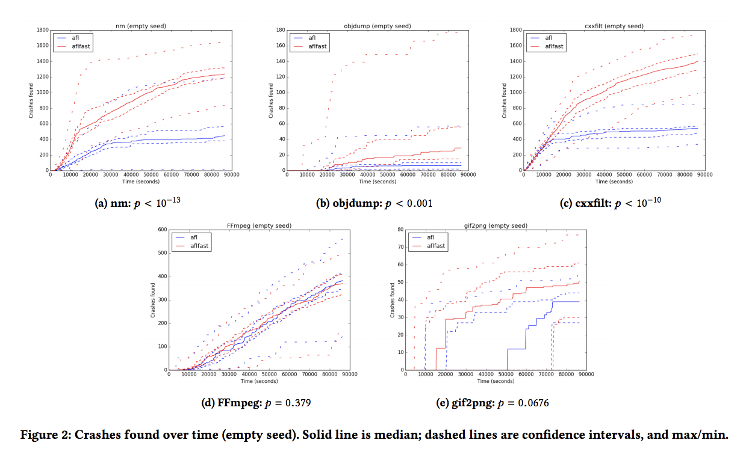
Evaluation Results: Statistically Comparisons
Main takeaway:
Only a single trail may yield to the wrong conclusion.
Running multiple trials and reporting averages is better.
Only comparing average may yield to the wrong conclusion.
Using statistical test (u-test/t-test) is better as the difference in averages may not be statistically significant with enough variance.

Slide 14
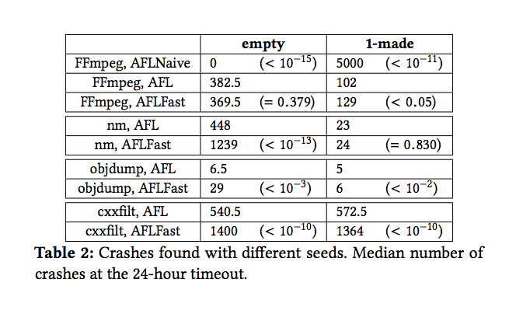
Evaluation Results: Seed Selection
Main takeaway:
The details of the initial seed may unimportant but there is an interaction between seeds and results.
Using a variety of seeds is better when evaluating programs and fuzzers.

Slide 15
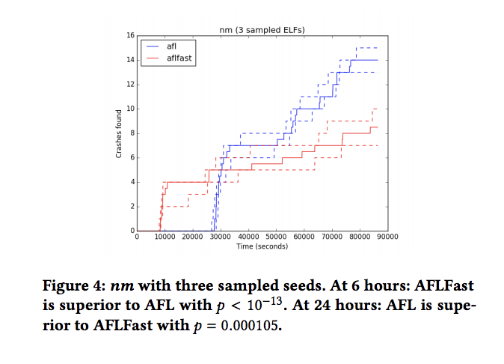
Evaluation Results: Timeout
Main takeaway:
Few hours (less than 6) may produce incomplete result.
Shorter times (over night run) may be more useful in real world scenarios.
Some particular algorithms might be better with longer running times to find out significant number of crashes.

Slide 16
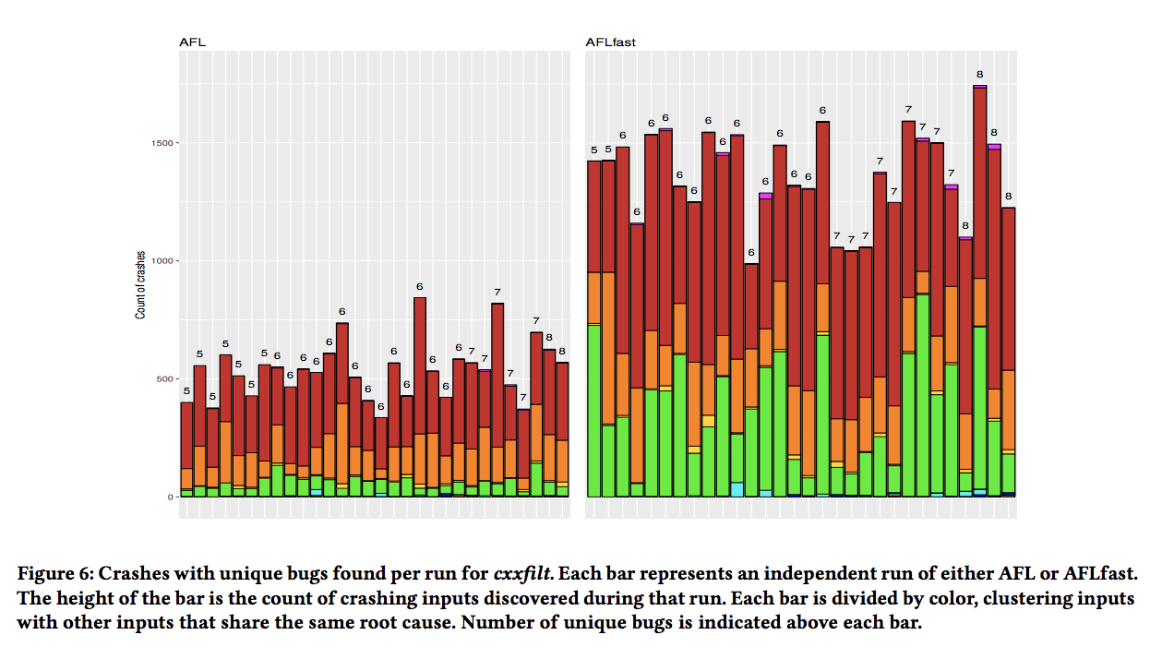
Evaluation Results: Effectiveness
Main takeaway:
Stack hashing is far better than coverage profiles, but not than ground truth.
Heuristics rather than ground truth as de-duplication strategy can lead to misleading or wrong conclusions.
Code coverage as performance measure is secondary with primary ground truth strategy.

Slide 17
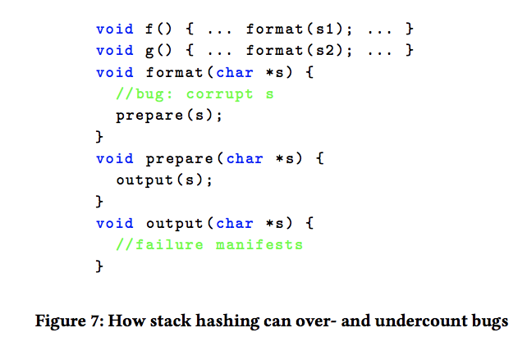
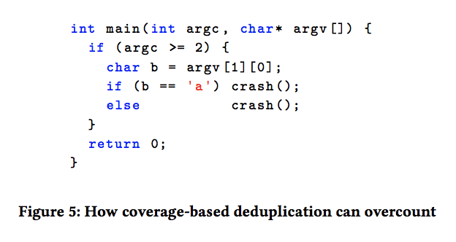
Examples of De-duplication Over/Under-count

Slide 18
Evaluation Results: Target Programs
Main takeaway:
Insufficient number of targets and different version may yield to the wrong conclusion.
So, the suite should select programs with clear details (number of program, when bug found and fixed, etc), the suite should be large enough, the version should be same during comparison.
And testing should also handle the overfitting.
Real programs suite:
Google Fuzzer Test suite.
Binutils programs: nm, objdump and cxxfilt.
Image processing programs: FFmpeg and gif2png.
Artificial programs suite:
DARPA CGC.
LAVA-M: base64, md5sum, uniq, and who.

Slide 19
Conclusion
Authors recommend that fuzz testing evaluations should have the following elements:
Multiple trials with statistical tests.
A range of benchmark target programs with known bugs.
Measurement of performance in terms of known bugs with coverage as a secondary effectiveness.
A consideration of various seed choices including empty seed.
Timeouts of at least 24 hours, or else justification.

Slide 20
Thank you

