Slide 1
T-Fuzz: Fuzzing by Program Transformation
Authors: Hui Peng, Yan Shoshitaishvili, Mathias Payer
Published in 39th IEEE Symposium on Security and Privacy (SP ’18)

Slide 2
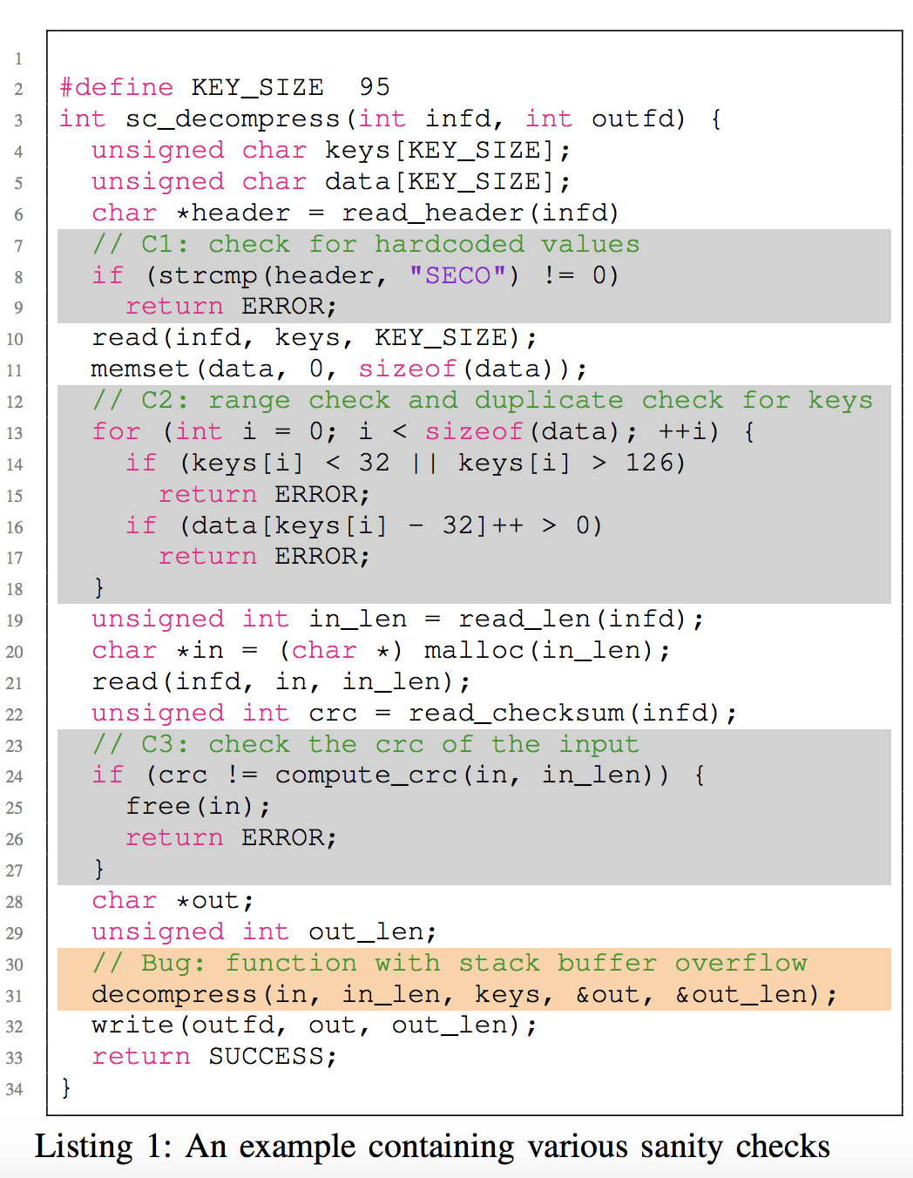
[Bug in line #31]: function with stack buffer overflow
Sanity check(s):
[C1 in line #08]: check for hardcoded magic values
[C2 in line #14]: range check and duplicate check for keys
[C3 in line #24]: check the crc of the input
Challenge: 4 return statements before buggy line.
Approach: Bypass or Neglect the sanity checks!

Slide 3
Introduction
Program can contain complex sanity check (i.e. magic values, checksums, or hashes).
That prevents fuzzer to execute some portion of the code that may contain bugs.
Fuzzer struggles with code coverage and fails to trigger vulnerabilities.
The existing state-of-art approaches used to bypass the sanity check.
But it is time-consuming and also gets stuck to find input for complex sanity check.
Authors introduce the Transformational Fuzzing (T-Fuzz) to address this issue.
A light-weight dynamic tracing based technique detect and remove the complex sanity check from the target program and generate transformed program.
T- Fuzz covers more code and finds more true bugs than any existing technique.

Slide 4
Related Works
The followings are previous works:
The existing state-of-art approaches used heavyweight program analysis techniques to bypass the sanity checks.
The existing approaches rely on imprecise heuristics or complex input mutation techniques (e.g., symbolic execution or taint analysis) to bypass sanity checks.
T-Fuzz differs from previous efforts in terms of detecting critical check, transforming program by removing checks, analyzing crashes and reproducing bugs in original programs.

Slide 5
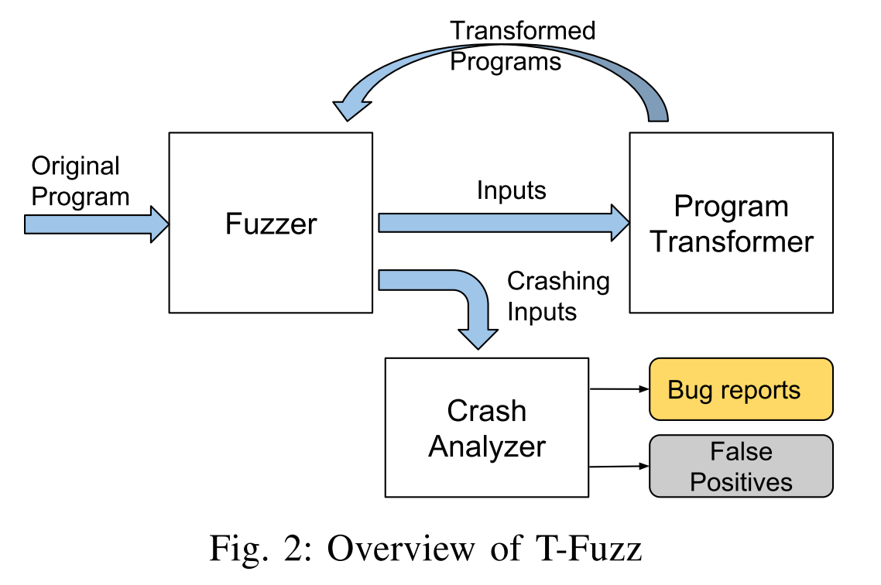
How T-Fuzz Works (1/2)
The basic workflow of T-Fuzz:
Fuzzer (AFL):
Coverage based Heuristic fuzzer
Program Transformer:
Detect non-critical check
Remove/neglect sanity check
Crash Analyzer:
Filtering out false positives
Reproducing true bugs

Slide 6
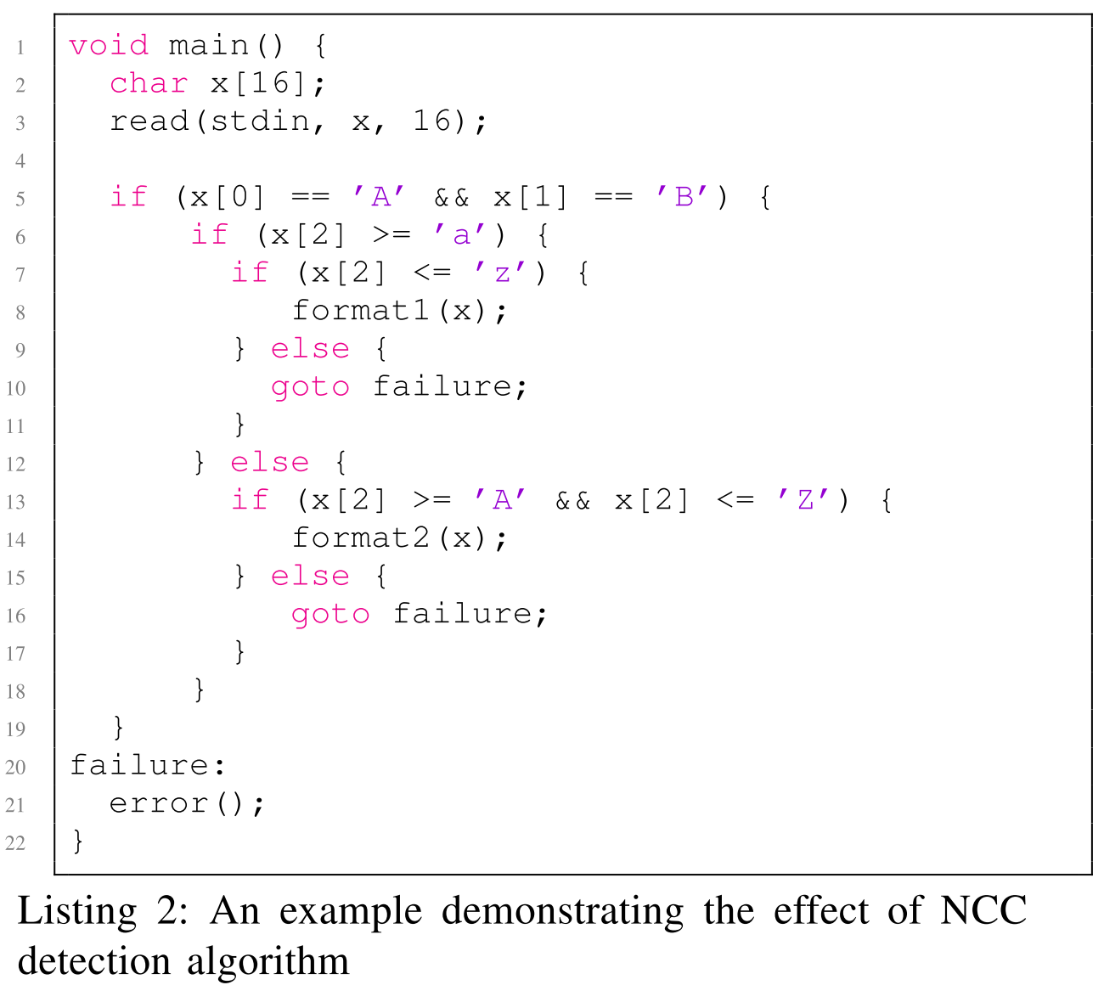
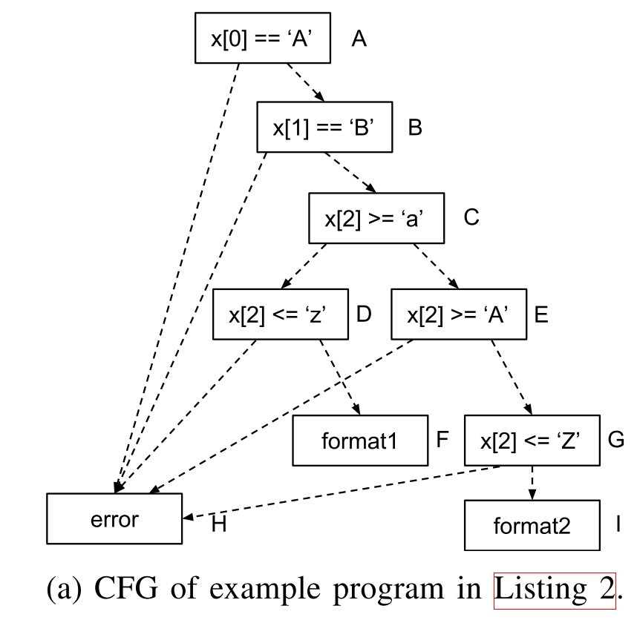
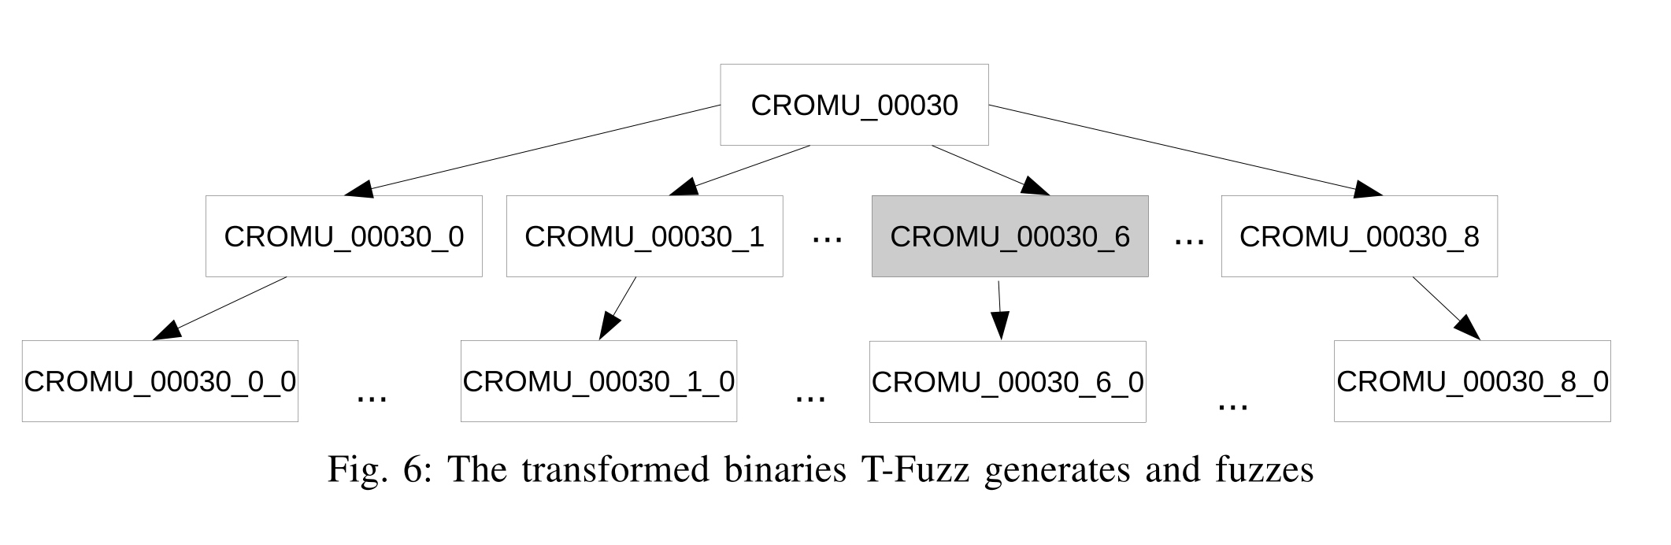
How T-Fuzz Works (2/2)

Slide 7
Implementation of the Solution
Create a prototype in Python with a set of open source tools:
Fuzzer: AFL
Program Transformer: angr tracer and radare2
Crash Analyzer: angr
Running configuration:
﻿Ubuntu 16.04 LTS
Intel i7- 6700K processor
32 GB of memory

Slide 8
Evaluation of the Solution
Setup a large-scale evaluation on three datasets:
DARPA CGC dataset
LAVA-M dataset
Set of real-world libraries

Slide 9
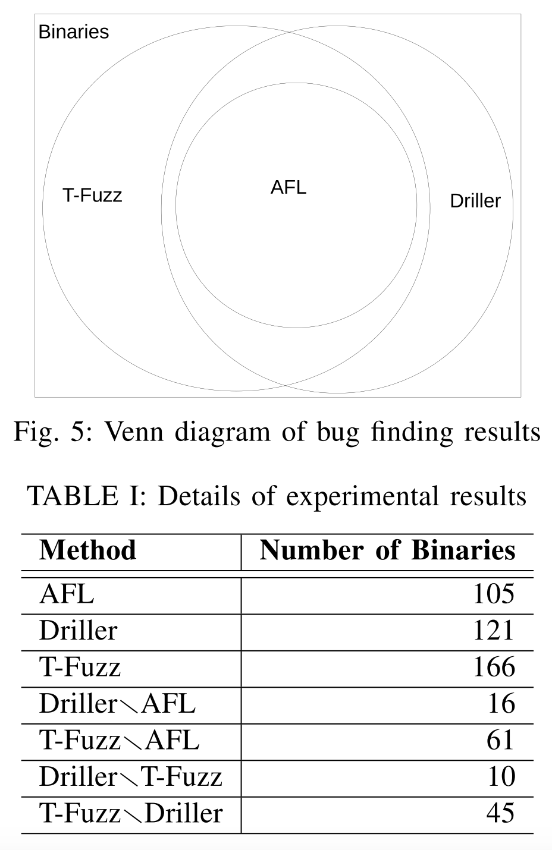
(1) Run on the DARPA CGC dataset (1/2)
CGC: A set of vulnerable programs used in the Cyber Grand Challenge event hosted by DARPA.
The dataset contains a total of 248 challenges with 296 binary programs.
Run the CGC binaries with 3 different configurations:
AFL (coverage based heuristic tool)
Driller (symbolic execution based tool)
T-Fuzz (proposed prototype)
Each binary was fuzzed for 24 hours with an initial seed of “fuzz” on the same set of binaries.

Slide 10
(1) Run on the DARPA CGC dataset (2/2)
Main takeaway:
All of the bugs found by AFL were discovered by both Driller and T-Fuzz.
T-Fuzz found bugs in 45 additional binaries in which Driller failed to find bugs.
45 binaries contain complex sanity checks.
Constraint solvers timeout to generate bypass input.
T-Fuzz failed to find bugs in 10 binaries in which Driller found bugs.
Reason#1: False positive occurs in the code path leading to a true bug.
Reason#2: True bug is hidden deep in a code path containing many sanity checks.

Slide 11
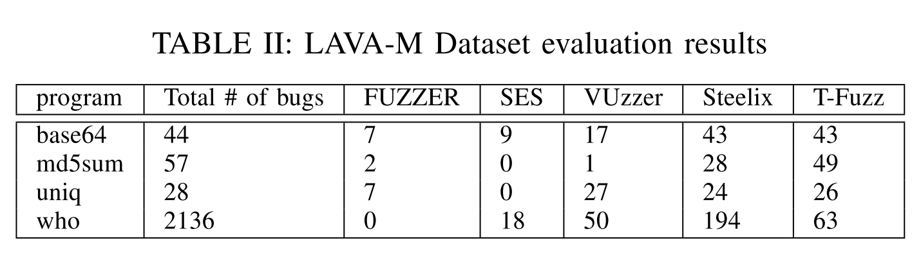
(2) Run on the LAVA-M dataset (1/2)
LAVA-M: A subset of the LAVA dataset consisting of 4 utilities from coreutils.
The dataset contains a set of vulnerable programs created by automatically injecting bugs.
Run the LAVA-M binaries with 5 different configurations:
FUZZER (coverage guided fuzzing tool)
SES (symbolic analysis based tool)
VUzzer (???)
Steelix (???)
T-Fuzz (proposed prototype)
Each binary was fuzzed for 5 hours.

Slide 12
(2) Run on the LAVA-M dataset (2/2)
Main takeaway:
FUZZER and SES performed worse than other tools.
Steelix and VUzzer performed well on base64, uniq and who.
Reason#1: Static analysis tools easily recover the hardcoded magic bytes of sanity check.
Reason#2: LAVA-M provides well formatted seeds to reach the injected code path.
T-Fuzz found more bugs in md5sum that were not found by Steelix and Vuzzer.
Contains hard sanity checks (i.e. MD5 sum) and so can not bypass those hard sanity checks.
T-Fuzz performed worse than Steelix in who due to the limited time budget.
Number of sanity check is huge that results in 578 generated transformed programs.

Slide 13
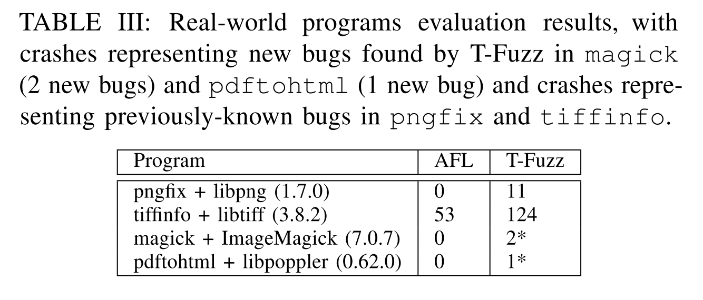
(3) Run on the real-world libraries (1/2)
- A set of libraries of 4 real-world program:
pngfix/libpng
tiffinfo/libtiff
magick/ImageMagick
pdftohtml/libpoppler
Run the libraries with 2 different configurations:
AFL (coverage based heuristic tool)
T-Fuzz (proposed prototype)
Each program was fuzzed for 24 hours with random seeds of 32 bytes.

Slide 14
(3) Run on the real-world libraries (2/2)
Main takeaway:
AFL did not trigger any crashes in pngfix, magick, pdftohtml and only found less than half of the crashes T-Fuzz found in tiffinfo.
Stuck very quickly for random seed.
Fail to bypass when code paths protected by multiple sanity checks. [?]
T-Fuzz found 3 new bugs (marked by *): 2 in magick and 1 in pdftohtml.
1 bug of magick has already been fixed in a recent revision.
Authors reported the remaining 2 to the developers.

Slide 15
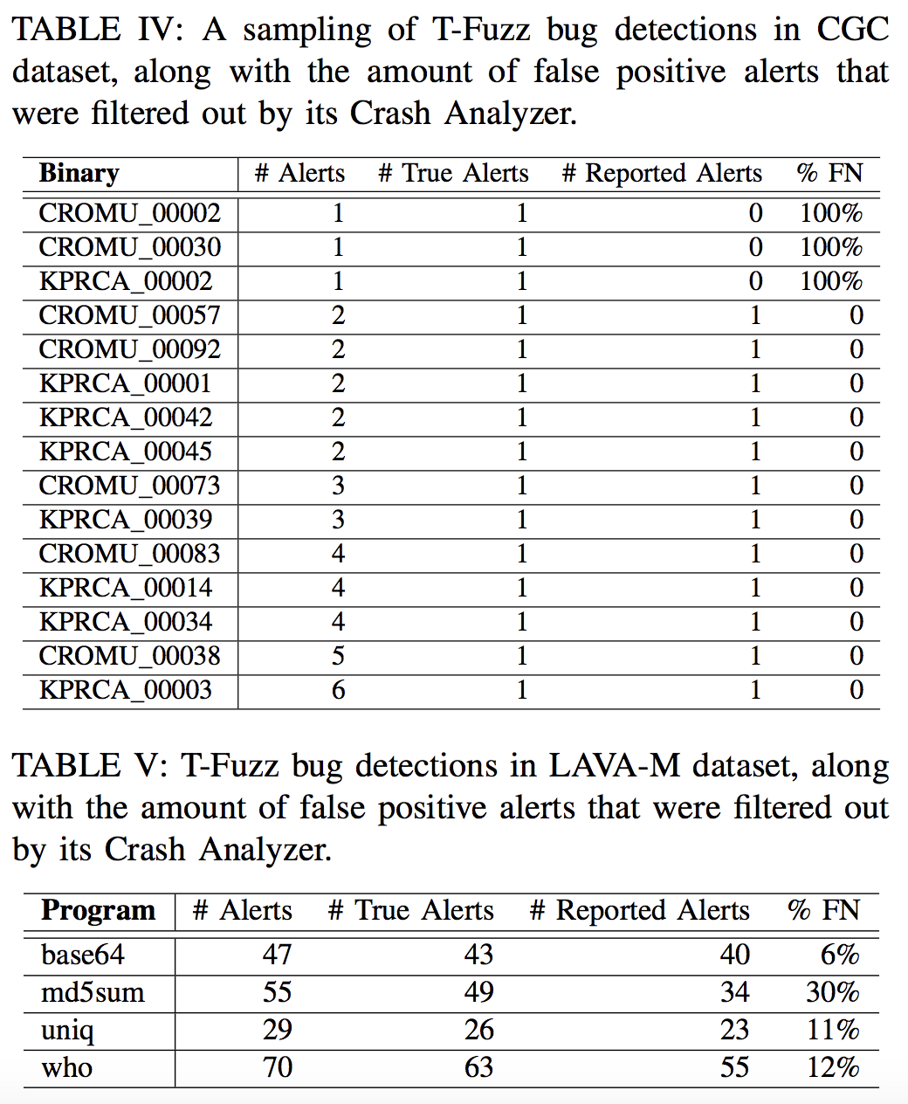
False Positive Reduction
The Crash Analyzer filter out false positive detections from program transformations.
The false positive detections that actually do hint at a bug resulting false negative reports.
In the CGC dataset and the LAVA-M dataset, T-Fuzz raised Crash Analyzer with 2.8 alerts and 1.1 alerts respectively for each true bug on average.
In CGC dataset and LAVA-M dataset, Crash Analyzer has an average false negative rate of ?% and 15%, respectively.

Slide 16
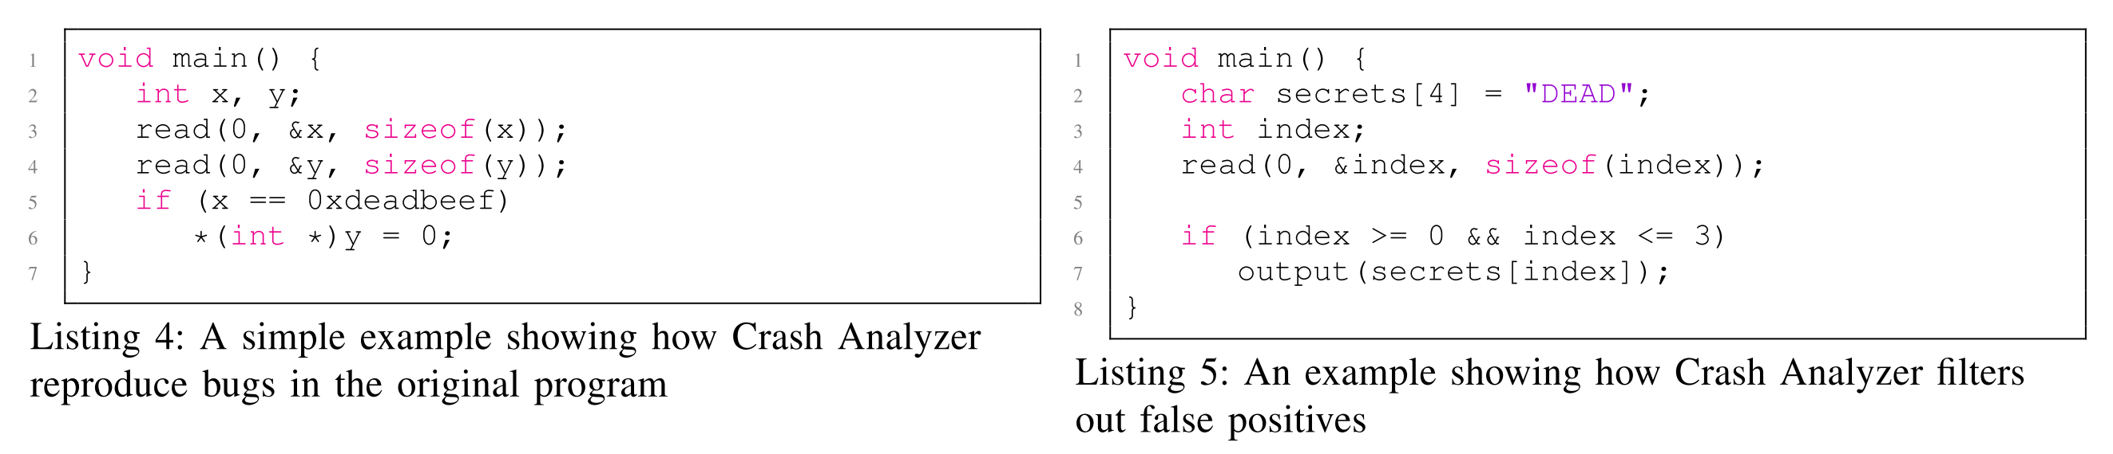
Some Examples

Slide 17
Threats to Validity
Running on different targets might change comparison results.
Setups with less or biased test suites might decrease performance.
Different seed value might produce different result in different test inputs.
Choosing different time limits might impact the experimental results.
Etc.

Slide 18
Future Directions
Developing heuristics on combining program transformation and input mutation.
Developing better approaches to cover the large search space.
Developing better approaches to filter the set of candidate crashes.
Etc.

Slide 19
Conclusion
T-Fuzz shows significantly better performance in the presence of “hard” sanity checks (i.e. checksum, hashing) in the target program.
T-Fuzz also suffers in limited time budget when the huge number of sanity check results in large number of transformed programs.
T-Fuzz is available at https://github.com/HexHive/T-Fuzz

Slide 20
Thank you

