Slide 1
Taming Compiler Fuzzers
Authors:Yang Chen, Alex Groce, Xiaoli Fern, Chaoqiang Zhang, Weng-Keen Wong, Eric Eide, John Regehr
Published in 34th ACM SIGPLAN conference on Programming language design and implementation, PLDI '13

Slide 2
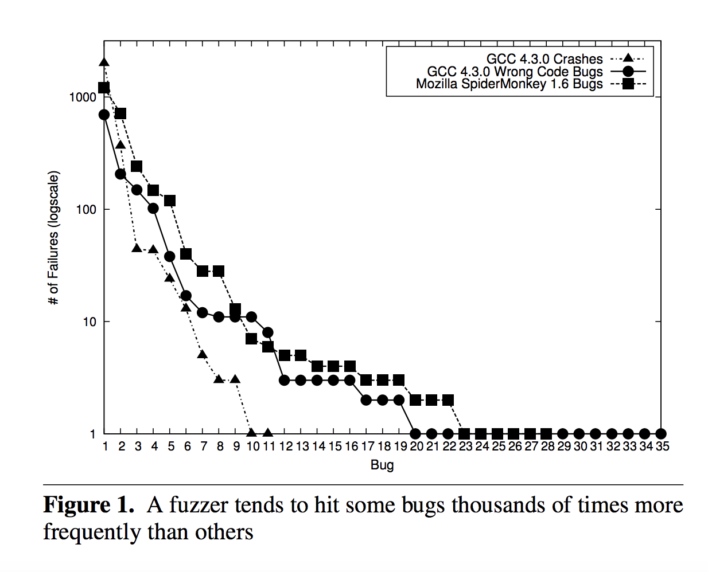
In November 2012, authors found 2,403 open bugs in GCC’s bug database.
The median-aged bug in this list was well over two years old.
Limited resources and inflexible deadlines may cause low-priority bugs to linger unfixed for months or years.

Slide 3
Abstract
Fuzzer: aggressive random testing tool.
- a single test case generator reported thousands of bugs for a single engine.
Currently users filter out undesirable test cases:
- Using ad-hoc methods
- Grepping test results manually
Fuzzer taming problem:
- Error inducing test cases are huge but mostly undesirable
Rank diverse and interesting test cases.
Evaluate for two fuzzers: JavaScript engines and C compilers.

Slide 4
Introduction
A typical workflow for using a random fuzzer:
start running the random tester
go to the bed
in the morning look for new failure inducing test cases
But Step 3 can be time-consuming and unrewarding, because
Sheer volume of failure inducing test cases
Most of them are redundant, undefined and unspecified
Many test cases can be difficult to debug
Noncritical bugs that may also already be known

Slide 5
Related Works
The followings are previous works:
jsfunfuzz used tools like grep to filter out test cases triggering bugs that have predictable symptoms and trigger known bugs.
During testing of mission file systems at NASA (Groce et al.) used hand-tuned rules to avoid repeatedly finding the same bugs.
McKeeman’s C compiler fuzzer and QuickCheck used built-in greedy support to reduce the size of test inputs.
Zeller and Hildebrandt formalized Delta Debugging as test case reduction.
Taming a fuzzer differs from previous efforts in terms of ignoring duplicate bug, detecting undesirable bug, ranking bug and the overall goal of taming a fuzzer.

Slide 6
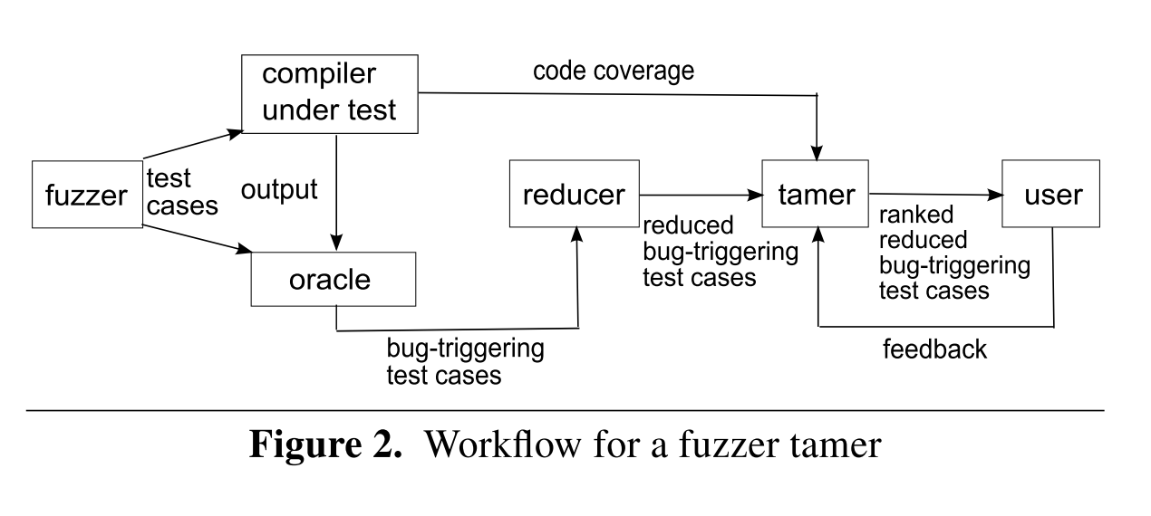
How Fuzzer Tamer Works (1/2)

Slide 7
How Fuzzer Tamer Works (2/2)
The workflow for a fuzzer tamer:
Fuzzer generates random test cases.
Reference compiler compiles test cases with code coverage information.
Oracle detects bug triggering test cases by watching reference compiler’s output.
Reducer produces the reduced bug triggering test cases.
Tamer ranks those reduced bug triggering test cases.

Slide 8
Characterize the taming problem
Main-problem:
Given a potentially large collection of test cases, each of which triggers a bug, rank them in such a way that test cases triggering distinct bugs are early in the list.
Sub-problem:
If there are test cases that trigger bugs previously flagged as undesirable, place them late in the list.

Slide 9
Distance Functions for Test Cases
The more “similar” two test cases, or two executions of the compiler on those test cases, the more likely they are to stem from the same fault.
L1: Levenshtein Distance (Edit Distance):
test cases themselves
output of the compiler as it crashes (if any)
output of Valgrind on a failing execution (if any)
L2: Euclidean distance (Vector Distance):
lexical feature vectors: types, statements, operators, etc.
feature vectors from compiler executions: token, line, function, etc.
Normalization:
L1 distance using the length of the larger strings
L2 vector element using the tf-idf

Slide 10
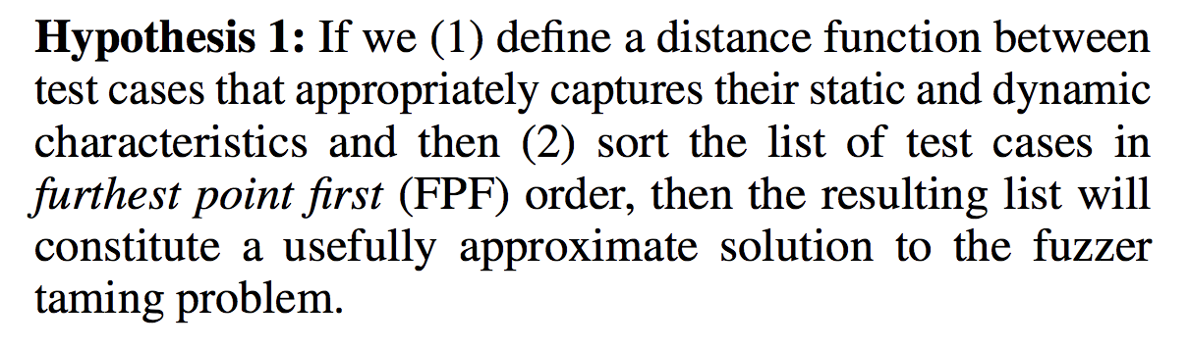
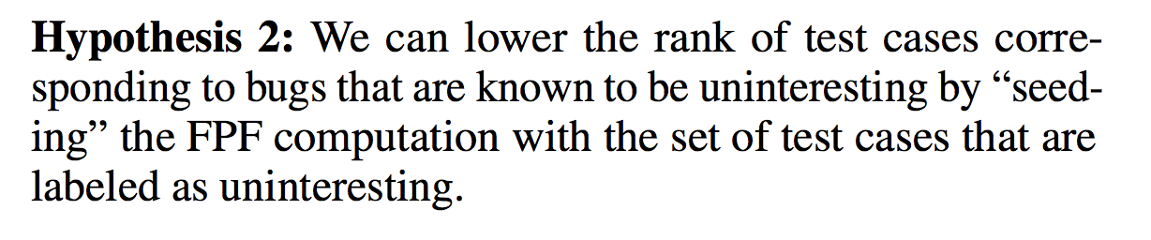
Ranking the Test Cases
The problem solving approach is based on the following idea:
Thus, the most highly ranked test case will be the one maximizing its minimum distance from any labeled test case.

Slide 11
Running Tests
Choose test inputs:
Choose C test inputs of Csmith
Choose JS test inputs of jsfunfuzz
Approach:
Define a distance function between test cases.
Sort the list of test cases in furthest point first (FPF) order.
Lower the rank of uninteresting test cases by seeding to FPF.
Apply the test cases:
GCC 4.3.0 (C compiler)
SpiderMonkey 1.6 (JS engine)

Slide 12
Evaluation of the Solution
Setup some experiments:
Effectiveness using Bug Discovery Curves
Selecting a Distance Function
Avoiding Known Faults
The Importance of Test-Case Reduction
Clustering as an Alternative to Furthest-Point-First (FPF)

Slide 13
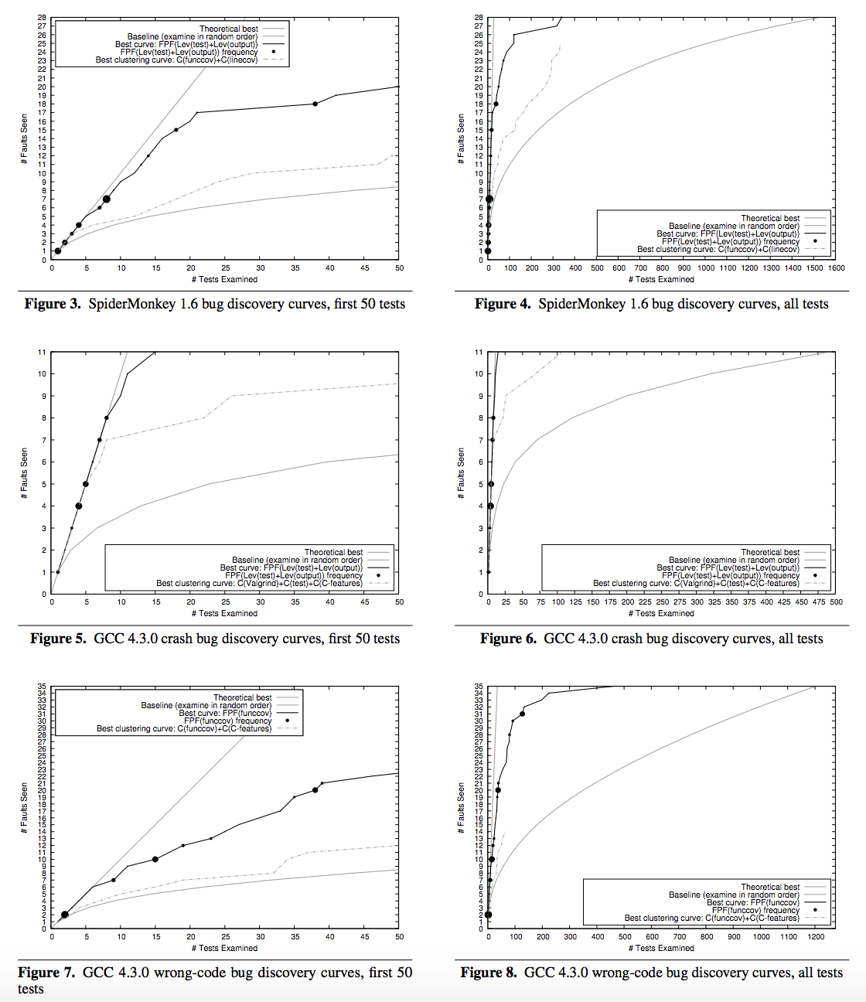
(1) Effectiveness using Bug Discovery Curves
Main-takeaway:
More distinct bugs can be detected in less time with ranked test instead of randomly chosen tests.
Ranked test cases provide better result than random test cases.

Slide 14
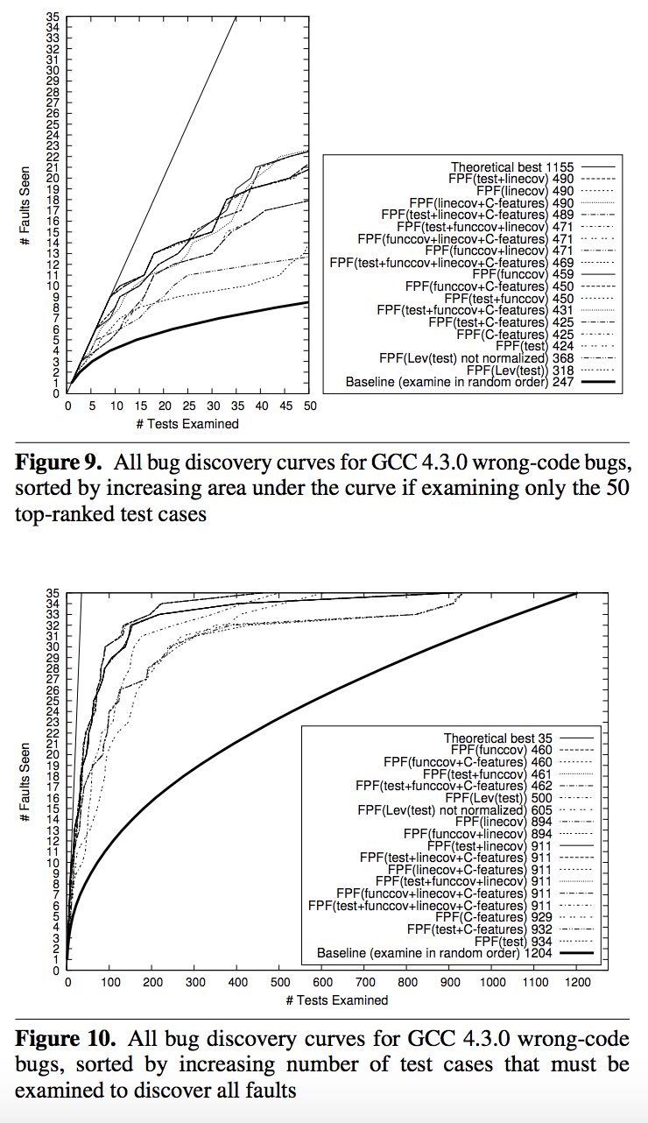
(2) Selecting a Distance Function
Main-takeaway:
L1 distance on the test-case text plus compiler output worked so well than their separate effects.
Compiler output plus C features worked well for GCC.
L1 distance based on test-case text alone (not normalized) performed moderately well for SpiderMonkey.
Coverage-based methods worked fairly well for SpiderMonkey.
Valgrind output alone performed extremely poorly in the long run for both GCC crashes and SpiderMonkey bugs.
Test-case text performed well with Levenshtein distance or when combined with line coverage.
Test-case text performed badly as a vectorization without line coverage.
Etc.

Slide 15
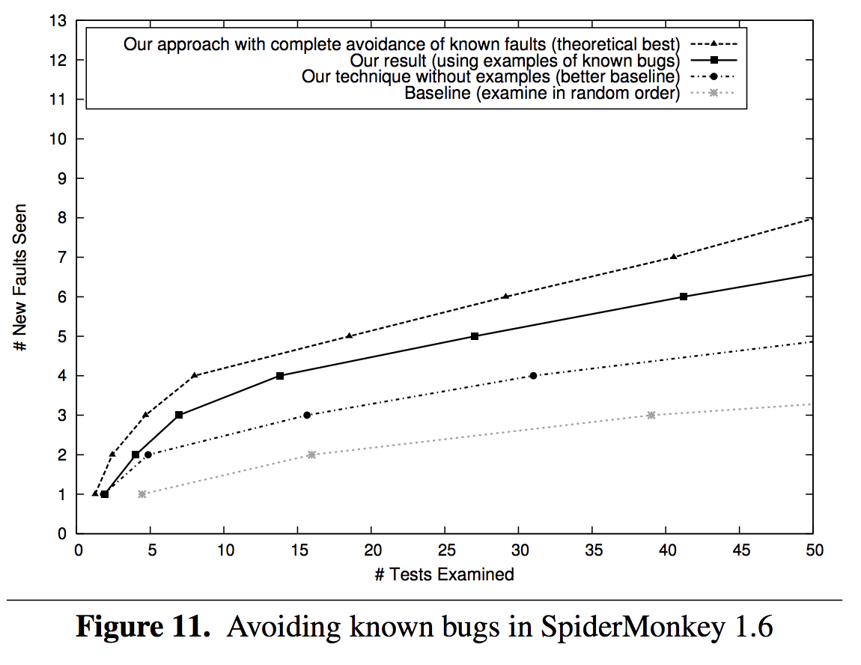
(3) Avoiding Known Facts
Main-takeaway:
Topmost curve (best case ): all known facts are removed.
Second curve (running case): five (or fewer) test cases for each known bug are used to seed the FPF.
Third curve (baseline): five (or fewer) test cases for each known bug are discarded.
Bottom curve (basic baseline): examined in random order.

Slide 16
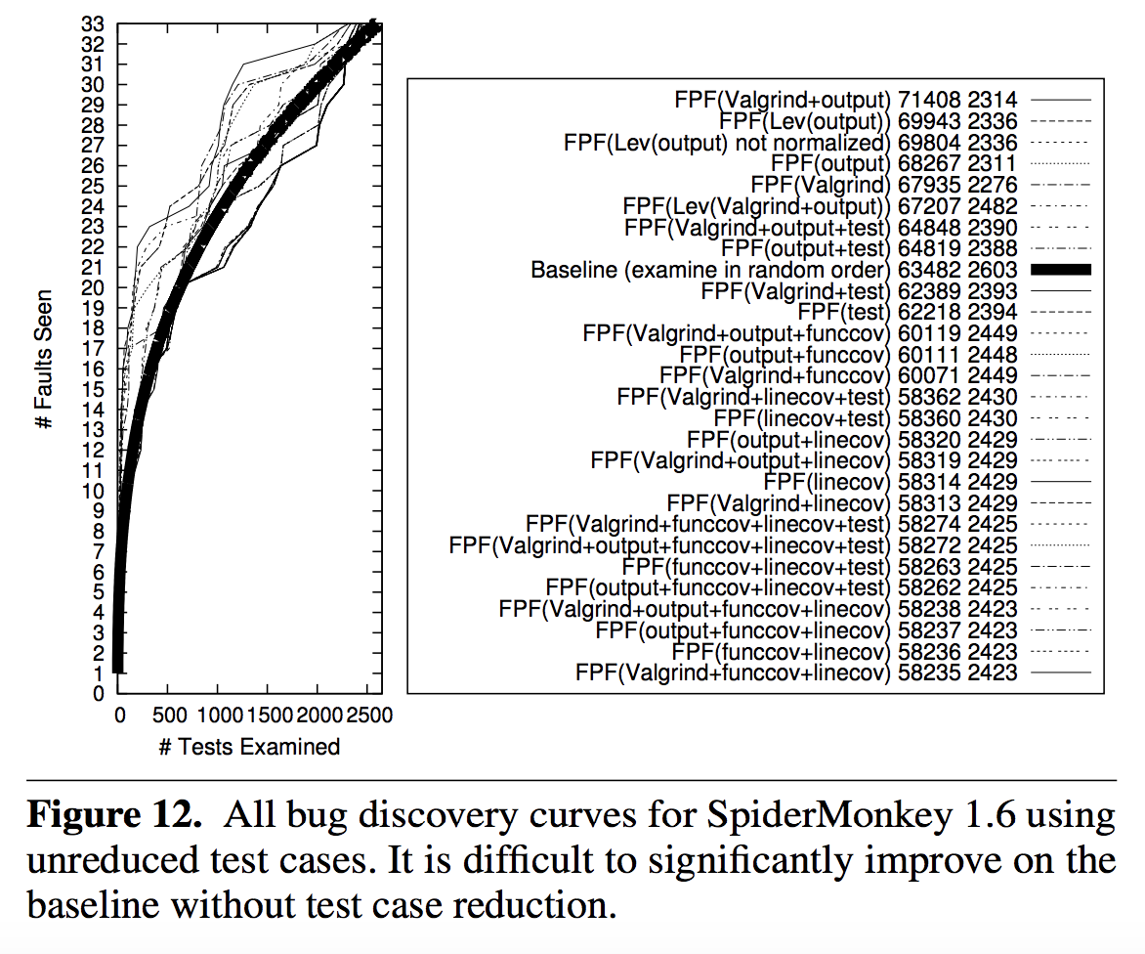
(4) The Importance of Test-Case Reduction
Main-takeaway:
Without test case reduction the overall discovery curve is worse than the baseline for many cases.
Reduced test cases triggered different bugs while unreduced test cases triggered many redundant bugs.
2,501 unreduced test cases that caused GCC 4.3.0 to crash, almost all triggered the same (single) bug that was triggered by the test case’s reduced version.

Slide 17
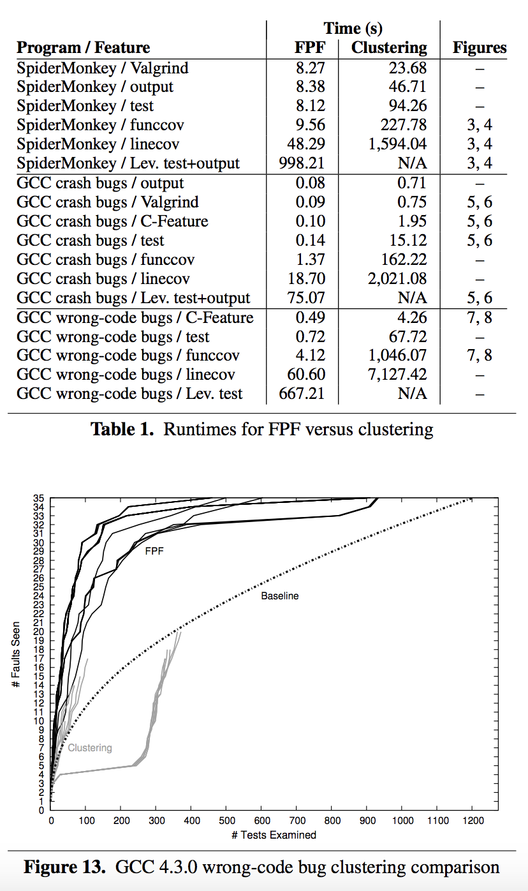
(5) Clustering as an Alternative to Furthest-Point-First (FPF)
Main-takeaway:
L1 is not compatible with X-mean clustering as it requires vector form as input.
Clustering independent feature vectors provides better result than Clustering large vectors combining multiple features.
Clustering with ranking provides better result than Clustering without ranking.
Clustering is more complex, more expensive and less effective and slow runtime than FPF.
clustering does not find all defects and even worse than the baseline in many cases.

Slide 18
Threats to Validity
Authors could not provide strong conclusion for choosing a specific setup of distance functions.
Different setup of distance functions might produce different result in different test inputs.
Running on different targets might change comparison results.
Setups with less or biased test suites might decrease performance.
Choosing different time limits might impact the experimental results.
Etc.

Slide 19
Future Directions
Improve by overcoming the mentioned Threats to Validity.
Apply into other complex interpreters for different languages.
?

Slide 20
Conclusion
Authors address and formulate fuzzer taming problem.
More distinct bugs in less time with ranked checking than a random ordering.
Evaluate the effectives with different type Bug Discovery Curves.
Results and Discussion:
Ranked order will be 4.6× faster in comparison to random order.
3,799 test cases triggering 46 bugs in a C compiler.
2,603 test cases triggering 28 bugs in a JavaScript engine.

Slide 21
