Slide 1
DeepFuzz: Automatic Generation of Syntax Valid C Programs for Fuzz Testing
Authors: Xiao Liu, Xiaoting Li, Rupesh Prajapati, Dinghao Wu.
Keywords: ...
Published in 2019 Conference on Artificial Intelligence (AAAI’19)

Slide 2
Introduction
GCC released in 1987 and over 3,410 bugs have been caught since it is created (Yang et al. 2011).
The code base of today’s GCC is around 15 million lines of code (Sun et al. 2016), close to the entire Linux kernel, which is around 19 million lines of code.
Verification: CompCert (Leroy et al. 2016) has made promising progress but challenging to fully verify all the features, results in limited features.
Grammar-based testing: Static is time-consuming and automated requires good understanding of input specification. i.e. C11 (ISO 2011) has 696 pages of detailed specification.
Learnt generative neural network based model can be used to the problem of automatically generating syntactically valid inputs for grammar-based fuzzing.

Slide 3
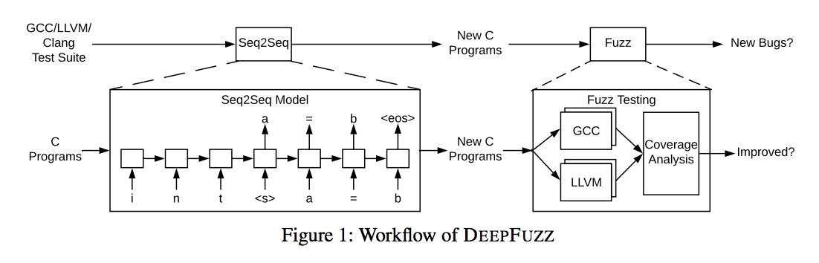
Workflow of DEEPFUZZ
Two main objectives:
﻿generate new programs
compiler testing efficacy
﻿ There are two stages:
﻿Program Generation
Compiler Testing

Slide 4
1) Program Generation
Training data set:
10,000 well-formed C programs from the GCC test suites.
Preprocess to avoid noise data:
comment, whitespace, and macro.
Train a learnt generative seq2seq model:
2 layers with 512 hidden LSTM units for each layer.
i.e. predict ‘main’ for a prefix ‘int’.
Sampling Variants to diversify the prediction:
NoSample, Sample, SampleSpace.
Generate new code from original seed sequence:
G1, G2, G3.

Slide 5
Sampling Variants
NoSample: Given a prefix sequence, predict the best next character on the learnt distribution.
Sample: Given a prefix sequence, propose to sample next character instead of picking the top predicted one.
SampleSpace: Only sample the next character among all the predicted ones over the threshold when the prefix sequence ends with a whitespace. This sampling method is a combination of Sample and NoSample.

Slide 6
Generation Strategy
G1: Insert the newly generated code based on the same prefix sequence at one place into the original well-formed programs.
G2: Generate new pieces of code with prefix sequences randomly picked from different locations in the original program and then insert back respectively.
G3: Chop out the same number of lines after the prefix sequence from the original program and insert the newly generated new lines into the position of the sentences that have been chopped out.

Slide 7
2) Compiler Testing
Three metrics to measure the effectiveness:
Pass rate:
The ratio of syntax valid program over generated C programs.
Use command line of gcc.
Coverage:
The line coverage, function coverage, and branch coverage.
Use gcov tool.
Bug:
Different compilers in different optimization levels.
Crash bugs and others code errors (internal compiler error).

Slide 8
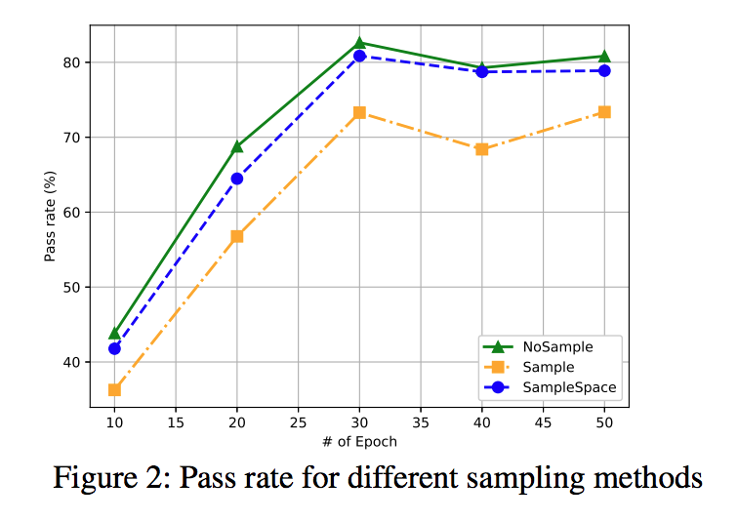
Experiment Results: Pass rate (1/2)
Epoch for G1:
The pass rate increases with more training from 10 to 30 epochs. The drop of pass rate after 30 epochs may be a result of overfitting.
The best pass rate for all sampling methods is achieved at 30 epochs training. The highest pass rate is 82.63%.

Slide 9
Experiment Results: Pass rate (2/2)
Sampling for G1:
For all the sampling methods, the pass rate increases within 30 epochs of training and after that, there is a small drop, may be for overfitting.
Comparing the pass rate for all the three sampling methods, NoSample achieves a better pass rate for every snapshot model than the other two methods Sample and SampleSpace. The highest pass rate is 82.

Slide 10
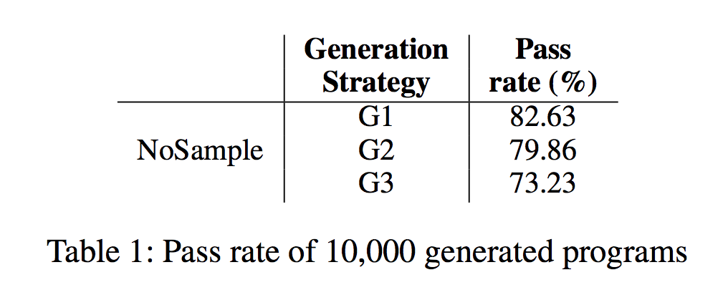
Experiment Results: Pass rate (3/3)
Generation Strategy for NoSample:
Comparing pass rate under three different generation strategies, G1 performs the best in terms of the pass rate under NoSample.
The reason for lower pass rate of G3 is probably that chopping out lines will introduce unbalanced statements, such as unclosed parenthesis, brackets, or curly brackets.

Slide 11
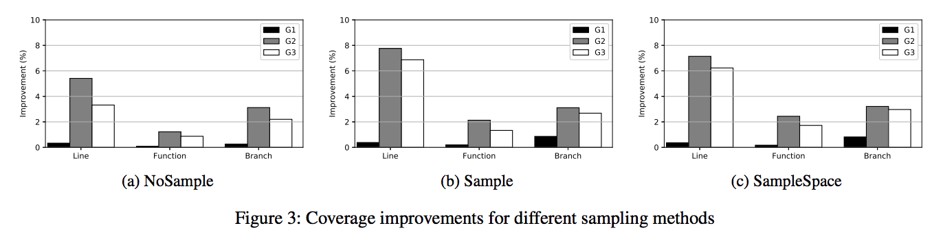
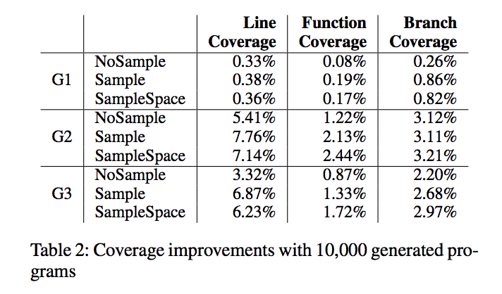
Experiment Results: Coverage (1/2)
Overall:
Among the three different sampling methods, Sample achieves the best performance in terms of line, function and branch coverage improvements.
G2 is always the best and G1 is always the worst for different sampling methods.
G2, insert two new lines at different locations, in most cases, achieves the best performance in terms of the line, function and branch coverage.

Slide 12
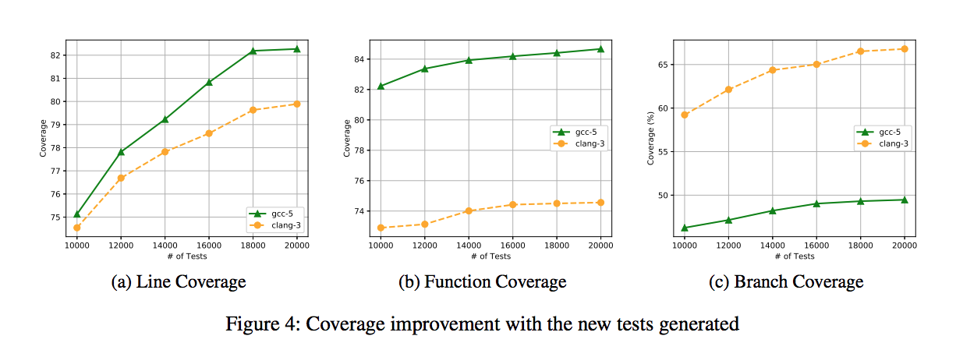
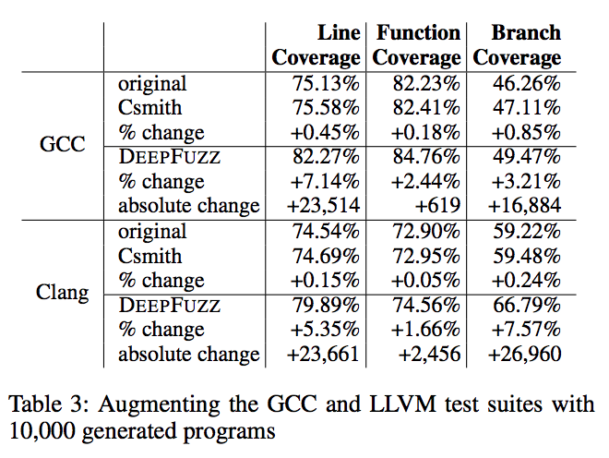
Experiment Results: Coverage (2/2)
Csmith vs DEEPFUZZ (on Sample and G2):
Csmith improved the coverage less than 1% for all the cases while DEEPFUZZ improves the coverage of line, function, and branch by 7.14%, 2.44%, and 3.21%, respectively. DEEPFUZZ achieves better coverage improvement than Csmith.
The performance of the coverage improvement pattern for DEEPFUZZ is similar over GCC-5 and Clang

Slide 13
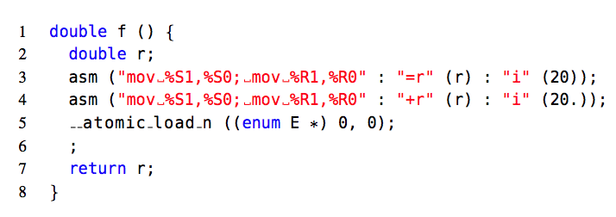
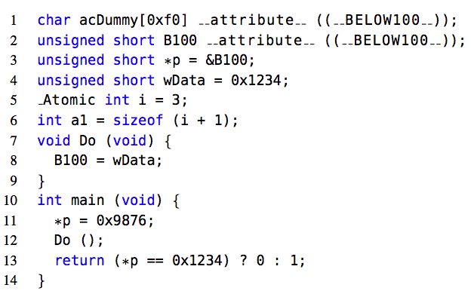
Experiment Results: New bugs
Results: 8 newly confirmed GCC bugs.
Elaborate 2 bugs:
GCC Bug 84290: DEEPFUZZ generate the two new lines (line 5 and line 6), which triggered an internal compile error of the built-in function __atomic_load_n.
GCC Bug 85443: This is a bug we reported. DEEPFUZZ generates the two new lines (line 5 and line 6), which introduced a segmentation fault of the _Atomic keyword.
Importance: This error is confirmed and fixed on GCC-5 and new test is added to the latest test suite.
GCC Bug 84290
GCC Bug 85443

Slide 14
Conclusion
In this paper, the authors propose a grammar-based fuzzing tool called DEEPFUZZ.
DEEPFUZZ automatically generates C programs based on a generative seq2seq model.
Authors use this new generated C programs to fuzz C compilers (GCC and Clang/LLVM).
The result provides better pass rate, code coverage and bug findings for DeepFuzz.

Slide 15
Thank you

