Slide 1
Fuzzing with Code Fragments
Authors: Christian Holler, Kim Herzig, Andreas Zeller
Published in 21st USENIX Security Symposium, 2012

Slide 2
Outlines
Abstract
Introduction
Related Works
How LangFuzz Works
Running Tests
Evaluation for the JavaScript engines
Adaption to the PHP engine
Some Examples
Economic Value
Threats to Validity
Future Directions
Conclusion

Slide 3
Abstract
Fuzzing is an automated software testing that randomly generates test cases and feed those test cases to target system to find vulnerabilities.
In order to be effective, the generated test cases must be common enough to be semantically valid. And, on the other hand, must be uncommon enough to trigger exceptional behaviors.
To resolve this conflict, Authors introduce LangFuzz by using a grammar to randomly generate valid programs and the mutated code fragments of problematic inputs.
Applied on the Mozilla JavaScript interpreter and the PHP interpreter, it discovered a total of 105 new severe vulnerabilities and 18 new defects causing crashes, respectively.

Slide 4
Introduction
Web interpreters (i.e. JavaScript, PHP) are practically error prone. They are likely to have many correctness and security related issues.
For instance, Mozilla Firefox fixes many vulnerability issues. But jsfunfuzz discovered more that 1,000 defects in the Mozilla JavaScript engine.
Thus LangFuzz was inspired by jsfunfuzz as fuzzing web interpreter is a promising field and has significant outcome.
LangFuzz takes the grammar as its input: given a JavaScript grammar, it will generate JavaScript programs; given a PHP grammar, it will generate PHP programs.
LangFuzz uses and recombines fragments of the previously problematic inputs to generate new programs as it has a higher chance to cause new problems than random input.
The combination of fuzz testing based on a language grammar and reusing project-specific issue-related code fragments makes LangFuzz an effective tool for security testing.

Slide 5
Related Works
The followings are previous works:
SmartFuzz (work by Molnar et al.) triggered integer related problems in x86 binaries by using symbolic execution.
CSmith (work by Yang et al.) found more than 450 previously unknown bugs for C compilers.
jsfunfuzz (work by Ruderman) discovered more that 1,000 defects in the Mozilla JavaScript engine.
crossfuzz tool (work by Zalewski) target different functionality in many popular browsers to find severe vulnerabilities.
LangFuzz differs from previous efforts in terms of security bugs (instead of correctness bugs), language-independent grammar (instead of hardcoded specific knowledge) and generative+mutative approach (mutually instead of individually).

Slide 6
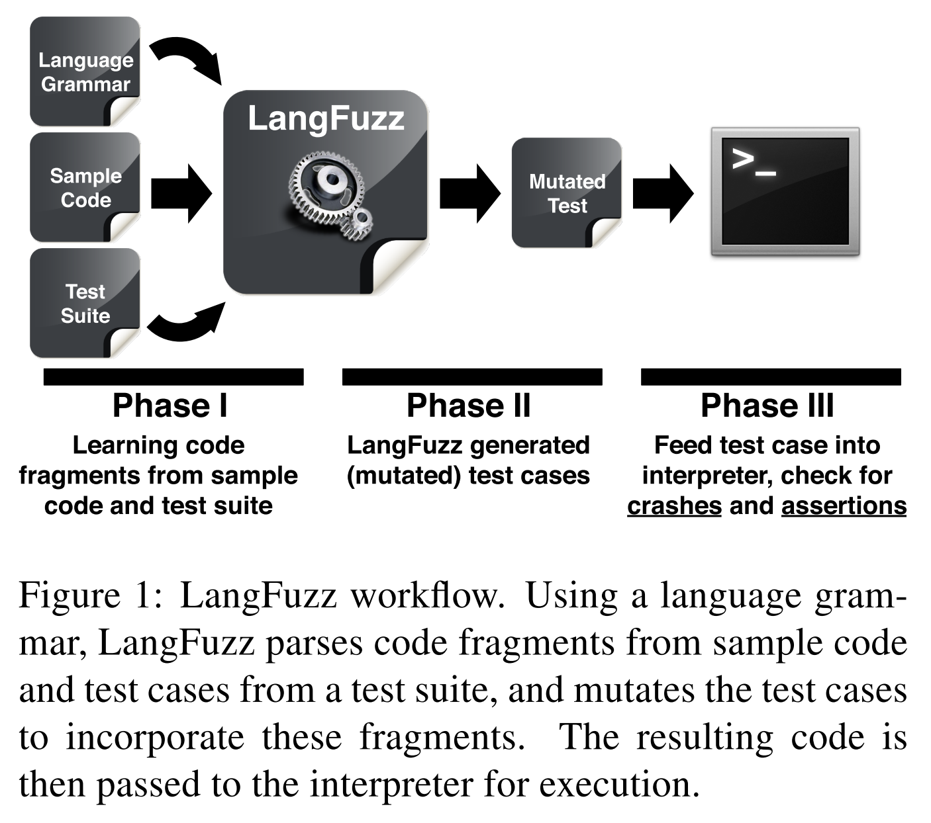
How LangFuzz Works (1/2)

Slide 7
How LangFuzz Works (2/2)
Phase I: Build up a fragment pool:
- The language grammar generates random fragments in a breadth-first manner.
- The parser separates the sample code and test suites into code fragments.
- Mutate code fragments with semantic adjustment.
Phase II: Generate new test cases:
- Select a target file and randomly pick some of the fragments.
- Then replace those fragments with other same type of fragments.
- Adjust fragments to the environment.
Phase III: Feed test cases to interpreter:
- Run test cases into interpreter with its proper test harness.
- Check for crashes and assertions.

Slide 8
Code Mutation
The mutation process consists of two phases: a learning phase in the beginning and the main mutation phase.
Learning phase:
- Process a certain set of sample input files using a parser for the given language.
- The parser will separate the input file into code fragments.
Mutation phase:
- A single target file is processed again using the parser.
- Randomly pick some of the fragments.
- Replace them with other fragments of the same type.

Slide 9
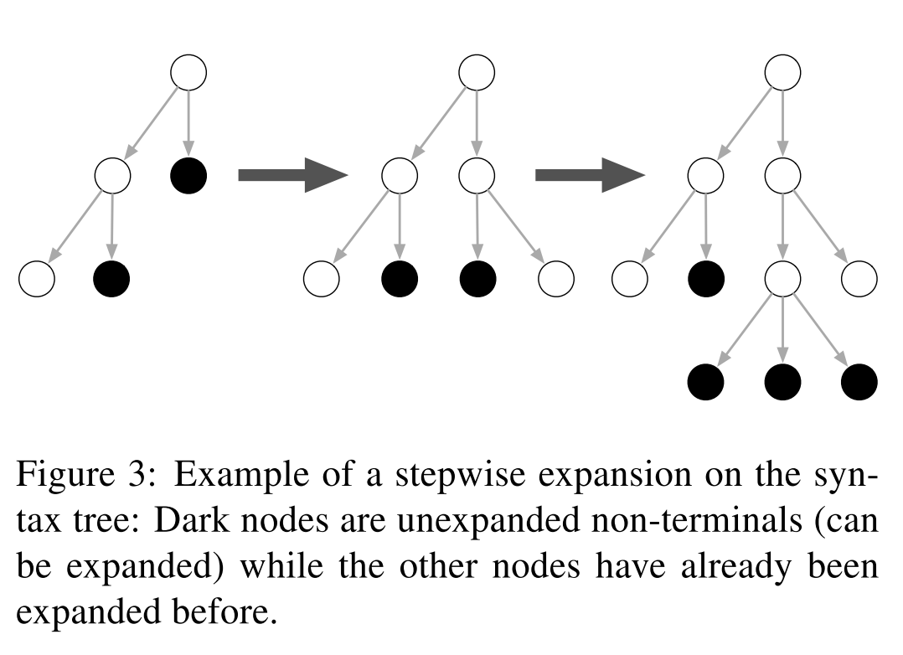
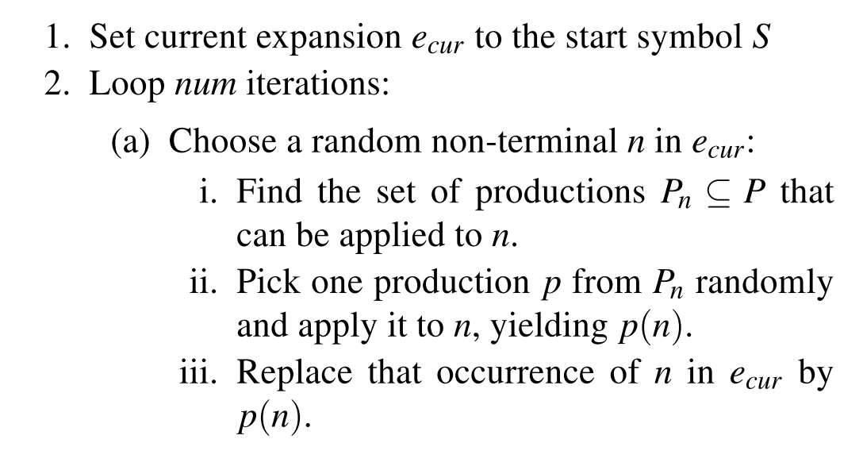
Code Generation
LangFuzz uses an algorithm that performs the generation in a breadth-first manner:
Finally, replace the remaining non-terminal symbols by sequences of terminal symbols if this algorithm does not yield a valid expansion after num iterations.

Slide 10
Adjusting Fragments to Environment
When a fragment is replaced by a different fragment, the new fragment might not fit with respect to the semantics of the remaining program; i.e. undeclared identifiers.
LangFuzz reduces the chances to have undeclared identifiers within the new fragment by replacing all identifiers in the fragment with:
- identifiers that occur somewhere in the rest of the program.
- built-in/globals identifiers.
The only way to identify such built-in/globals objects within LangFuzz is to require a list of these objects as (optional) argument.

Slide 11
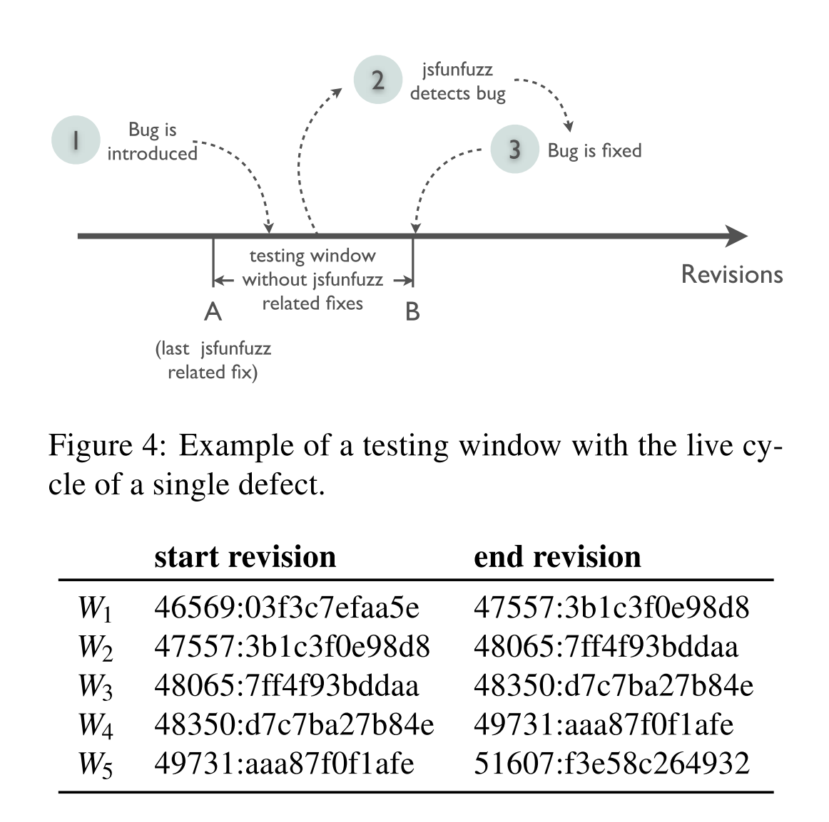
Running Tests (1/3)
Compare jsfunfuzz and LangFuzz using Mozilla’s JavaScript engine TraceMonkey:
Select time windows in which Mozilla maintains a list of defects found by jsfunfuzz and no defect fixes were applied.
jsfunfuzz would most likely not find any new defects.
the number of potential defects that can be found by LangFuzz is significantly reduced.

Slide 12
Running Tests (2/3)
Test harness: Mozilla test suite contains shell.js files with definitions required for all tests and must execute all shell files in the correct order to run a test. LangFuzz implements this logic in a test suite class to run the test with its proper test harness.
Persistent shell: Starting the JavaScript engine is slow and starting it repeatedly would cost enormous computation time. LangFuzz uses a persistent shell to runs a set of tests within one single JavaScript engine and signals completion when done.
Running multiple tests within a single shell allows individual tests to influence each other. It increased the number of defects detected.
Delta debugging: LangFuzz uses the delta debugging algorithm and the delta tool to filter out irrelevant test cases to determine which individual tests are relevant for failure reproduction among the multiple test cases.

Slide 13
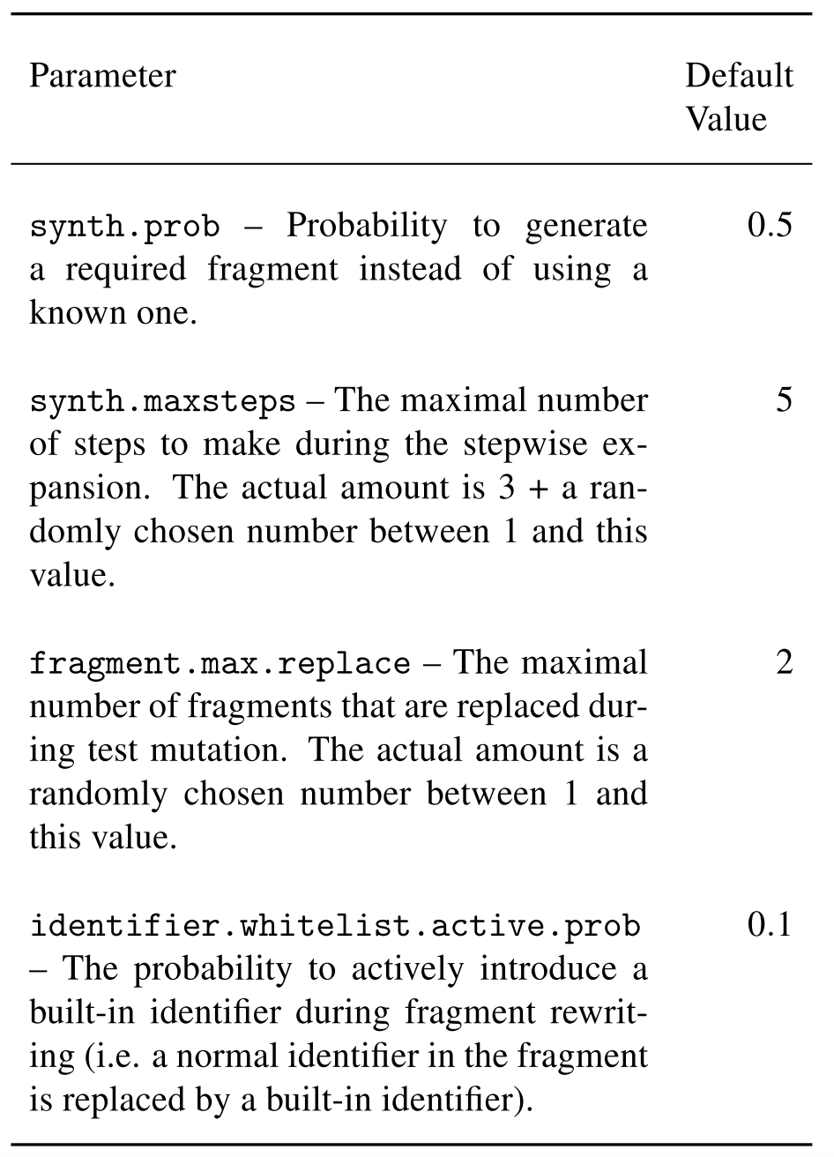
Running Tests (3/3)
Definitions:
Defect: Assertion violation and Crash bugs​
Grammar: Context Free Grammar​
Interpreter: Java and PHP Engine

Slide 14
Evaluation for the JavaScript engines
Setup three different experiment:
External validation: Compare LangFuzz and jsfunfuzz.
Internal validation: Compare code generation and code mutation.
Field study to detect real defects in current state of the art JavaScript engines.

Slide 15
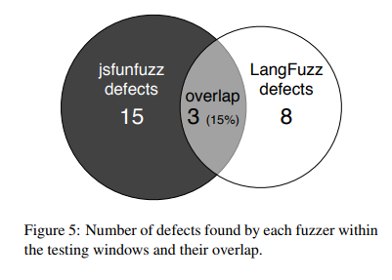

(1) External validation: Compare LangFuzz and jsfunfuzz (1/2)
Q1. To what extend do defects detected by LangFuzz and jsfunfuzz overlap?
LangFuzz and jsfunfuzz detect different defects (overlap of 15%) and thus should be used complementary to each other.

Slide 16

(1) External validation: Compare LangFuzz and jsfunfuzz (2/2)
Q2. How does LangFuzz’s detection rate compare to jsfunfuzz?
A generic grammar-based fuzzer like LangFuzz can be 53% as effective as a language-specific fuzzer like jsfunfuzz.

Slide 17
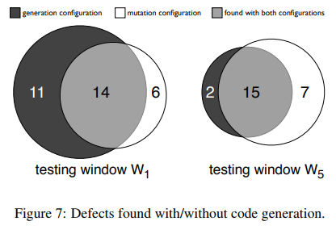
(2) Internal validation: Compare code generation and code mutation
Q3. How important is it that LangFuzz generates new code?
Q4. How important is it that LangFuzz uses learned code when replacing code fragments?
The combination of code mutation and code generation detects defects that not detected by either internal approach alone.
Combining both approaches makes LangFuzz more successful.

Slide 18
(3) Field study to detect real defects in current state of the art JavaScript engines (1/2)
Three different language interpreter engines:
Mozilla TraceMonkey (JavaScript):
- Trunk branch (beta version of Firefox 4)
- Type inference branch
Google V8 (JavaScript):
- Trunk branch (beta version of Chrome 10)
PHP engine:
- Trunk branch (SVN revision 309115)

Slide 19
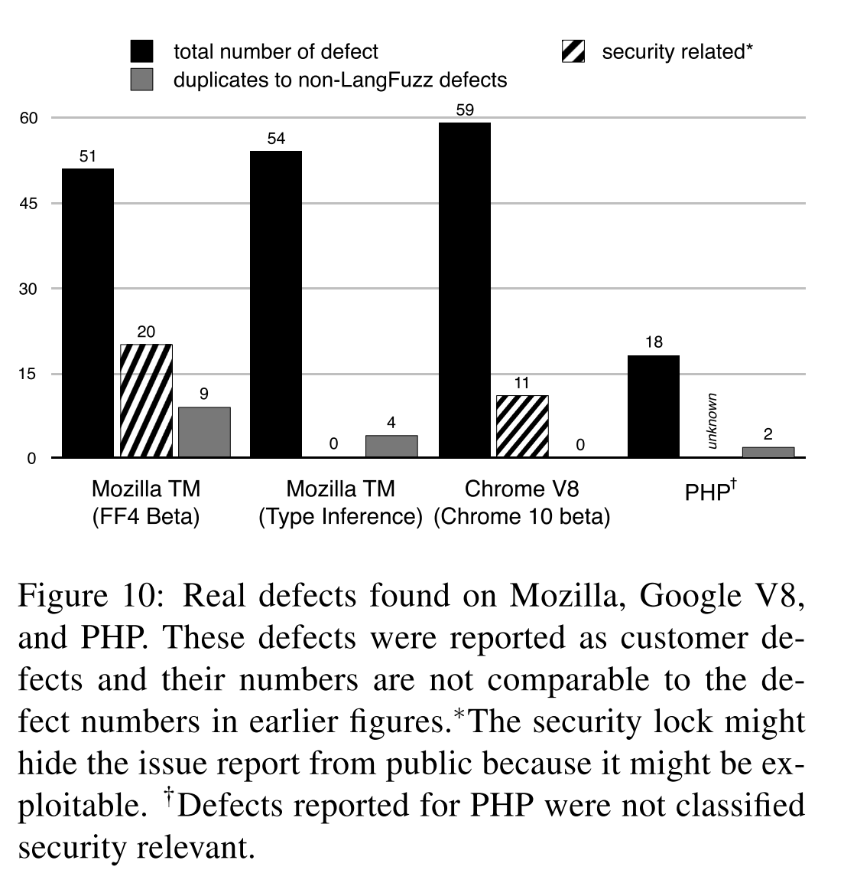

(3) Field study to detect real defects in current state of the art JavaScript engines (2/2)

Slide 20

Adaptation to the PHP engine
Authors considered the PHP experiment as a proof-of-concept adaptation and invested considerably less time into this experiment.
Adapting LangFuzz to test different languages is easy:
Integration of Language Grammar (Parser/Lexer Classes).
Integration of Test suite.
Adding Language-dependent Information (optional).

Slide 21
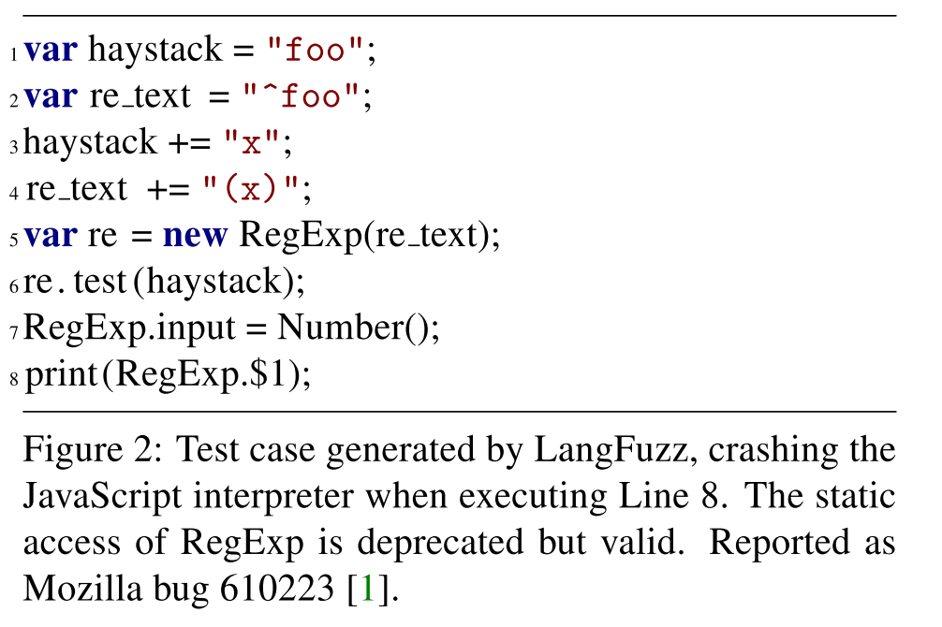
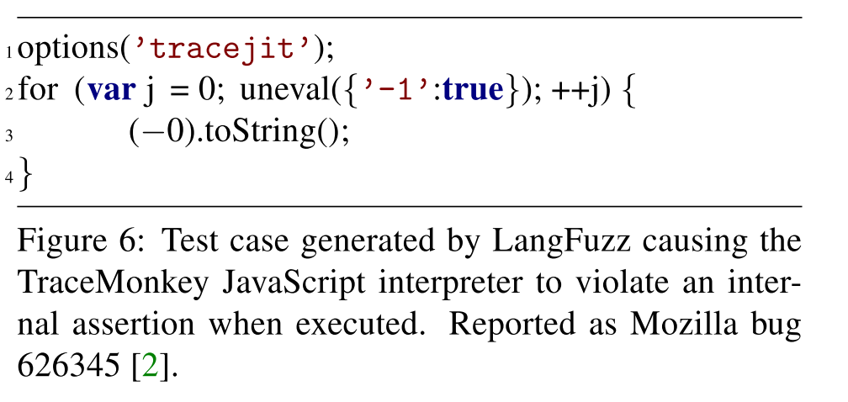
Some Examples (1/2)
Example of a generated test case exposing a security violation:
Example for a defect missed
by jsfunfuzz:

Slide 22
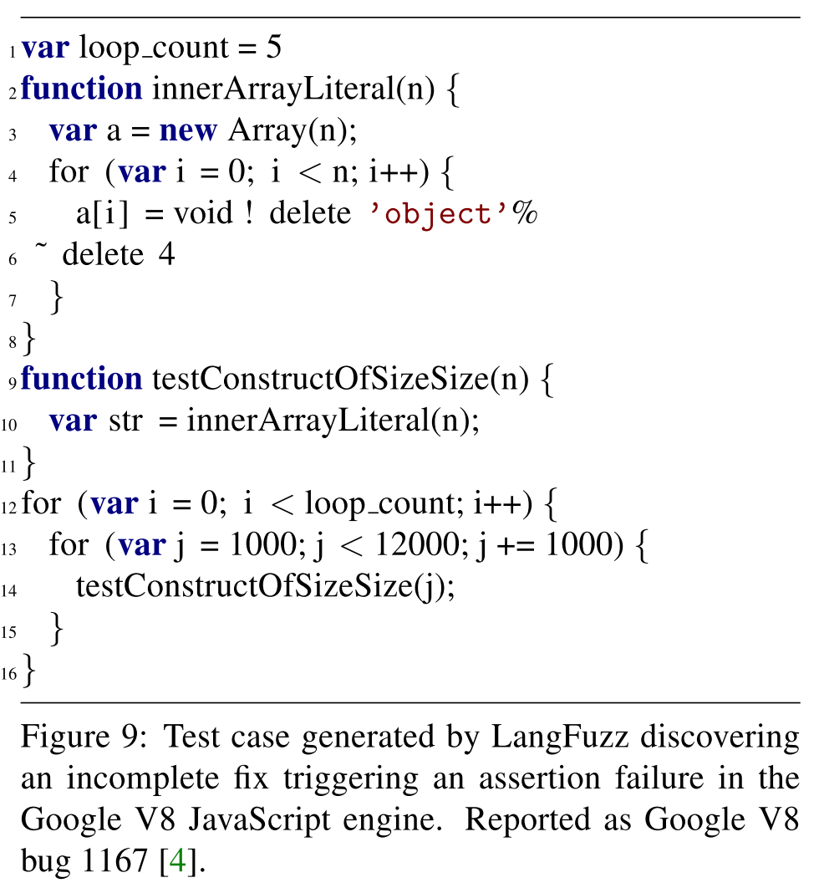
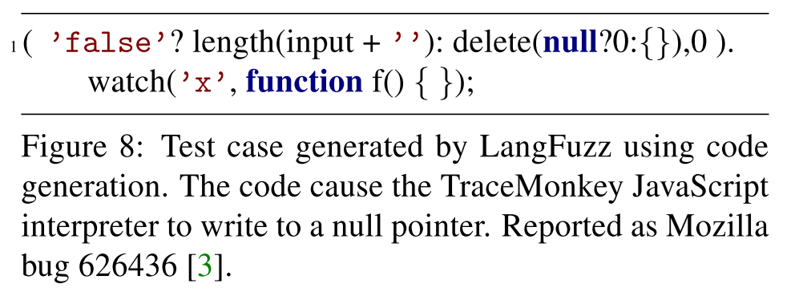
Some Examples (2/2)
Example of defect detected by
code generation:
Example for detected incomplete fix:

Slide 23
Economic Value
Many of the defects detected by LangFuzz were rewarded by bug bounty awards.
Defects found by the LangFuzz obtained 18 Chromium Security Rewards and 12 Mozilla Security Bug Bounty Awards within nine month.
The above awards translated into 50,000 US$ of bug bounties in real money.
LangFuzz became one of the top bounty collectors for Mozilla Trace-Monkey and Google V8 during this period.

Slide 24
Threats to Validity
Authors cannot generalize that LangFuzz will be able to detect defects in other interpreters for different languages.
Running LangFuzz and jsfunfuzz on different targets or testing windows might change comparison results.
Setups with less test cases or biased test suites might decrease LangFuzz’s performance.
Choosing different time limits for bug detection might impact the experimental results.
Some of the reported bugs might be duplicates that might impact the number of distinct defects discovered through the experiments.
LangFuzz contains a large amount of adjustable parameters but cannot guarantee that these values deliver the best performance.

Slide 25
Future Directions
Improve by overcoming the mentioned Threats to Validity.
Apply into other complex interpreters for different languages.
?

Slide 26
Conclusion
Fuzz testing is easy to apply, but generally needs language and project-specific knowledge to be most effective.
LangFuzz bases its testing strategy solely on the grammar, existing programs (e.g. test suites) and a very low amount of additional language-dependent information. In practice, this means that
- Changes to the language under test do not require any program maintenance apart from possible grammar updates.
- LangFuzz can be set up to cover a certain application domain through the choice of test cases.
LangFuzz is recommend for simple and effective automated testing of processors of complex input, including compilers and interpreters, especially those dealing with user-defined input.

Slide 27
Thank You

