Slide 1
﻿Static Detection of Event-based Races in Android Apps
Authors: ﻿
Yongjian Hu and Iulian Neamtiu.
Published in ﻿2018 Architectural Support for Programming Languages and Operating Systems (ASPLOS’18).
Keywords: ﻿
Mobile applications; Concurrency; Event-based race;
Happens-before; Static analysis; Google Android.

Slide 2
Event-based Races
Android Apps ← ﻿Event-driven model + Responsive GUI.
Main Thread: Access UI objects.
Non-main Thread: Long running task (i.e. file download) or I/O task.
Callback: Send message to main thread from non-main thread.
﻿This event-based model can lead to concurrency errors.
Example of ﻿event-based race:
﻿Two asynchronous tasks T1 and T2.
Assume that ﻿T1 always executes first, and T2 relies on some initialization performed by T1.
﻿If T2 executes first, the result can be a crash or error due to uninitialized data.

Slide 3
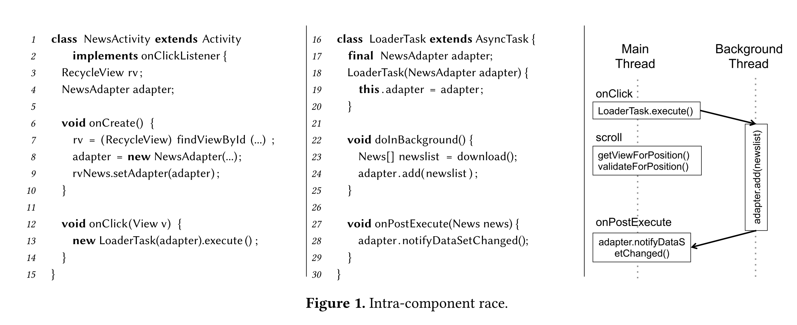
﻿Intra-component race

Slide 4
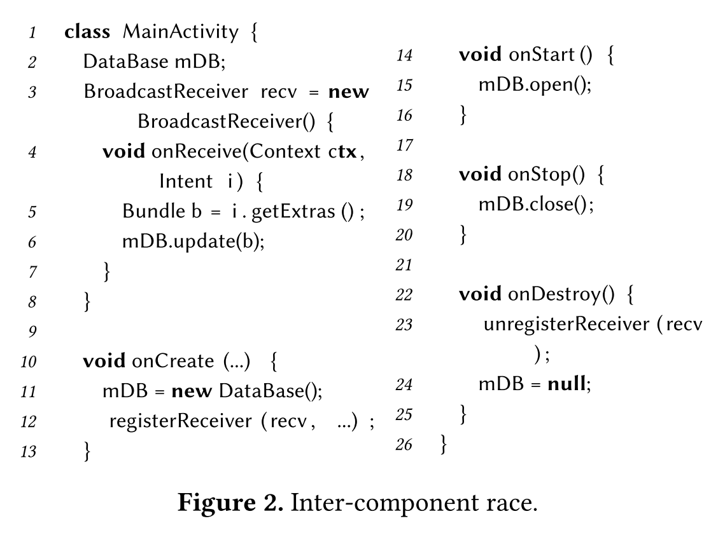
﻿Inter-component Race

Slide 5
Importance of Event-based Races
Since ﻿2008, concurrency being one of the top-5 most common bug.
﻿66% of the high-severity bugs are due to concurrency (based on ﻿a study of 18,000 fixed bugs).
﻿Event-driven races are 4-7 times more frequent than data races in Android apps.

Slide 6
Reason for Static Detection
﻿Several dynamic detectors have been proposed ﻿to find races:
DroidRacer
CAFA
EventRacer Android.
﻿However, dynamic detectors have two main issues:
First, ﻿they are prone to false negatives.
Second, ﻿these approaches suffer from good coverage.
﻿To address these issues, authors propose a static approach to event race detection.

Slide 7
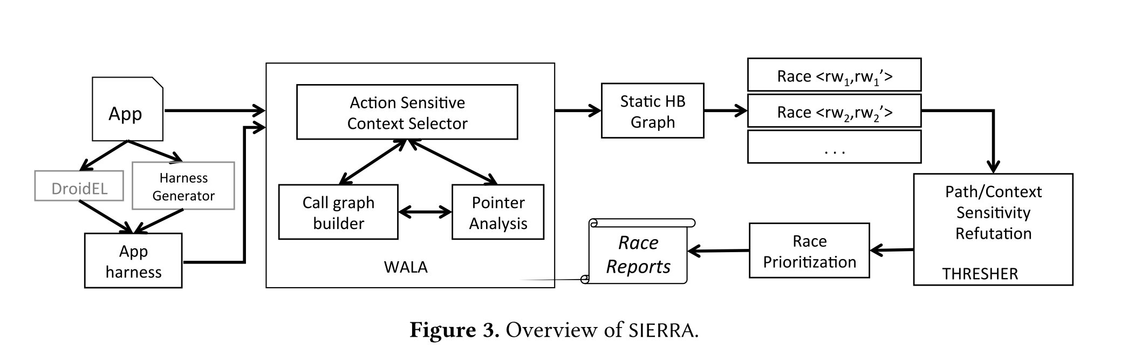
SIERRA
Notes:
DroidEL: ﻿ https://github.com/cuplv/droidel
Static Android framework modeling tool, examine app code and analyze view inflation and reflection.
The result is a transformed app with a single entry point ready to be analyzed by any Java program analysis framework WALA, SOOT, Etc.
﻿* Integrated into harness generator: multi-entry to single-entry main
WALA: https://github.com/wala/WALA
Context-sensitive analysis, Pointer analysis and Call graph construction.
* Context sensitivity: ﻿object sensitivity and call-site sensitivity + action sensitivity

Slide 8
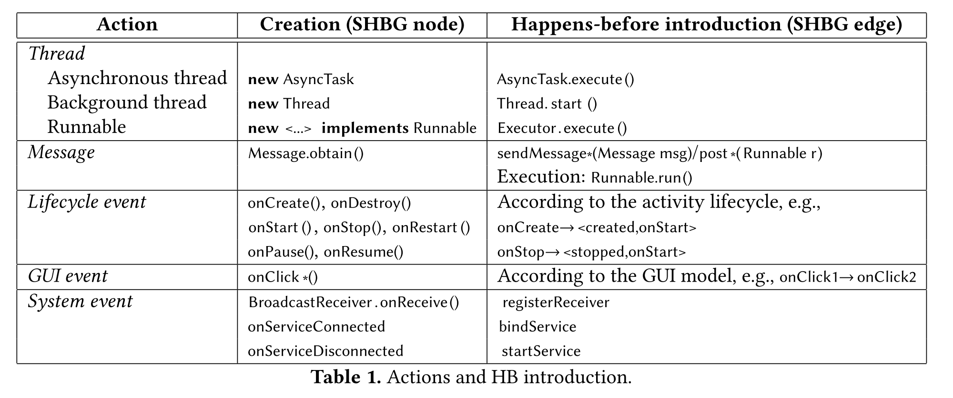
Static HB Graph

Slide 9
1. Action invocation rule
When an action is invoked, the sender action happens before the recipient.
Sender ≺ Receiver
For example,
The message sender’s action to the message’s Runnable.
The action in which a thread is created to the new action (that thread’s body).

Slide 10
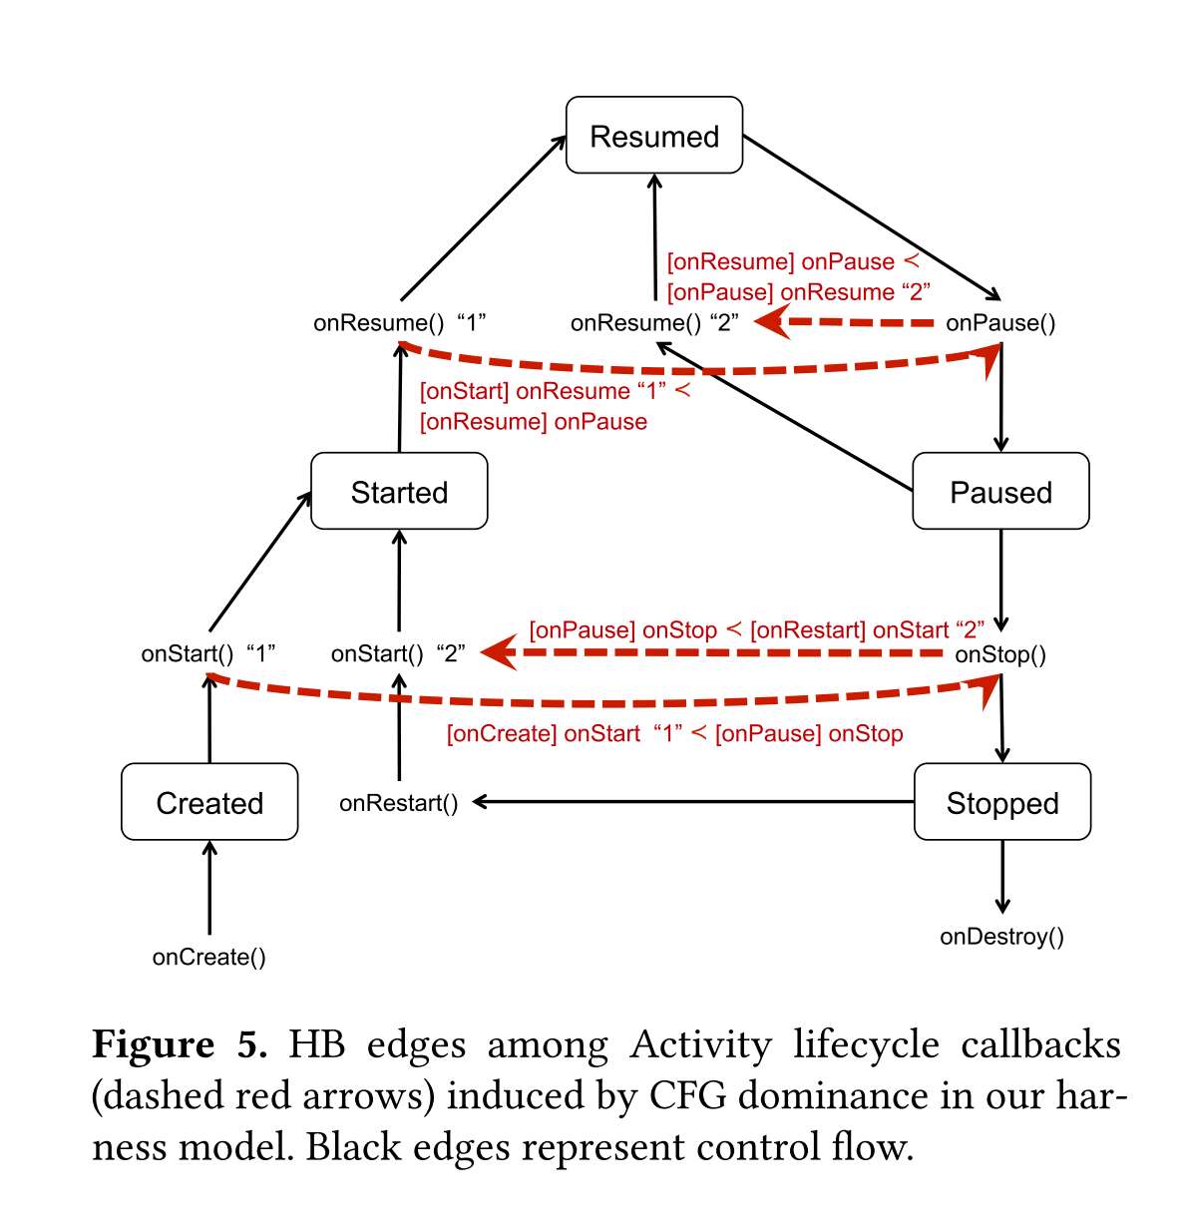
2. Android component lifecycle rule

Slide 11
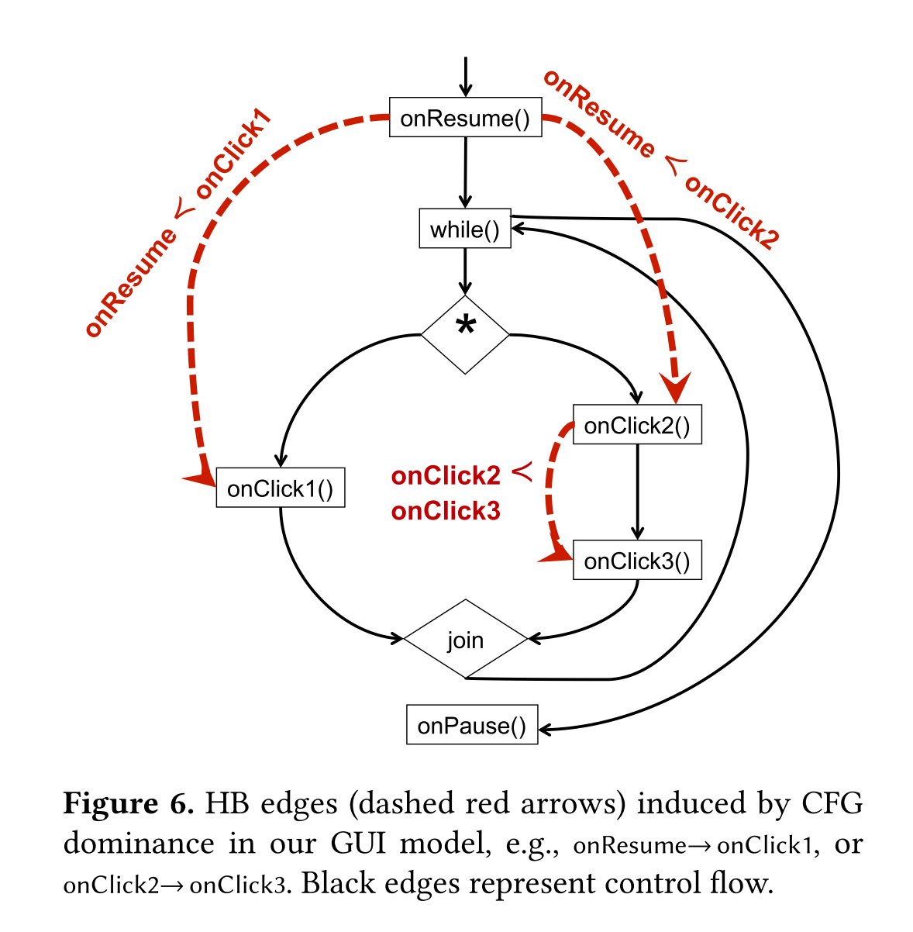
3. GUI layout/object order
Notes:
onClick() may call from onClickListener().
onClickListener < onClick

Slide 12
4. Intra-procedural domination
﻿Two outgoing calls e1 and e2 are in a method M of an activity A.
The e1 and e2 post actions A1 and A2, respectively.
The e1 dominates e2 if e1 always be invoked before e2.
Then A1 ≺ A2 .

Slide 13
5. Inter-procedural, intra-action domination
﻿Two outgoing calls e1 and e2 are in two separate methods M1 and M2 of the same activity A.
The e1 and e2 post actions A1 and A2, respectively.
The e1 always be invoked before e2?
The e2 can be invoked without involving e1?
Remove e1 and check whether e2 is still reachable.
If e2 is not reachable, then e1 dominates e2.
Then A1 ≺ A2 .

Slide 14
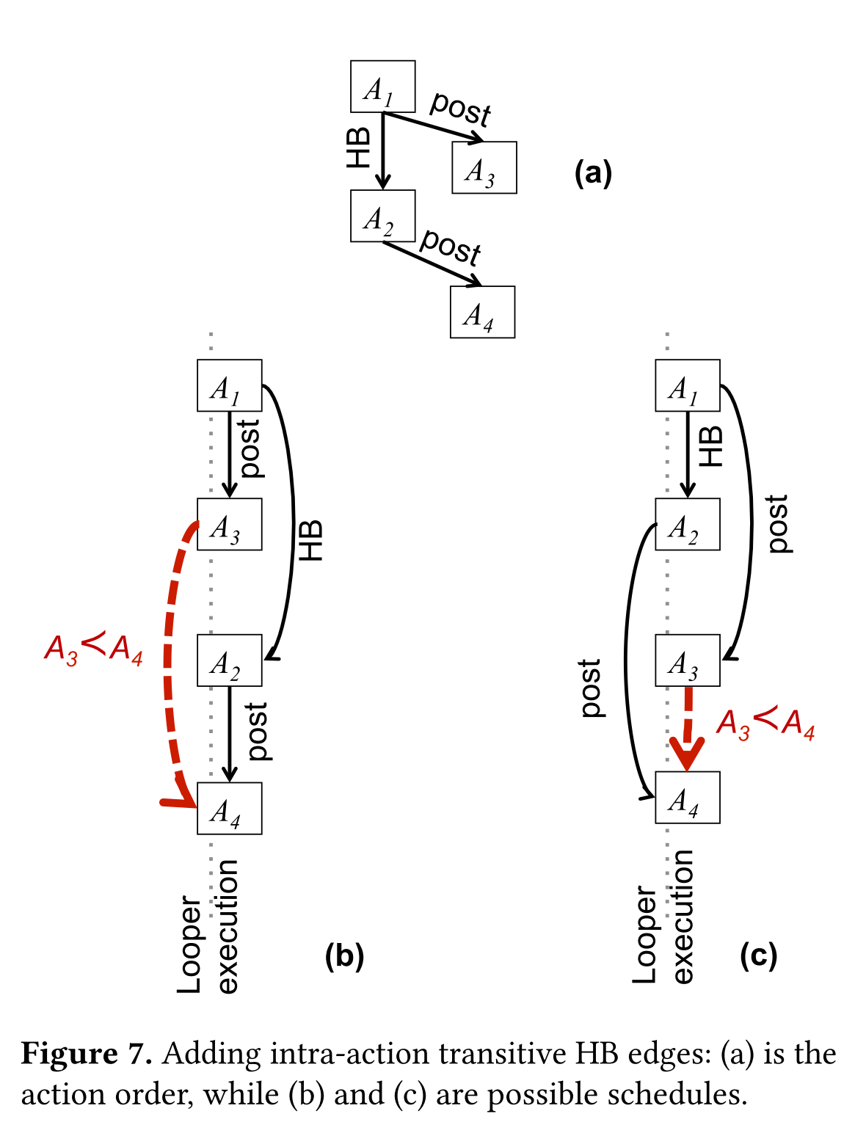
6. Inter-action transitivity
Notes:
A1 < A2, A1 post A3, A2 post A4.
A3 < A4

Slide 15
7. HB Transitivity
⇒
A1 ≺ A2
∧
A2 ≺ A3
A1 ≺ A3

Slide 16
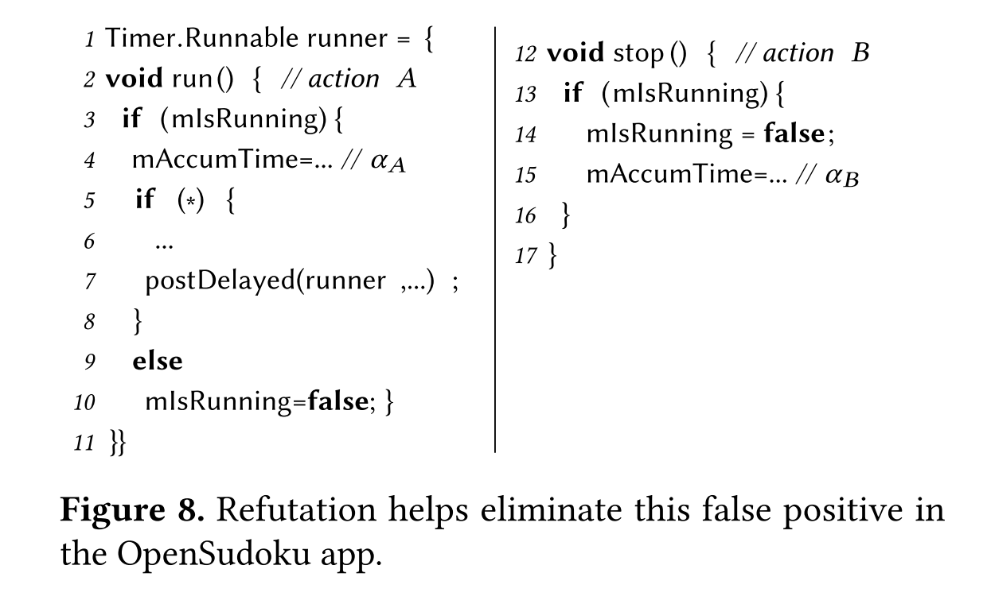
Refutation with Thresher
Notes:
﻿Accesses could be protected by ad-hoc synchronization.
﻿The backward analysis framework is based on Thresher.

Slide 17
Race prioritization
To help developers fix likely-harmful races, SIERRA prioritizes race reports using several heuristics:
Races in application code have higher priority than those in framework code.
Framework races directly invoked from app code have higher priority than those invoked from the library.
Races involved in pointer reference reads/writes are more likely to be dangerous as they can result in NullPointerException.

Slide 18
Evaluation
Two open source data set:
Gator’s benchmark:
20 apps
Various sizes: 63 KB ~ 5400 KB
Available for manually check
Compares SIERRA’s results with EventRacer.
F-droid repository:
174 apps
Median size of 1.1 MB
Not available for manually check
Metrics:
Effectiveness: How many potential races it can find.
Efficiency: How long it takes to analyze an app.
Notes:
Effectiveness: How many potential races it can find.
Efficiency: How long it takes to analyze an app.

Slide 19
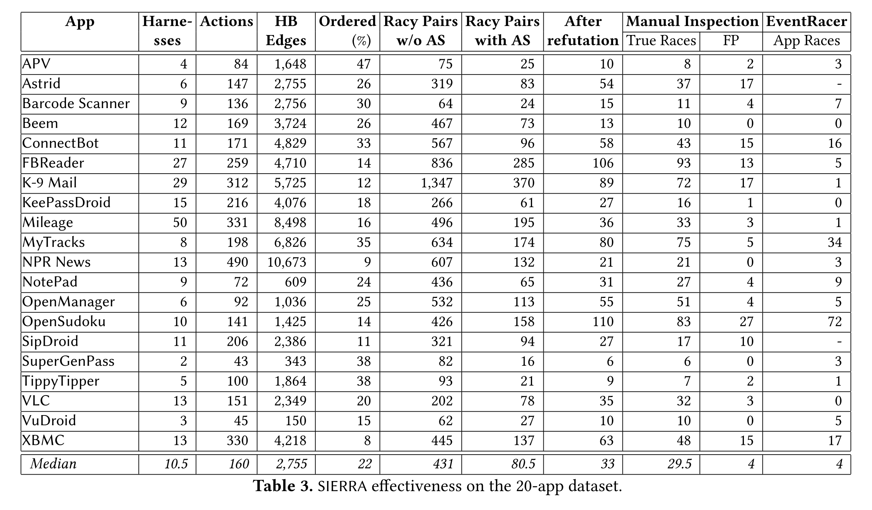
Effectiveness on 20-app dataset
Notes:
﻿Column 5 shows the fraction of HB edges compared with the total number of edges.
﻿Columns 6 and 7 show the number of racy pairs without and with action-sensitive contexts.
﻿The last column compares SIERRA’s results with EventRacer.

Slide 20
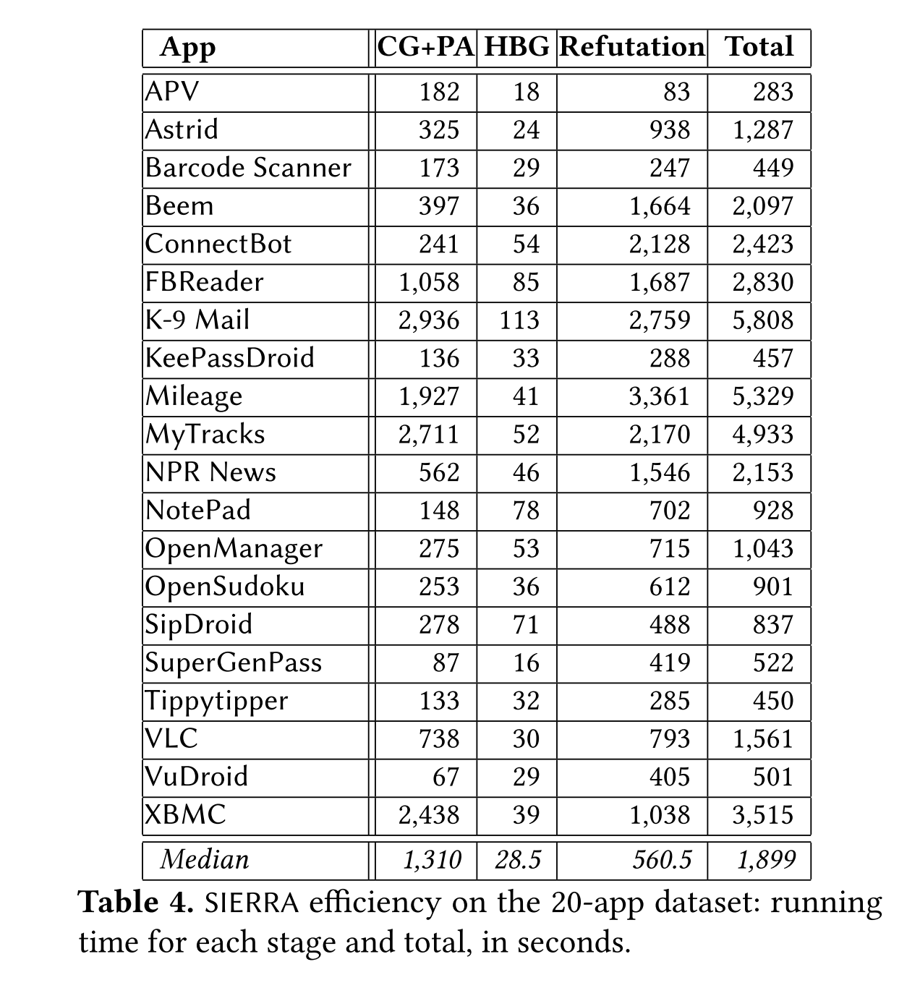
Efficiency on 20-app dataset
Notes:
﻿In total, SIERRA takes about 1,899 seconds per app, which is acceptable for a static analysis.

Slide 21
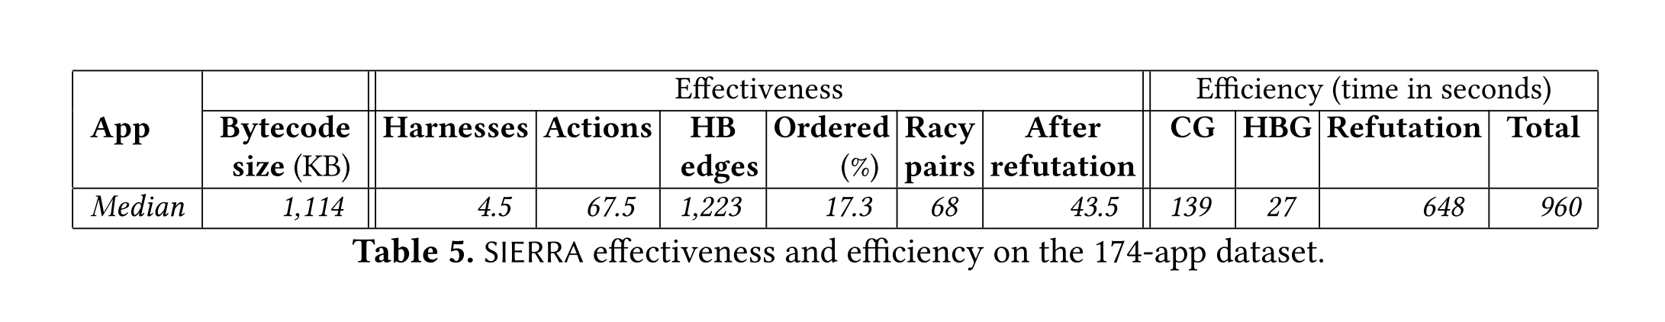
Effectiveness and Efficiency on 174-app dataset

Slide 22
Conclusion
﻿ SIERRA has the ability to provide more accurate results than EventRacer.
SIERRA fails to trigger some races that require a specific event order, but this order can be easily detected by the dynamic race detectors.
So, the static and dynamic race detection could be combined:
The static approach can find over-approximate candidate races.
The dynamic approach can verify the side effect.

Slide 23
Thank you

