Slide 1
Development of Intelligent Digital Certificate Fuzzer Tool
Authors: B Chandrasekar, B Ramesh, V Prabhu, S Sajeev, PK Mohanty, G Shobha.
Keywords: Digital Certificates; Mutation Fuzzing; OpenSSL; X.509.
Published in 2017 International Conference on Cryptography, Security and Privacy (ICCSP '17)

Slide 2
Introduction
Fuzzing → vulnerabilities through testing.
Final phase in the test cycle.
Network security: Digital certificates for authentication.
Authors analyzed the fuzzing of digital certificates.
Expose defects in digital certificate validation systems.

Slide 3
Types of Fuzzers
Dumb fuzzer: pseudo random.
﻿ Mutation fuzzer: ﻿block swapping or bit flipping.
﻿ Generation fuzzer: ﻿divide base cases into chunks to build new packets.
﻿ Evolutionary fuzzer: ﻿loop back feedback system to learn.
﻿ Specification-based fuzzer: ﻿model-based approach.
﻿ Protocol-based fuzzer: ﻿specifications are mandatory and ﻿scope limited to protocol.

Slide 4
Interfacing of Fuzzers
Interfacing the fuzzer to the input of the target software system.
Several methods can be considered:
One stage approach:
- Feed a continuous stream of bits from the fuzzer to the system.
Two stage approach:
- Creating the files in a staging area from the fuzzer.
- Using an agent to feed the files into the target software.

Slide 5
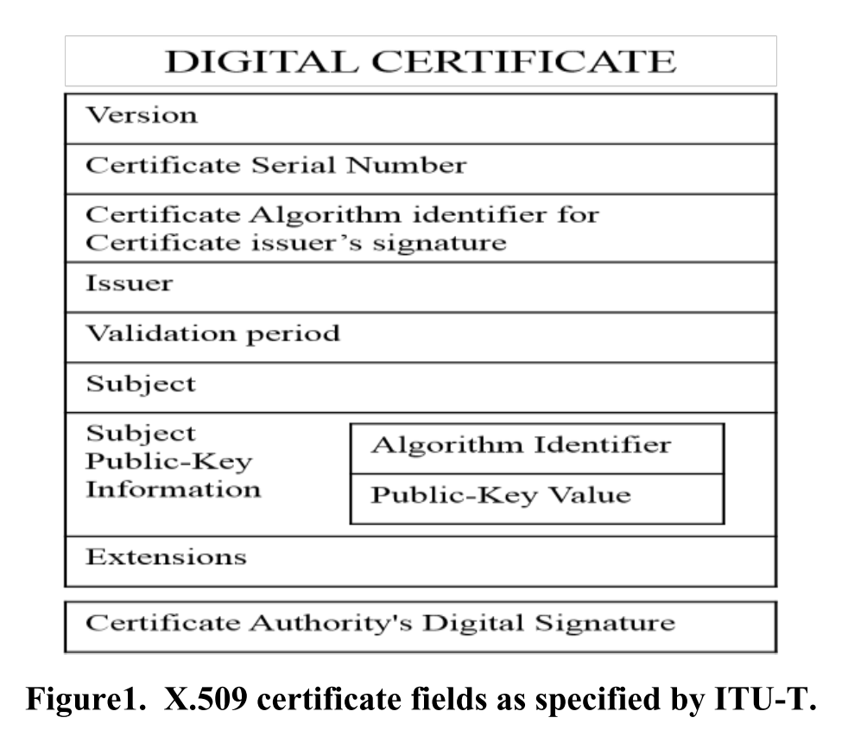
Network Security
Certification Authority (CA)
Digital Certificates (X.509 standard)
Public Key Cryptography
SSL (Secure Socket Layer)
Public Key Infrastructure (PKI)

Slide 6
Why Fuzzing ?
OpenSSL library to read and write digital certificates.
Implemented with SSL (secure socket layer) protocols
Shifted to TLS (transport layer security) protocols.
Written in C.
Challenges:
Certificates are subject to duplication and tampering.
Leading to impersonation and spoofing attacks.

Slide 7
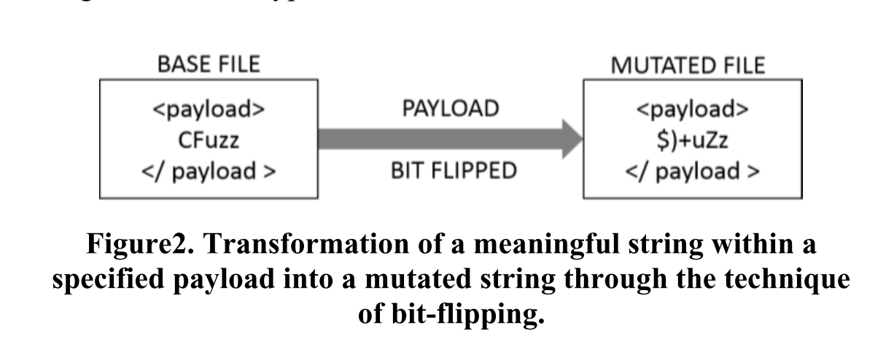
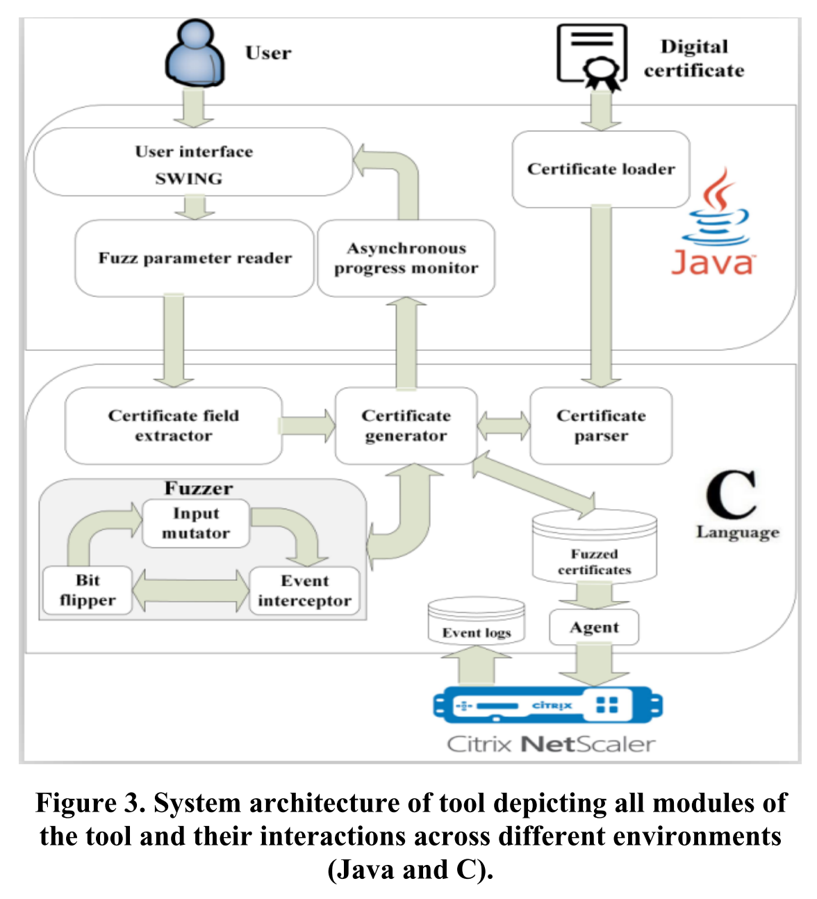
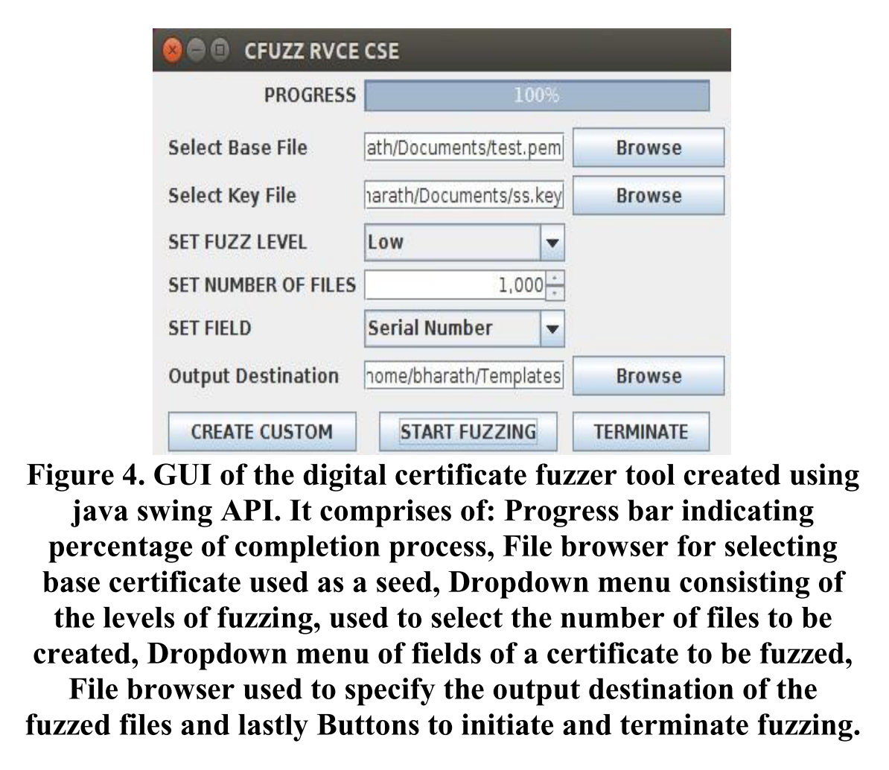
Cfuzz (﻿protocol-based fuzzer with ﻿bit flipping ﻿mutation)

Slide 8
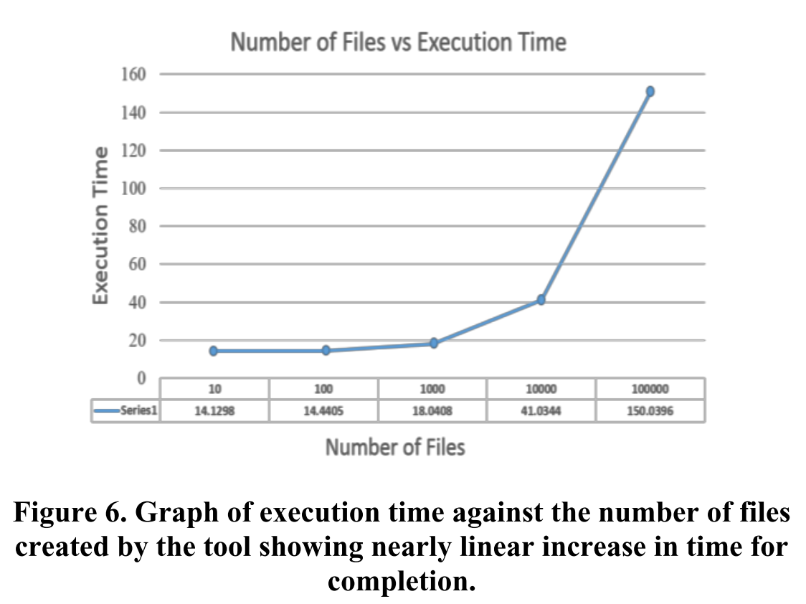
Evaluation (1/2)
The metric for comparison used is execution time.
The execution time varies in almost a linear fashion with respect to the number of files.

Slide 9
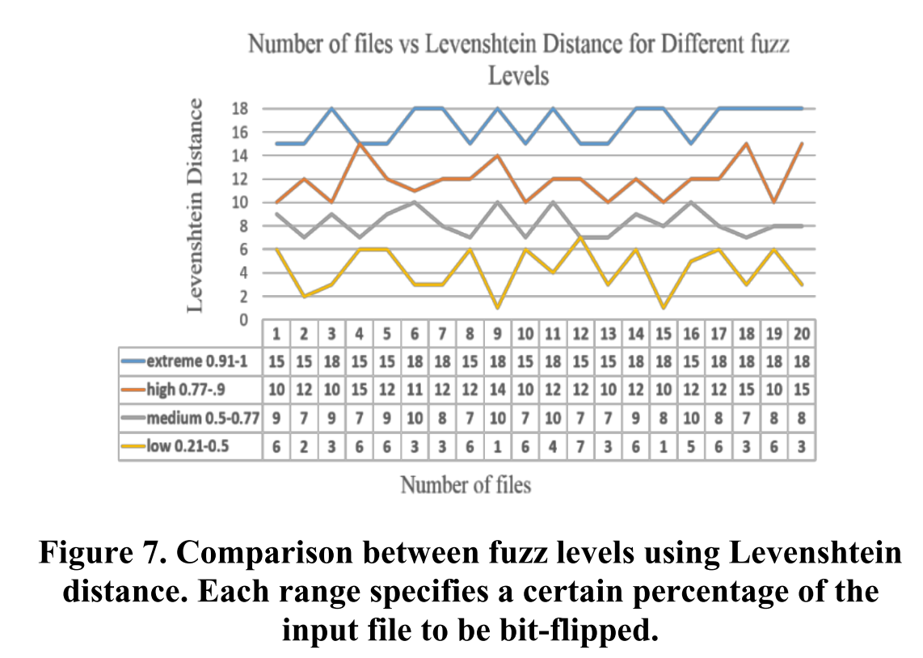
Evaluation (2/2)
﻿The metric for comparison used is Levenshtein distance.
﻿The fuzz ratio value of low is 0.21 to 0.5; medium is 0.5 to 0.77, high is 0.77 to 0.9 and extreme is 0.9 to 1.
Extreme fuzz level results in higher L-distance than others fuzz level.
The number of input files do not have significant differences in case of L-distance.

Slide 10
Conclusion
Creating several thousand fuzzed certificates.
Tested on the Citrix NetScaler.
﻿ It also has the following benefits:
Quality assurance
Security: segmentation faults or memory corruption
Code coverage analysis
GUI based user interaction
﻿
The idea of digital certificate fuzzing is fairly new and novel which requires further research and development.

Slide 11
Thank you

