Slide 1
Testing Machine Learning Algorithms for Balanced Data Usage
Authors:
Arnab Sharma, Heike Wehrheim
Paderborn University, Germany
Presenter:
Md Rafiqul Islam Rabin
University of Houston
2019 12th IEEE Conference on Software Testing, Validation and Verification (ICST)

Slide 2
Introduction
Application of machine learning (ML) algorithms
ML algorithms to decision-making processes
The fairness of ML comes in focus.
Fairness for the learning phase: balanced data usage.
A metamorphic testing approach for checking balanced data usage.

Slide 3
Fairness Testing
Definition:
Checking whether an ML classifier on some training data is biased.
(e.g. in terms of gender or age).
Example:
A loan-granting software is discriminating against “address”:
Person (name, age, salary, bank stmt, …, address1) → Yes
Person (name, age, salary, bank stmt, …, address2) → NO

Slide 4
Type of Fairness Testing
Prediction Phase
Whether a change to the value of a feature in an input leads to a change in the prediction.
X (x1, x2, …, xk, …, xn) → ?
Training Phase
Whether algorithm treats all data in the training set equally.
Orderings of features
Orderings of data instances.

Slide 5
Balance Data Usage
Objective:
Check whether the learner is only learning training data or biased in terms of design.
Problem: Test oracle is unknown.
What should be the “correct” outcome of the learning process? No ground-truth.
Solution: Balance data usage.
What: Defining “learning what’s in the data”.
How: Defining a number of metamorphic transformations.

Slide 6
Metamorphic Relations
Steps:
Defining a number of metamorphic transformations.
Applying these transformations in dataset.
Comparing the outcome of learning for transformations.
Metamorphic transformations: mm-transformation
Permutation of rows (training data instances)
Permutation of columns (feature ordering)
Metamorphic relations:
An ML algorithm is “balanced” when the metamorphic transformations on training data results in equivalent outcomes.
C. Shuffling of feature names
D. Renaming of feature values

Slide 7
Systematic Equivalence Checking
Proposed two techniques: (neither sound nor complete):
Comparing the model representations.
Compare the parameters of two models
i.e. weights and offset for SVM
i.e. branches and leafs for DT
Applied to:
NN, SVM, DT, LR, AdaBoost.
2. Testing equality of models.
Compare the output of two models
i.e. M1(x) =? M2(x)
Applied to:
KNN, Large DT, and others.
Notes:
Formally, we require ML algorithms to be invariant under certain transformations carried out on their inputs. More precisely, we require ML algorithms to return the same model when trained on inputs which are related in a specific way. In the context of metamorphic testing, such relations on inputs are called metamorphic relations.
If an ML algorithm is not invariant under a certain mm-transformation, we say that it is sensitive to the mmtransformation.

Slide 8
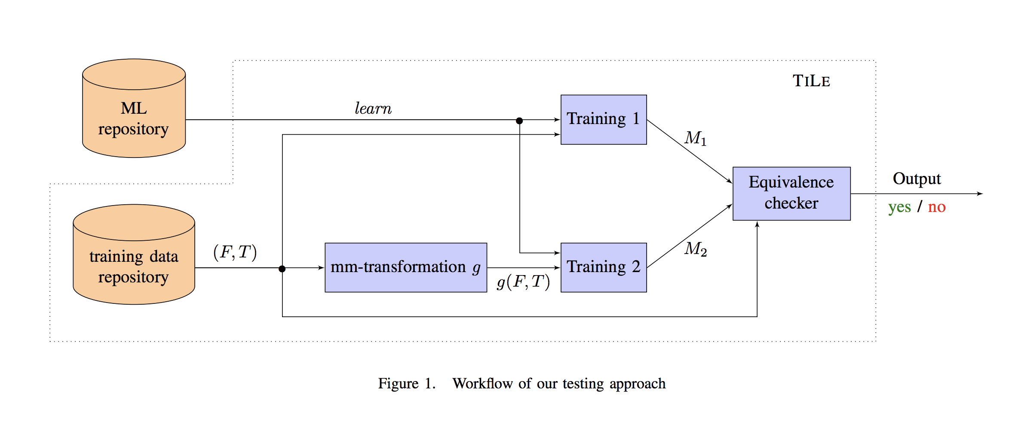
TILE

Slide 9
Evaluation
RQ1 Are state-of-the-art ML classifiers balanced?
RQ2 Is TILE able to detect unbalancedness in classifiers?
RQ3 Is our equivalence testing approach able to detect nonequivalent predictive models?
RQ4 Which permutation strategy is most effective for finding non-balancedness?

Slide 10
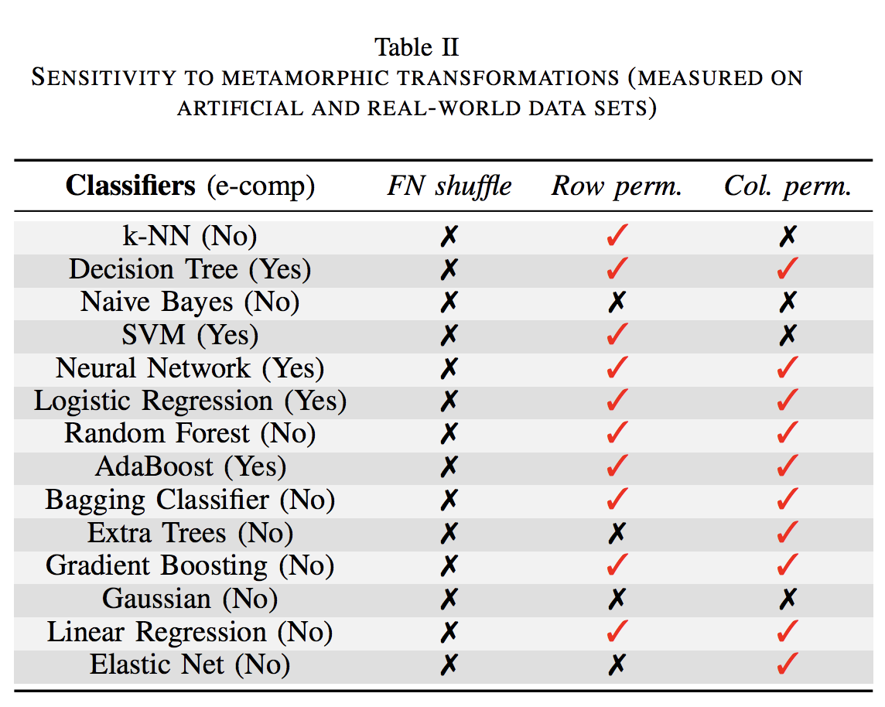
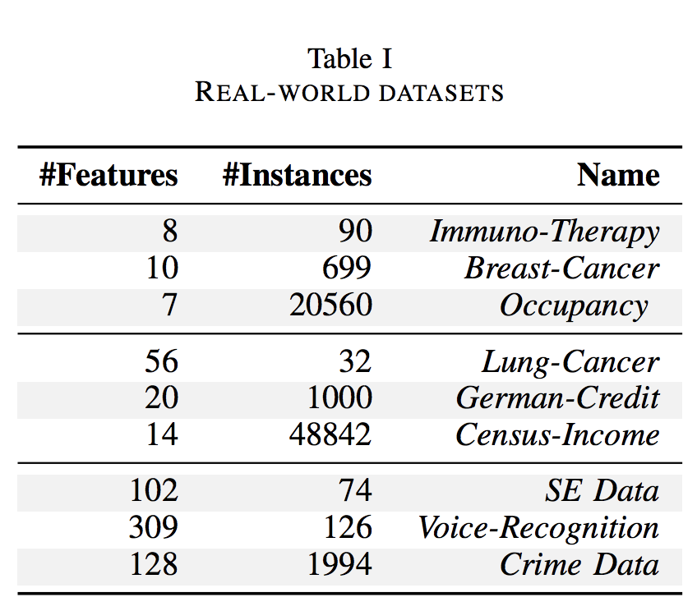
RQ1 Are state-of-the-art ML classifiers balanced?
Choose 14 ML classifiers from Python “scikit-learn” library.
Collect 9 training sets from the UCI machine learning repository.
Apply all sorts of mm-transformations.

Slide 11
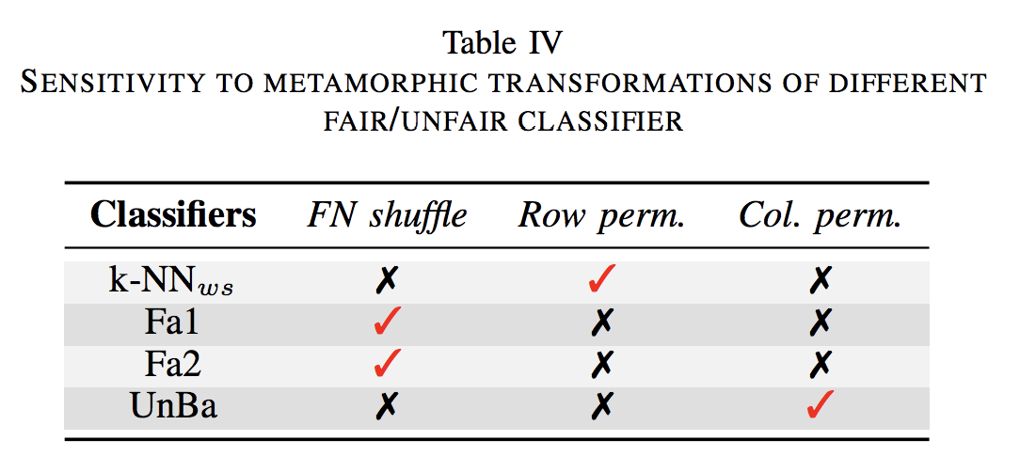
RQ2 ... to detect unbalancedness in classifiers?
Unbalanced classifiers:
Fa1 (arbitrary feature of the data set)
Fa2 (arbitrary feature of the data set)
K-NNws (last 500 training instances only)
UnBa (ignoring last feature)

Slide 12
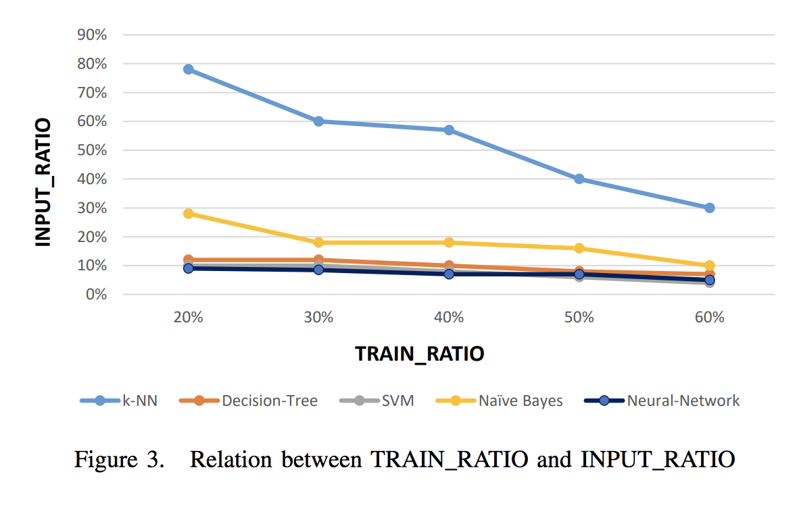
RQ3 … to detect nonequivalent predictive models?
Nonequivalent classifiers:
Train an ML classifier on original data (M1)
Modify 2% percentage of class labels
Train the ML classifier on modified data (M2)
Compare M1 and M2

Slide 13
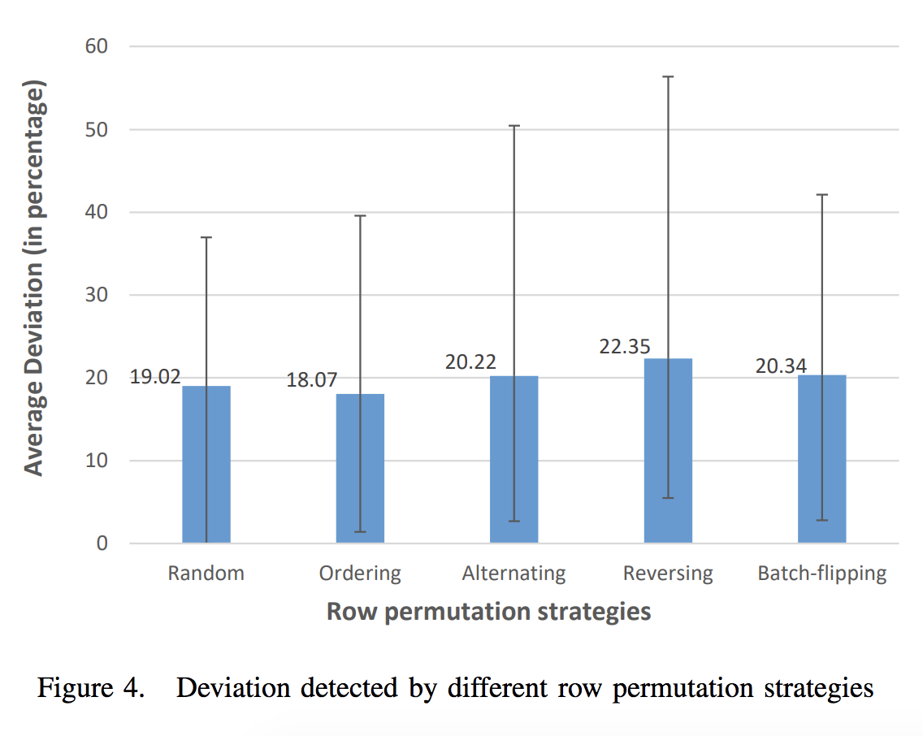
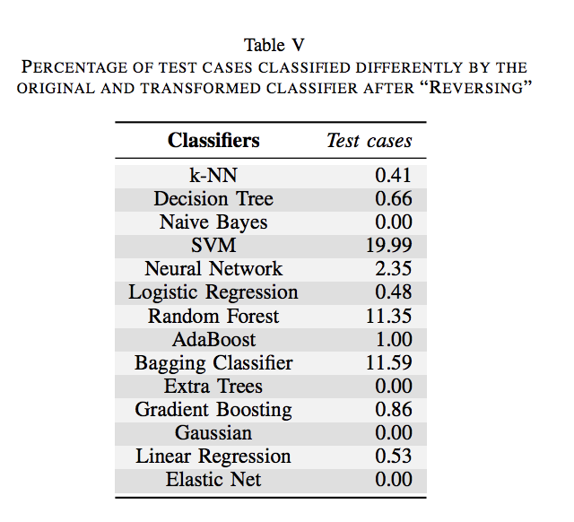
RQ4 Which permutation strategy is most effective ...?
Permutation strategies:
Random
Ordering
Alternating
Reversing
Batch-flipping

Slide 14
Threats to Validity
TILE are not easily repeatable because of the randomness involved in experiments.
It may possible that unbalancedness only occurs on this training data.
The correctness of the implementation of TILE.

Slide 15
Conclusion
Formalization of balanced data usage via metamorphic relations.
Checking equivalence of ML predictive models using equivalence computation and testing.
Developing a testing tool TILE for checking for balanced data usage.
Evaluating on ML algorithms taken from the scikit-learn library using real-world datasets.
12 out of 14 ML algorithms are sensitive to mm-transformations.

Slide 16
Thank You

Slide 17
References
https://ieeexplore.ieee.org/document/8730187

