Slide 1
Two phases of a language model
🤘 Cache Me If You Can · Talk 1
Maciek Draguła · Nathan Maurice

Slide 2
What you notice when you chat with a model
  You press Enter. For a moment, nothing happens.
  Then the answer arrives one piece at a time, at a steady pace.
  These are two different jobs. This morning you will measure both.

Slide 3
Words you will hear all morning
  Token: a piece of text, usually a word or part of a word. Models read and write tokens.
  Time to first token (TTFT): from sending the prompt to the first token of the answer.
  Tokens per second per user: how fast the answer arrives once it has started.

Slide 4
Phase one: prefill
  The model reads the whole prompt in one pass and builds its internal state (the KV cache: Act II).
  In every layer, a matrix of all prompt tokens is multiplied by the layer’s weights.
  The weights are read from memory once, and used for every token of the prompt.
  Prefill decides the time to first token.

Slide 5
Phase two: decode
  The answer is written one token at a time.
  Each new token needs a full pass through the model, for that one token.
  Every weight is read from memory again, and used for just one multiplication and one addition.
  Decode decides the tokens per second.

Slide 6
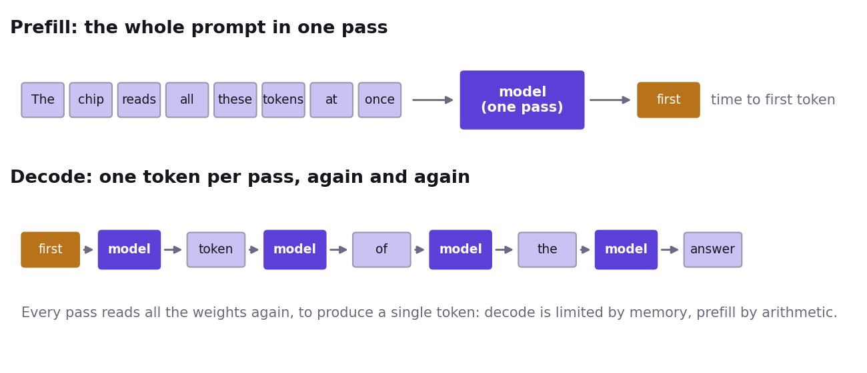
Prefill and decode, side by side

Slide 7
Compute-bound and memory-bound
  Compute-bound: the time is set by how much arithmetic the cores have to do.
  Memory-bound: the time is set by how many bytes have to travel from memory to the cores.
  Before a core can use a weight, the weight has to travel from memory (DRAM) to the core.
  Prefill uses each weight hundreds of times once it arrives, so the arithmetic takes most of the time: compute-bound.
  Decode uses each weight once, so most of the time goes into waiting for the next weight: memory-bound.
  Same model, same chip, two different limits.

Slide 8
A speed limit you can work out on a napkin
  At one user, each decode step reads all the weights once.
  minimum time per token = bytes read per step ÷ memory bandwidth
  Example: 1.8 GB read per token ÷ 288 GB/s (one n150) ≈ 6.2 ms, so at most about 160 tokens per second.
  For one user and these number formats, a program that reads every weight once per token can only get closer to it.
  Smaller formats, batching and speculative decoding move the limit itself: Act III and Talk 3.
  The same formula works for any accelerator, GPUs included.

Slide 9
Act I
  Your model answers a question.
  Time both phases against prompt length.
  Work out the speed limit for your model on your card, and compare.

