Slide 1
The chip you are driving
🤘 Cache Me If You Can · Talk 2
Maciek Draguła · Nathan Maurice

Slide 2
What is behind your notebook
  A Tenstorrent Wormhole n150 card.
  A grid of Tensix cores. Each core has its own compute engines and 1.5 MB of fast local memory (SRAM).
  12 GB of DRAM next to the grid, reachable at about 288 GB/s.
  The cores talk to the DRAM and to each other over a network on the chip.

Slide 3
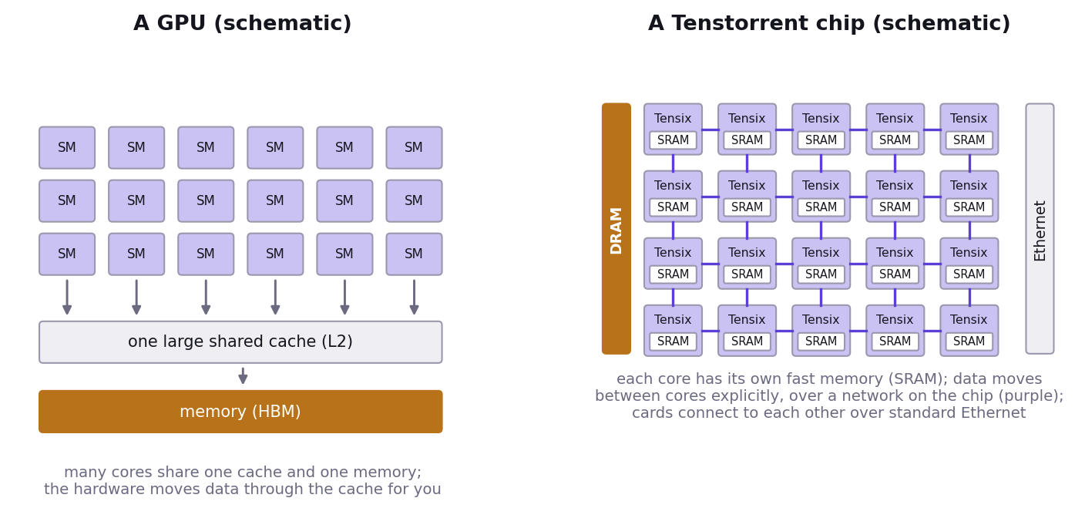
A GPU and a Tenstorrent chip

Slide 4
  GPU: many cores share one large cache and one memory; the hardware moves data through the cache for you.
  Tenstorrent: a grid of Tensix cores, each with its own SRAM; data moves between cores explicitly, over a network on the chip; chips connect over standard Ethernet.
  A short introduction to the Tensix core (video): https://www.youtube.com/watch?v=WcljPiCl5eM

Slide 5
Near memory and far memory
  Far: DRAM. Large and comparatively slow to reach. The weights and the KV cache live here.
  Near: SRAM in each core. Small and fast. This is where the arithmetic happens.
  A decode step is a loop: bring weights from far memory, use them once, move on.
  That’s why the speed limit is a bandwidth number, not a compute number.

Slide 6
Tiles
  The hardware moves and multiplies data in blocks of 32 × 32 numbers, called tiles.
  One new token is one row, but it still occupies a whole tile.
  That’s one reason a single user leaves most of the chip’s arithmetic idle, and why batching helps (Act III).

Slide 7
Kernels, and why the first run is slow
  The cores run small programs called kernels. Usually one basic operation each: an addition, a matrix multiplication, a softmax.
  More complex kernels combine several, for example a matrix multiplication and its activation function.
  TT-NN compiles a kernel the first time an operation runs with a new shape, and keeps it on disk.
  The warm-up in Act 0 ran everything once so that these compilations were done before you needed them.

Slide 8
Trace
  Every operation (for example ttnn.matmul) is sent to the card as a command: hundreds or thousands per model.
  The same commands repeat at every decode step.
  With trace, TT-NN records them once and replays the recording at every later step: the host no longer resends them.
  It’s switched on throughout the tutorial.
  What is left after trace is time on the card itself, including a small fixed cost for every operation. For a small model, those fixed costs add up.
  In Act IV you will use trace yourself.

Slide 9
What Act I measured
  Time to first token grew with the prompt: prefill does work for every prompt token.
  Tokens per second barely moved: decode’s cost is mostly reading the weights.
  The gap between your measurement and the speed limit is the time not spent reading weights.

Slide 10
Act II
  Write attention yourself, on the real GPT-2.
  Generate text without a cache: recompute everything for every new token.
  Add the cache. Same text, different cost.

Slide 11
