Slide 1
What changes at scale
🤘 Cache Me If You Can · Talk 3
Maciek Draguła · Nathan Maurice

Slide 2
What you measured is still true at scale
  Prefill is compute-bound and decode is memory-bound, on one chip and on a thousand.
  The KV cache is still what makes generating text affordable.
  Batching still buys throughput until something else runs out.
  Fused operations and trace, which you used in Act IV, are how production code removes the cost of every command.

Slide 3
When the model doesn’t fit on one chip
  Tensor parallelism: each layer is split across chips, and the chips exchange partial results at every layer.
  Now the network between chips is a second speed limit next to memory bandwidth.
  The napkin math gains a term: bytes exchanged between chips per token.

Slide 4
Prefill and decode on different chips
  They want different hardware: prefill needs arithmetic, decode needs memory bandwidth.
  Disaggregated serving: some chips only prefill, others only decode, and the KV cache travels between them.
  Pointless for a 1.5B model on one card; decisive for a 400B model on a Galaxy.

Slide 5
Serving many users
  Requests arrive all the time, so batches are rebuilt at every step (continuous batching).
  The KV cache is stored in fixed-size pages, like virtual memory, so users can come and go.
  A load balancer decides which group of chips gets which request.

Slide 6
Speculative decoding: why it helps
  Decoding is expensive per token: in Act I, prefill got through hundreds of times more tokens per second than decode.
  But some tokens are easy to predict: after “1, 2, 3, 4,” almost anything would guess “5,”.
  So a small draft model, trained to imitate the large one, guesses the next few tokens quickly. Some models even predict several tokens at once (multi-token prediction).
  The large model checks all the guesses in one pass, the way prefill reads a prompt, and keeps the correct ones.
  It pays off because decode is memory-bound: checking five tokens costs about as much as generating one.

Slide 7
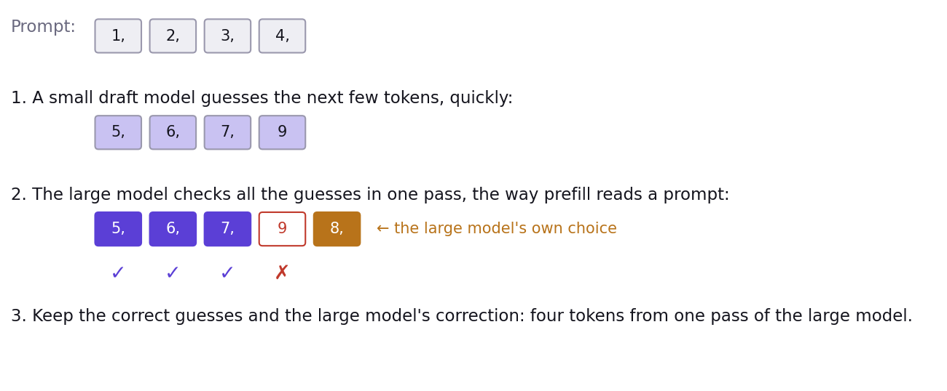
Speculative decoding, step by step

Slide 8
Today’s results
  The Speedrun leaderboard.
  The fastest few rerun their race on the projector and show their code.

Slide 9
So long, and thanks for all the FLOPs
  Everything you used today is open source: tt-metal, TT-NN, tt_transformers.
  The notebooks, with the answers for Acts 0 to III, are yours to keep.
  Questions.

